Slide 1


Slide 2
Topics to cover
Intro to Spark
Spark Architecture
Spark Ecosystem
MapReduce
Demo and how it works
Testing Aspects.
Automation of Spark Jobs.

Slide 3
What is Spark?
Unified computing engine
Supports multiple languages
Speed
Extends MapReduce algo of Hadoop
Advanced Analytics

Slide 4
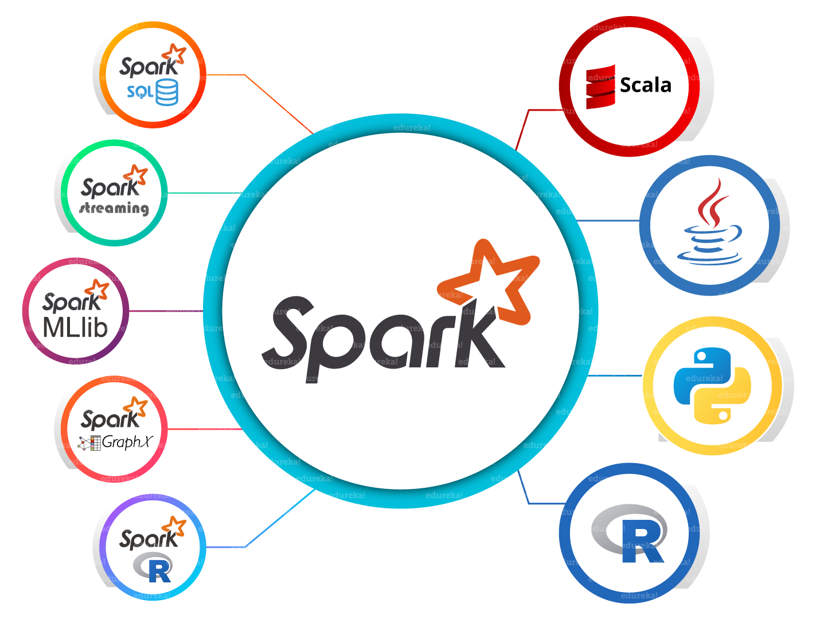
Spark Architecture

Slide 5
Resilient Distributed Datasets (RDD)
RDDs represent data or transformations on data
RDDs can be created from Hadoop Input Formats (such as HDFS files), “parallelize()” datasets, or by transforming other RDDs (you can stack RDDs)
Lazy evaluation: Nothing computed until an action requires it
Example: messages = textFile(...).filter(_.startsWith(“ERROR”)).map(_.split(‘\t’)(2))

Slide 6
RDD supports two types of operations:
Transformation:
Some of the Transformation functions are map, filter, flatMap, groupByKey, reduceByKey, aggregateByKey, pipe, and coalesce.
Action: Some of the Action operations are reduce, collect, count, first, take, countByKey, and foreach.

Slide 7
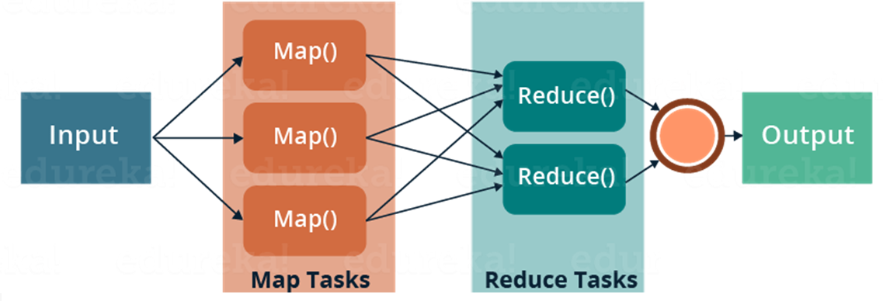
What is MapReduce?
MapReduce

Slide 8
Example :
Input
Splitting
Mapping
Shuffling
Reducing
Final Result
List(K1,V1)
K2, List(V2)
K1,V1
Deer 1
Bear 1
River 1
Bear 2
Bear (1,1)
Deer Bear River
List(K3,V3)
Deer, Bear, River, Car, Car, River, Deer, Car and Bear
Car(1,1,1)
Car 3
Car 1
Car 1
River 1
Bear 2
Car 3
Deer 2
River 2
Car Car River
Deer(1,1)
Deer 2
Deer Car Bear
Deer 1
Car 1
Bear 1
River(1,1)
River 2

Slide 9
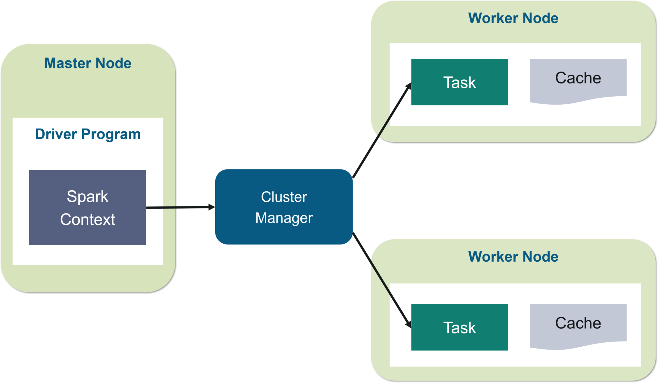
Working of Spark Architecture
Apache Spark follows a master/slave architecture with two main daemons and a cluster manager –
Master Daemon – (Master/Driver Process)
Worker Daemon –(Slave Process)

Slide 10
Spark – Interpreter
Run Scala Spark interpreter
$ spark-shell
Python interpreter
$ pyspark
Job submission
$ spark-submit

Slide 11
Example
spark-shell scala> val inputfile = sc.textFile(“hello.txt”)
scala> val counts = inputfile.flatMap(line => line.split(" ")).map(word => (word, 1)).reduceByKey(_+_);
scala> counts.toDebugString
scala> counts.cache()
scala> counts.saveAsTextFile("output")
In Scala file
C:\Users\Anurag_Deb\Downloads\spark-2.4.3-bin-hadoop2.7>
scalac -classpath ./jars/spark-core_2.11-2.4.3.jar SparkWordCount.scala
jar -cvf wordcount.jar SparkWordCount*.class ./jars/spark-core_2.11-2.4.3.jar
spark-submit --class SparkWordCount --master local wordcount.jar
Storage Space : http://localhost:4040

Slide 12
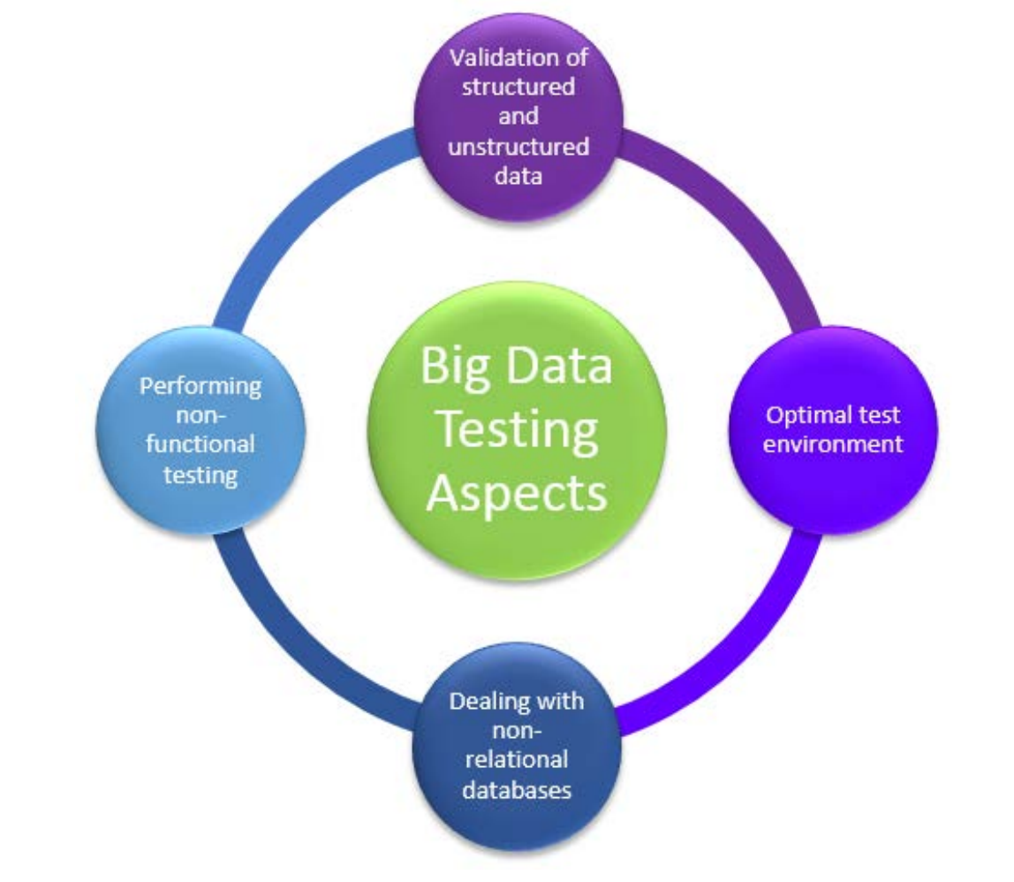
Big Data Testing Aspects
Some of the key aspects of Big Data testing are the following.
Data type validation
Range and constraint validation
Code and cross-reference validation
Structured validation

