Slide 1
Fundamentals of deep learning for multi-gpus Lab 1, part 1: introduction and motivation

Slide 2
Lab 1: Gradient Descent vs Stochastic Gradient Descent, and the Effects of Batch Size
Lab 2: Multi-GPU DL Training Implementation using Horovod
Lab 3: Algorithmic Concerns for Training at Scale
Course Overview
Notes:
Overview of Lecture / Lab 1:
The class starts with a deep dive into the motivation. This is the most important part of the class. The class will be delivered to participants with very different backgrounds. From academics with very extensive Deep Learning experience though IT professionals responsible for the design of AI clusters to research / IT managers. As a consequence its very important to set the correct expectations around the content and make the rationale for considering large scale training clear.
The motivation leads to a section illustrating real examples of large scale training. The goal of this section is to demonstrate that this is not only a theoretical conversation but a real world problem that was already tackled by many institutions.
The second part of the class is focused on theory and aims to bring the class to the same level of understanding of basic optimization concepts. Preferably we would like the participants to come already equipped with this knowledge (and that will be expressed by the class prerequisites) but that will rarely be the case so a level of recap is necessary even for more advanced users.
The theoretical part is composed of three parts what is then further reflected by the Lab flow:
Part 1 – Overview of the key concepts - This part will introduce the most fundamental concepts of training machine learning algorithms. We will use the simplest possible neural network to demonstrate those basic principles.
Part 2 – Training Neural Networks - This part will build on top of the knowledge gained in Part 1. We will discuss the differences between our simple neural network and the neural networks used to solve practical problems and discuss the implications of those differences. We will evolve the code developed in Part 1 to make is a larger neural network.
Part 3 – Multi GPU training – Finally we will review the theory of Multi GPU training and evolve the model developed in Part 2 to take advantage of multiple GPUs available in the system. Finally we will discuss some of the key limitations of the approach we have taken in this class what will set the scene for Lecture / Lab 2.

Slide 3
Part 1: Gradient Descent
Part 2: Stochastic Gradient Descent
Part 3: Optimizing training with batch size
Lab 1 overview
Notes:
Overview of Lecture / Lab 1:
The class starts with a deep dive into the motivation. This is the most important part of the class. The class will be delivered to participants with very different backgrounds. From academics with very extensive Deep Learning experience though IT professionals responsible for the design of AI clusters to research / IT managers. As a consequence its very important to set the correct expectations around the content and make the rationale for considering large scale training clear.
The motivation leads to a section illustrating real examples of large scale training. The goal of this section is to demonstrate that this is not only a theoretical conversation but a real world problem that was already tackled by many institutions.
The second part of the class is focused on theory and aims to bring the class to the same level of understanding of basic optimization concepts. Preferably we would like the participants to come already equipped with this knowledge (and that will be expressed by the class prerequisites) but that will rarely be the case so a level of recap is necessary even for more advanced users.
The theoretical part is composed of three parts what is then further reflected by the Lab flow:
Part 1 – Overview of the key concepts - This part will introduce the most fundamental concepts of training machine learning algorithms. We will use the simplest possible neural network to demonstrate those basic principles.
Part 2 – Training Neural Networks - This part will build on top of the knowledge gained in Part 1. We will discuss the differences between our simple neural network and the neural networks used to solve practical problems and discuss the implications of those differences. We will evolve the code developed in Part 1 to make is a larger neural network.
Part 3 – Multi GPU training – Finally we will review the theory of Multi GPU training and evolve the model developed in Part 2 to take advantage of multiple GPUs available in the system. Finally we will discuss some of the key limitations of the approach we have taken in this class what will set the scene for Lecture / Lab 2.

Slide 4
Context: why use multiple gpus?
Notes:
To put it in perspective

Slide 5
Trends in Computational power
Historically we never had large datasets or compute
10⁷
GPU-Computing perf
1.5X per year
1000X
By 2025
10⁶
10⁵
Transistors (thousands)
1.1X per year
10⁴
10³
1.5X per year
10²
Single-threaded perf
Notes:
Fortunately, for the last several decades we have benefited from almost an exponential increase in computational performance. Even though that trend for classical CPU computing clearly is coming to an end, because of the progress in GPU computing we can still benefit from that exponential relationship.

Slide 6
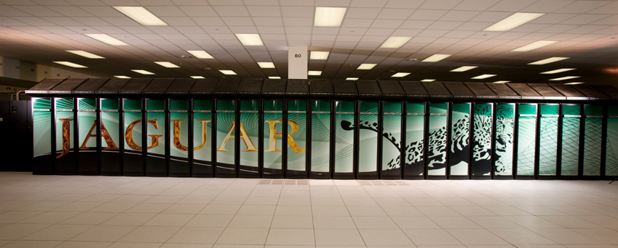
Trends in Computational power
2 PF/s in November 2009
Notes:
In November 2009 Jaguar system illustrated above constituted the world’s most performant supercomputing cluster and delivered 1.759 PetaFLOPS (that is 10^15 floating point operations per second).

Slide 7
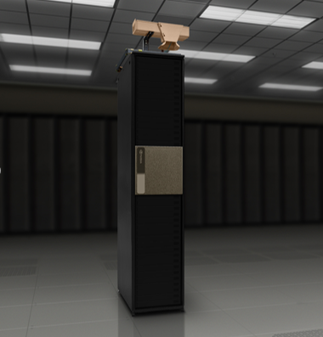
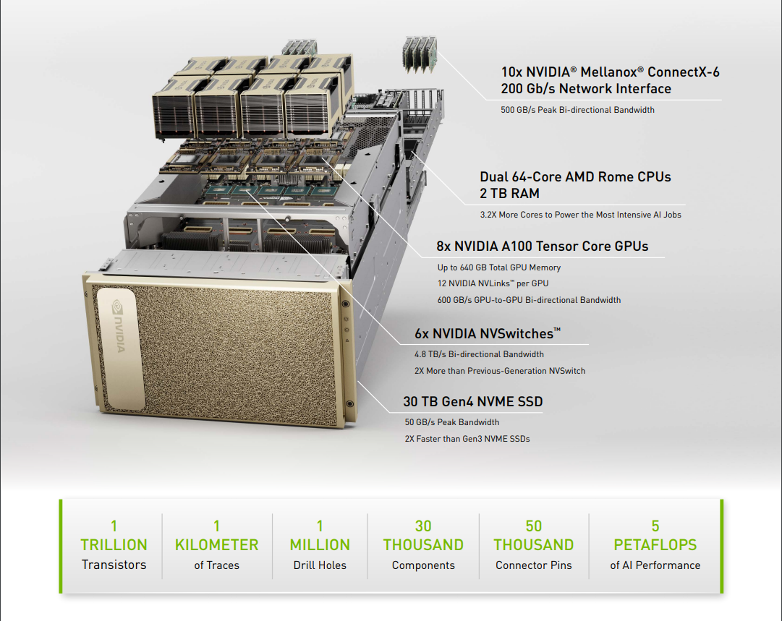
Trends in Computational power
5 PF/s today
Notes:
Today a single system delivers 2 peta FLOPs for training neural networks.
Computational power accessible only to world’s largest superpowers in November 2009 is now available to everyone due to presence of dense GPU systems in the cloud.
Next slide

Slide 8
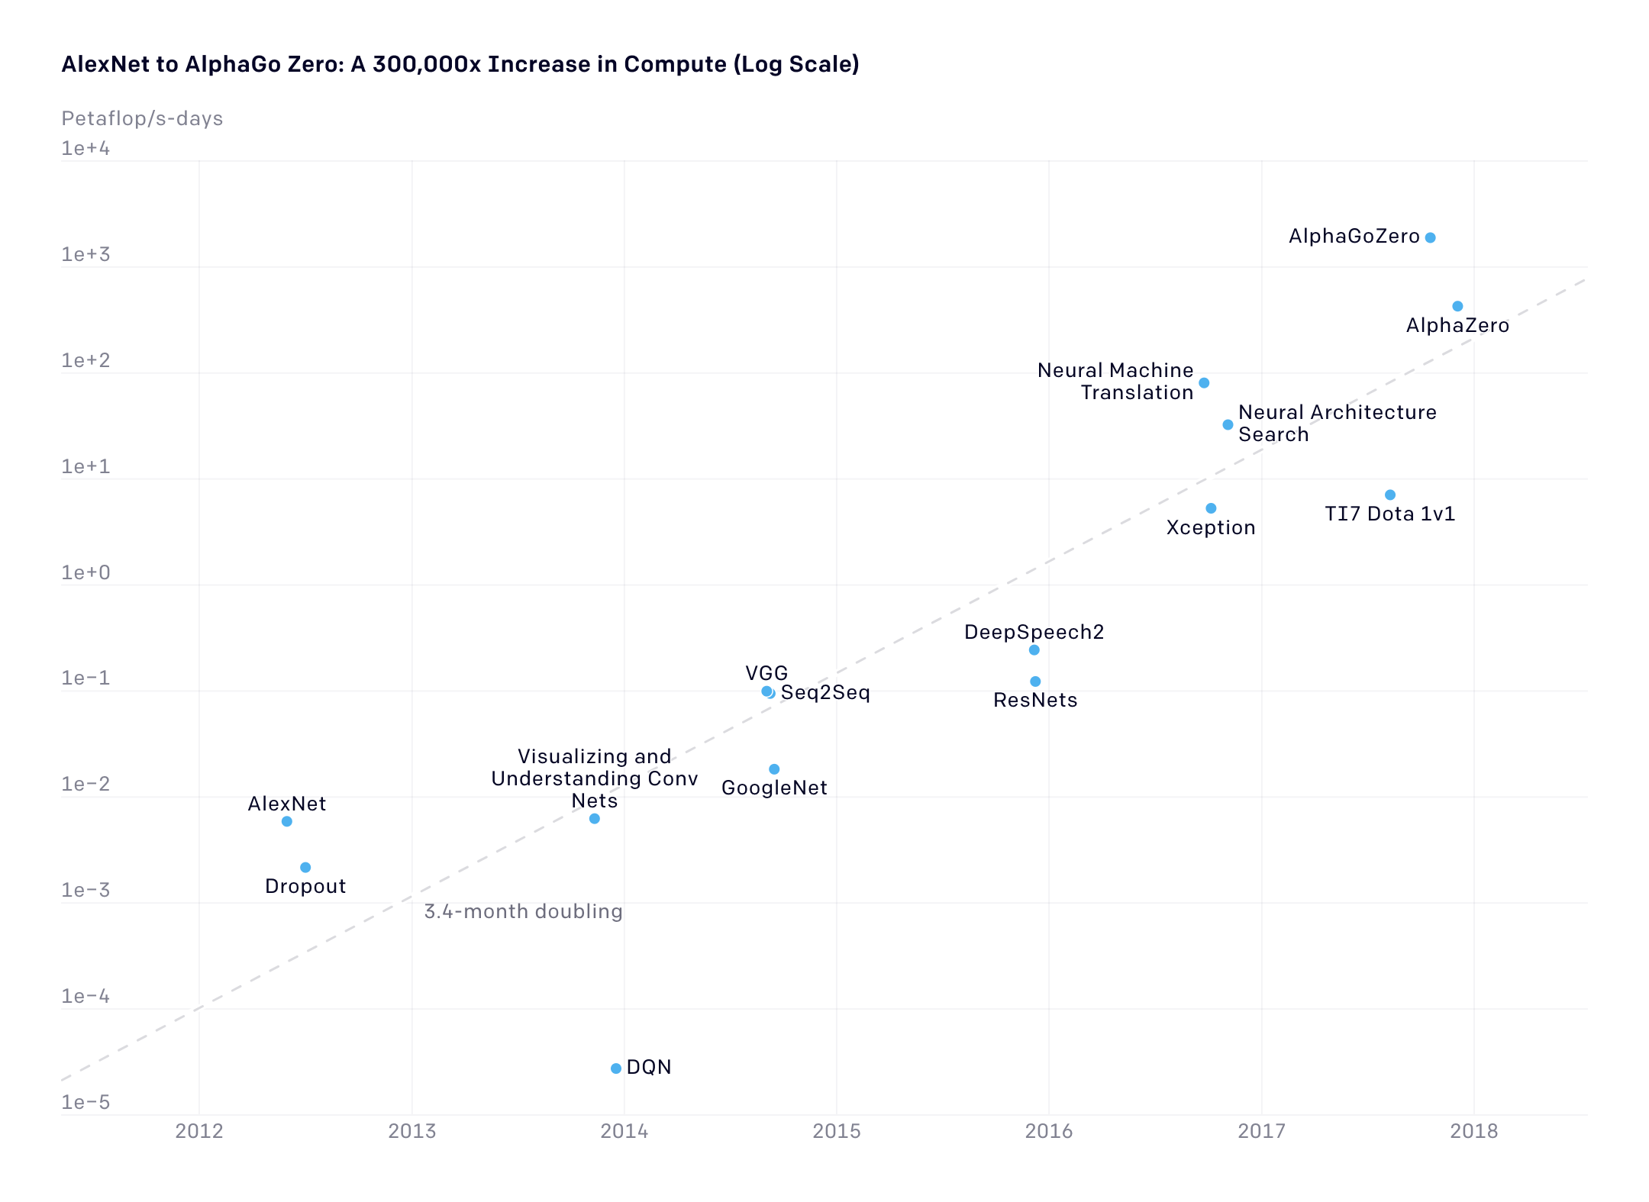
Neural Network complexity is Exploding
Source: OpenAI
Notes:
Training large networks was impossible until 2015-16
Made possible by techniques such as batch normalization
Size matters
Larger neural networks more accurate
However, neural network complexity also increases
Increasing data sets + complexity requires vastly more compute power.
Example: Google Translate parameter size > 9 billion entries, requires 100 ExaFlops
Next slide

Slide 9
1000 petaflop/s-days = O(100 years) on a dual CPU server
Notes:
The availability of compute is critical as without it the training time of those models is beyond what an engineering or research team can deal with..

Slide 10
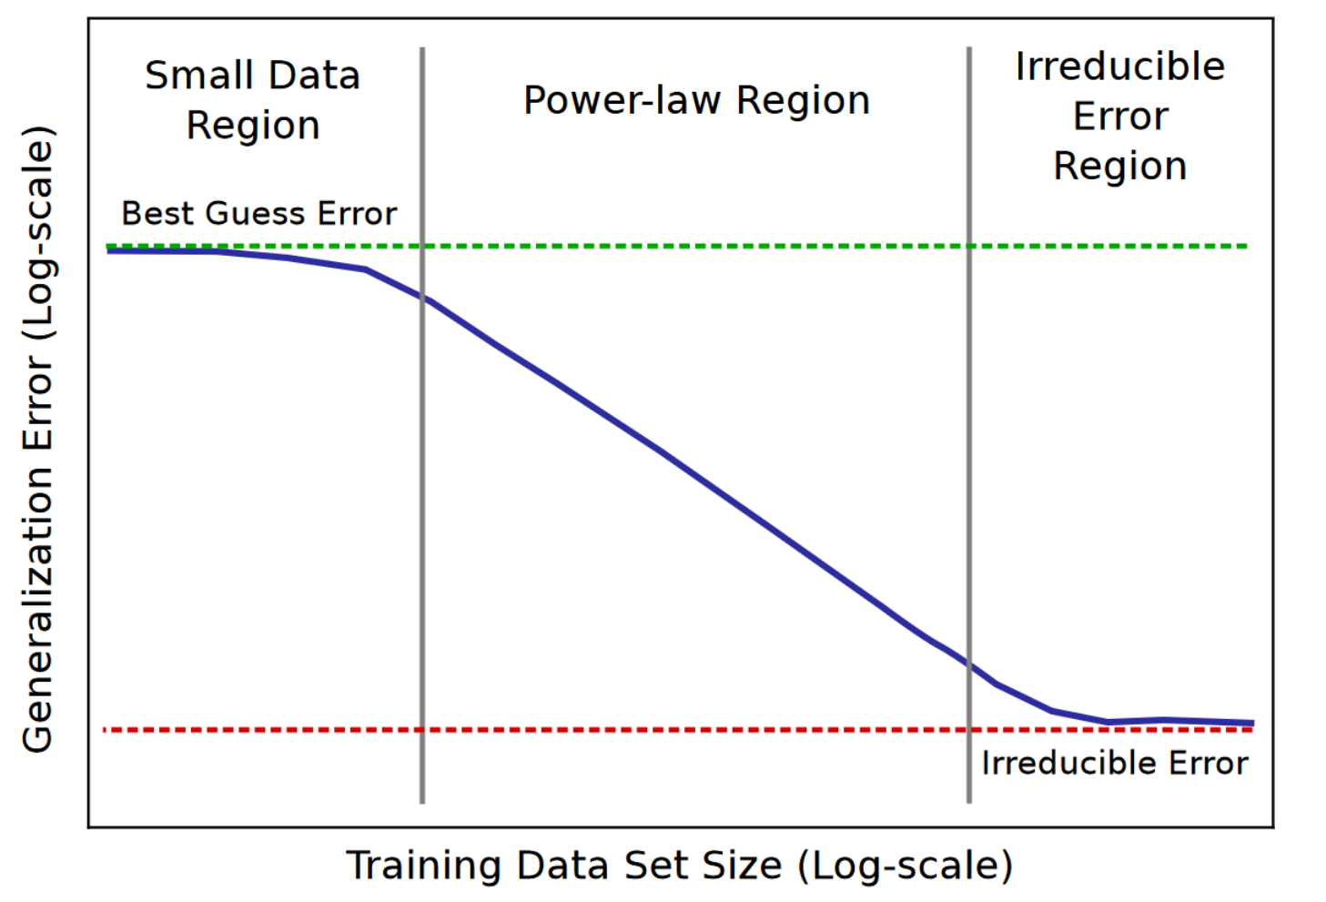
Exploding Datasets
Power-law relationship between dataset size and accuracy
Hestness, J., et al. (2017). Deep Learning Scaling is Predictable, Empirically. arXiv: 1712.00409
Notes:
This work provides father empirical evidence for this relationship between data and accuracy. This is ground breaking as for the first time in machine learning history we seem to have an algorithm which not only is predictable empirically but also which promises to be able to deliver an arbitrary performance given enough data.
This is a good news as it gives us warranties of being able to solve problems but also a bad news as the data and compute cost is non trivial.

Slide 11
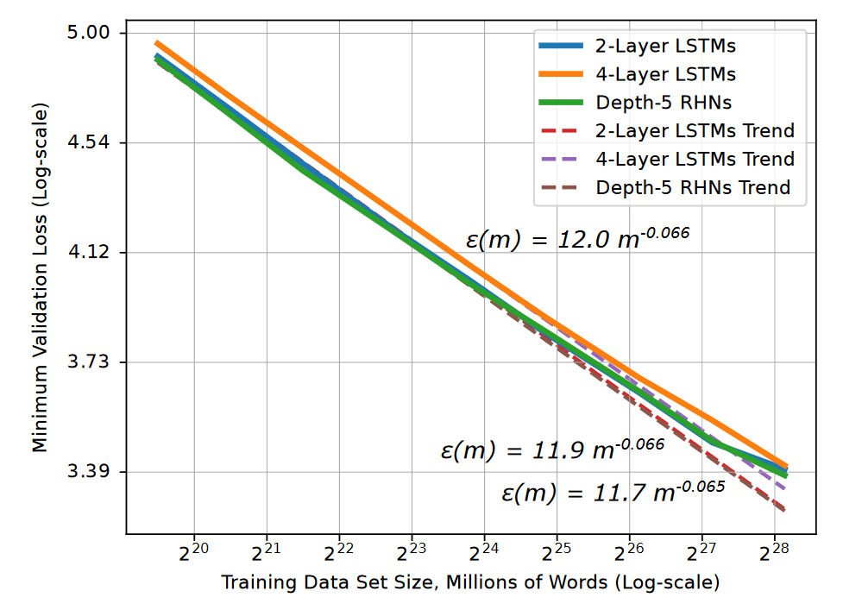
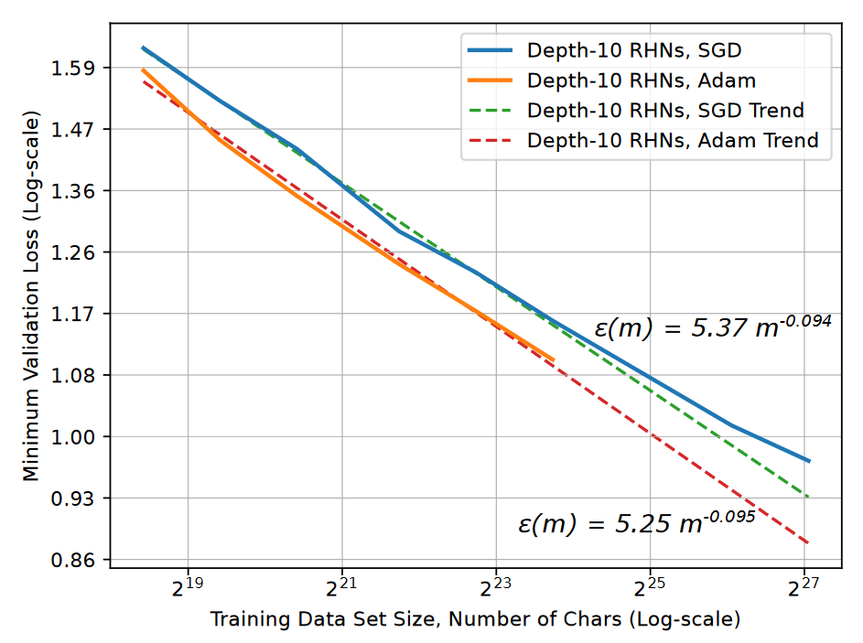
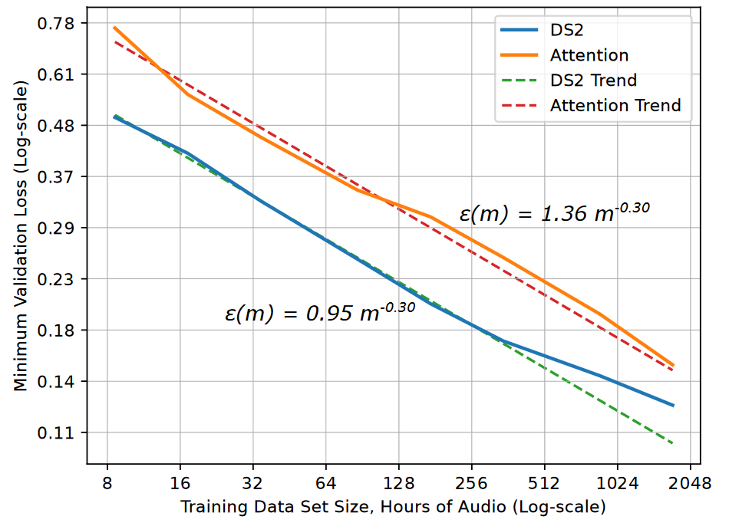
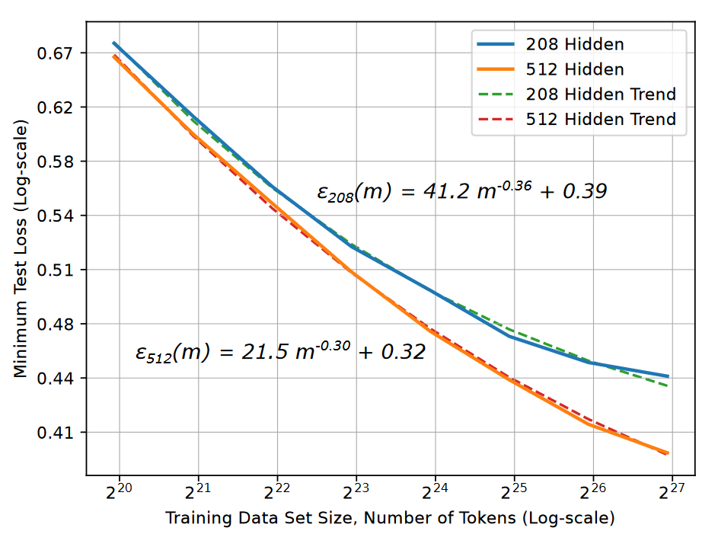
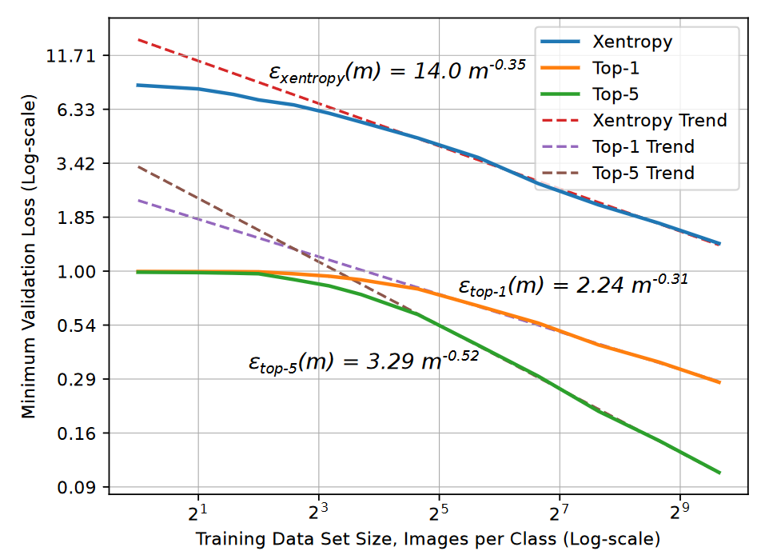
Exploding Datasets
Power-law relationship between dataset size and accuracy
Translation
Language Models
Character Language Models
Image Classification
Attention Speech Models
Hestness, J., et al. (2017). Deep Learning Scaling is Predictable, Empirically. arXiv: 1712.00409
Notes:
This paper from Baidu research takes this work further and validates this assumption not only on a much wider set of models but also across a much wider set of problems.
It provides further empirical evidence for this relationship between data and accuracy.
Next slide

Slide 12
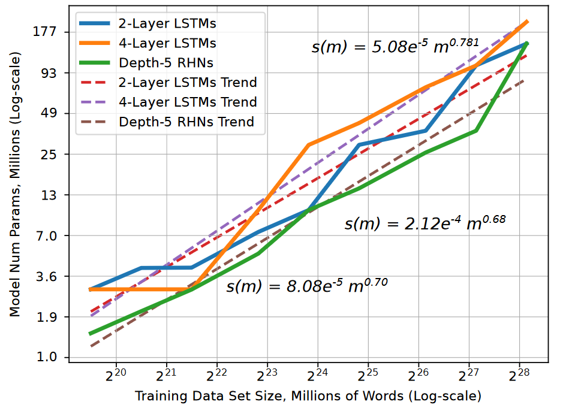
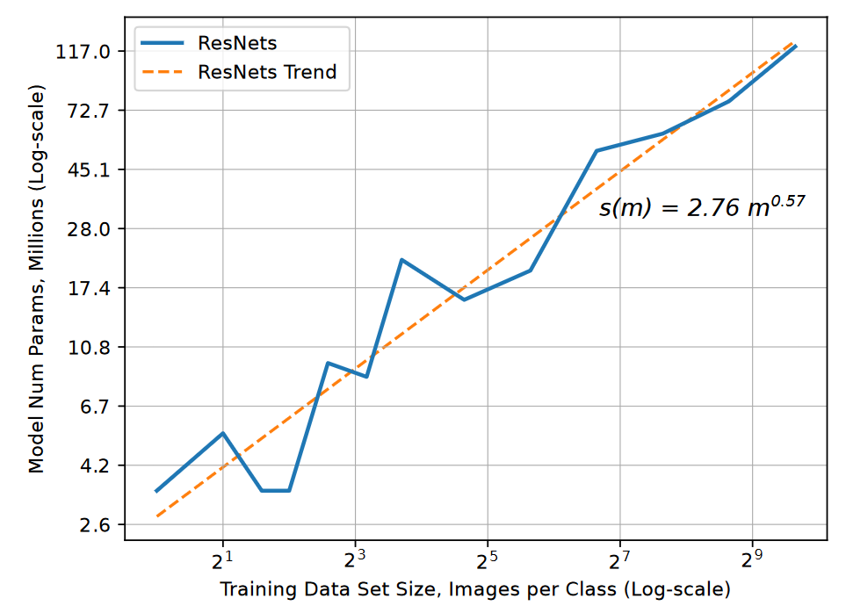
Exploding Model Complexity
Though model size scales sublinearly
Hestness, J., et al. (2017). Deep Learning Scaling is Predictable, Empirically. arXiv: 1712.00409
Notes:
The good news is that this relationship (between the model size and dataset size) is sub-linear!

Slide 13
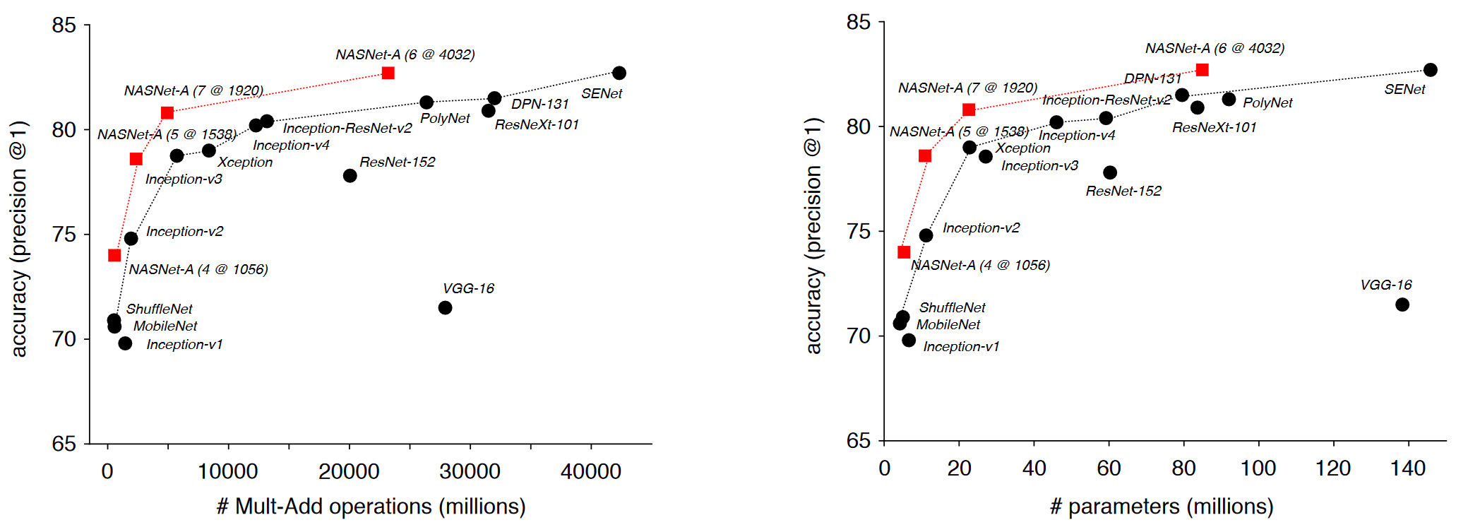
Exploding model complexity
Though model size scales sublinearly
Zoph, Barret, et al. (2017). "Learning transferable architectures for scalable image recognition." arXiv: 1707.07012
Notes:
And we have very good empirical evidence for that.

Slide 14
IMPLICATIONS

Slide 15
Implications
Good and bad news
The good news: Requirements are predictable.
We can predict how much data we will need.
We can predict how much computing power we will need.
The bad news: The values can be significant.
The silver lining is that deep learning has taken impossible problems and made them merely expensive.
Notes:
The good news is the fact that now we can predict how much data we will need to meet our performance goals.
The bad news is that because of the nature of this relationship for a lot of problems the data volumes can be high.

Slide 16



Implications
Deep learning is experimental; we need to train quickly to iterate
Idea
Code
Experiment
Notes:
This is borrowed from Andrew Ng. The goal of this slide is to explain to the participants that Neural Network development is a highly iterative process and that their team will need to iterate hundreds if not thousands of times.
This is clearly not practical if the iteration time takes months or years. We need our research staff to iterate quickly.

Slide 17
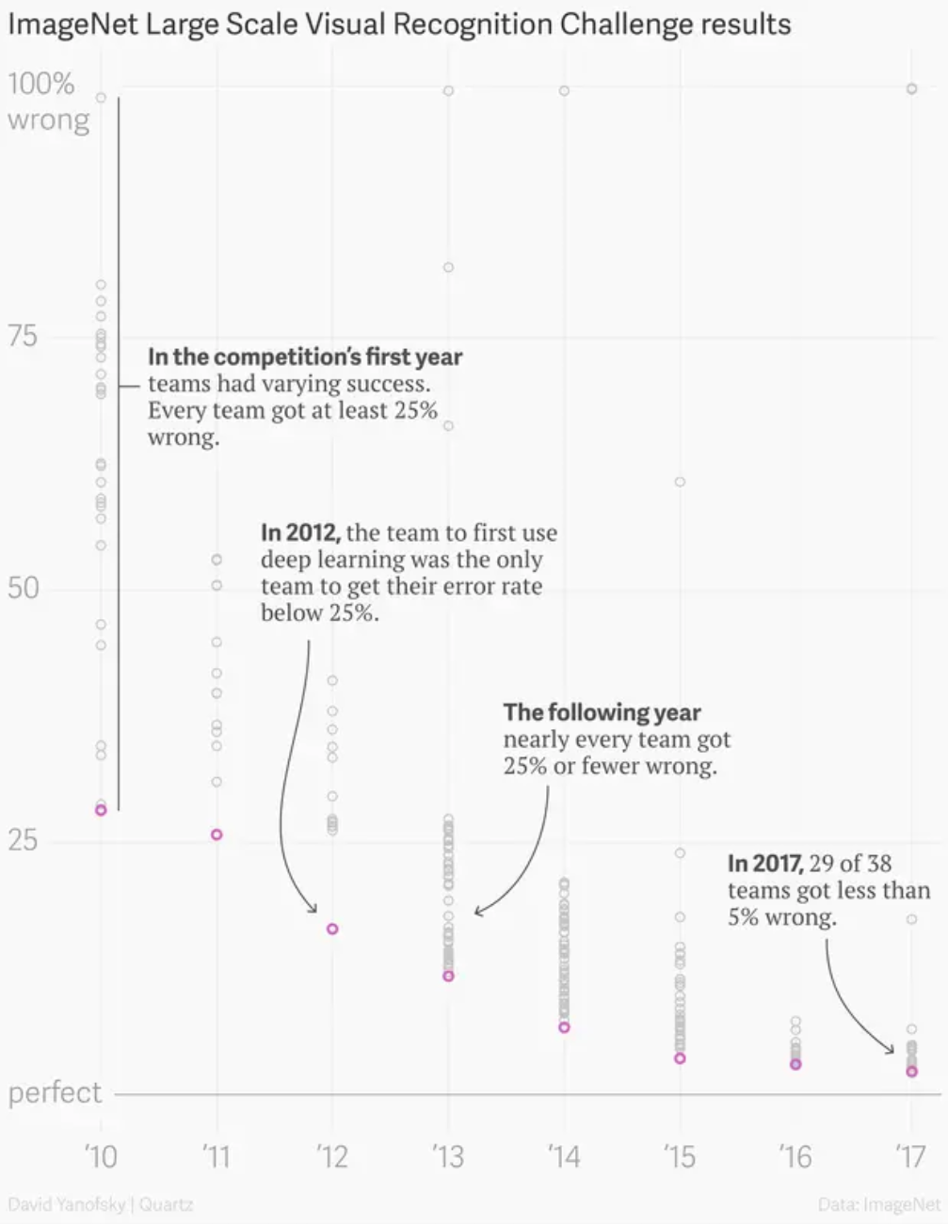
iteration time
Short iteration time is fundamental for success
Notes:
The conclusion is a dramatic decrease in the feasible training time which can be achieved with other models as well.

Slide 18
Intro to the lab

Slide 19
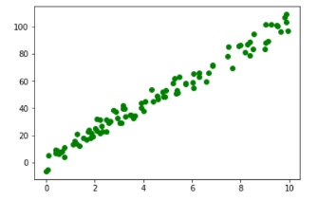
Starting with a linear model
y = w*x + b
Our goal is to find best model parameters (combination of w and b) to fit the data
y
w
b
x
1

