Slide 1
Evaluating the energy impact of device parameters for DNN inference on edge
Anurag Dutt, Sri Pramodh Rachuri, Ashley Lobo, Nazeer Shaik, Anshul Gandhi, Zhenhua Liu
Notes:
Good Afternoon. My name is Anurag Dutt and I am currently a 2nd year PhD student in Computer Science at Stony Brook University. I am here to present our work which is still a work in progress on Evaluating Energy impact of edge device parameters primarily CPU and GPU frequency on Deep Learning inference tasks.

Slide 2
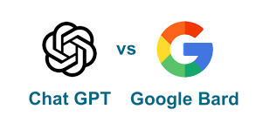

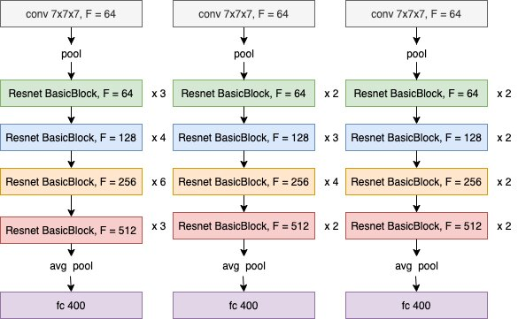
Motivation
Deployment of large DNN models
Edge Computing
Examples - Jetson lineup
Battery-Operated
Deployed in resource scarce environments
Large parameter space to optimize
Hardware parameters
Notes:
Efficient Deployment of deep learning models on edge devices is challenging primarily because edge devices are themselves resource constrained and they are generally battery operated and deployed in resource scarce environments. Furthermore the NVIDIA suite of edge devices have a large parameter space in terms of CPU and GPU frequency that can be tuned which complicates the problem of finding the energy optimal configuration. As such practitioners often rely on using existing tools such as DVFS and often settle for suboptimal energy savings.
Motivate need for energy efficiency in edge better on this slide and next: could say edge devices can be battery-operated, etc.

Slide 3
Introduction
Sustainable DNN workload deployments on the Edge
Study the impact of hardware parameters
CPU frequency
GPU frequency
Compare the performance of multiple Deep Learning workloads on default device configuration vis-a-vis adjusting CPU and GPU frequencies for optimal energy usage
Notes:
As such, as a part of our of work we strive to study the impact of hardware knobs, primarily CPU and GPU frequency on 6 different Deep Learning workloads on two different NVIDIA edge devices. Our goal is to investigate energy consumption of these devices under multiple deep learning workloads and compare with default device configurations including different DVFS governors to see if we can do better.
DVFS may not be known at this point in your ppt, maybe remove DVFS reference from last bullet

Slide 4
Experimental Setup
Power readings for each edge device are polled at 100ms intervals
Overhead for 100 ms < 0.5%; Overhead for more frequent polling (10 ms or 1 ms) > 2%
PyTorch for all the workloads except for YOLOv4 (OpenCV)
I2C interface is polled in a separate thread for more granular readings
Each experiment on a given model
One out of x CPU+GPU Freq combinations
Fixed workload - 3200 inferences inputs
10 reruns; variance was less than 5%
Notes:
The study involves power monitoring for devices, with readings taken at 100ms intervals to maintain a low power overhead of less than 0.5%. We chose to write our own power profiler which polls the I2C interface because it gave us the control on how granularly we can poll the power readings while controlling for the polling overheads. Workloads are primarily handled via PyTorch and OpenCV. The experimental setup includes multiple tests on each workload with various CPU+GPU frequency setups, a fixed workload of 3,200 inference inputs per configuration, and repeated trials till we achieve a variance of under 5%.

Slide 5
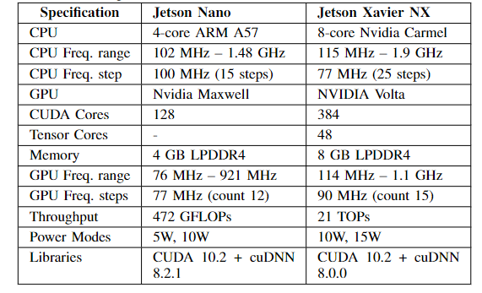
Experimental Setup - Device Specifications
Notes:
The device specifications of jetson Nano include a 4-core ARM A57 CPU, 128 cuda cores, a CPU frequency range of (click1) 102 MHz – 1.48 GHz incremented at approximately 100Mhz, and a GPU frequency range of 76 MHz – 921 MHz incremented at 77MHz. The device offers 180 possible GPU and CPU frequency combinations.
The device configurations of Jetson Xavier NX include an 8-core Nvidia Carmel CPU, 384 CUDA cores with a (click 2) CPU frequency range of 115 MHz – 1.9 GHz incremented at 77MHz, and a GPU frequency range of 114 MHz – 1.1 GHz incremented at 90MHz. The device offers 375 possible GPU and CPU frequency configurations.

Slide 6
Experimental Setup - Workloads
The workloads chosen span across 3 different categories of Deep Learning use-cases:
Image Classification (AlexNet, ResNet-18, MobileNet)
Object Detection (YOLOv4 - Tiny)
Natural Language Classification (BERT-Tiny, distilBERT)
MobileNet, BERT-Tiny, DistilBERT, and YOLOv4-Tiny are tailored for edge devices, characterized by their lightweight architecture and efficient performance.
Notes:
Our selection of deep learning workloads are categorized into three use-cases: Image Classification ( AlexNet, ResNet-18, and MobileNet), Object Detection ( YOLOv4-Tiny), and Natural Language Classification ( BERT-Tiny and DistilBERT). Emphasis is placed on MobileNet, BERT-Tiny, DistilBERT, and YOLOv4-Tiny, as these models are specifically optimized for edge devices due to their minimalistic design and efficient execution, ideal for environments with limited computational resources.

Slide 7
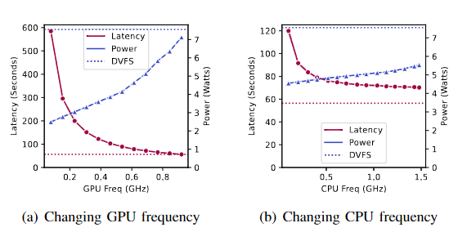
Evaluation - Frequency Sweeps on Nano
DVFS Governor
CPU Default - “schedutil”
GPU Default - “nvhost_podgov”
Highest freq - CPU 89%; GPU 83%
Other governors < 1% variation
Monotonic relation with freq
Impact of CPU Freq < GPU Freq
Notes:
For baselines we perform frequency sweeps on Nano with default DVFS governors, for analyzing the impact of GPU and CPU frequency scaling on power and inference time for an AlexNet inference workload on Jetson Nano for a batch size of 16. (click 1) The results show that power consumption increases almost monotonically with GPU frequency and not surprisingly (click 2) power consumption is more sensitive to GPU frequency over CPU frequency.

Slide 8
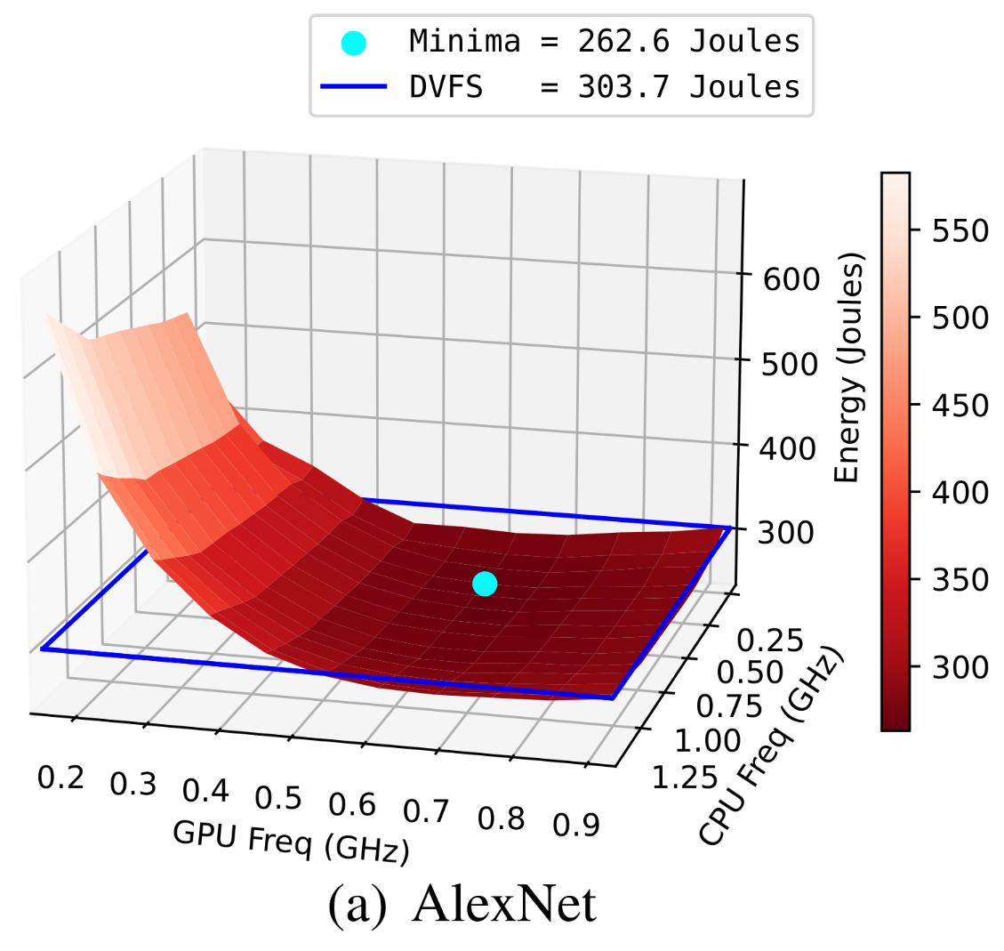
Evaluation - Energy usage trends on Nano
GPU Freq substantially impacts Energy but not monotonic
Minima consumes 13% lower than DVFS
Notes:
While individually tuning the CPU and GPU frequency and capturing energy measurements we find that there exists an optimal device configuration where the energy usage of the DNN workload is minimized. The X and Y axis are CPU and GPU frequency respectively and the Z axis is energy. For the 6 workloads we consistently find that energy consumption consistently decreases as the CPU and GPU frequency increase till it reaches a minima and the increases again.
(click 1) The energy profile surface is more susceptible to GPU frequency than CPU frequency given the nature of execution of the DNN workload. (click2) We also find that the energy profile minima is substantially lower than the default DVFS configuration.

Slide 9
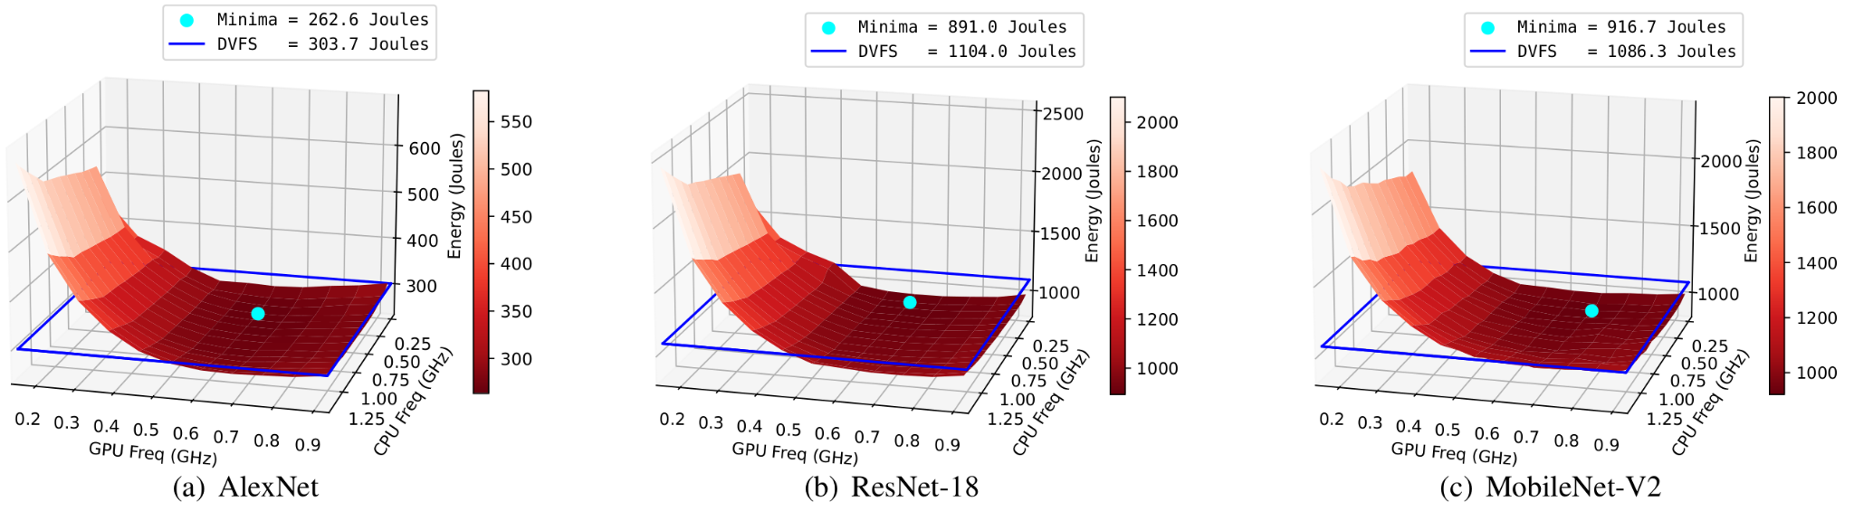
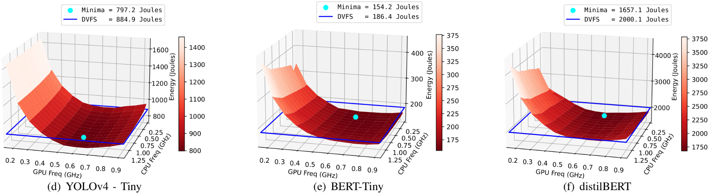
Evaluation - Energy usage trends on Nano
Minima consumes 13%, 19%, 15%, 9%, 17%, 17% lower energy than DVFS
Notes:
For all the 6 workloads we find that there exists a energy optimal configuration where for a specific CPU and GPU frequency to total energy consumption is minimized.
(Click 1) For the 6 aforementioned workloads the energy usage is minimized between 9% and 19% depending on the workload

Slide 10
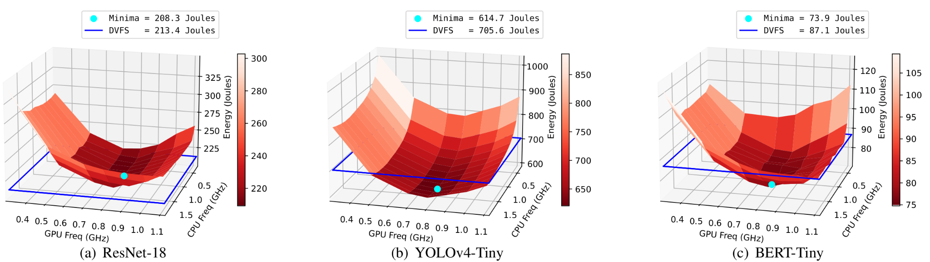
Evaluation - Energy usage trends on Xavier NX
Not monotonicity of GPU and CPU Freq is more prominent
Minima consumes 2%, 13%, 15% lower energy than DVFS
Notes:
The Energy profile trend and the existence of the optimal CPU-GPU frequency was even more evident for the Xavier NXs. We clearly see that the energy consumption of Xavier NX is significantly lower often by at least 2×and sometimes as much 4×. Given the newer generation of Xavier NX, this is not wholly unexpected. We also observe a greater increase in energy (compared to the minima) at higher frequencies for Xavier NX, resulting in a steeper trough-like surface; by contrast, the energy values appear to plateau and only slightly increase at higher frequencies under Nano

Slide 11
IMPACT OF OTHER FACTORS:
Compared to LibTorch implementation in C++, python implementation in PyTorch consumes 16% more energy due to python overheads
However, LibTorch is not commonly used during prototyping due to ease of usage of Python and compilation overheads
LibTorch is commonly used in high performance systems due to its energy and latency benefits
Impact of turning off lazy-loading and garbage collection were found to to 1.82% and 1.65% reduction in total energy, respectively
Notes:
Just to be sure our analysis is correct, we retroactively check if there are any overheads associated with energy usage particularly for DNN workload execution in python and background processes such as garbage collection and lazy-loading. We find that while there are some overheads associated with python i.e a C++ implementation of the same workload nets about 16% lower energy consistently for all workloads but the energy topology shape stays the same. There are very minor overheads associated background processes between 1.5% and 2% of total energy costs.
This may not be needed as we did not have it in WIP, but ok to keep if you have time left (I doubt).

Slide 12
Conclusion
Selecting optimal freq configuration gives upto 19% savings in energy for Jetson Nano as compared to DVFS
Selecting optimal freq configuration gives upto 15% savings in energy for Xavier NX as compared to DVFS
Energy savings at the are not free!!! Latency trade-offs to the tune of 28% - 35% are observed

Slide 13
THANK YOU Q&A

Slide 14
Experimental Setup
Power readings for each device are polled at 100ms intervals
Overhead for 100 ms < 0.5%; Overhead for more frequent polling (10 ms or 1 ms) > 2%
PyTorch for all the workloads except for YOLOv4 (OpenCV)
150 CPU/GPU Freq combinations for Nano and 375 combinations for Xavier NX
Each experiment consisted of running a DNN inference workload with a specified batch size under a specific CPU and GPU frequency setting
Each workload in a given experimental configuration was repeated 3200 times and each experiment was repeated 10 times
Variance in energy readings for the all the experimental configurations was much less than 5%

