Slide 1
Multi-Agent Learning in Generative Adversarial Self Imitation Learning
MA-GASIL
Anurag Dutt, Pratyush Ranjan

Slide 2
Introduction
Imitation Learning - the agents learns from labeled/good examples, imitates a better agent.
Self imitation learning is when agent imitates itself, by training on the past good trajectories.
Generative-Adversarial networks - The Generator tries to fool the Discriminator, Learning succeeds when the Discriminator cannot differentiate the “real” and the “fake or generated” labels.
The “fake” data is now from the same distribution as the “real” data.

Slide 3
Motivation
In a recent paper, GASIL showed promising result over the GAIL.
We implemented GASIL for multi-agent scenario.
Predator and Prey compete with each other,
the predator learns on GASIL model
The prey learns on DDPG model
As the model learns, GASIL wins over DDPG → predator hunts prey.
We show that the GASIL outperforms DDPG.
We also experiment with - Model based GASIL (don’t have results yet)

Slide 4
Related Work
GAL - In GANs, a discriminator is trained to discriminate whether a given sample is drawn from data distribution or model distribution. A generator (i.e., model) is trained to “fool” the discriminator by generating samples that are close to the real data.
Reward Learning - true reward function may not be optimal or even known, GASIL learns a discriminator which acts as an internal reward function that the policy should maximize.
Self Imitation Learning- directly from the past experience by retrieving similar states in the past and choosing the best action made in the past. GASIL directly learns to imitate past good trajectories without learning a generative model. GASIL can be viewed as a generative adversarial extension of self-imitation learning

Slide 5
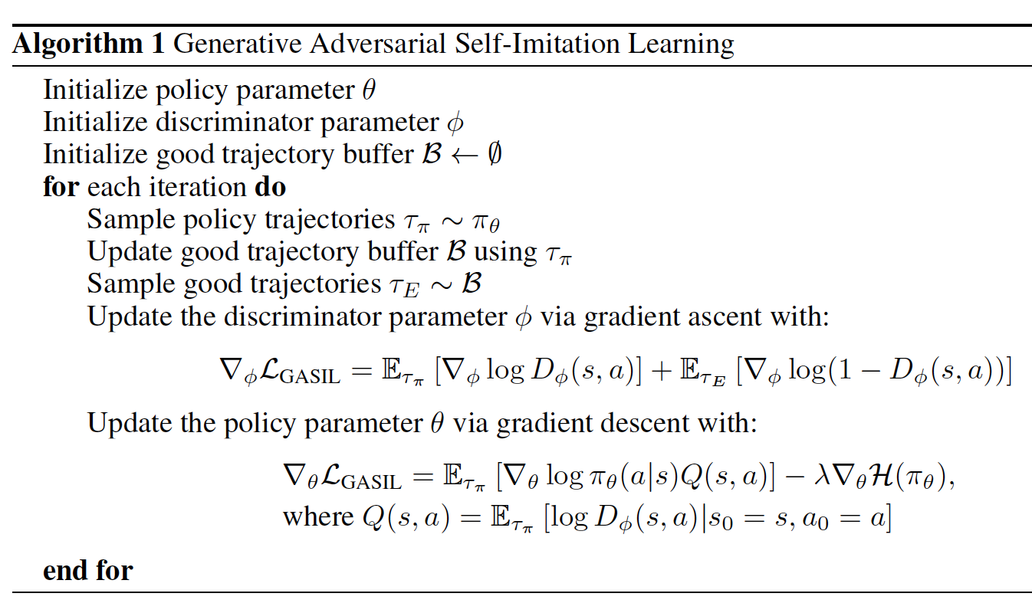
Approach

Slide 6
Approach
Updating good trajectory buffer - GASIL maintains a good trajectory buffer B of the trajectories that achieved high reward in the past.
Updating discriminator (D) and policy (P) - The agent learns to imitate good trajectories contained in the good trajectory buffer B using generative adversarial imitation learning.

Slide 7
Experimental Results
7 Million Episodes, ~ 1 Million Episodes Per Day, 1 Week Training

Slide 8
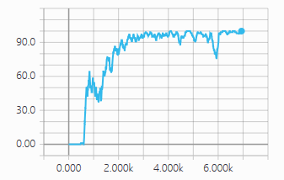
Experimental Results
Less than 20%: Prey Win, Predator Loses
Around 50%: Both Prey and Predators are equally good.
Greater than 80%: Predator Wins, Prey Loses.

Slide 9
Results and Conclusion
Till 500K episodes, the predator is not able to catch the prey <5% of time.
After 600K episodes, the predator is able to catch prey 60% of the time
After 2 Million episode, the predator is able to catch prey 90% of time.
The predator shows a consistent high hunt rate after 2 million episodes. > 90%
Conclusion: The MAGASIL model with Independent Learned Agents outperforms the DDPG Model.

Slide 10
Future Work
Things we are working on -
Model Based GASIL - added improvement where the model is learnt after a certain number of episodes, the model is then used to evaluate policies by simulating rewards.
Multi-Modal GASIL - GASIL implementation with multiple policy distributions, is learned separately as a “skill” and applied for higher rewards.

