Slide 1
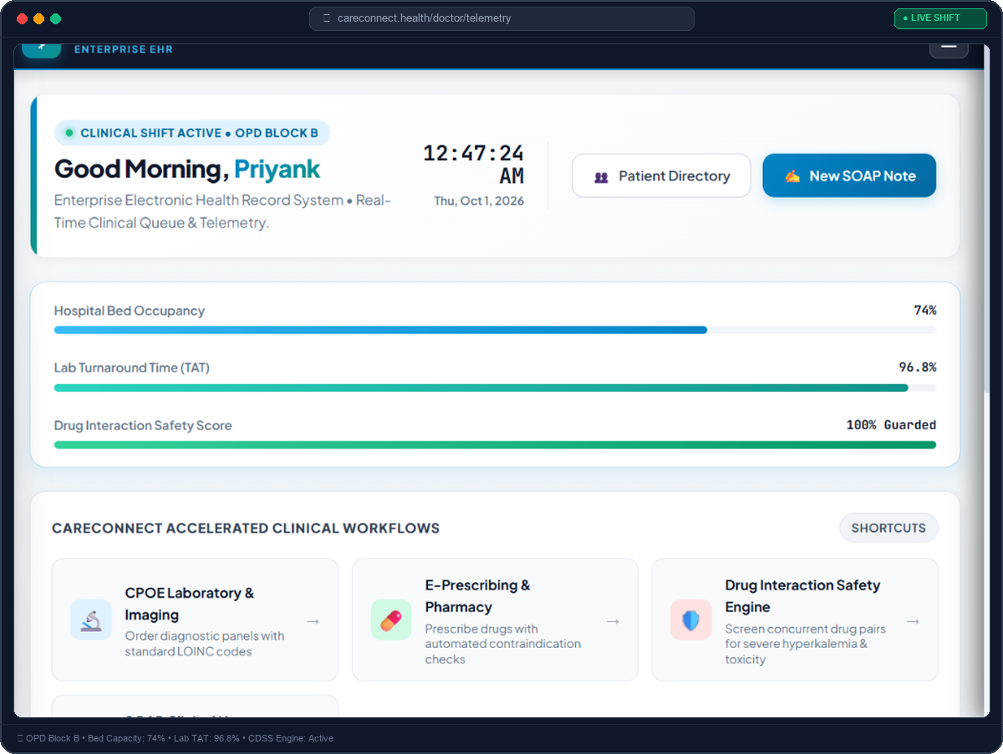
⚕️ CARECONNECT HEALTHCARE IT • ENTERPRISE CLINICAL PLATFORM
CareConnect EHR
Next-Gen Clinical Healthcare Management & Telemetry System
⚡ Real-Time CPOE Diagnostics: LOINC-coded lab & imaging requisitions with STAT priority queues.
🛡️ Drug Safety CDSS Engine: Automated drug-drug interaction & allergy contraindication safeguards.
📋 SOAP Clinical Encounters: Standardized medical history & cryptographically locked physician notes.
🏥 Patient Access Portal: Lifetime MRN self-service vitals, medication cards & lab results.
PROJECT METADATA & PRESENTATION DETAILS
• Lead Presenter: Priyank | Healthcare Informatics Lead
• Stack: Spring Boot 3 • Angular 17 • JWT • Relational H2 Persistent Storage
🟢 LIVE HOSPITAL TELEMETRY STREAM ACTIVE • WARD CAPACITY: 74% • TAT: 96.8%

Slide 2
CARECONNECT ENTERPRISE EHR • PROJECT PRESENTATION
Executive Summary: The Healthcare Transformation Need
🚨 Traditional Healthcare Bottlenecks
• Fragmented Paper Records: Illegible physician handwriting causes life-threatening medication administration errors.
• Dangerous Drug Interactions: No automated checks when co-prescribing drugs like Warfarin and Aspirin (bleeding risk).
• Diagnostic Requisition Delays: Lost paper slips for lab/radiology increase Lab Turnaround Time (TAT) and patient length-of-stay.
• Lack of Patient Transparency: Patients cannot review their vital histories, laboratory trends, or consult summaries remotely.
• Absence of Audit Governance: Non-compliance with HIPAA standards for tracking who viewed or altered medical charts.
💡 CareConnect Digital Breakthroughs
✓ End-to-End Paperless CPOE: Instant digital order routing with international LOINC diagnostic coding and STAT prioritization.
✓ Automated Drug Safety CDSS: Real-time clinical decision engine scanning drug-drug interactions and allergies prior to signature.
✓ Structured SOAP Encounters: Standardized clinical histories locked with digital clinician authentication.
✓ Self-Service Patient Access: Direct patient empowerment with real-time vitals flowsheets, lab releases, and active Rx cards.
✓ Full HIPAA Audit Readiness: Immutable audit trail capturing every chart view, order issuance, and clinician login with remote IP.

Slide 3
CARECONNECT ENTERPRISE EHR • PROJECT PRESENTATION
Enterprise Architecture: 4-Tier Scalable Clinical System
🖥️ Frontend Layer
Angular 17 Standalone
• Component-driven reactive UI architecture
• Real-time autocomplete & patient filters
• Reactive state management via RxJS
• Responsive clinical workstations & tablets
⚙️ Backend Core
Spring Boot 3 (Java 17)
• Modular RESTful micro-architecture
• Spring Data JPA transactional persistence
• Clinical Decision Support (CDSS) rules
• Strict DTO isolation preventing data leaks
🔒 Identity & Access
Spring Security 6 & JWT
• HMAC-SHA256 encrypted Bearer token auth
• 4-Tier RBAC: Doctor, Nurse, Admin, Patient
• Method-level `@PreAuthorize` guards
• HIPAA compliance audit trail logging
💾 Persistence Engine
File-Backed H2 Database
• Persistent disk storage (zero data loss on refresh)
• Automated schema synchronization via Hibernate
• Pre-seeded mock patient cohorts & clinical rules
• Production-ready path to Oracle / PostgreSQL

Slide 4
CARECONNECT ENTERPRISE EHR • PROJECT PRESENTATION
Doctor Control Room: Clinical Queue & Real-Time Telemetry
🩺 Real-Time Operational Cockpit
• Live Clinical Shift Monitor: Displays active duty shift (OPD Block B) with pulsing green live status indicator.
• Live Ticking Digital Clock: Monospace real-time clock updating every second via Angular ChangeDetectorRef.
• Hospital Bed Occupancy (74%): Live telemetry tracking available ward and intensive care unit capacities.
• Lab Turnaround Time (96.8%): Performance metric measuring swiftness of diagnostic reporting from labs to doctors.
• Drug Safety Guard Score (100%): Real-time clinical decision engine preventing concurrent contraindications.
• Accelerated Action Shortcuts: One-click jump to Patient Directory, CPOE Labs, E-Prescribe, and SOAP Notes.
🟢 Active Telemetry: Ward beds (74%), Lab TAT (96.8%), and real-time clock sync in Angular 17

Slide 5
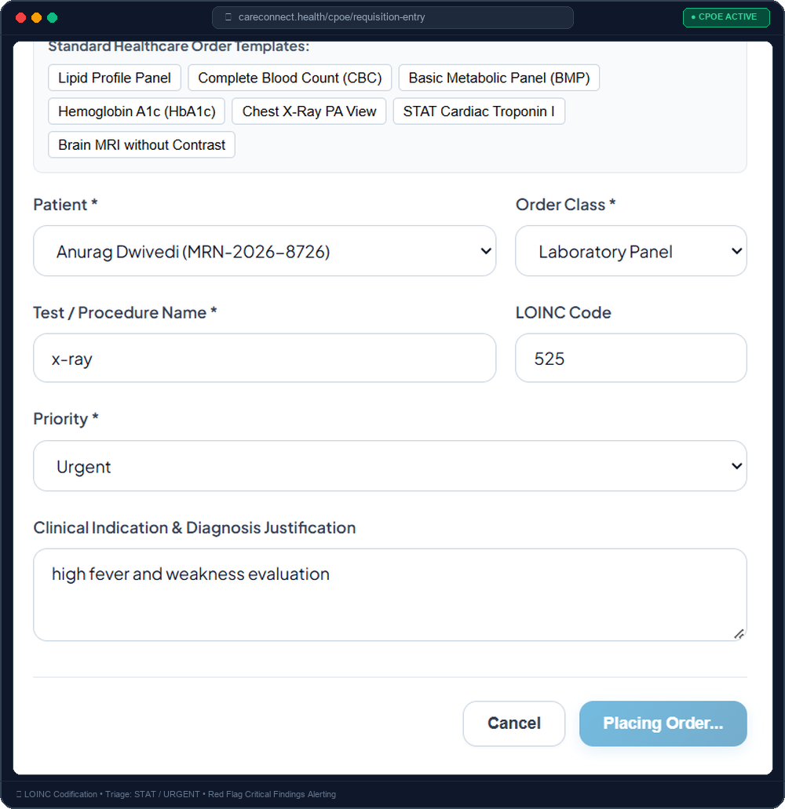
CARECONNECT ENTERPRISE EHR • PROJECT PRESENTATION
CPOE: Computerized Provider Order Entry & Diagnostic Findings
🔬 Paperless Diagnostic Lifecycle
✓ Standard LOINC Tagging: Every lab & imaging test uses international LOINC standards (e.g., 57698-3 for Lipid Panel, 36554-4 for Chest X-Ray).
✓ Triage Priority Routing: Support for ROUTINE, URGENT, and emergency STAT queues to accelerate critical lab samples.
✓ Clinical Indication Mandate: Doctors specify diagnostic justifications (e.g. 'high fever and weakness evaluation').
✓ Result Findings & Reporting: Lab techs and radiologists record quantitative results and biological normal ranges.
✓ ⚠️ Red Flag (Abnormal) Triaging: One-click abnormal flag highlights critical results in red on doctor worklists and hospital telemetry.

Slide 6
CARECONNECT ENTERPRISE EHR • PROJECT PRESENTATION
Clinical Safety: E-Prescribing & Drug-Drug Interaction CDSS
💊 E-Prescription Workflow
• Patient Autocomplete & Search with instant suggestion popups
• Dosage, Route (Oral, IV, Topical), Frequency, and Duration
• Pharmacy SIG Instructions ('Take 1 tablet daily after food')
• Prescription Refill tracking & status lifecycle (ACTIVE / DISCONTINUED)
• Hospital Formulary Quick-Fill chips for common drugs
🛡️ Drug Interaction Engine
⚠️ Real-Time Background Cross-Check before doctor authorization
⚠️ Severity Classification: HIGH, MODERATE, LOW clinical risk
⚠️ Mechanism Explanation (e.g. CYP2C19 inhibition)
⚠️ Clinical Override Protocol: Doctors must explicitly review & confirm risk
⚠️ High-Risk Pairs Guarded: Warfarin + Aspirin, Lisinopril + Spironolactone
📋 SOAP Clinical Documentation
✓ Subjective (S): Patient history, symptoms, and chief complaint
✓ Objective (O): Physical exam, vitals flowsheet, and lab findings
✓ Assessment (A): Differential diagnosis & ICD-10 codification
✓ Plan (P): Medications, follow-up schedule, and patient counseling
✓ Cryptographic Digital Signatures locking notes upon completion

Slide 7
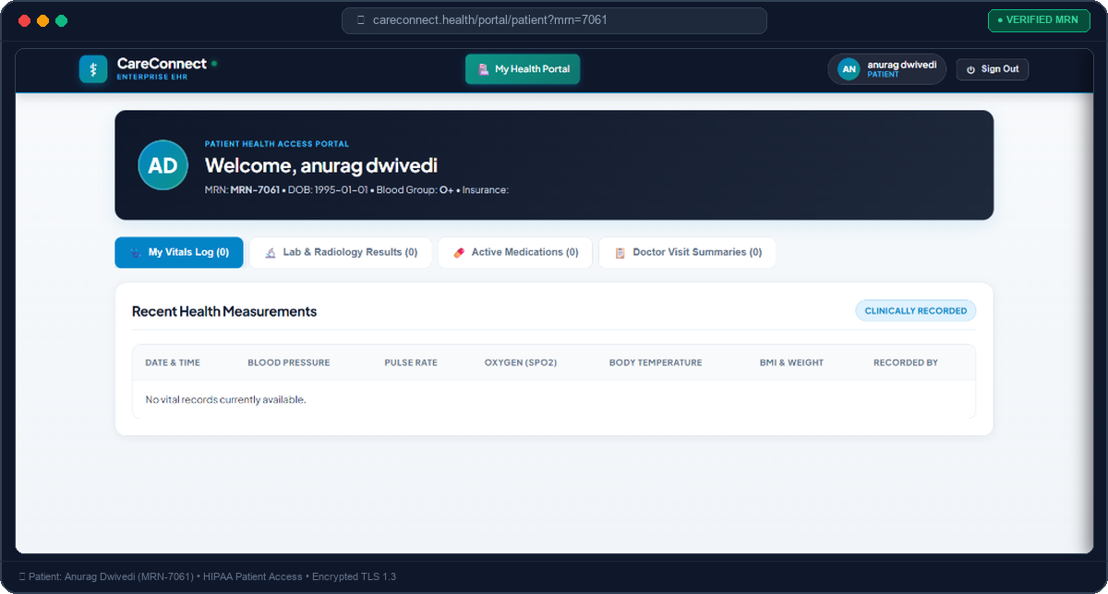
CARECONNECT ENTERPRISE EHR • PROJECT PRESENTATION
Patient Empowerment: Self-Service Health Access Portal
🧑 Direct Patient Engagement
• Unique Medical Record (MRN): Automated generation of lifetime identifier (e.g. MRN-7061 for Anurag Dwivedi).
• Personal Vitals Flowsheet: Patients track historical trends of Blood Pressure, Heart Rate, SpO2, and WHO BMI status.
• Diagnostic Lab Results Access: Complete visibility into completed blood panels and radiology impressions.
• Pharmacy Medication Cards: Clear dosage, frequency, and instructions to ensure medication adherence.
• Visit Consult Summaries: Patients can review attending doctor advice from any internet-connected device.
• Clinician Preview Switcher: Doctors and nurses can preview how records appear to any patient.
📊 Vitals Telemetry
Real-time tracking for Blood Pressure, Heart Rate, SpO2 & BMI recorded during triage.
💊 Active Prescriptions
Instant access to verified doctor consults, medications, dosages & LOINC lab reports.

Slide 8
CARECONNECT ENTERPRISE EHR • PROJECT PRESENTATION
Regulatory Governance, Audit Trail & Future Horizon
🔒 Security & Regulatory Compliance
✓ Granular Role Separation (RBAC): Doctors have prescribing privileges; Nurses manage triage and vitals; Patients have read-only access to their charts.
✓ Immutable Audit Trail: Every chart view, order creation, and diagnosis entry records timestamp, user, action, and remote IP address.
✓ Data Loss Prevention: Relational file-backed database ensures persistent operational durability during server restarts.
✓ Data Minimization: Endpoints expose only required DTO schemas to prevent accidental data leaks.
🚀 Future Strategic Roadmap
★ HL7 / FHIR Interoperability: RESTful FHIR R4 standard export for seamless health data sharing between hospitals.
★ AI-Powered Clinical Scribe: Ambient voice-to-text generating automated draft SOAP notes during consultations.
★ Telehealth WebRTC Consultations: Integrated encrypted video calling directly inside the patient portal.
★ Predictive Sepsis & ICU Triage: Machine learning early warning scores (NEWS2) derived from real-time vitals flowsheets.
★ Smart Pharmacy Dispense Integration: Barcode Medication Administration (BCMA) scanning verification at bedside.

Slide 9

Thank You.

