Slide 1

Stock Price Analyzer using heaps and stacks
Real-Time Stock Price Analyzer Using Heap and Stack (Integrated with Machine Learning for Prediction)
Team Members
Dhairya Joshi(B24ME1024)
Utkarsh Bansal(B24ES1009)
Anurag Pawar(B24MT1007)
Shankar Suthar(B24PH1023)
Github Link
https://github.com/dhairya2006-del/Stock-price-analyzer

Slide 2

Agenda
Presentation Overview
▸ Introduction — Challenges in Stock Price Analysis
▸ Key Financial Problems (Span, NGE, Profit)
▸ System Architecture & Data Pipeline
▸ DSA-Based Feature Engineering (Heap, Stack)
▸ Machine Learning Models
▸ Model Evaluation (MAE Comparison)
▸ Dashboard & Visualization
▸ Key Insights & Future Scope

Slide 3
The Problem — Why AI in Finance?
The need for intelligent financial decision-making
❌ THE CHALLENGE
✅ THE AI SOLUTION
▸ Stock markets are inherently volatile — prices change every second
▸ Traditional technical analysis relies on human intuition and manual charting
▸ Billions of dollars are lost annually due to poorly timed trades
▸ Human traders cannot process vast datasets in real time
▸ AI can identify hidden patterns in historical price data
▸ Machine Learning models adapt to changing market dynamics
▸ Algorithms process thousands of data points in milliseconds
▸ Quantitative trading firms already use AI for 70%+ of trades
This project focuses on solving core stock analysis problems using efficient data structures.

Slide 4
Key Financial Concepts
Understanding the building blocks of stock analysis
Stock Span
Maximum Profit (Buy-Sell Problem)
Running Max/Min
Top-K Prices
Next Greater Element
Number of consecutive prior trading days where the stock price was less than or equal to today's price. Key indicator of bullish momentum.
Maximum profit achievable from a single buy-sell transaction over a historical window. Tracks the optimal entry and exit points.
The highest and lowest prices observed across the entire trading history. Defines the volatility range and support/resistance levels.
The K highest stock prices seen so far, maintained using a min-heap. Helps identify price ceilings and resistance zones in trading.
Finds the next higher price for each day. Detects breakout opportunities. Implemented using stack. O(n) complexity.

Slide 5
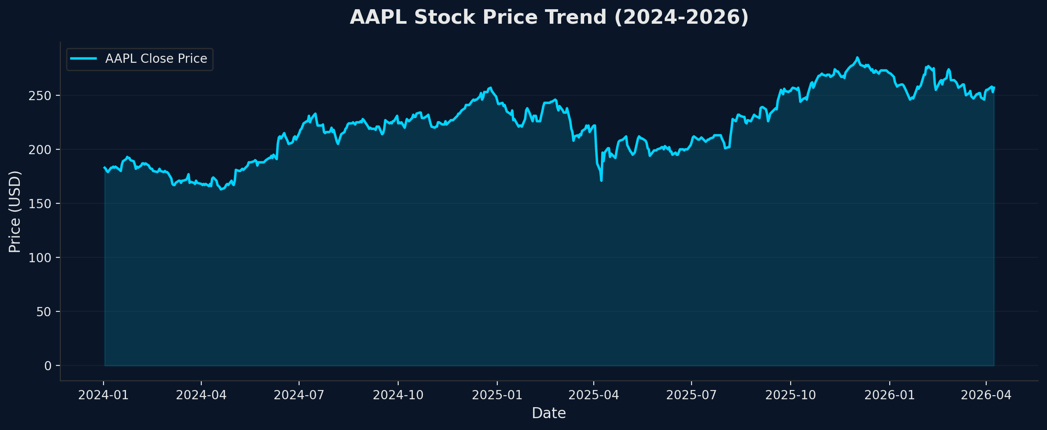
AAPL Stock Price Analysis
2+ years of Apple Inc. daily closing prices

Slide 6

Project Architecture & Data Pipeline
End-to-end flow from raw data to predictions
1. Data Acquisition
Download AAPL stock data from Yahoo Finance API (yfinance)
2. Feature Engineering (C++ DSA Engine)
• Stock Span (Stack) • Next Greater Element (Stack) • Maximum Profit (Greedy) • Top-K Prices (Heap)
3. ML Training
Train 3 models: Linear Regression, Random Forest, XGBoost
4. Evaluation
Compare models using MAE metric and time-based train/test split
5. Dashboard
Streamlit dashboard for interactive visualization and analysis

Slide 7
Data Structures Powering Financial Analysis
How fundamental algorithms drive feature engineering
Stack (Core Component)
Min-Heap (Priority Queue)
Greedy / Kadane's
Stock Span & Next Greater Element
Top-K Prices & Running Extremes
Maximum Profit Opportunity
• Stock Span Problem • Next Greater Element Problem • O(n) amortized complexity • Monotonic stack implementation
• Maintains top K prices efficiently • O(log K) per insertion • Tracks all-time max/min prices • Constant-time lookups for extremes
• Best buy-sell profit calculation • Single pass O(n) algorithm • Tracks minimum buy price seen • Updates max profit dynamically

Slide 8
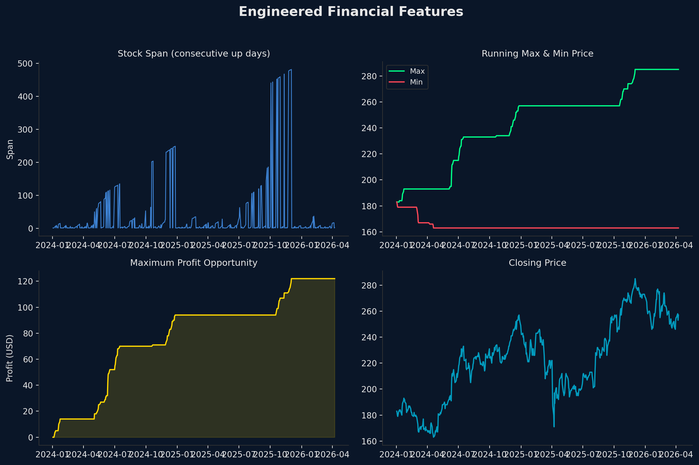
Engineered Financial Features
Derived features that feed into ML models

Slide 9
AI/ML Models for Stock Prediction
Three supervised learning models trained on financial features
Baseline
Ensemble
Boosting
Linear Regression
Random Forest
XGBoost
• Simple, interpretable model • Learns linear relationship between features and next-day price • Features: price, span, max, min, profit • Baseline model for comparison
• Ensemble of 100 decision trees • Handles non-linear relationships • Uses lagged features to avoid leakage
• Gradient-boosted tree ensemble • Learning rate: 0.1, Max depth: 5 • Regularized to prevent overfitting • Same feature set as Random Forest • Industry-standard for tabular data

Slide 10
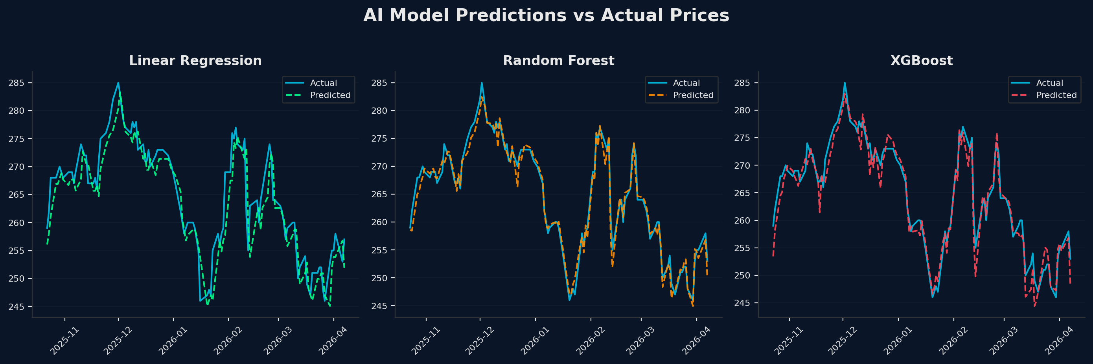
Predicted vs Actual — Visual Comparison
How well each model tracks real stock prices

Slide 11
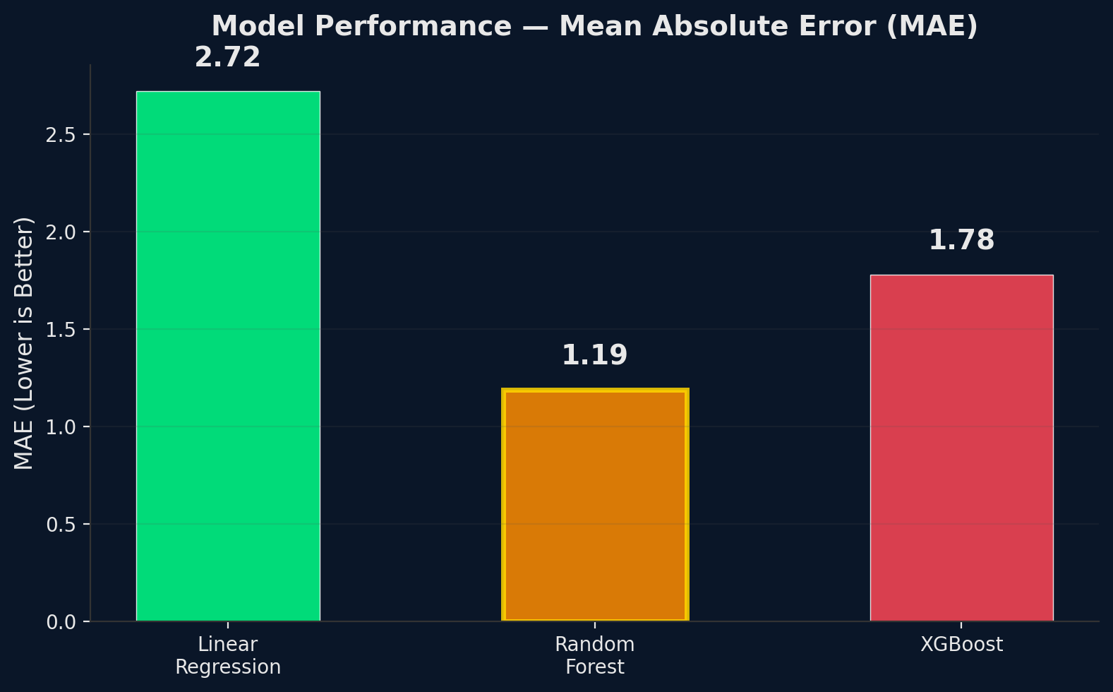
Model Performance — MAE Comparison
Mean Absolute Error (lower is better)
📊 RESULTS SUMMARY
Linear Regression MAE:
2.72
Random Forest MAE:
1.19
XGBoost MAE:
1.78
🏆 BEST MODEL
Random Forest — MAE 1.19
Random Forest achieves lowest MAE (1.19), demonstrating effectiveness of non-linear models.

Slide 12
Interactive Streamlit Dashboard
Real-time exploration of predictions and metrics
▸ 📈 Price Dashboard — Historical stock price trends with time-series visualization
▸ 📊 Model Comparison — Side-by-side actual vs predicted plots for all 3 models
▸ 📉 Performance Metrics — Live MAE computation and automatic best-model selection
▸ 📂 Sidebar Navigation — Clean, intuitive page switching between all views
▸ 🔄 Auto-Refresh Data — Loads latest prediction results from CSV on each run
Streamlit
Matplotlib
Pandas
scikit-learn

Slide 13
Key Findings & Insights
What we learned from applying AI to stock price prediction
▸ Random Forest outperforms other models with MAE of 1.19 — demonstrating that ensemble methods capture non-linear market dynamics better than simple linear approaches
▸ Engineered features (span, max/min price, profit) significantly improve prediction accuracy over using raw price data alone — domain knowledge matters in finance AI
▸ Time-based train/test split prevents data leakage — a critical requirement for financial forecasting where temporal order must be preserved
▸ C++ feature engine processes data efficiently — DSA-optimized algorithms (Stack O(n), Heap O(log K)) enable real-time feature computation at scale
▸ Stack-based algorithms efficiently solve span and next greater element problems in linear time.

Slide 14
Technology Stack
Languages, libraries, and tools used
C++
Python
scikit-learn
Core DSA engine implementing: • Stack (Span, NGE) • Heap (Top-K prices) • Greedy (Max Profit)
Data acquisition (yfinance), ML training, evaluation, dashboard
Linear Regression & Random Forest models
XGBoost
Streamlit
Matplotlib
Gradient-boosted decision tree regressor
Interactive web-based analysis dashboard
Data visualization and chart generation

Slide 15
Future Scope & Enhancements
Where this project can go next
▸ Integrate real-time sentiment analysis from financial news and social media APIs
▸ Add LSTM / Transformer-based deep learning models for sequential pattern recognition
▸ Expand to multi-stock portfolio analysis with correlation-based risk assessment
▸ Implement real-time prediction pipeline with streaming data ingestion
▸ Add technical indicators (RSI, MACD, Bollinger Bands) as additional features
▸ Deploy as a cloud-hosted web application with user authentication

Slide 16

Thank You!
Stock Price Analyzer using heaps and stacks

