Slide 1


AIRBNB TRAVEL DATA ANALYSIS
by: Anurag Gupta,
Hemant Sharma

Slide 2
Table of contents
01
02
03
04
Introduction
Objective
Problem Statement
Presentation

Slide 3
INTRODUCTION
Airbnb is an American company that facilitates an online marketplace for lodging, primarily homestays for vacation rentals, and tourism activities. It basically connecting travelers with local hosts who want to rent out their homes with people who are looking for accommodations in that locality. On the other hand, this platform enables host to list their available space and earn extra income in the form of rent and it also enables travelers to book unique homestays from local hosts, saving them money and giving them a chance to interact with locals.

Slide 4
OBJECTIVE
In the world of rising new technology and innovation, Travel industry is advancing with the role of Data Science and Analytics. Data analysis can help them to understand their business in a quiet different manner and helps to improve the quality of the service by identifying the weak areas of the business.
Benefits:
Help out to make better business decisions.
Help analyze customer trends and satisfaction, which can lead to new and better products and services.
Gives better insight of customers base.
Helps in easy flow for managing resources.

Slide 5
Problem Statement
Travel industries are having important reflection of the economy from past few decades, and Airbnb housing price ranges are of great interest for both Hosts and Traveler. In this project, we are analyzing the various aspects with different use cases which covers many aspects of Airbnb listings. It helps in not only understanding the meaningful relationships between attributes but it also allows us to do our own research and come-up with our findings.

Slide 6
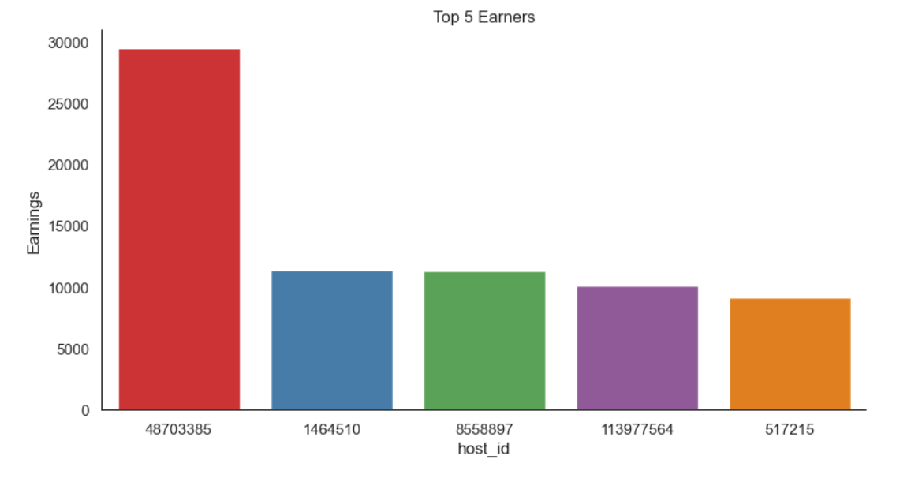
Top 5 Earners w.r.t Host_id?
Conclusion:
In the above Chart, we've listed/ploted Top 5 Earners in terms of Hosts, one after the other.
From the above visual, We can say that Host with id “48703385” is the top earner who earned more than 29000 followed by host id “146410” and “8558897”

Slide 7
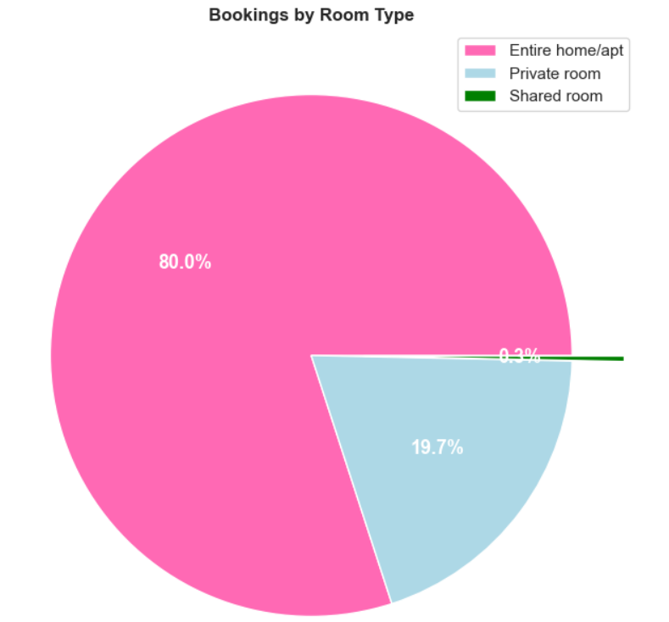
Which Room Types are booked more?
Conclusion:
This beautiful "Pie Chart" displays the Most Preferred 'Room Type' by Guests.
To conclude this Chart, We can say, "Entire home/apt" was the First Choice/Most Preferred Room Type by approx ’80%' Guests followed by "Private Room" and "Shared Room" which are about ’19.7%' & ‘0.3%' respectively.

Slide 8
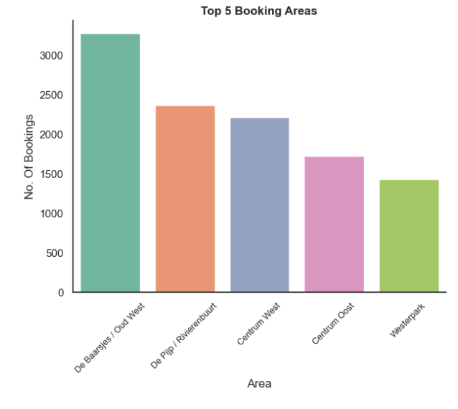
Any particular location getting maximum number of bookings?
Conclusion:
This Pie Chart, shows Top 5 Area who's having Maximum Number of Bookings.
To conclude above Chart, We can say, Most of the Bookings of around “3000” were takes place for "De Baarsjes/Oud West" followed by “De Pijp/Rivierenbuurt” and “Centrum West”

Slide 9
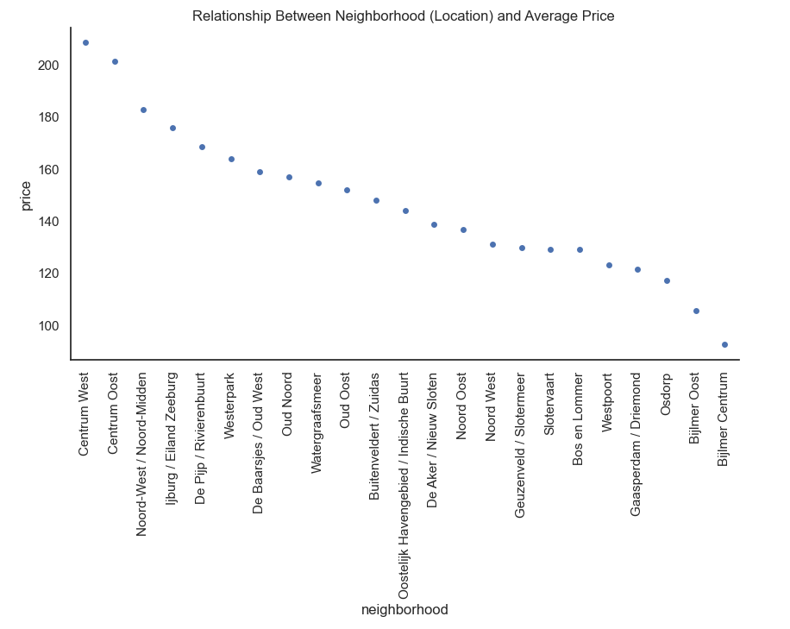
Neighbourhood vs Price-
Conclusion:
In the above Chart, we've listed/ploted Relationship between Neighbourhood and Average Price.
From the above visual, We can say that-
1- Centrum West has a highest average price 208.31
2- Centrum Oost has a 2nd highest average price 201.22
3- Noord-West / Noord-Midden has a 3rd highest average price 182.73

Slide 10
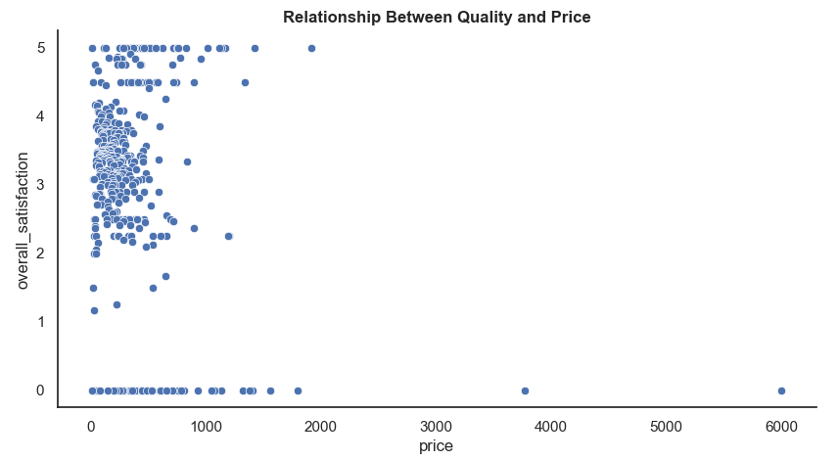
Overall Satisfaction Vs Price-
Conclusion:
In the above Chart, we've listed/ploted Realtionship between Quality and Price.
In the above scatterplot plot we can see that if the 'price' is higher than the 'overall_satisfaction(quality)' is less and where the 'price' is less than the 'overall_satisfaction(quality)' is high. For example: price=313 then the overaoverall_satisfaction(quality) is 5.0 and in other side price=6000 then the overall_satisfaction(quality) is 0.0

Slide 11
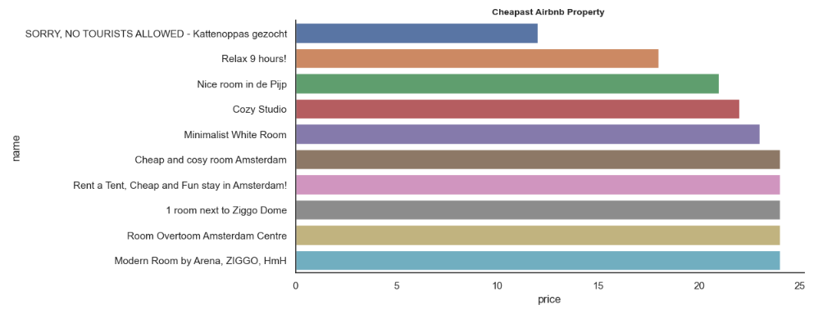
Cheapest Airbnb property in Amsterdam-
Conclusion:
In the above Chart, we've listed/ploted 10 Cheapest Airbnb property in Amsterdam, one after the other.
From the above bar chart we see 10 cheapest properties in which the 'Kattenoppas gezocht' is the cheapest property with the price of $12

Slide 12
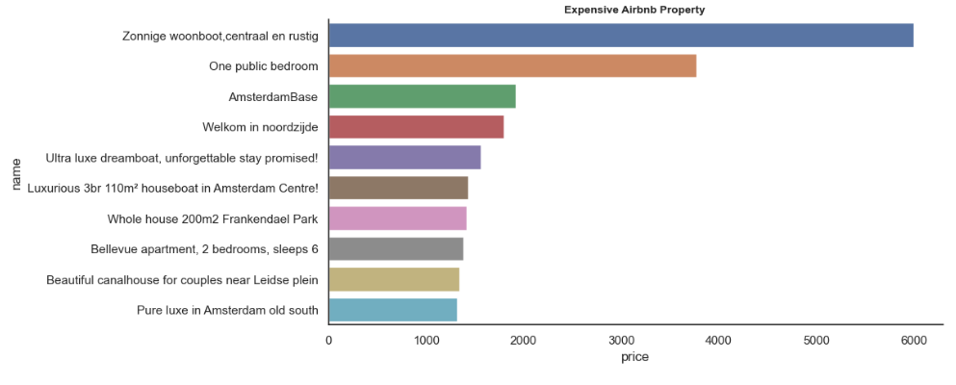
Expensive Airbnb property in Amsterdam-
Conclusion:
In the above Chart, we've listed/ploted 10 Cheapest Airbnb property in Amsterdam, one after the other.
From the above bar chart we see 10 expensive properties in which the 'Zonnige woonboot,centraal en rustig' is the expensive property with the price of $6000

Slide 13

Thanks!
/

