Slide 1
Global Cancer Survival and Mortality Prediction
Anuragini Sinha
Mohammad Isleem
Alphonsa Kochupurckal Devasia

Slide 2
Introduction
In this project , we evaluate and compare machine learning regression models for predicting cancer survival and mortality rates.
Advances in machine learning (ML), particularly regression-based models, offer new ways to predict cancer outcomes.
Regression models estimate survival and mortality probabilities, supporting early intervention.
Why it is important ?
Early detection significantly improves survival and reduces healthcare costs .
Timely diagnoses remains a challenge, especially in developing countries

Slide 3
Data Sources
Dataset
Cancer
Datasets Used:
Cancer Death Rates by Age
Cancer Death Rates by Type
5-Year Survival Rates by Cancer Type

Slide 4
Models Used
Models:
Random Forest Regressor
Decision Tree Regressor
CatBoost Regressor
AdaBoost Regressor

Slide 5
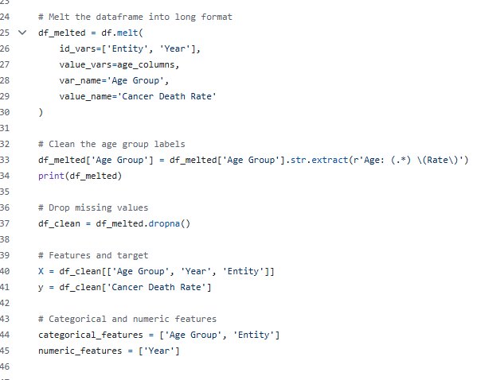
Cancer death rate by age (Model – RandomForestRegressor)
Preprocessing:
Used melt function to reshape the dataset
Dropped rows with missing values to ensure data quality
Converted to long format for better model training.

Slide 6
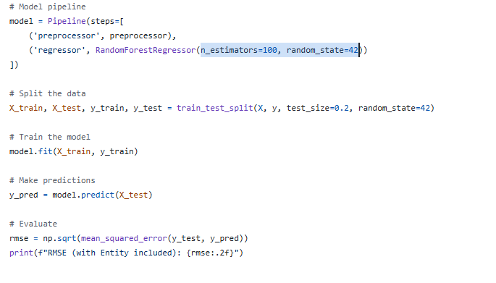
Cancer death rate by age (Model – RandomForestRegressor)
Model Pipeline and Training :
Numeric Features (Year) used without changes.
Features (Age Group, Entity) - One-Hot Encoded.
Feature (X) :Age group , year , entity
Feature (Y) : Cancer Death Rate
Random Forest Regressor (n_estimators=100, random_state=42)
Train-test split: 80% training, 20% testing.

Slide 7
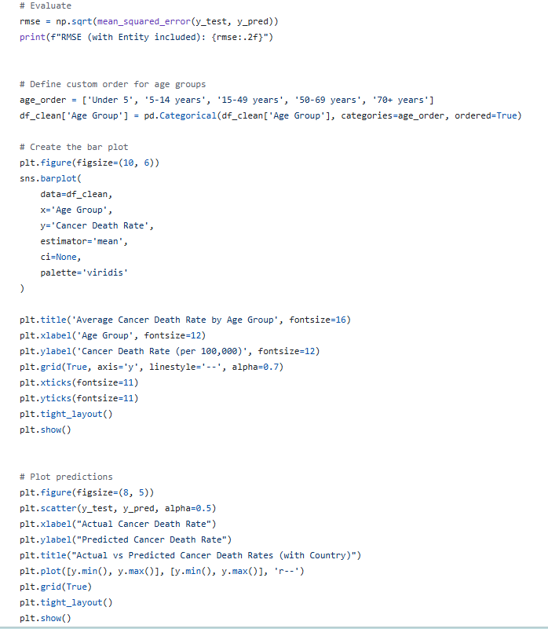
Cancer death rate by age (Model – RandomForestRegressor)
Evaluation
Metric: Root Mean Squared Error
Achieved RMSE =

Slide 8
Cancer death rate by age (Model – RandomForestRegressor) Average Cancer Death Rate by Age Group.

Slide 9
Cancer death rate by age Model – Random Forest Regressor Result Actual vs Predicted Cancer Death Rates

Slide 10
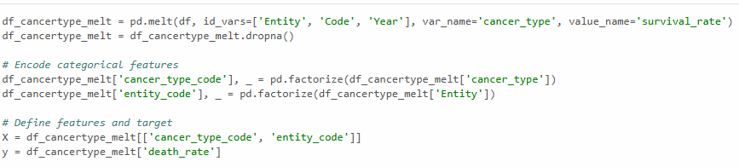
Cancer Death rate by Type (Model – RandomForestRegressor )
Preprocessing:
Simplified complex column names for clarity
Used melt function to create long format dataset
Dropped rows with missing values to ensure data quality
Categorical variables cancer type , entity encoded into numerical variables

Slide 11
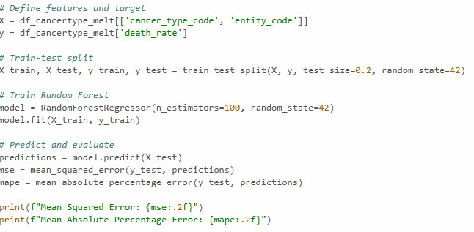
Cancer Death rate by Type (Model –RandomForestRegressor)
Model Pipeline and Training :
Feature (X) :Cancer Type code , Entity Code
Feature (Y) : Cancer Death Rate
Random Forest Regressor (n_estimators=100, random_state=42)
Train-test split: 80% training, 20% testing.

Slide 12
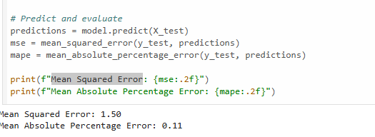
Cancer Death rate by Type (Model – RandomForestRegressor )
Evaluation
Metric: Mean Squared Error
Achieved MSE = 1.50
Achieved Mean Absolute percentage Error = 0.11

Slide 13
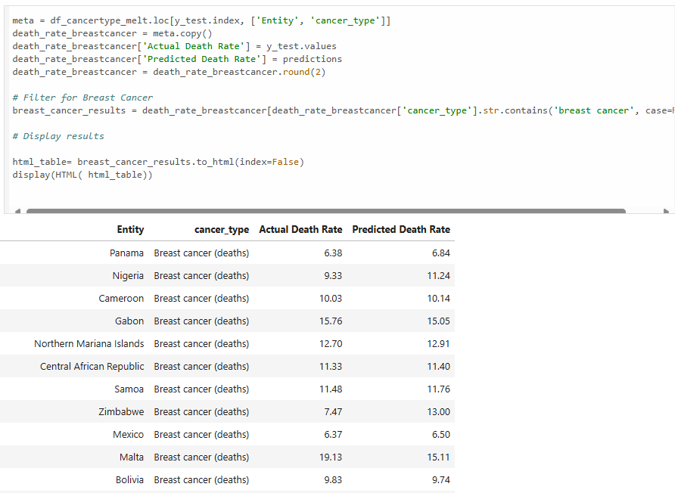
Cancer death rate by Type Model – Random Forest Regressor Actual VS Predicted Death Rate for Breast Cancer for all Countries

Slide 14
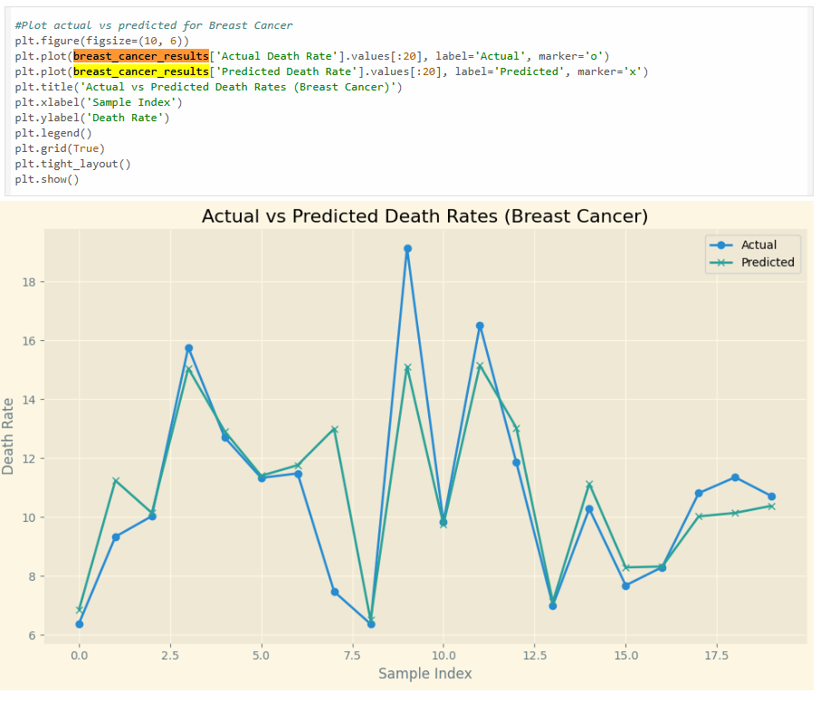
Cancer death rate by Type Model – Random Forest Regressor Plot for Actual VS Predicted Death Rate for Breast Cancer for all Countries

Slide 15
Cancer Death rate by Type (Model – DecisionTreeRegressor)
Preprocessing:
Used melt function to create long format dataset
Dropped rows with missing values to ensure data quality
Categorical variables cancer type , entity encoded into numerical variables

Slide 16
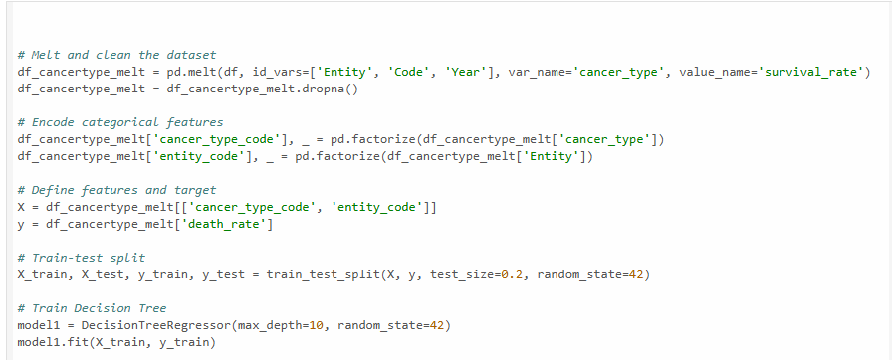
Cancer Death rate by Type (Model – DecisionTreeRegressor )
Model Pipeline and Training :
Feature (X) :Cancer Type code , Entity Code
Feature (Y) : Cancer Death Rate
DecisionTreeRegressor(max_depth=10, random_state=42)
Train-test split: 80% training, 20% testing.

Slide 17
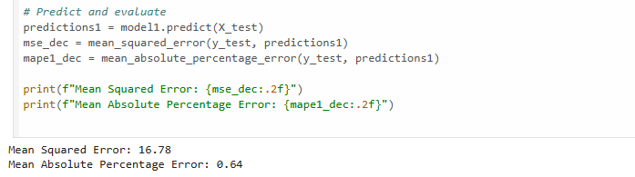
Cancer Death rate by Type (Model – DecisionTreeRegressor)
Evaluation
Metric: Mean Squared Error
Achieved MSE = 16.78
Achieved Mean Absolute percentage Error = 0.64

Slide 18
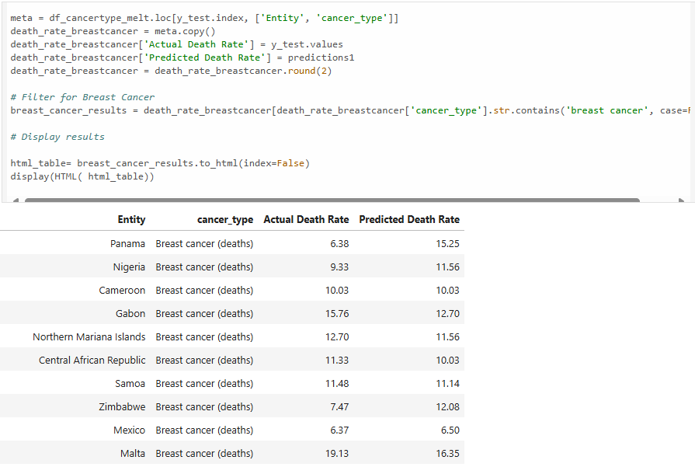
Cancer Death rate by Type (Model – DecisionTreeRegressor) Actual VS Predicted Death Rate for Cancer Type

Slide 19
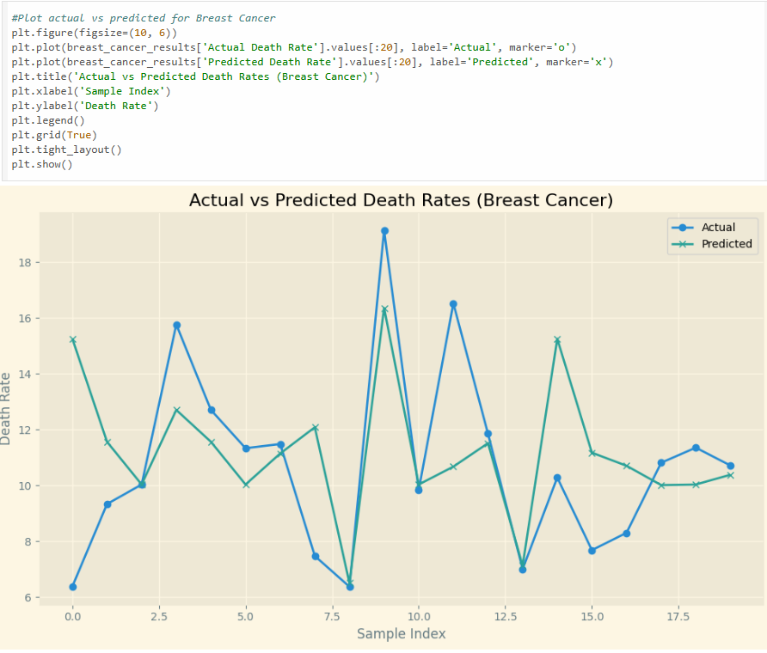
Cancer death rate by Type (Model – DecisionTreeRegressor) Plot for Actual VS Predicted Death Rate for Breast Cancer for all Countries

Slide 20
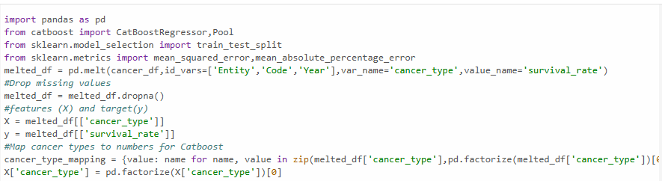
Cancer Survival rate by Type (Model – CatBoostRegressor)
Preprocessing:
Used melt function to create long format dataset
Dropped rows with missing values to ensure data quality
Categorical variables cancer type encoded into numerical variables

Slide 21
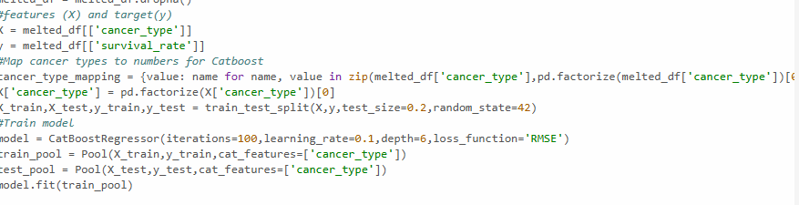
Cancer Survival rate by Type (Model – CatBoostRegressor)
Model Pipeline and Training :
Feature (X) :Cancer Type
Feature (Y) : Survival Rate
CatBoostRegressor(iterations=100,learning_rate=0.1,depth=6,loss_function='RMSE’)
Train-test split: 80% training, 20% testing.

Slide 22
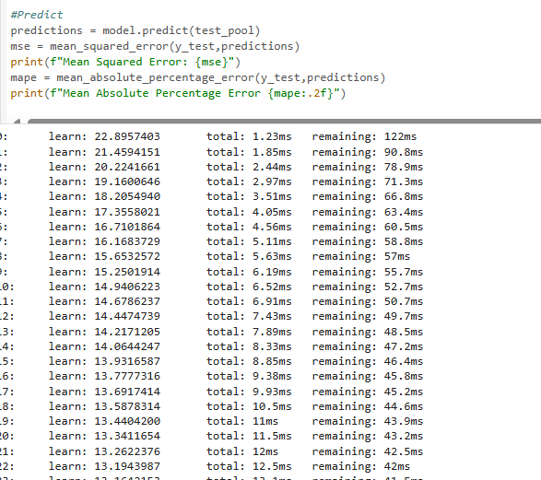
Cancer Survival rate by Type (Model – CatBoostRegressor)

Slide 23
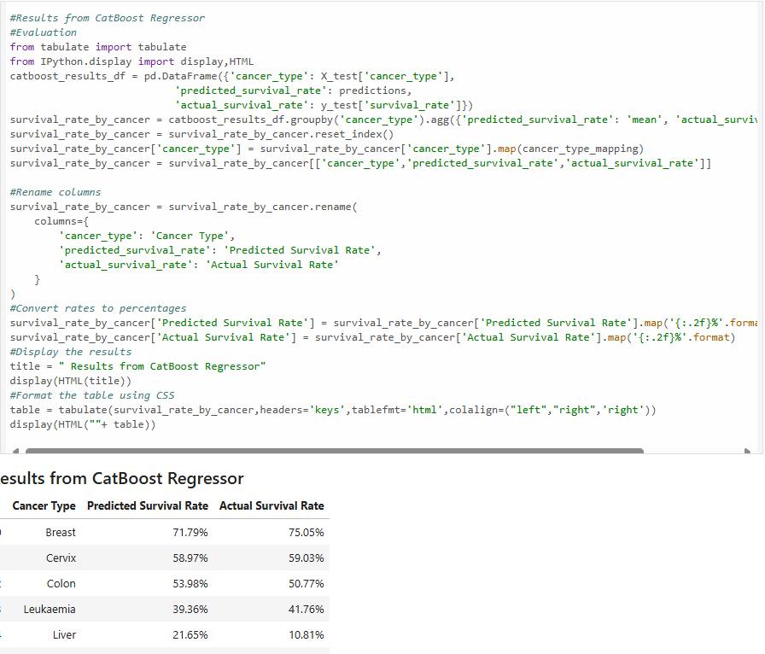
Cancer survival rate by Type (Model – CatBoostRegressor) Actual VS Predicted survival Rate for Cancer Type

Slide 24
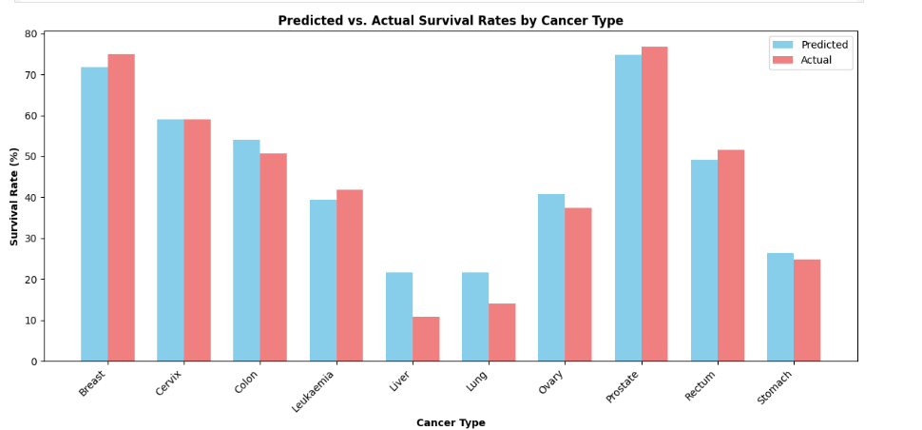
Cancer survival rate by Type (Model – CatBoost Regressor) Plot for Actual VS Predicted Survival Rate

Slide 25
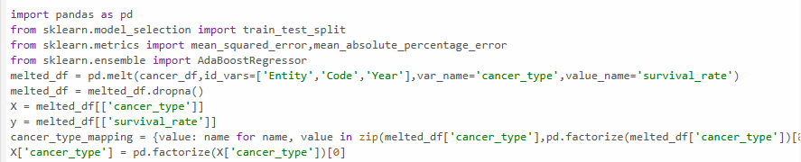
Cancer Survival rate by Type (Model – AdaBoostRegressor)
Preprocessing:
Used melt function to create long format dataset
Dropped rows with missing values to ensure data quality
Categorical variables cancer type encoded into numerical variables

Slide 26
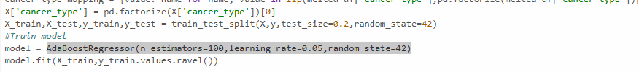
Cancer Survival rate by Type (Model – AdaBoostRegressor)
Model Pipeline and Training :
Feature (X) :Cancer Type
Feature (Y) : Survival Rate
AdaBoostRegressor(n_estimators=100,learning_rate=0.05,random_state=42)
Train-test split: 80% training, 20% testing.

Slide 27
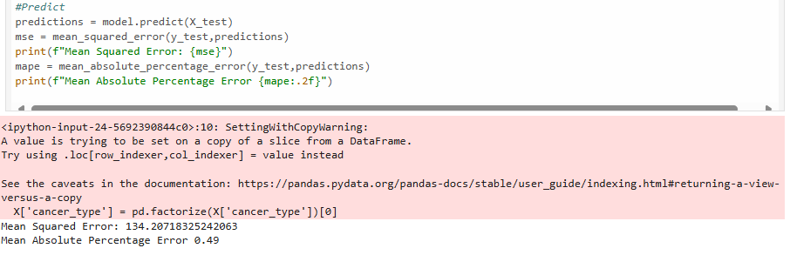
Cancer Survival rate by Type (Model – AdaBoostRegressor)
Metric: Mean Squared Error
Achieved MSE = 134.20
Achieved Mean Absolute percentage Error = 0.49

Slide 28
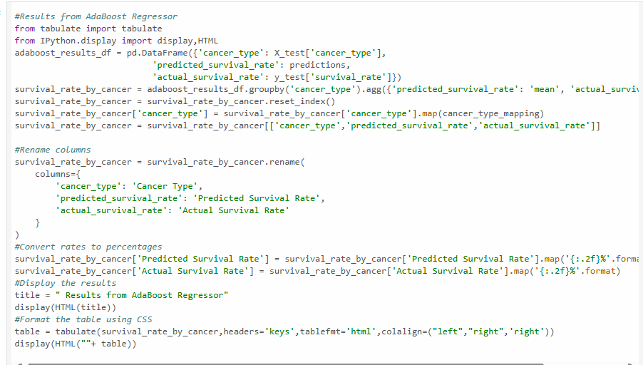
Cancer Survival rate by Type (Model – AdaBoostRegressor) Actual VS Predicted survival Rate for Cancer Type

Slide 29
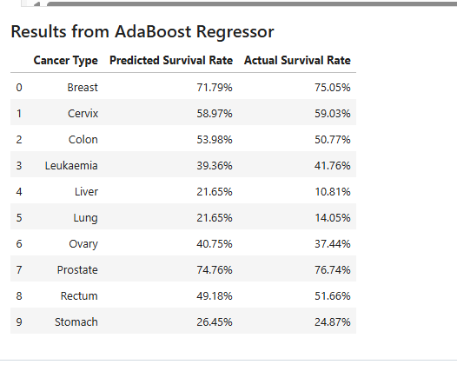
Cancer Survival rate by Type (Model – AdaBoost Regressor) Actual VS Predicted Survival Rate

Slide 30
Model Performance
Decision Tree: Best (MSE = 16.78, MAPE = 0.64%)
Random Forest: Moderate (MSE = 100.37)
CatBoost & AdaBoost: Higher MSE, low MAPE (~0.5%)

Slide 31
Future Works
Apply hyperparameter tuning to optimize model performance.
Perform advanced feature engineering to enhance feature richness.
Develop a patient-facing application for real-time survival/mortality prediction.
Explore deep learning models for handling larger, more complex datasets.

