Slide 1

Haskell
Anurag Jaiswal

Slide 2
Overview
What
Why
History
Tools

Slide 3
What
Haskell is a purely functional, lazy, statically-typed programming language.
Purely Functional.
Functions are value
Values never change
Lazy.
Statically Typed.

Slide 4
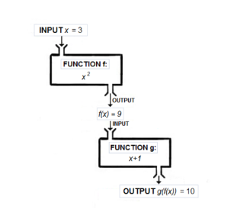
Functional
Functions are first-class.
Haskell programs is centered around evaluating expressions rather than executing instructions.

Slide 5
Pure
Haskell expressions are always referentially transparent, that is:
No mutation! Everything (variables, data structures…) is immutable.
Expressions never have “side effects” (like updating global variables or printing to the screen).
Calling the same function with the same arguments results in the same output every time.
Benfits:
Equational reasoning and refactoring.
Parallelism.
Fewer headaches.

Slide 6
Lazy
Expressions are not evaluated until their results are actually needed
possible to define and work with infinite data structures.
reasoning about time and space usage becomes much more complicated!

Slide 7
Types
Strong
Static
Type inference
Polymorphic

Slide 8
Why
Not Difficult, just different.

Slide 9
Why
C – Engineering.
Java, C# - Business.
Haskell – Mathematics.
Patient development
Strong theoretical roots
Fosters innovation

Slide 10
Why
Industrial Strength
Performance
Llibraries

Slide 11
History
1980s – Many functional languages
1987 – Standarization committee is formed.
1990 – Haskell 1.0
1997 – Haskell 98
2009 – Haskell 2010

Slide 12
History
Many Compilers
Glorious Glasgow Haskell Compiler (GHC)
Most popular
Many features

Slide 13
Tools
Haskell platform.
GHCi
Haskell Read, Evaluate Print Loop (REPL)
Text Editors
IDE
EclipseFP
Leksah

Slide 14
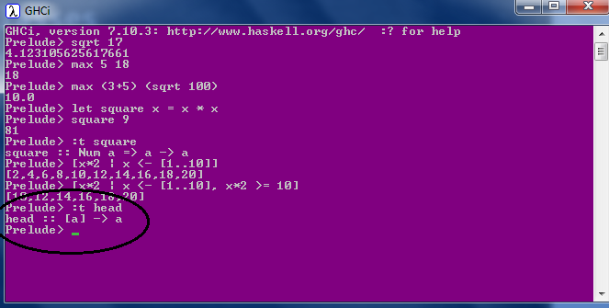
Types & TypeClass
Int
Integer
Float
Double
Bool
Char
Composited: List & Tuples
Polymorphic
parametric polymorphism
subtype polymorphism
coercion polymorphism

Slide 15
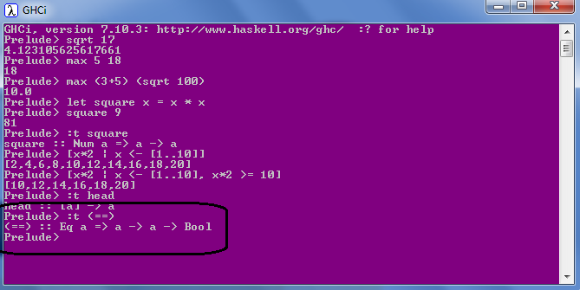
Types & TypeClass
Eq
Ord
Show
Enum
Bounded
Num
Integral
Floating

Slide 16
Functions

Slide 17
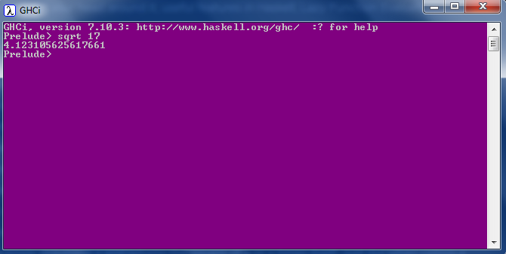
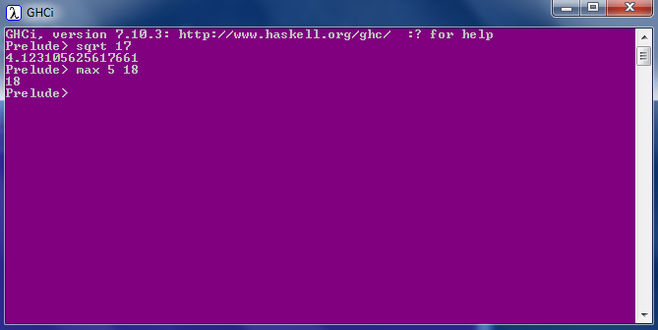
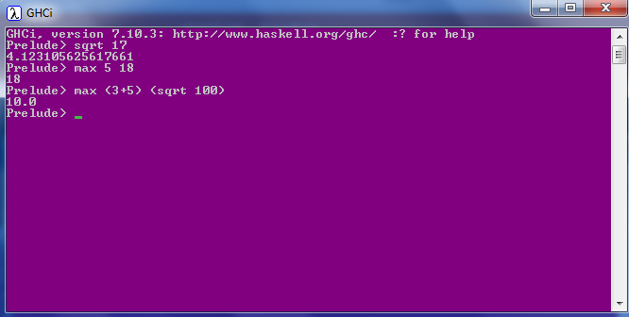
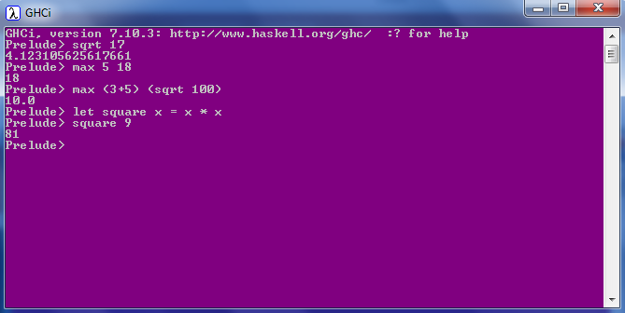
Calling a function
No parentheses
No commas
No returns

Slide 18
Pure functions
All functions are pure
Cannot modify state.
Cannot depend on state only arguments.
Examples
Get current time
Print string to console
Read a file
Length of a string
Get random numbers

Slide 19

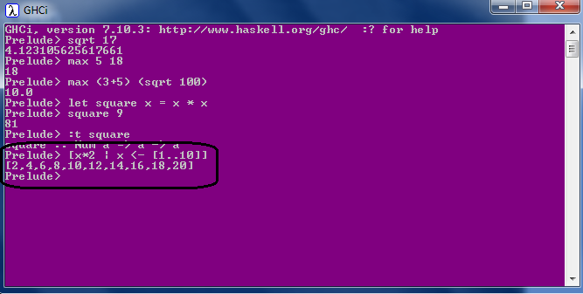
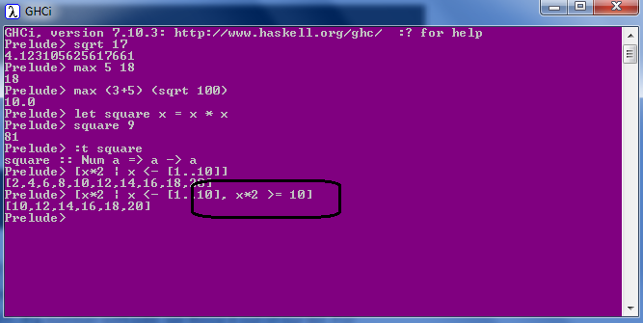
List Comprehension
Mathematics: set comprehensions

Slide 20
Pattern Matching
factorial :: (Integral a) => a -> a
factorial 0 = 1
factorial n = n * factorial (n - 1)
Guards
max' :: (Ord a) => a -> a -> a
max' a b
| a > b = a
| otherwise = b
first :: (a, b, c) -> a
first (x, _, _) = x
second :: (a, b, c) -> b
second (_, y, _) = y
Where
bmiTell weight height
| bmi <= skinny = "underweight!"
| bmi <= normal = "normal."
| bmi <= fat = "fat!"
| otherwise = "whale!!"
where bmi = weight / height ^ 2
skinny = 18.5
normal = 25.0
fat = 30.0
head' :: [a] -> a
head' [] = error "Can't call head on an empty list!"
head' (x:_) = x
Let
cylinder r h =
let sideArea = 2 * pi * r * h
topArea = pi * r ^2
in sideArea + 2 * topArea

Slide 21
Recursion
quicksort :: (Ord a) => [a] -> [a]
quicksort [] = []
quicksort (x:xs) =
let smallerSorted = quicksort [a | a <- xs, a <= x]
biggerSorted = quicksort [a | a <- xs, a > x]
in smallerSorted ++ [x] ++ biggerSorted
No Loops
Tail recursion

Slide 22
Algebric Data type
Can mix product and sum types together.
data PaymentResponse = Paid String
| CardExpired Int Date
| HttpError Int String
| AuthError
Product
struct Book {
public string title;
public int book_id;
};
data Tree = Leaf Char
| Node Tree Int Tree
deriving Show
tree :: Tree
tree = Node (Leaf 'x') 1 (Node (Leaf 'y') 2 (Leaf 'z'))
data Maybe a = Nothing | Just a
safeHead :: [a] -> Maybe a
safeHead [] = Nothing
safeHead (x:_) = Just x
Sum
enum Days { Sun, Mon, tue, Wed, thu, Fri, Sat };

Slide 23
Higher Order Functions
Curried functions & Partial Functions
map :: (a -> b) -> [a] -> [b]
Every function in Haskell officially only takes one parameter.
ghci> map (+3) [1,5,3,1,6]
[4,8,6,4,9]
multThree :: (Num a) => a -> a -> a -> a
multThree x y z = x * y * z
List Comprehension equivalent:
[x+3 | x <- [1,5,3,1,6]]
multThree 3 5 9
((multThree 3) 5) 9
filter :: (a -> Bool) -> [a] -> [a]
ghci> filter (>3) [1,5,3,2,1,6,4,3,2,1]
[5,6,4]

Slide 24
Higher Order Functions
Function composition
sum of all odd squares that are smaller than 10,000
ghci> sum (takeWhile (<10000) (filter odd (map (^2) [1..])))
166650
oddSquareSum :: Integer
oddSquareSum = sum . takeWhile (<10000) . filter odd . map (^2) $ [1..]
oddSquareSum :: Integer
oddSquareSum =
let oddSquares = filter odd $ map (^2) [1..]
belowLimit = takeWhile (<10000) oddSquares
in sum belowLimit

Slide 25
Lazy, Strict; Folds
Higher Order Functions
f x y = x + 2
f 5 (29^35792)
f (release_monkeys(), increment_counter()

Slide 26
Add a Slide Title - 4

Slide 27
Add a Slide Title - 5

