Slide 1

Haskell
Anurag Jaiswal

Slide 2
Agenda
Overview
Functions
Types
Patterns
Advanced

Slide 3
Overview

Slide 4
Background
C – Engineering.
Java, C# - Business.
Haskell – Mathematics.
Patient development
Strong theoretical roots
Fosters innovation

Slide 5
History
1980s – Many functional languages
1987 – Standardization committee is formed.
1990 – Haskell 1.0
1997 – Haskell 98
2009 – Haskell 2010

Slide 6
What
Haskell is a purely functional, lazy, statically-typed programming language.

Slide 7
Functional
Functions are first-class.
Haskell programs is centered around evaluating expressions rather than executing instructions.

Slide 8
Pure
Haskell expressions are always referentially transparent, that is:
No mutation! Everything (variables, data structures…) is immutable.
Expressions never have “side effects” (like updating global variables or printing to the screen).
Calling the same function with the same arguments results in the same output every time.
Benfits:
Equational reasoning and refactoring.
Parallelism.
Fewer headaches.

Slide 9
Pure
Any side effects a program may have (such as performing I/O) are moved to a non-pure runtime, keeping the language itself pure.

Slide 10
Lazy
Expressions are not evaluated until their results are actually needed
possible to define and work with infinite data structures.
reasoning about time and space usage becomes much more complicated!

Slide 11
Why
Not Difficult, just different.

Slide 12
Functions

Slide 13
Pure functions
All functions are pure
Cannot modify state.
Cannot depend on state only arguments.
Examples
Get current time
Print string to console
Read a file
Length of a string
Get random numbers

Slide 14
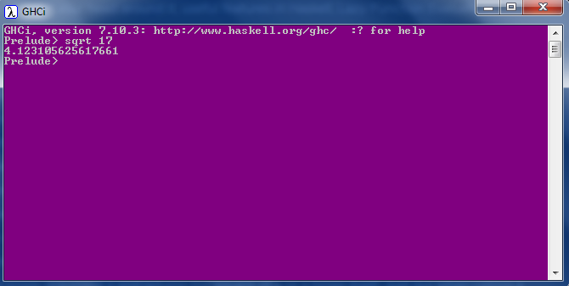
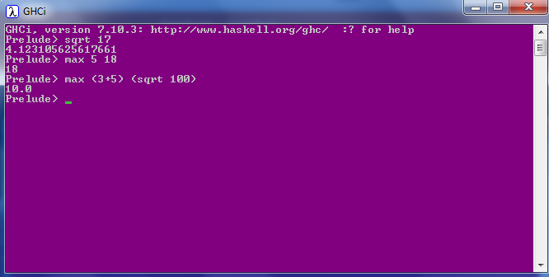
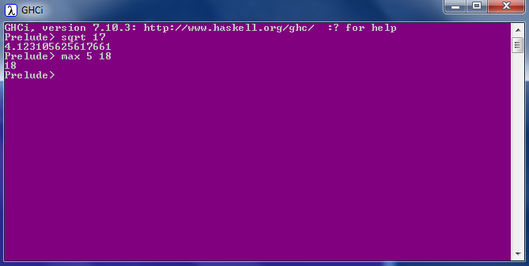
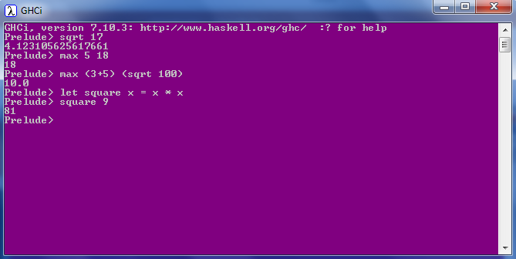
Calling a function
No parentheses
No commas
No returns

Slide 15

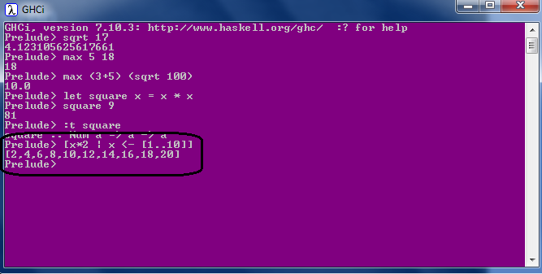
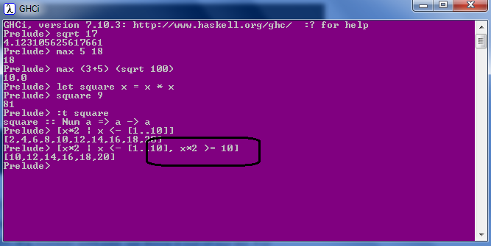
List Comprehension
Mathematics: set comprehensions

Slide 16
Pattern Matching
No Conditionals
factorial :: (Integral a) => a -> a
factorial 0 = 1
factorial n = n * factorial (n - 1)
Guards
max' :: (Ord a) => a -> a -> a
max' a b
| a > b = a
| otherwise = b
first :: (a, b, c) -> a
first (x, _, _) = x
second :: (a, b, c) -> b
second (_, y, _) = y
Where
bmiTell weight height
| bmi <= skinny = "underweight!"
| bmi <= normal = "normal."
| bmi <= fat = "fat!"
| otherwise = "whale!!"
where bmi = weight / height ^ 2
skinny = 18.5
normal = 25.0
fat = 30.0
head' :: [a] -> a
head' [] = error "Can't call head on an empty list!"
head' (x:_) = x
Let
cylinder r h =
let sideArea = 2 * pi * r * h
topArea = pi * r ^2
in sideArea + 2 * topArea

Slide 17
Recursion
No Loops
Purity
Simple code
Better Compiler optimisations
Tail call optimization
Guarded Recursion
quicksort :: (Ord a) => [a] -> [a]
quicksort [] = []
quicksort (x:xs) =
let smallerSorted = quicksort [a | a <- xs, a <= x]
biggerSorted = quicksort [a | a <- xs, a > x]
in smallerSorted ++ [x] ++ biggerSorted
Notes:
http://stackoverflow.com/questions/310974/what-is-tail-call-optimization
http://stackoverflow.com/questions/13042353/does-haskell-have-tail-recursive-optimization

Slide 18
Lazy
Strict evaluation
f x y = x + 2
f (release_monkeys(), increment_counter())
f 5 (29^35792)
GHCi> define g(a, b, c) = if a then b else c
GHCi> l = g(h, i, j)
(i) and (j) would both be evaluated in an eager language.
l' = if h then i else j
(i) or (j) would be evaluated, but never both.
Lazy language led to a Pure language.
Infinite data structures.
Dynamic Programming is Easy.
take 3 (repeat 7)
fibs = 0 : 1 : zipWith (+) fibs (tail fibs)

Slide 19
Higher Order Functions
Function composition
sum of all odd squares that are smaller than 10,000
ghci> sum (takeWhile (<10000) (filter odd (map (^2) [1..])))
166650
oddSquareSum :: Integer
oddSquareSum = sum . takeWhile (<10000) . filter odd . map (^2) $ [1..]
oddSquareSum :: Integer
oddSquareSum =
let oddSquares = filter odd $ map (^2) [1..]
belowLimit = takeWhile (<10000) oddSquares
in sum belowLimit

Slide 20
Higher Order Functions
Curried functions & Partial Functions
Every function in Haskell officially only takes one parameter.
map :: (a -> b) -> [a] -> [b]
ghci> map (+3) [1,5,3,1,6]
[4,8,6,4,9]
multThree :: (Num a) => a -> a -> a -> a
multThree x y z = x * y * z
List Comprehension equivalent:
[x+3 | x <- [1,5,3,1,6]]
multThree 3 5 9
((multThree 3) 5) 9
filter :: (a -> Bool) -> [a] -> [a]
ghci> filter (>3) [1,5,3,2,1,6,4,3,2,1]
[5,6,4]

Slide 21
Higher Order Functions
Fold
foldr; foldl; foldl'
ghci> foldr (+) 0 [1..13]
"(1+(2+(3+(4+(5+(6+(7+(8+(9+(10+(11+(12+(13+0)))))))))))))“
ghci> foldl (+) 0 [1..13]
"(((((((((((((0+1)+2)+3)+4)+5)+6)+7)+8)+9)+10)+11)+12)+13)"
Careful with Lazy!!

Slide 22
Types

Slide 23
Types (What)
Strong
Static
Type inference
Polymorphic

Slide 24
Types (Why)
For static check safety
For Domain modelling
If it compiles, it will be correct (mostly) !!
Static type for unit testing.

Slide 25
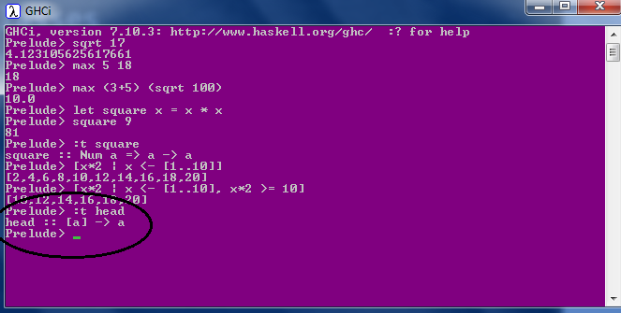
Types & TypeClass
Int
Integer
Float
Double
Bool
Char
Composited: List & Tuples
Polymorphic
parametric polymorphism
subtype polymorphism
coercion polymorphism
Type inference

Slide 26
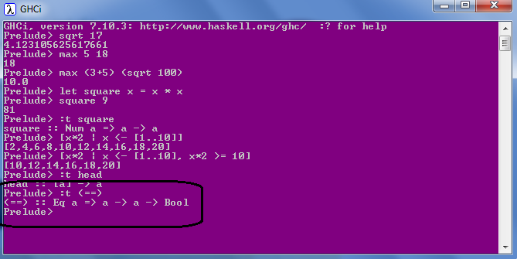
Types & TypeClass
Eq
Ord
Show
Enum
Bounded
Num
Integral
Floating

Slide 27
Types & Domain Driven design
struct Customer
{
string FirstName;
string MiddleName;
string LastName;
string Email;
bool isEmailVerified;
int PhoneNumber;
}
Max Size (Constraints)
Optional
Valid
Which fields are linked ?
Verified ?
Domain Logic
Rule 1 : If Email is changed, IsEmailVerified should be set to False.
Rule 2: IsEmailVerified can be set only be a trusted Service.
Either Email or PhoneNumber is Mandatory.

Slide 28
Algebric Data type
Can mix product and sum types together.
Closed
PayPal Support ??
Product
data PaymentMethod =
| Cash
| Cheque Int
| Card CardType CardNumber
struct Book {
public string title;
public int book_id;
};
Sum
data PaymentResponse = Paid String
| CardExpired Int Date
| HttpError Int String
| AuthError
enum Days { Sun, Mon, tue, Wed, thu, Fri, Sat };
What goes here ? What is common ?
Open
What goes here ?
Data and behavior scattered
OO version:
interface IPaymentMethod {..}
class Cash: IPaymentMethod {..}
class Cheque: IPaymentMethod {..}
class Card: IPaymentMethod {..}
PayPal Support ?? Surprises

Slide 29
Types & Domain Driven design
Closed
PayPal Support ??
data PaymentMethod =
| Cash
| Cheque Int
| Card CardType CardNumber
handlePaymentMethod :: PaymentMethod -> string
handlePaymentMethod p@(Cash) = "Paid By Cash! Should Go Cashless!!"
handlePaymentMethod p@(Cheque n) = "Paid By Cheque, Cheque number " ++ n
handlePaymentMethod p@(Card cardType cardNumber ) = "Paid By Card. Card Type: " ++ cardType ++ "Card Number: " ++ cardNumber

Slide 30
Types & Domain Driven design
struct Customer
{
string FirstName;
string MiddleName;
string LastName;
string Email;
bool isEmailVerified;
int PhoneNumber;
}
data Customer =
Person
{
FirstName :: String SafeStrings,
MiddleName :: String Maybe SafeStrings,
LastName :: String SafeStrings,
Email :: String EmailInfo,
IsEmailVerified :: bool
PhoneNumber :: Int Maybe PhoneInfo
}
deriving (Show)
module SafeStrings (
String255, -- we export the data type but not the constructors
SafeStrings, -- only safe way to build a String
) where
data String255 = String255 String
SafeStrings :: String -> Just String255
SafeStrings s | s.Length <= 255 = Just String255 s
| otherwise = Nothing
module Emails (
..
) where
data EmailInfo =
| Unverified SafeEmailAddr
| Verified VerifiedEmailAddr

Slide 31
Types & Domain Driven design
struct Customer
{
string FirstName;
string MiddleName;
string LastName;
string Email;
bool isEmailVerified;
int PhoneNumber;
}
data Customer =
Person
{
FirstName :: String SafeStrings,
MiddleName :: String Maybe SafeStrings,
LastName :: String SafeStrings,
Email :: String EmailInfo,
IsEmailVerified :: bool
PhoneNumber :: Int Maybe PhoneInfo
}
deriving (Show)
data ContactInfo =
| EmailOnly EmailInfo
| PhoneOnly PhoneInfo
| EmailAndPhone EmailInfo PhoneInfo
data Customer =
Person
{
FirstName :: String SafeStrings,
MiddleName :: String Maybe SafeStrings,
LastName :: String SafeStrings,
ContactInfo :: ContactInfo
}
deriving (Show)
What about this rule??
Either Email or PhoneNumber is Mandatory.
Illegal states should not be allowed.
A contact must have Email or phone number. =>
have Email OR
must have a phone number OR
have both Email and phone number

Slide 32
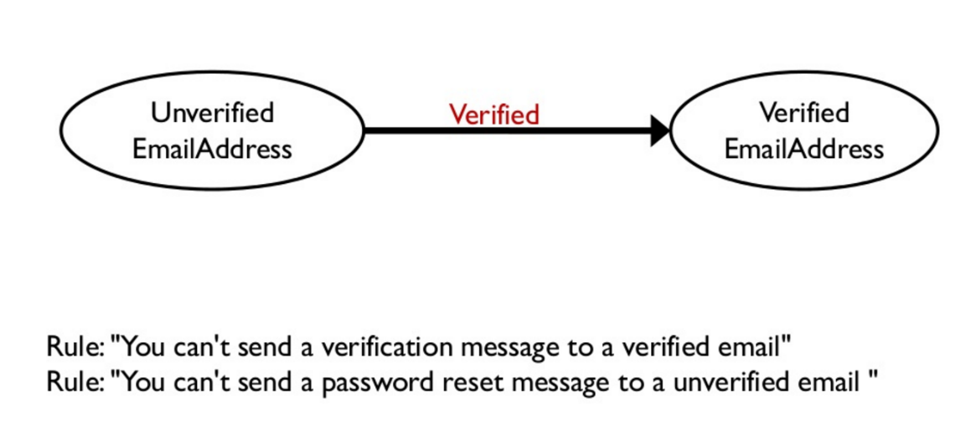
Types & Domain Driven design
States and Transitions

Slide 33
Patterns

Slide 34
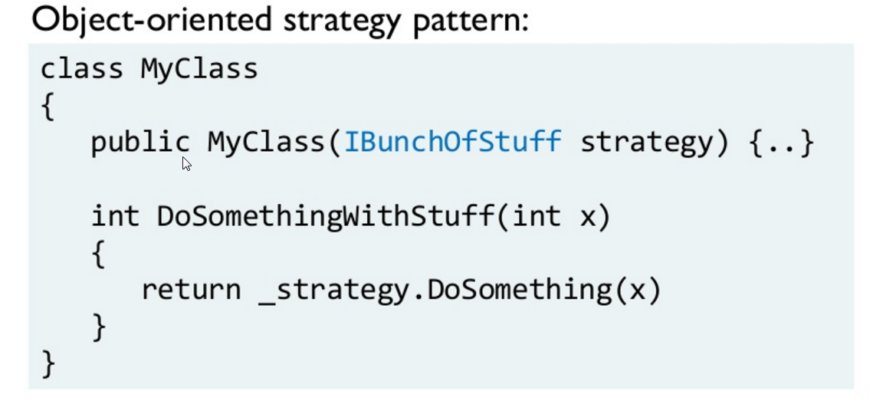
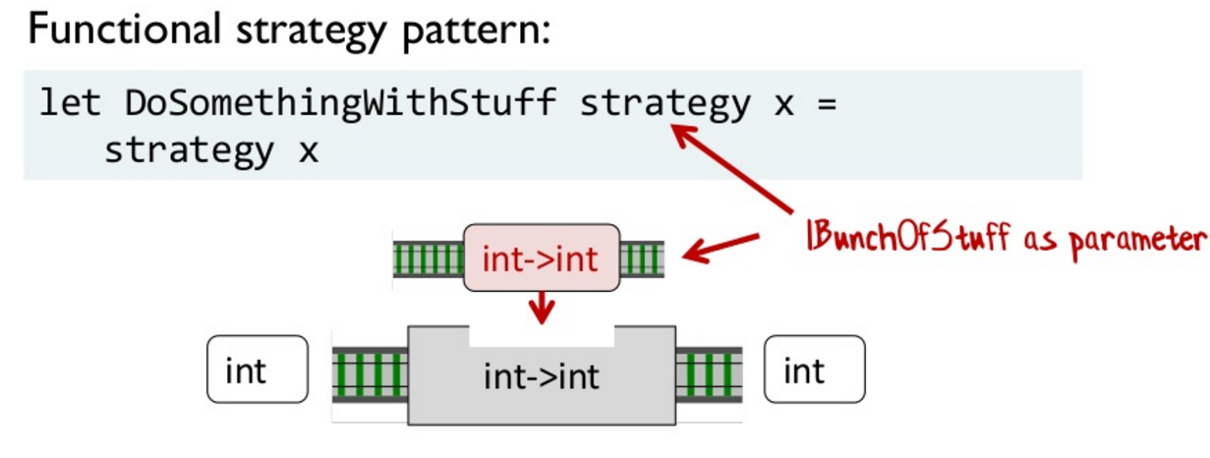
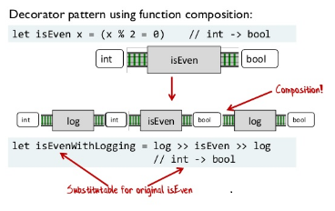
Patterns

Slide 35
Advanced

Slide 36
Hello World

Slide 37
Functor, Applicative, Monads, Monoid
Mathematics ahead !!

Slide 38
Not Difficult.. Just different.

