Slide 1

Haskell
Anurag Jaiswal

Slide 2
Overview
What
Why
History
Tools

Slide 3
What
Haskell is a purely functional, lazy, statically-typed programming language.
Purely Functional.
Functions are value
Values never change
Lazy.
Statically Typed.

Slide 4
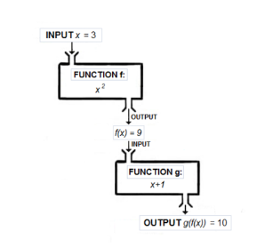
Functional
Functions are first-class.
Haskell programs is centered around evaluating expressions rather than executing instructions.

Slide 5
Pure
Haskell expressions are always referentially transparent, that is:
No mutation! Everything (variables, data structures…) is immutable.
Expressions never have “side effects” (like updating global variables or printing to the screen).
Calling the same function with the same arguments results in the same output every time.
Benfits:
Equational reasoning and refactoring.
Parallelism.
Fewer headaches.

Slide 6
Lazy
Expressions are not evaluated until their results are actually needed
possible to define and work with infinite data structures.
reasoning about time and space usage becomes much more complicated!

Slide 7
Types

Slide 8
Why
Not Difficult, just different.

Slide 9
Why
C – Engineering.
Java, C# - Business.
Haskell – Mathematics.
Patient development
Strong theoretical roots
Fosters innovation

Slide 10
Why
Industrial Strength
Performance
Llibraries

Slide 11
History
1980s – Many functional languages
1987 – Standarization committee is formed.
1990 – Haskell 1.0
1997 – Haskell 98
2009 – Haskell 2010

Slide 12
History
Many Compilers
Glorious Glasgow Haskell Compiler (GHC)
Most popular
Many features

Slide 13
Tools
Haskell platform.
GHCi
Haskell Read, Evaluate Print Loop (REPL)
Text Editors
IDE
EclipseFP
Leksah

Slide 14
Functions

Slide 15
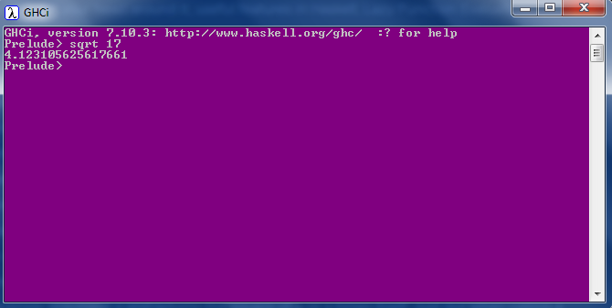
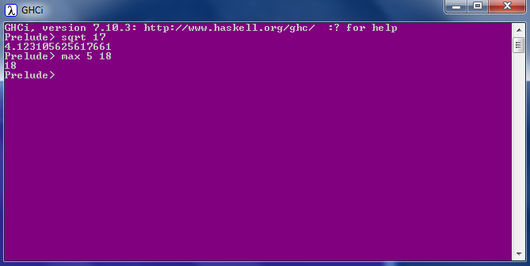
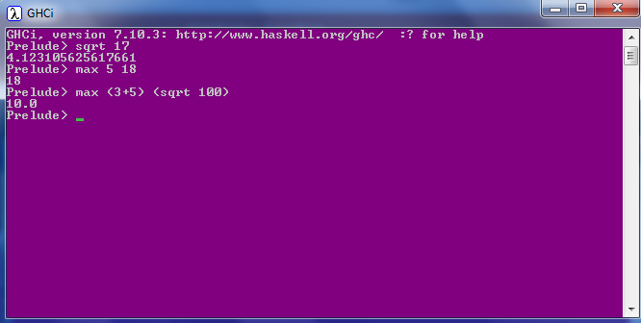
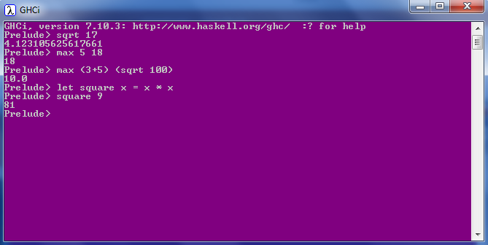
Calling a function
No parentheses
No commas
No returns

Slide 16
Pure functions
All functions are pure
Cannot modify state.
Cannot depend on state only arguments.
Examples
Get current time
Print string to console
Read a file
Length of a string
Get random numbers

Slide 17

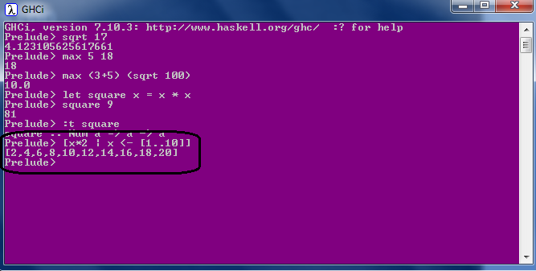
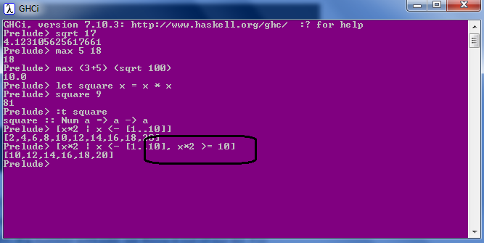
List Comprehension
Mathematics: set comprehensions

Slide 18
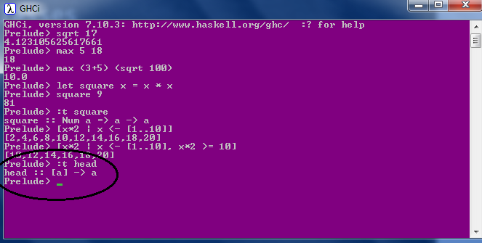
Types & TypeClass
Int
Integer
Float
Double
Bool
Char
Composited: List & Tuples

Slide 19
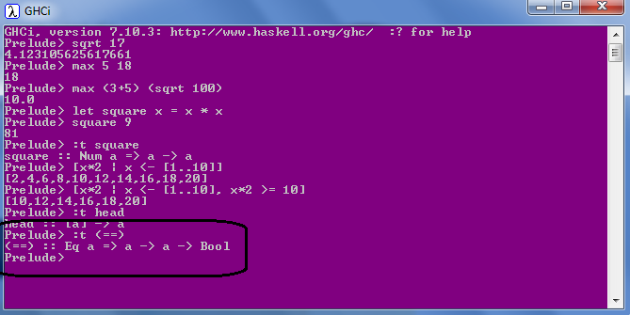
Types & TypeClass
Eq
Ord
Show
Enum
Bounded
Num
Integral
Floating

Slide 20
Algebric Data type
Eq
Ord
Show
Enum
Bounded
Num
Integral
Floating

Slide 22
Add a Slide Title - 4

Slide 23
Add a Slide Title - 5

