Slide 1

Haskell
Anurag Jaiswal

Slide 2
Overview
Overview
Types
Functions
Patterns

Slide 3
What
Haskell is a purely functional, lazy, statically-typed(a.k.a awesome) programming language.
Purely Functional.
Functions are value
Values never change
Lazy.
Statically Typed.

Slide 4
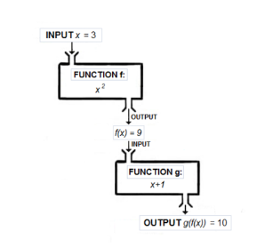
Functional
Functions are first-class.
Haskell programs is centered around evaluating expressions rather than executing instructions.

Slide 5
Pure
Haskell expressions are always referentially transparent, that is:
No mutation! Everything (variables, data structures…) is immutable.
Expressions never have “side effects” (like updating global variables or printing to the screen).
Calling the same function with the same arguments results in the same output every time.
Benfits:
Equational reasoning and refactoring.
Parallelism.
Fewer headaches.

Slide 6
Lazy
Expressions are not evaluated until their results are actually needed
possible to define and work with infinite data structures.
reasoning about time and space usage becomes much more complicated!

Slide 7
Types
Strong
Static
Type inference
Polymorphic

Slide 8
Why
Not Difficult, just different.

Slide 9
Why
C – Engineering.
Java, C# - Business.
Haskell – Mathematics.
Patient development
Strong theoretical roots
Fosters innovation

Slide 10
Why
Industrial Strength
Performance
Llibraries

Slide 11
History
1980s – Many functional languages
1987 – Standarization committee is formed.
1990 – Haskell 1.0
1997 – Haskell 98
2009 – Haskell 2010

Slide 12
History
Many Compilers
Glorious Glasgow Haskell Compiler (GHC)
Most popular
Many features

Slide 13
Tools
Haskell platform.
GHCi
Haskell Read, Evaluate Print Loop (REPL)
Text Editors
IDE
EclipseFP
Leksah

Slide 14
Types

Slide 15
Types
For static check safety
For Domain modelling
If it compiles, it will be correct (mostly) !!
Static type for unit testing.

Slide 16
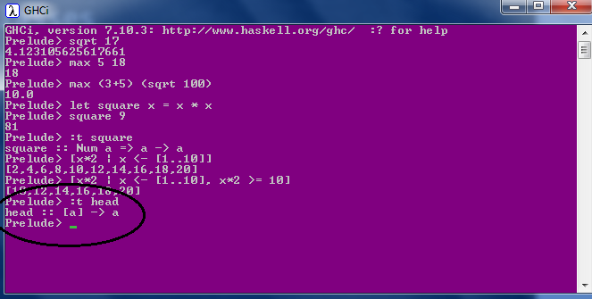
Types & TypeClass
Int
Integer
Float
Double
Bool
Char
Composited: List & Tuples
Polymorphic
parametric polymorphism
subtype polymorphism
coercion polymorphism
Type inference

Slide 17
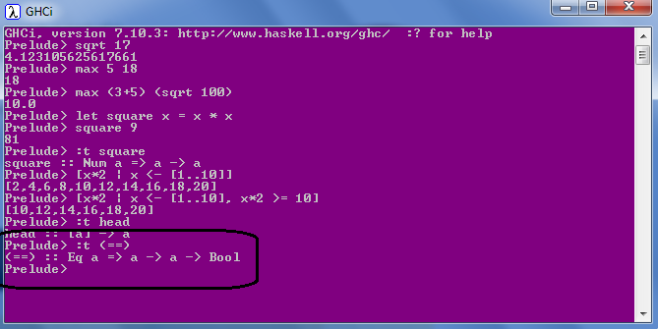
Types & TypeClass
Eq
Ord
Show
Enum
Bounded
Num
Integral
Floating

Slide 18
Types & Domain Driven design
struct Customer
{
string FirstName;
string MiddleName;
string LastName;
string Email;
bool isEmailVerified;
int PhoneNumber;
}
Max Size (Constraints)
Optional
Valid
Which fields are linked ?
Verified ?
Domain Logic
Rule 1 : If Email is changed, IsEmailVerified should be set to False.
Rule 2: IsEmailVerified can be set only be a trusted Service.
Either Email or PhoneNumber is Mandatory.

Slide 19
Algebric Data type
Can mix product and sum types together.
Closed
PayPal Support ??
Product
data PaymentMethod =
| Cash
| Cheque Int
| Card CardType CardNumber
struct Book {
public string title;
public int book_id;
};
Sum
data PaymentResponse = Paid String
| CardExpired Int Date
| HttpError Int String
| AuthError
enum Days { Sun, Mon, tue, Wed, thu, Fri, Sat };
What goes here ? What is common ?
Open
What goes here ?
Data and behavior scattered
OO version:
interface IPaymentMethod {..}
class Cash: IPaymentMethod {..}
class Cheque: IPaymentMethod {..}
class Card: IPaymentMethod {..}
No Nulls !!
data Maybe a = Nothing | Just a
safeHead :: [a] -> Maybe a
safeHead [] = Nothing
safeHead (x:_) = Just x
PayPal Support ?? Surprises

Slide 20
Types & Domain Driven design
struct Customer
{
string FirstName;
string MiddleName;
string LastName;
string Email;
bool isEmailVerified;
int PhoneNumber;
}
data Customer =
Person
{
FirstName :: String SafeStrings,
MiddleName :: String Maybe SafeStrings,
LastName :: String SafeStrings,
Email :: String EmailInfo,
IsEmailVerified :: bool
PhoneNumber :: Int Maybe PhoneInfo
}
deriving (Show)
module SafeStrings (
String255, -- we export the data type but not the constructors
SafeStrings, -- only safe way to build a String
) where
data String255 = String255 String
SafeStrings :: String -> Just String255
SafeStrings s | s.Length <= 255 = Just String255 s
| otherwise = Nothing
module Emails (
..
) where
data EmailInfo =
| Unverified SafeEmailAddr
| Verified VerifiedEmailAddr

Slide 21
Types & Domain Driven design
struct Customer
{
string FirstName;
string MiddleName;
string LastName;
string Email;
bool isEmailVerified;
int PhoneNumber;
}
data ContactInfo =
| EmailOnly EmailInfo
| PhoneOnly PhoneInfo
| EmailAndPhone EmailInfo PhoneInfo
data Customer =
Person
{
FirstName :: String SafeStrings,
MiddleName :: String Maybe SafeStrings,
LastName :: String SafeStrings,
Email :: String EmailInfo,
IsEmailVerified :: bool
PhoneNumber :: Int Maybe PhoneInfo
}
deriving (Show)
data Customer =
Person
{
FirstName :: String SafeStrings,
MiddleName :: String Maybe SafeStrings,
LastName :: String SafeStrings,
ContactInfo :: ContactInfo
}
deriving (Show)
What about this rule??
Either Email or PhoneNumber is Mandatory.
Illegal states should not be allowed.
A contact must have Email or phone number. =>
have Email OR
must have a phone number OR
have both Email and phone number

Slide 22
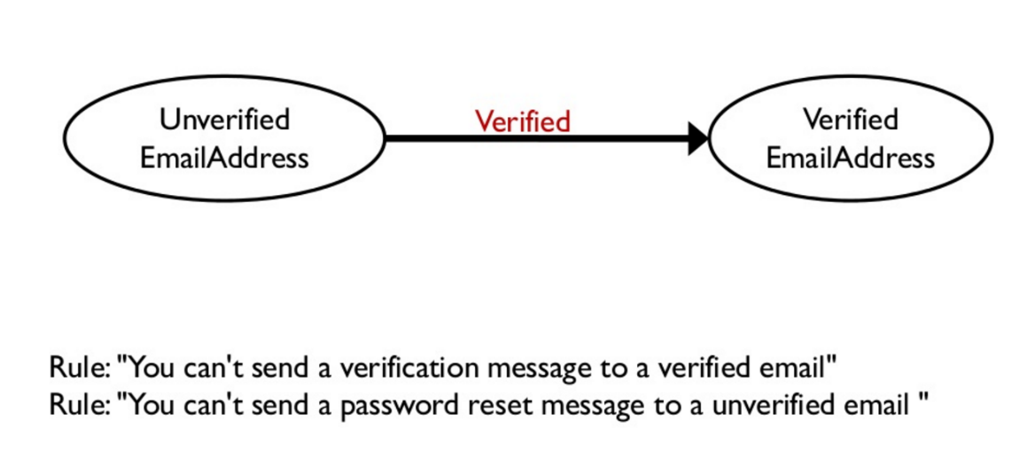
Types & Domain Driven design
States and Transitions

Slide 23
Functions

Slide 24
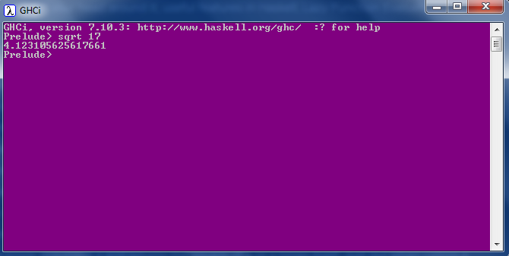
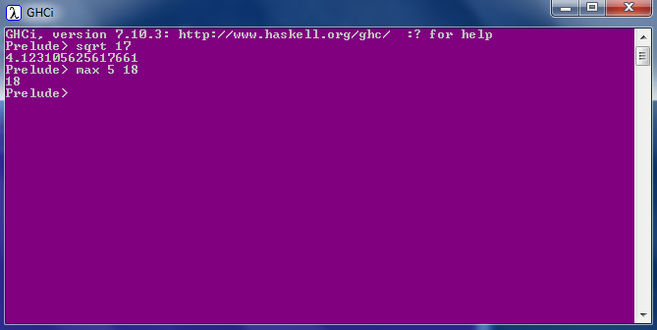
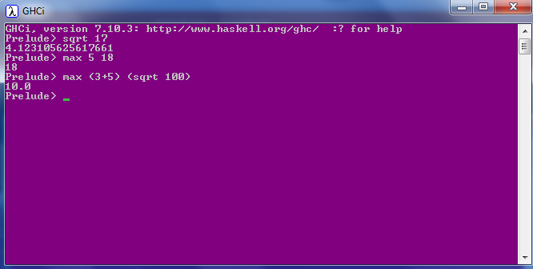
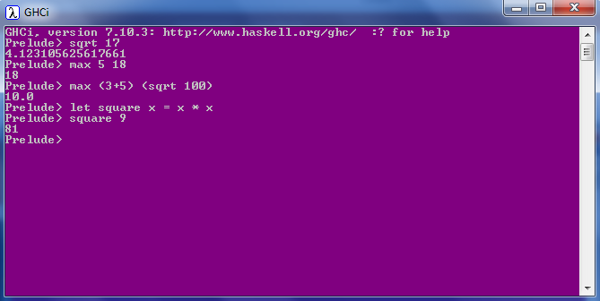
Calling a function
No parentheses
No commas
No returns

Slide 25
Pure functions
All functions are pure
Cannot modify state.
Cannot depend on state only arguments.
Examples
Get current time
Print string to console
Read a file
Length of a string
Get random numbers

Slide 26

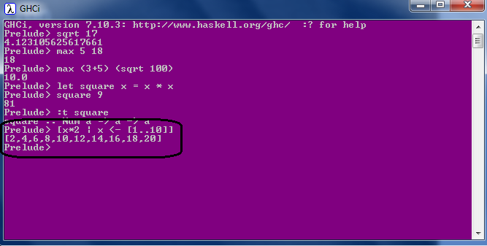
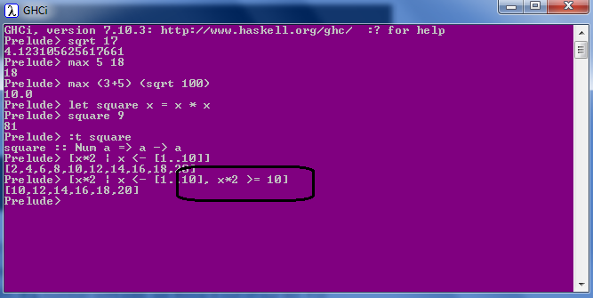
List Comprehension
Mathematics: set comprehensions

Slide 27
Pattern Matching
factorial :: (Integral a) => a -> a
factorial 0 = 1
factorial n = n * factorial (n - 1)
Guards
max' :: (Ord a) => a -> a -> a
max' a b
| a > b = a
| otherwise = b
first :: (a, b, c) -> a
first (x, _, _) = x
second :: (a, b, c) -> b
second (_, y, _) = y
Where
bmiTell weight height
| bmi <= skinny = "underweight!"
| bmi <= normal = "normal."
| bmi <= fat = "fat!"
| otherwise = "whale!!"
where bmi = weight / height ^ 2
skinny = 18.5
normal = 25.0
fat = 30.0
head' :: [a] -> a
head' [] = error "Can't call head on an empty list!"
head' (x:_) = x
Let
cylinder r h =
let sideArea = 2 * pi * r * h
topArea = pi * r ^2
in sideArea + 2 * topArea

Slide 28
Pattern Matching
Closed
PayPal Support ??
data PaymentMethod =
| Cash
| Cheque Int
| Card CardType CardNumber
handlePaymentMethod :: PaymentMethod -> string
handlePaymentMethod p@(Cash) = "Paid By Cash! Should Go Cashless!!"
handlePaymentMethod p@(Cheque n) = "Paid By Cheque, Cheque number " ++ n
handlePaymentMethod p@(Card cardType cardNumber ) = "Paid By Card. Card Type: " ++ cardType ++ "Card Number: " ++ cardNumber

Slide 29
Recursion
quicksort :: (Ord a) => [a] -> [a]
quicksort [] = []
quicksort (x:xs) =
let smallerSorted = quicksort [a | a <- xs, a <= x]
biggerSorted = quicksort [a | a <- xs, a > x]
in smallerSorted ++ [x] ++ biggerSorted
No Loops
Tail call optimisation

Slide 30
Lazy, Strict
Higher Order Functions
f x y = x + 2
f (release_monkeys(), increment_counter())
Strict evaluation
f 5 (29^35792)
GHCi> define g(a, b, c) = if a then b else c
GHCi> l = g(h, i, j)
(i) and (j) would both be evaluated in an eager language.
l' = if h then i else j
(i) or (j) would be evaluated, but never both.
Lazy language led to a Pure language.
Infinite data structures.
Dynamic Programming is Easy.
take 3 (repeat 7)
fibs = 0 : 1 : zipWith (+) fibs (tail fibs)

Slide 31
Higher Order Functions
Curried functions & Partial Functions
map :: (a -> b) -> [a] -> [b]
Every function in Haskell officially only takes one parameter.
ghci> map (+3) [1,5,3,1,6]
[4,8,6,4,9]
multThree :: (Num a) => a -> a -> a -> a
multThree x y z = x * y * z
List Comprehension equivalent:
[x+3 | x <- [1,5,3,1,6]]
multThree 3 5 9
((multThree 3) 5) 9
filter :: (a -> Bool) -> [a] -> [a]
ghci> filter (>3) [1,5,3,2,1,6,4,3,2,1]
[5,6,4]

Slide 32
Higher Order Functions
Function composition
sum of all odd squares that are smaller than 10,000
ghci> sum (takeWhile (<10000) (filter odd (map (^2) [1..])))
166650
oddSquareSum :: Integer
oddSquareSum = sum . takeWhile (<10000) . filter odd . map (^2) $ [1..]
oddSquareSum :: Integer
oddSquareSum =
let oddSquares = filter odd $ map (^2) [1..]
belowLimit = takeWhile (<10000) oddSquares
in sum belowLimit

Slide 33
Higher Order Functions
Fold
foldr; foldl; foldl'
ghci> foldr (+) 0 [1..13]
"(1+(2+(3+(4+(5+(6+(7+(8+(9+(10+(11+(12+(13+0)))))))))))))“
ghci> foldl (+) 0 [1..13]
"(((((((((((((0+1)+2)+3)+4)+5)+6)+7)+8)+9)+10)+11)+12)+13)"
Careful with Lazy!!

Slide 34
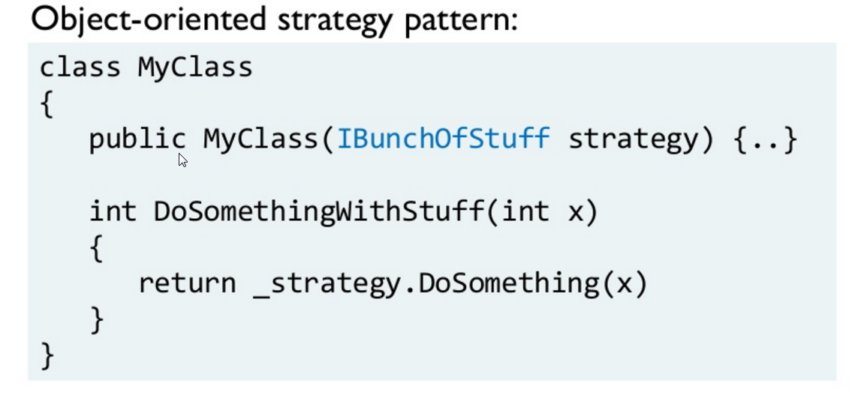
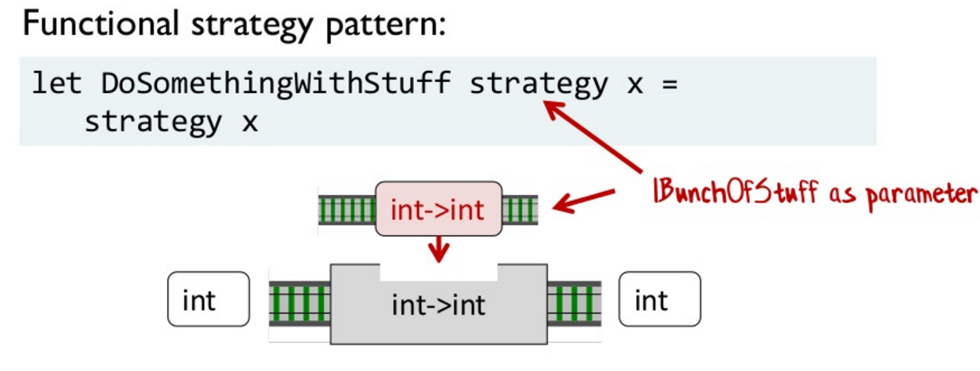
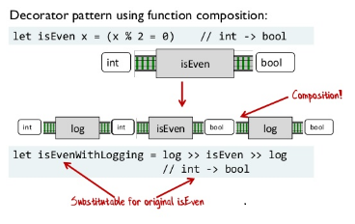
Patterns

Slide 35
Functor, Applicative, Monads, Monoid
Mathematics ahead !!

