Slide 1
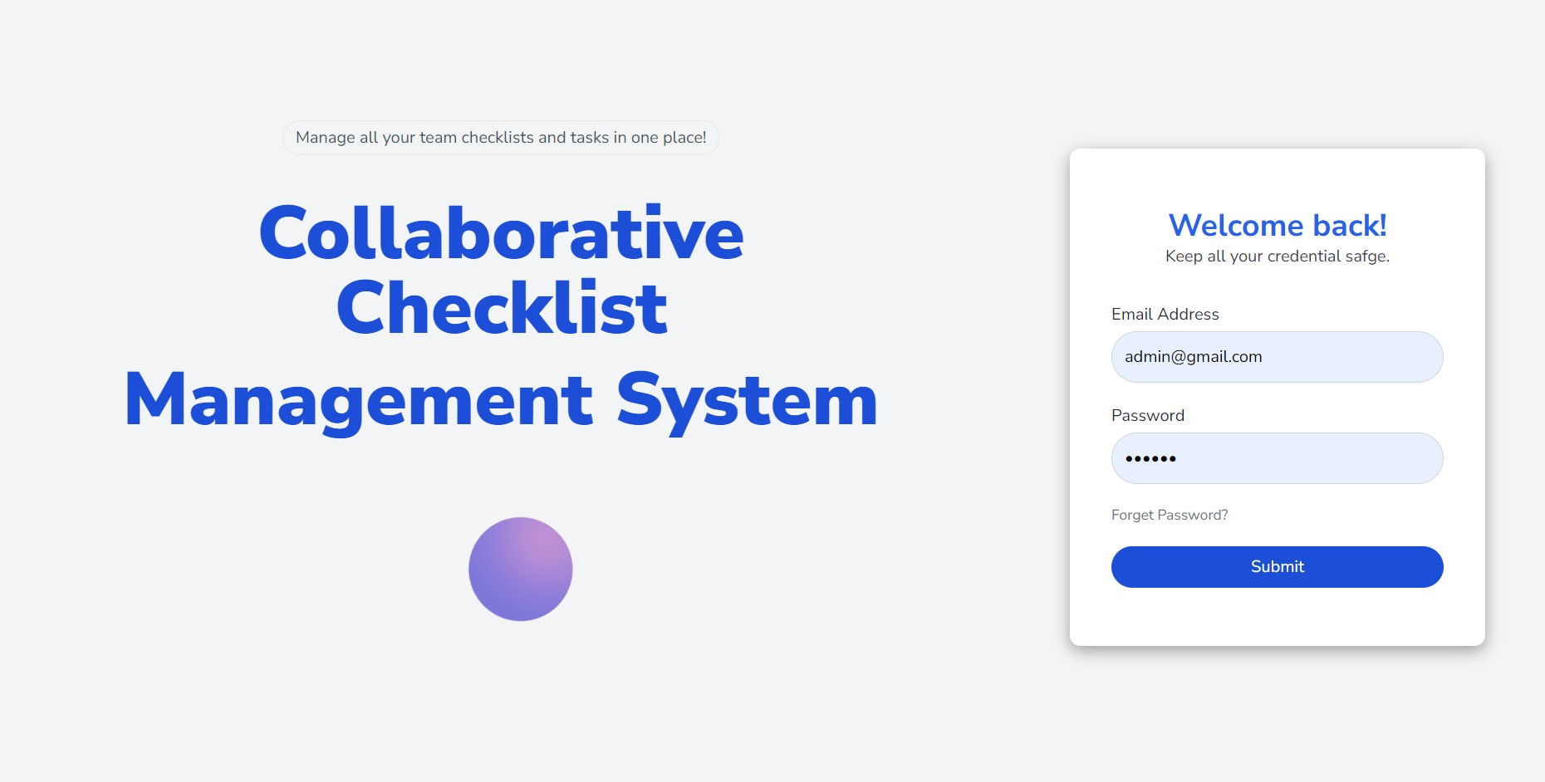
Collaborative Checklist Management System
MERN Stack Project
Name: Anurag Kumar
Registration Number: 12500607
Section: 224BV
INT219 & INT222
Lovely Professional University

Slide 2
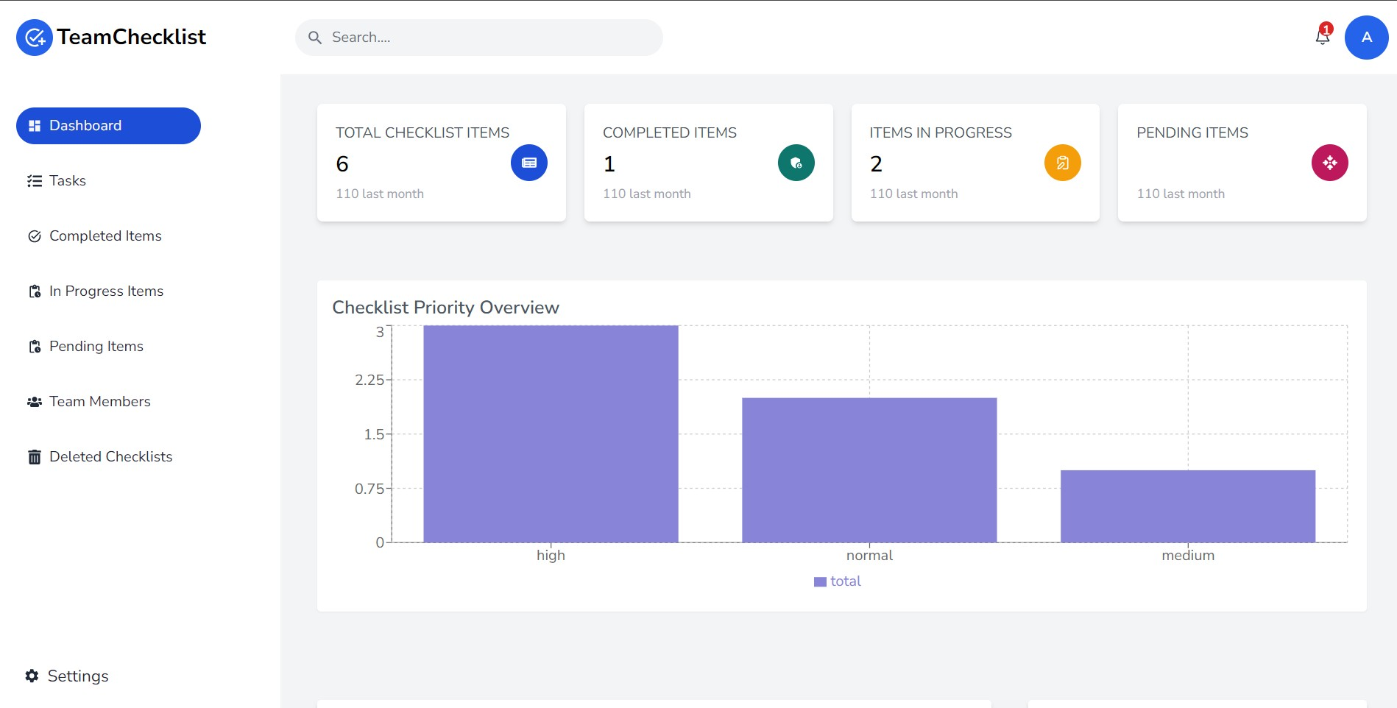
Problem Statement
Teams struggle to manage tasks using spreadsheets.
Need system for checklist, assignment, tracking, deadlines & notifications.

Slide 3
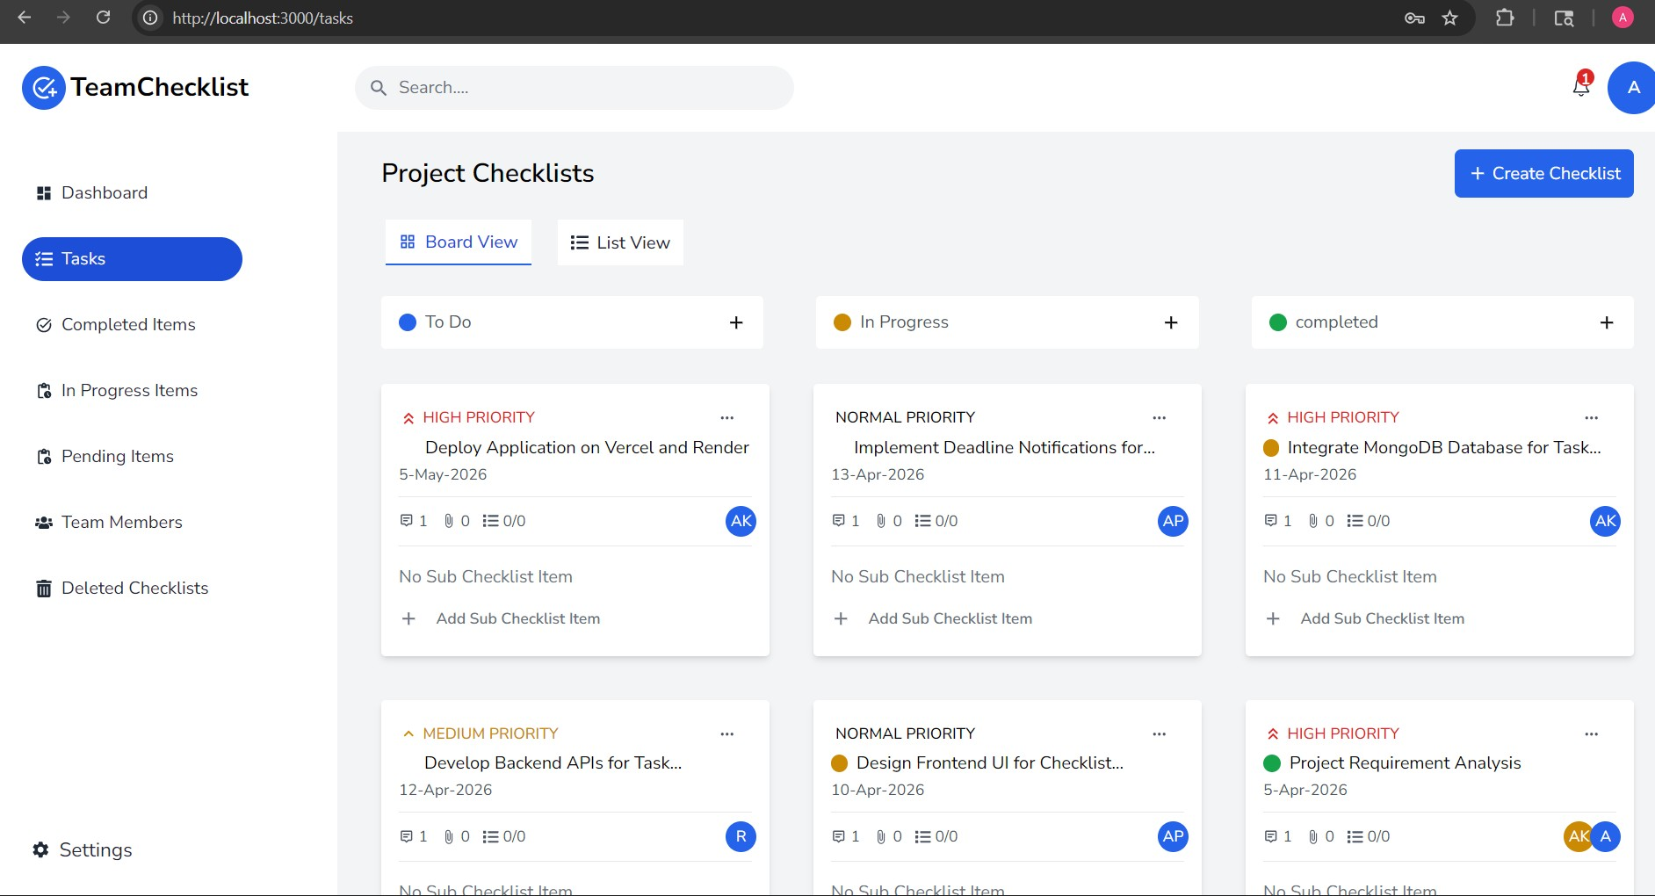
Project Overview
Full-stack MERN application
Manages tasks & checklists
Improves team collaboration

Slide 4
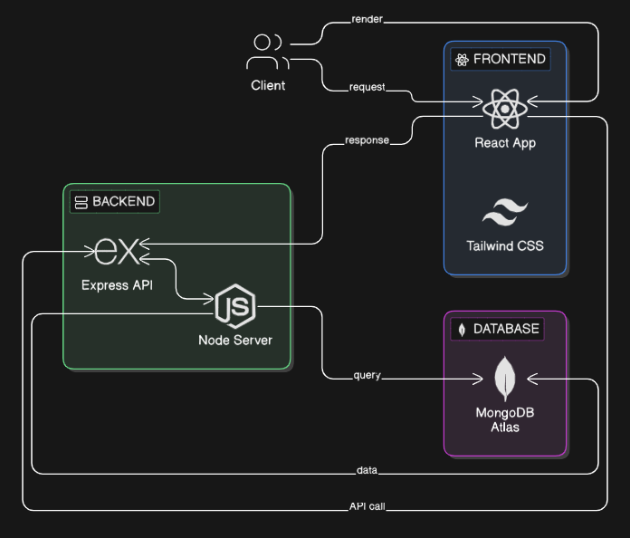
Technology Stack
Frontend: React, Tailwind
Backend: Node, Express
Database: MongoDB Atlas

Slide 5
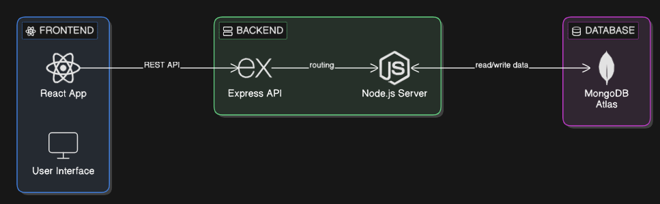
System Architecture
React Frontend → Express API → Node Server → MongoDB

Slide 6
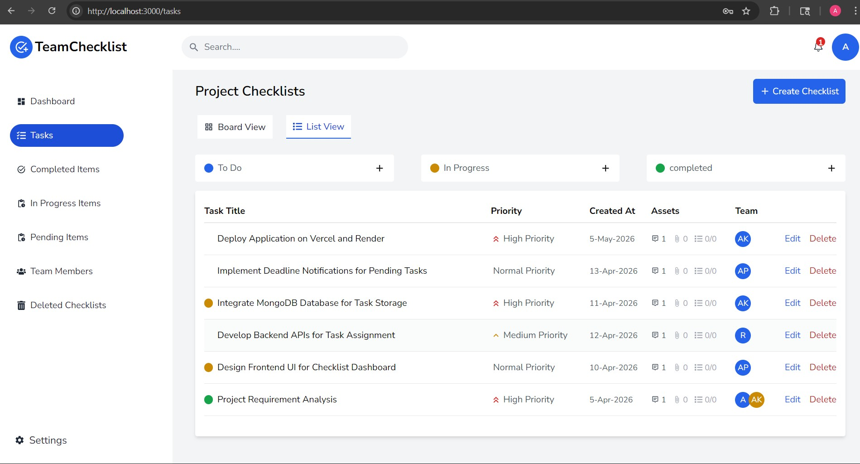
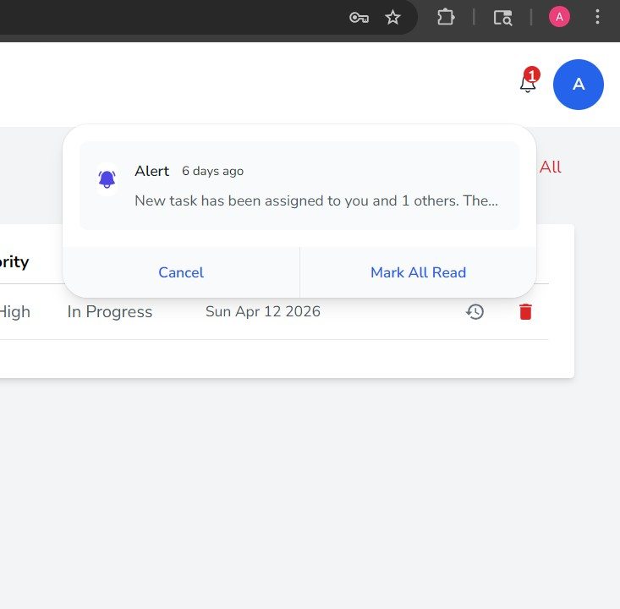
Key Features
Checklist creation
Task assignment
Status tracking
Deadlines
Notifications

Slide 7
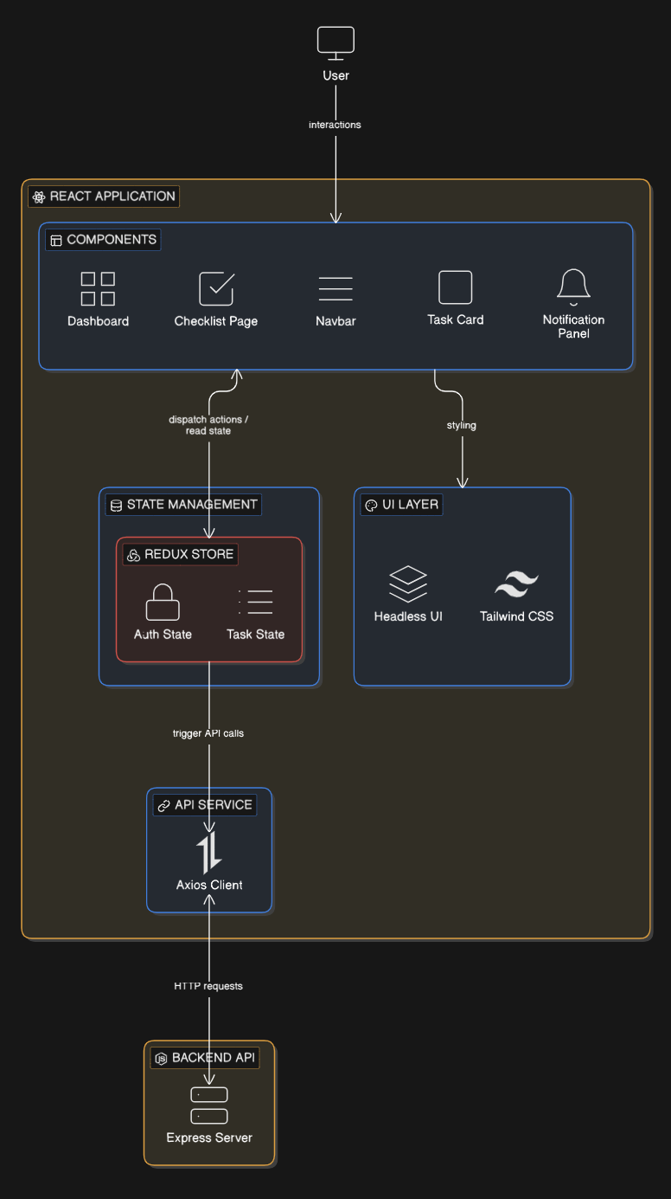
Frontend Architecture
React Components
Redux State Management
Responsive UI

Slide 8
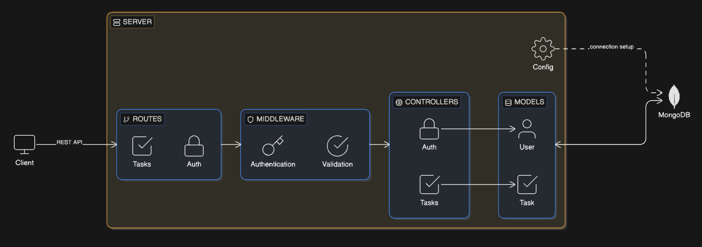
Backend Architecture & API Design
Controllers
Models
Routes
Middleware

Slide 9
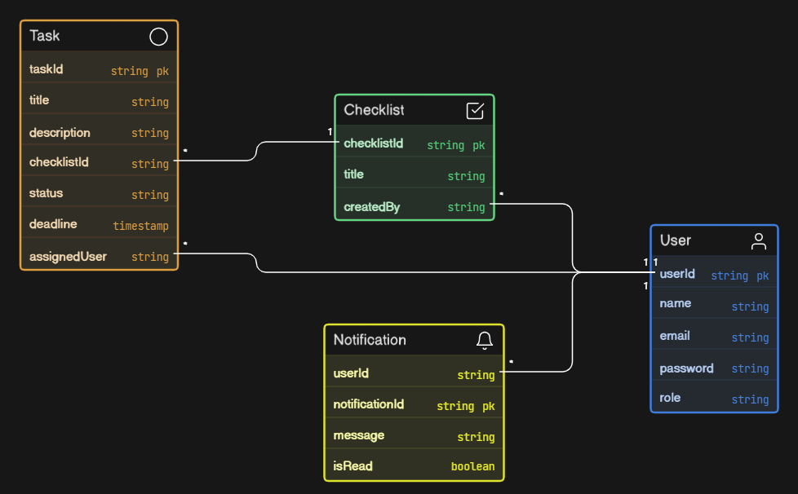
Database Design & Data Handling
Users
Tasks
Checklists
Notifications

Slide 10
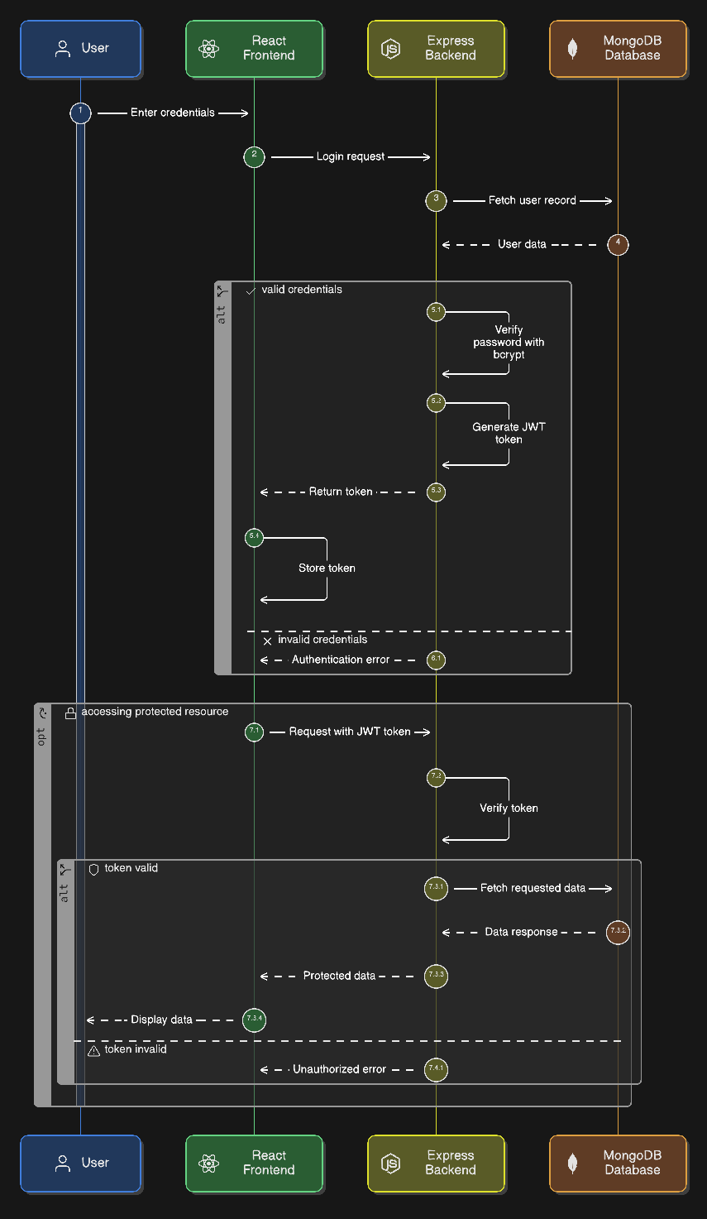
Authentication & Security
JWT Authentication
Bcrypt Password Hashing
Protected Routes

Slide 11
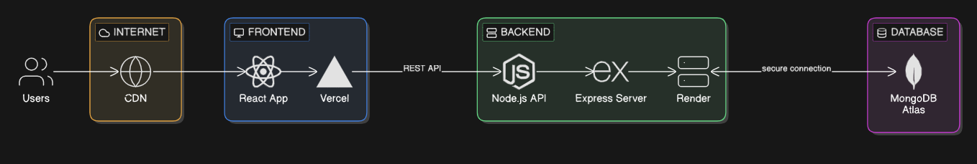
Hosting & Live Deployment
Frontend: Vercel
Backend: Render
Database: MongoDB Atlas

Slide 12
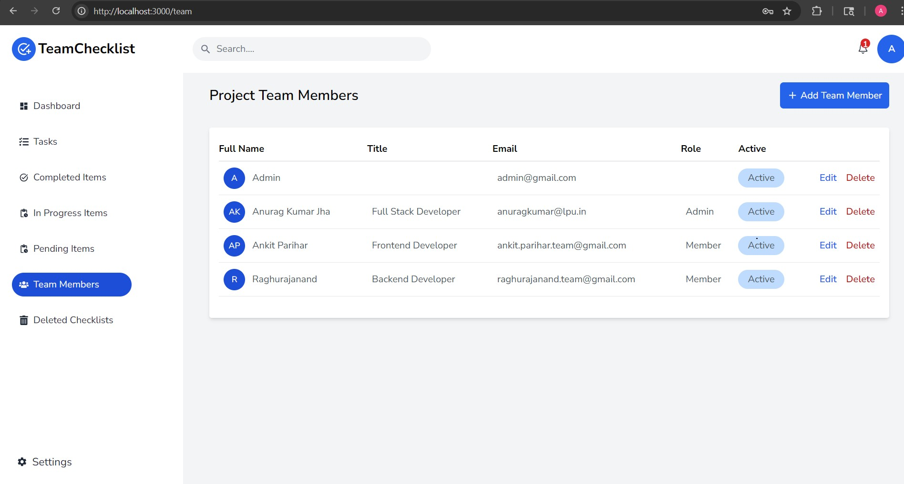
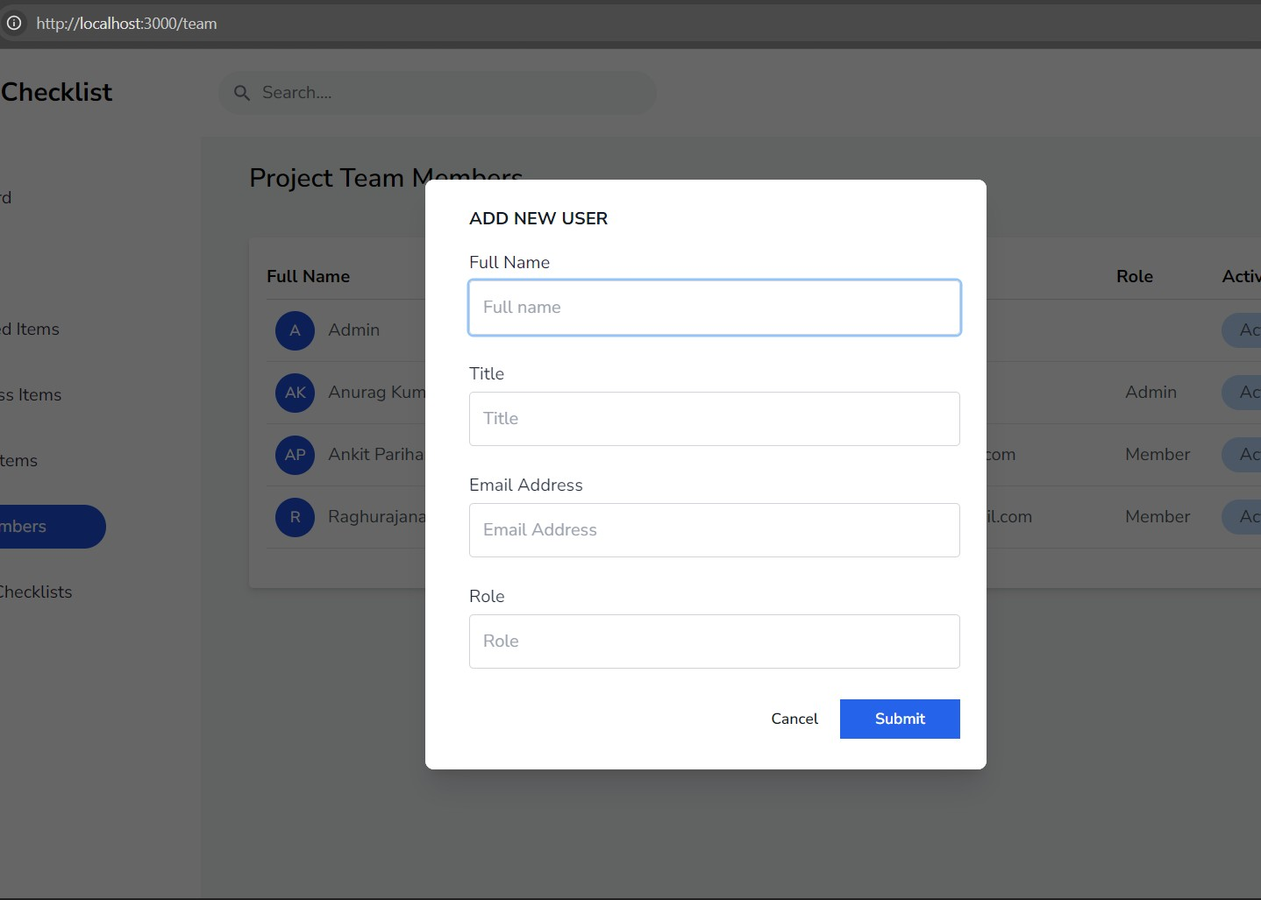
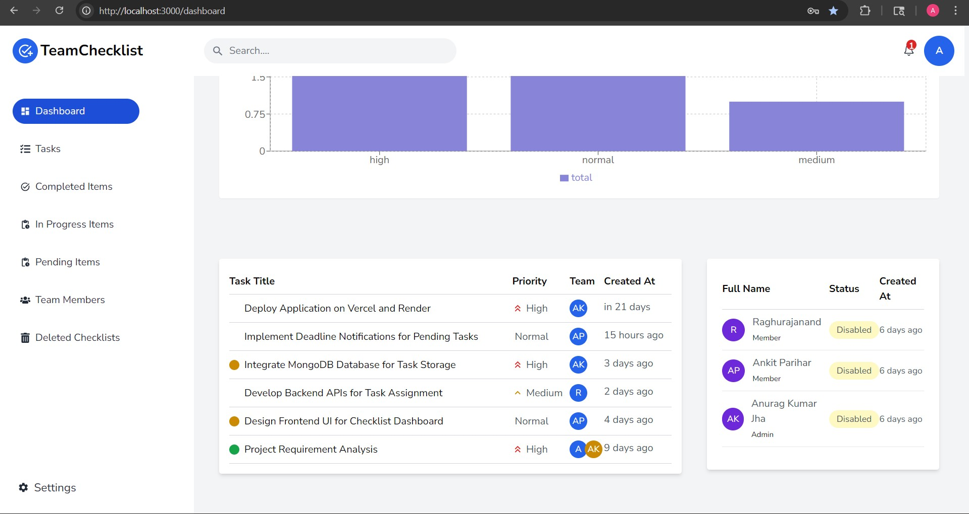
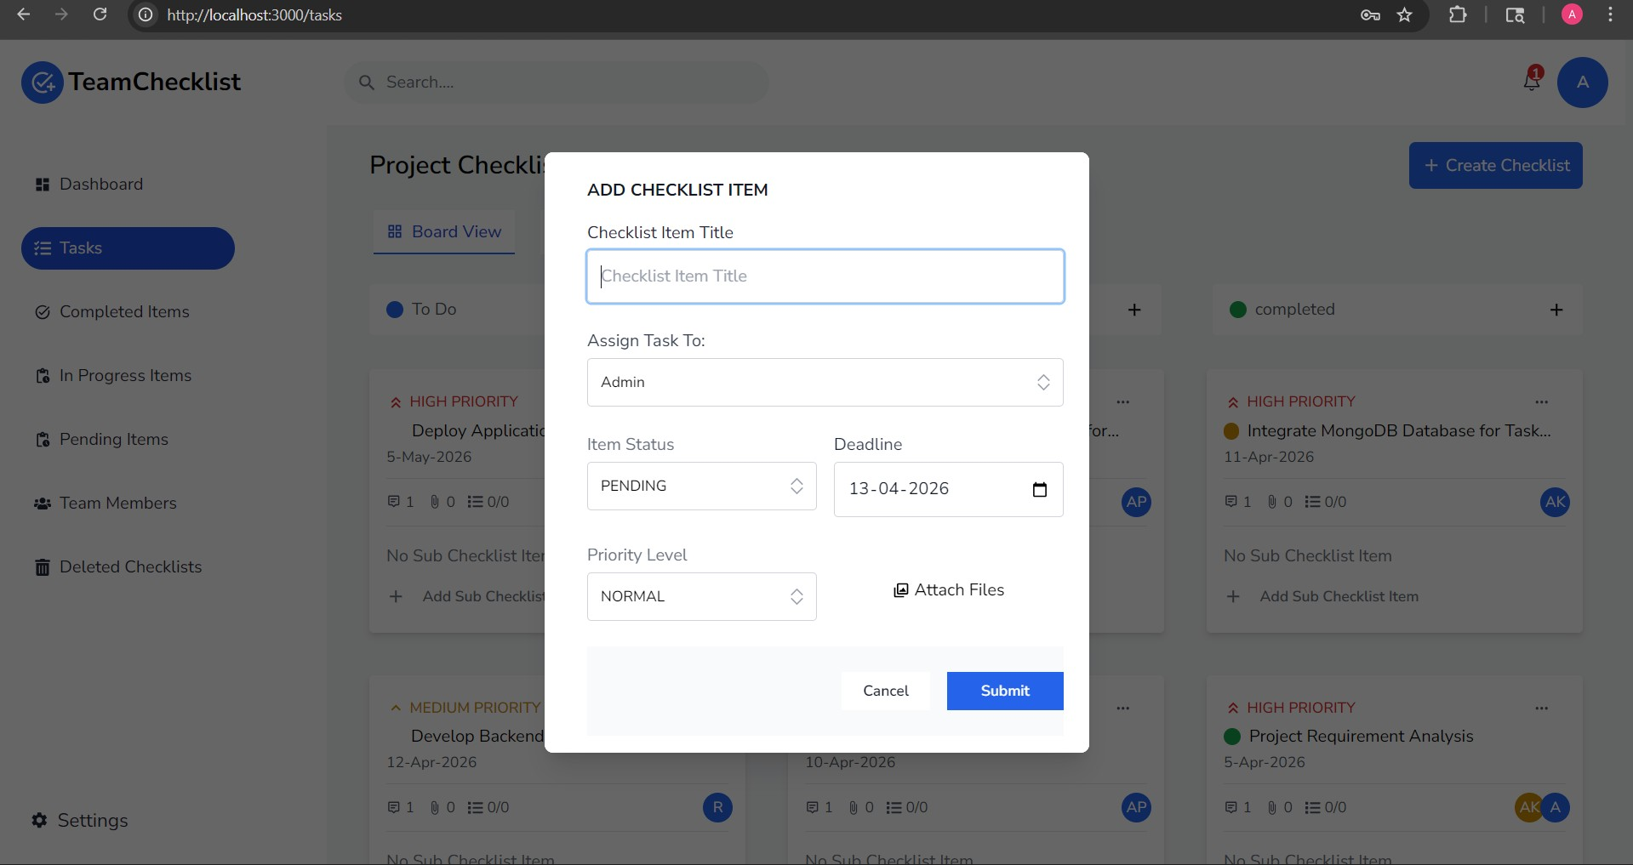
Project Demo
Login
Dashboard
Create Tasks
Assign Tasks
Track Progress

Slide 13
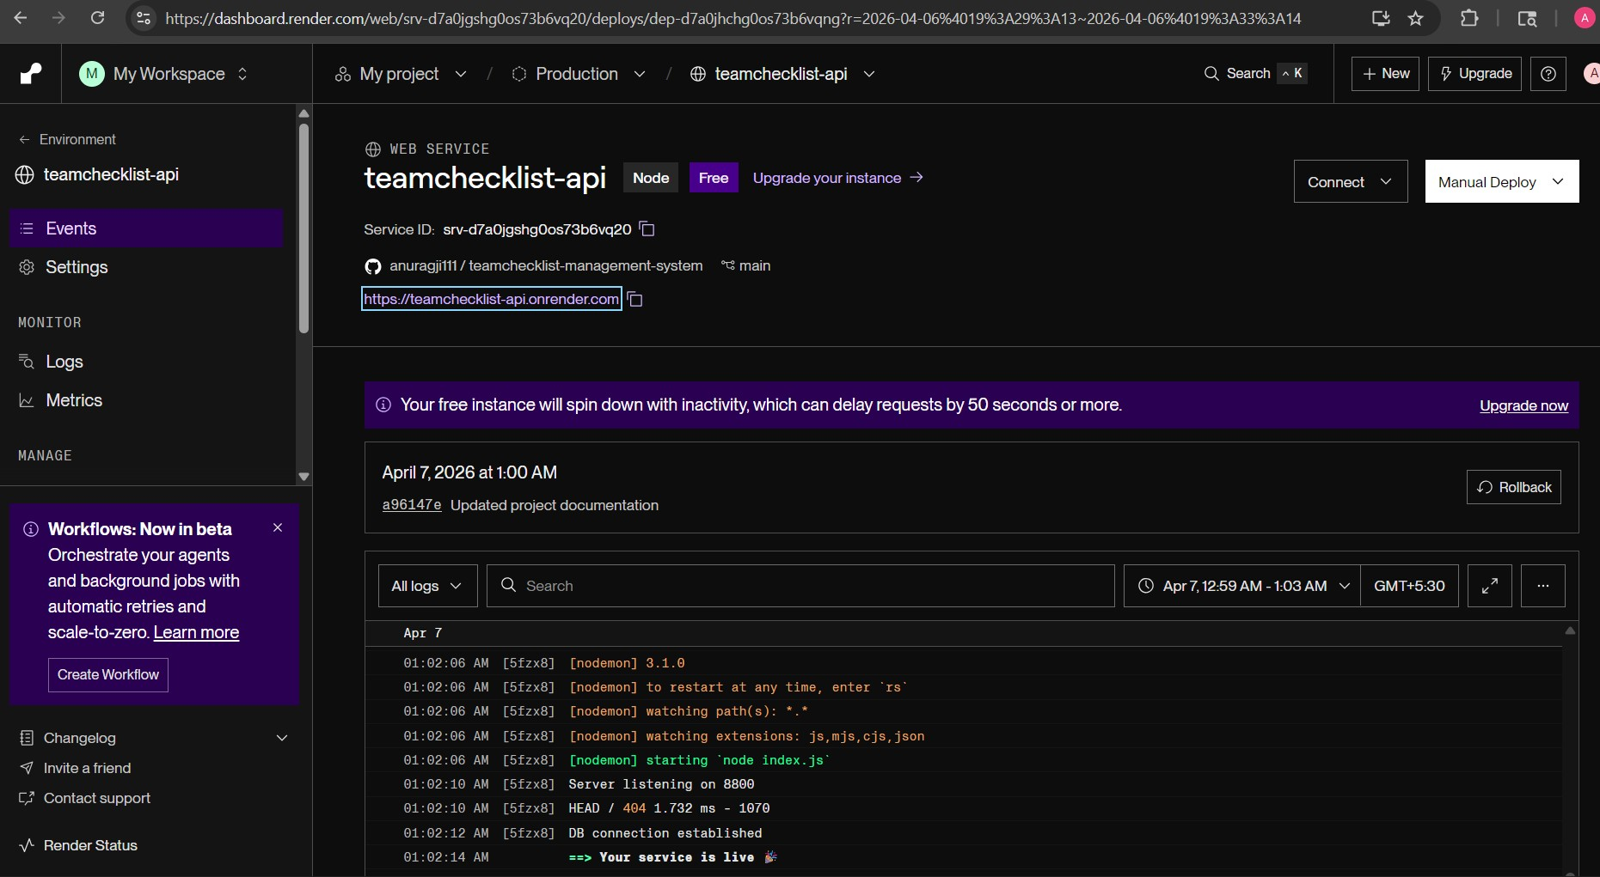
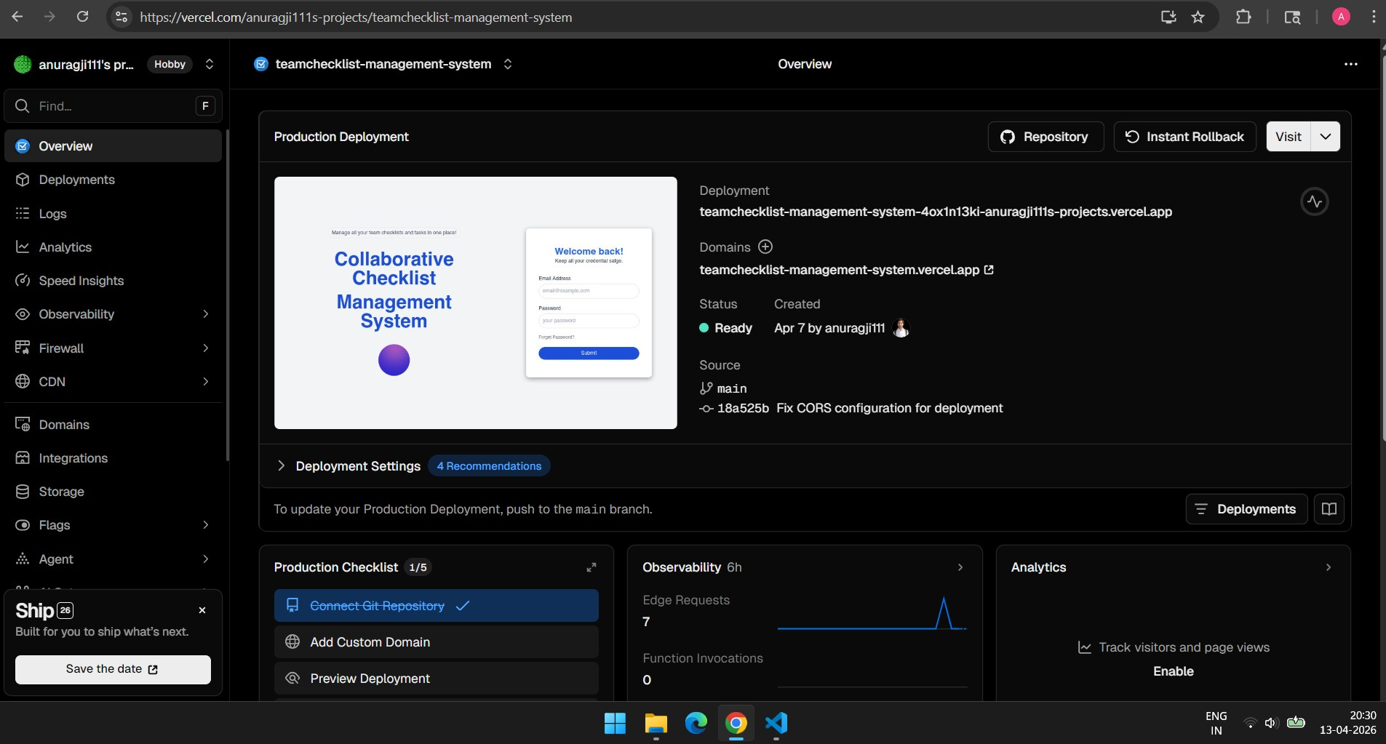
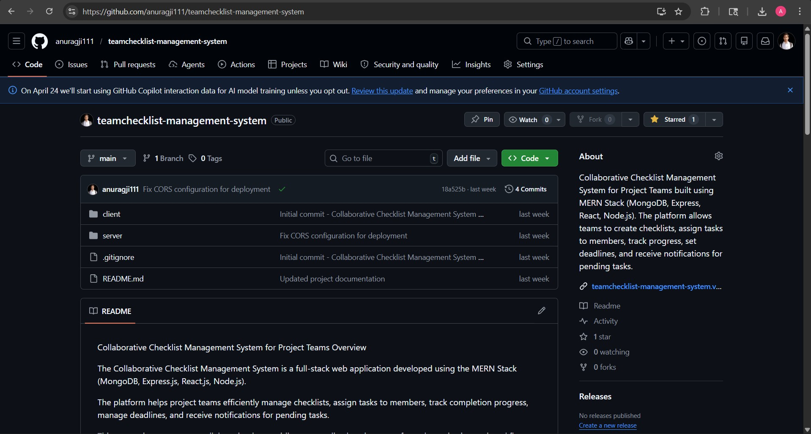
Live Demo
Frontend Link: https://teamchecklist-management-system.vercel.app/ Backend Link: https://teamchecklist-api.onrender.com/ GitHub Link: https://github.com/anuragji111/teamchecklist-management-system

Slide 14
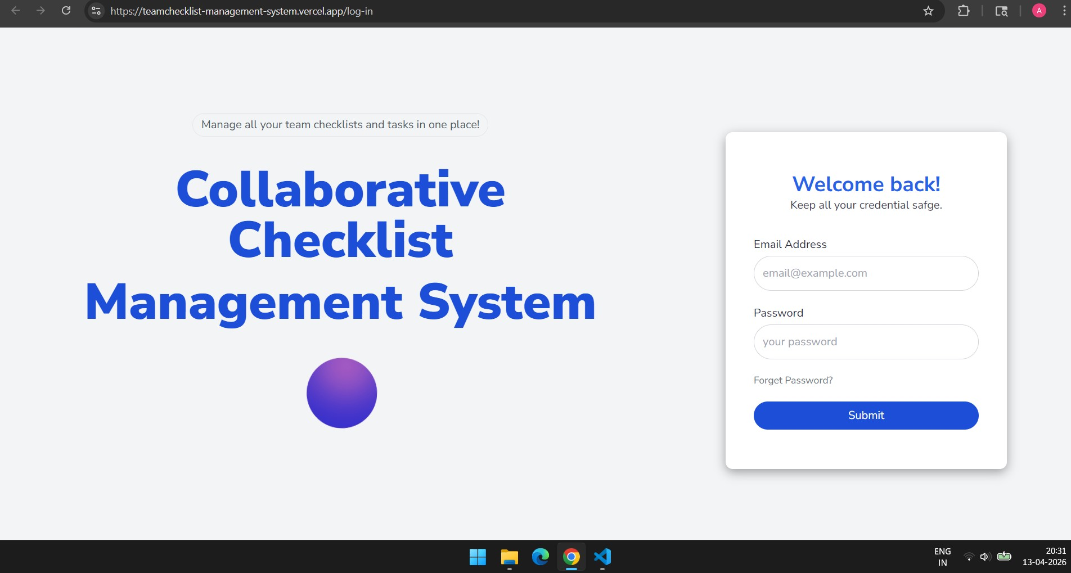
Conclusion
Improves team productivity
Centralized task management
Scalable MERN system

