Slide 1
Toxic or Malignant comment classification
By Prajwal Kumar at Zummit infolabs

Slide 2
The problem
To classify Toxic or Malignant comments from the dataset consisting of comments from different social media celebs account and find out the percentage of toxicity in the comments

Slide 3
Dataset Description
We are provided with a large number of Wikipedia comments which have been labeled by human raters for toxic behavior. The types of toxicity are:
toxic
severe_toxic
obscene
threat
insult
Identity_hate
Dataset link: https://www.kaggle.com/competitions/jigsaw-toxic-comment-classification-challenge/data

Slide 4
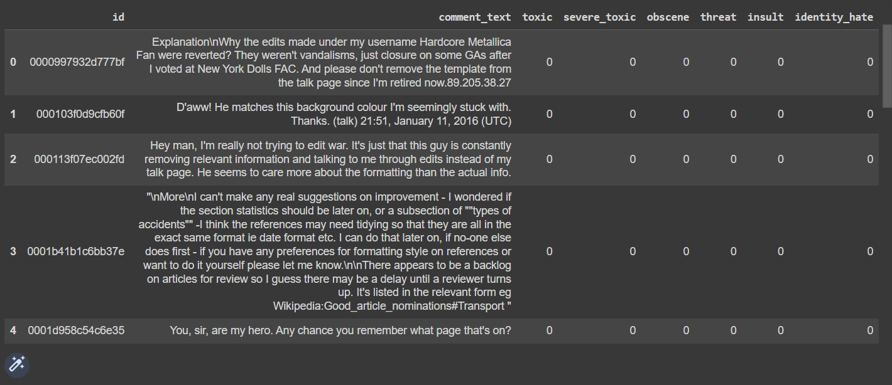
Dataset Description

Slide 5
Implementation

Slide 6
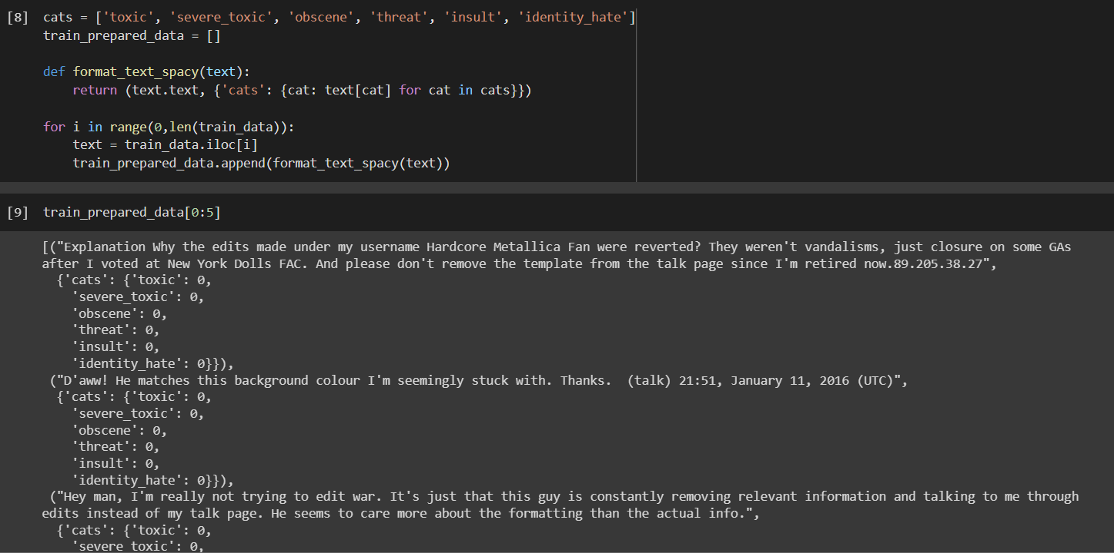
The result is a list of tuples, where each tuple contains a text and its corresponding labels for each category in "cats". This prepared data can be used to train a multi-label text classification model using the Spacy library.

Slide 7
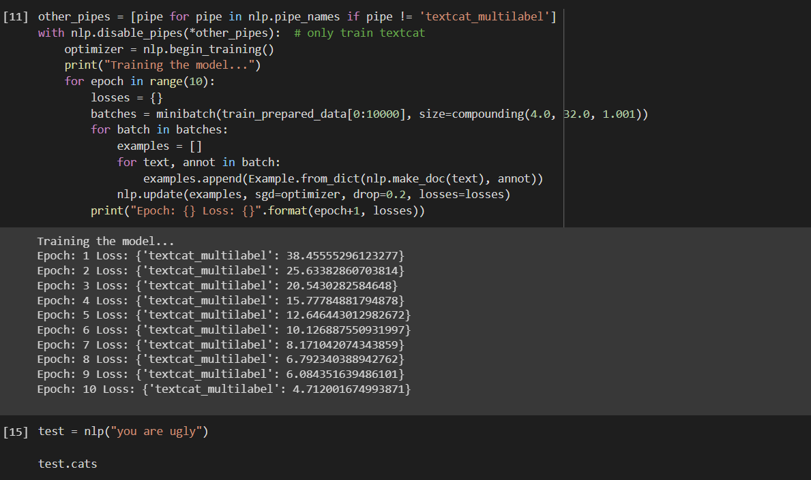
In summary, this code trains a multi-label text classification model using the Spacy library for the English language, and then tests it on a sample text "you are ugly".

Slide 8
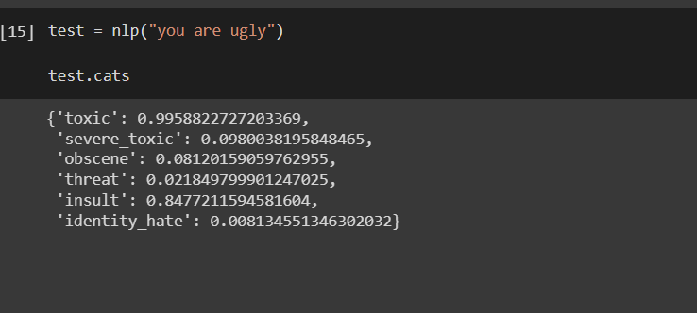
Output:

Slide 9
Use-Case
Overview:
There has been a remarkable increase in the cases of cyberbullying and trolls on various social media platforms.
Many celebrities and influences are facing backlashes from people and have to come across hateful and offensive comments.
This can take a toll on anyone and affect them mentally leading to depression, mental illness, self-hatred and suicidal thoughts.
Our goal is to build a prototype of online hate and abuse comment classifier which can used to classify hate and offensive comments so that it can be controlled and restricted from spreading hatred and cyberbullying.

Slide 10
Use-Case
Methodology:
There are millions of different comments and feedbacks on Numerous Wikipedia Pages:
Run the classifier on nearly 150,000 random comments out of numerous Wikipedia Pages and sources.
Train the Model to predict and classify the given Sample comment into several subcategories.
Use the model to input comment from any Social Media Database, into our classifier and simply state whether the comment is toxic or not, also classify it’s toxicity.
Using different methods of classifying a bag of Comments and Feedbacks from Wikipedia pages, predict the toxicity of the new comment with an original train dataset.

Slide 11
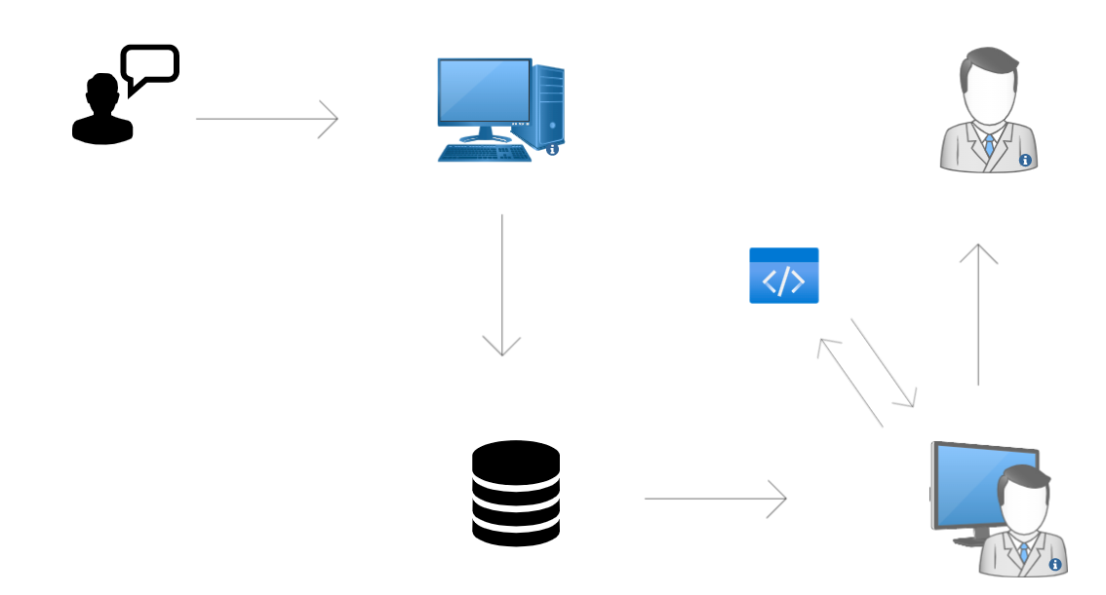
Use-Case
Comment Input
Commenter
Social Media Platform
Client
Classifier
Storing into DB
Output report
Output score
Data Input
DB Access
Social Media Site Database
Engineer

Slide 12
Use-Case
Applications:
There are number of Applications of out toxic comment classifier in the industry:
Government Cybersecurity and Anti-bullying body.
Digital fraud and threat avoidance.
Could help different companies to analyze toxicity and insultful comments for their business.
Age restrictions on certain platforms like online gaming and social media.
Company can thoroughly analyze customer feedback and sentiments.

Slide 13
Thank You

