Slide 1

building a mindset for single table design
Amazon DynamoDB for SQL Devs
ANURAG KALE
Cloud Software Architect, AWS Data Hero
@iAnuragKale
Notes:
Hello and Welcome to my talk. Thanks for being here. I appreciate your presence given that you could be at many of the better talks today.
I am going to talk about building a mindset for single table design. Lets take a moment to understand what this means.
There are two components to this talk
Single Table Design and
Mindset to use it to the fullest
Before moving any further, lets try to understand what Single Table is. It is basically a way of modelling the data in your database so that all your entities and the relationship between them are stored in ONE TABLE of the NoSQL Database. We will get to look at what this means in the talk.
The other aspect of this is why it came to be? The simple answer to this question is disctributed nature of NoSQL. It facilitates the best use of NoSQL database to get predictable performance at any scale. Why should you care? – In simple words, if you don’t, you would end up using a fork to dig a hole in the ground.

Slide 2



$whoami
Anurag Kale
AWS Data Hero (since 2021)
Cloud Software Architect at Polestar Digital
Organiser
AWS UG Göteborg
AWS UG Pune (Previously)
Socials
Twitter – https://twitter.com/iAnuragKale
LinkedIn - https://www.linkedin.com/in/anuragkale/

Slide 3

AGENDA
Meet Single Table
The Core
Trade-offs
Primary Key
Items
GSI
Denormalization is your friend
Relationships exist
Plan ahead – Access Patterns
Rethinking capacity planning / scaling
ACID
OLTP heavy
Terms and nomenclature
What / Who
Additional app side responsibility

Slide 4
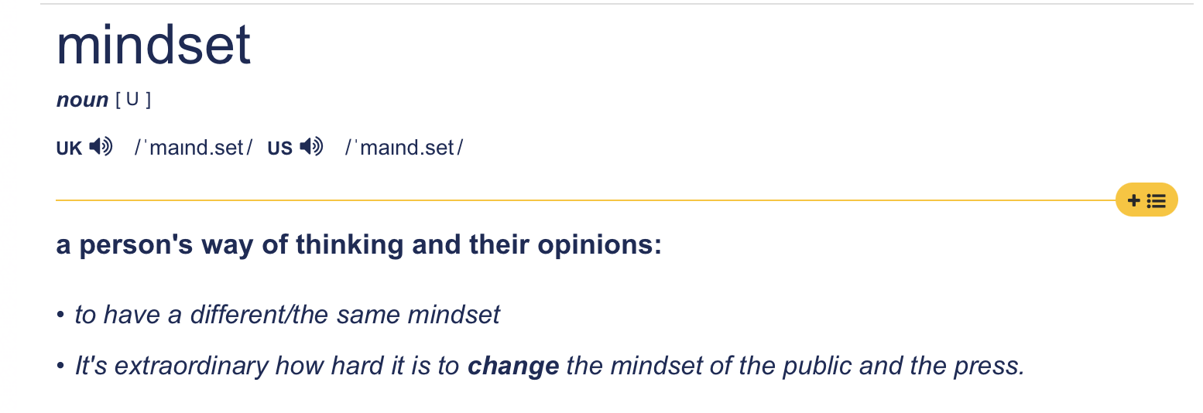
What / who
Solutions Architects
Developers
SQL Developers
DBA’s
From Cambridge Dictionary
Notes:
What is this talk about?
This is my attempt to summarise in retropective the shift in my way of thinking that was required to get full benefits of the NoSQL Method
Who is this talk directted towards ?
This talk will be particularly helpful if you are a Solutions Architect or a Development lead who gets to select and design data models for the data layer. This will also help developers understand why things work, they way they work in DynamoDB.
Before we go any further, lets meet and greet the single table design concept very quickly.

Slide 5


THE sINGLE taBLE
Notes:
Talk about single design here. Comments from Slide 1

Slide 6
TABLE
PK | SK
ORDER#657 | PRODUCT#110 | Name | Cost
 |  | Pilot Friction Roller | 15,30 SEK
ORDER#657 | PRODUCT#115 | Manufacturer | ExpiryDate
 |  | HP | 1650453839
ORDER#657 | PRODUCT#119 | ISBN | Title
 |  | 978-3-16-148410-0 | Exploring DDB
ORDER#657 | CUST#010 | Name | Email | customersince
 |  | John Doe | jdoe@email.com | 1650413837
Notes:
Before we begin our journey, lets try to get on the same page with some terminologies.

Slide 7
PRIMARY KEY
PK | SK
ORDER#657 | PRODUCT#110 | Name | Cost
 |  | Pilot Friction Roller | 15,30 SEK
ORDER#657 | PRODUCT#115 | Manufacturer | ExpiryDate
 |  | HP | 1650453839
ORDER#657 | PRODUCT#119 | ISBN | Title
 |  | 978-3-16-148410-0 | Exploring DDB
ORDER#657 | CUST#010 | Name | Email | customersince
 |  | John Doe | jdoe@email.com | 1650413837
Notes:
PK = Partition Key
SK = Sort Key
PK + SK = Primary Key
By naming the columns using generic terms like PK and SK, we achieve what is called as *Key overloading*
The primary key now can hold more than one entity type.
Using this pattern, you can now hold all the entities in your data model to fit into a single table.
This effectively is equivalent to a database or schema in a relational database, but instead of having a table per entity, you cram all the entities into a single table.

Slide 8
ITEM
PK | SK
ORDER#657 | PRODUCT#110 | Name | Cost
 |  | Pilot Friction Roller | 15,30 SEK
ORDER#657 | PRODUCT#115 | Manufacturer | ExpiryDate
 |  | HP | 1650453839
ORDER#657 | PRODUCT#119 | ISBN | Title
 |  | 978-3-16-148410-0 | Exploring DDB
ORDER#657 | CUST#010 | Name | Email | customersince
 |  | John Doe | jdoe@email.com | 1650413837

Slide 9
PK | SK
ORDER#657 | PRODUCT#110 | Name | Cost
 |  | Pilot Friction Roller | 15,30 SEK
ORDER#657 | PRODUCT#115 | Manufacturer | ExpiryDate
 |  | HP | 1650453839
ORDER#657 | PRODUCT#119 | ISBN | Title
 |  | 978-3-16-148410-0 | Exploring DDB
ORDER#657 | CUST#010 | Name | Email
 |  | John Doe | jdoe@email.com
Global Secondary Index
PK | SK
PRODUCT#110 | ORDER#657 | Name | Cost
 |  | Pilot Friction Roller | 15,30 SEK
PRODUCT#115 | ORDER#657 | Manufacturer | ExpiryDate
 |  | HP | 1650453839
PRODUCT#119 | ORDER#657 | ISBN | Title
 |  | 978-3-16-148410-0 | Exploring DDB
CUST#010 | ORDER#657 | Name | Email
 |  | John Doe | jdoe@email.com
Notes:
There is also another type of Index called the Local Secondary Index, but the use cases of it haven’t popped up so much in my career.
LSI VS GSI, in LSI you only get to swap your SK with some other attribute. There are a few more differences that I am not going to delve into here.

Slide 10

THE Core

Slide 11
Plan Ahead–Know your access Patterns
What is Access Pattern?
In plain English, it is how your client (API) / UI interacts with your database.
Why is it important?
Driving point for Single Table Design
Example Access Patterns
(on demand taxi service)
Fetch location of all cabs near to request location.
Update start location, end location and rider, host details
Reduces frequent calls to DDB
Allows you to best use DDB Power
Notes:
An access patten in simple terms is how your client(browser or API) / UI interacts with your database.
It’s important to have all the patterns set up to effectively design the data model.
The rule of thumb is – avoid joins, collect commonly used data in a single item or collection.
A clear set of access patterns is key to a successful DDB Design.
How does this differ from SQL? – In Relational Databased we create the data model which represents the entities involved in the application and the relationships they have in them. There is no thought given or expected to write down things like what are the queries that will be fired? How much compute is required to support this application? Can that be reduced by clubbing commonly used data points into a single call?
With DDB, it is expected that the queries you fire are well thought and you plan the data structure of your model to be inline with it so that we can reduce the amount of compute required to produce the requested data structure of the client.

Slide 12
Access patterns for Goodreads clone
User can create an account using email address
User can add a book they want to read to a “To-Read” List.
User can rate book on the scale of 1 to 5
User can - Add summary, read date and optionally load a picture of the book.
User can -Search books added by user by Title, Author, Genre.
User can - Can list their entire To-read and Already Read books
Author - can see how many people have their books by title in list [Both, to read or read]
Notes:
Goodreads is a web service / Website where authors and book readers meet and interact. You can discover books and read review about them. As an author, you can see what is being written about the book and you can use this platfrom to interact with your readers. So if I want to implemet a very simple clone of this service, these would be my access patterns.
Spend more time on explaining the acccess patterns
What do you do next after the access patterns.

Slide 13
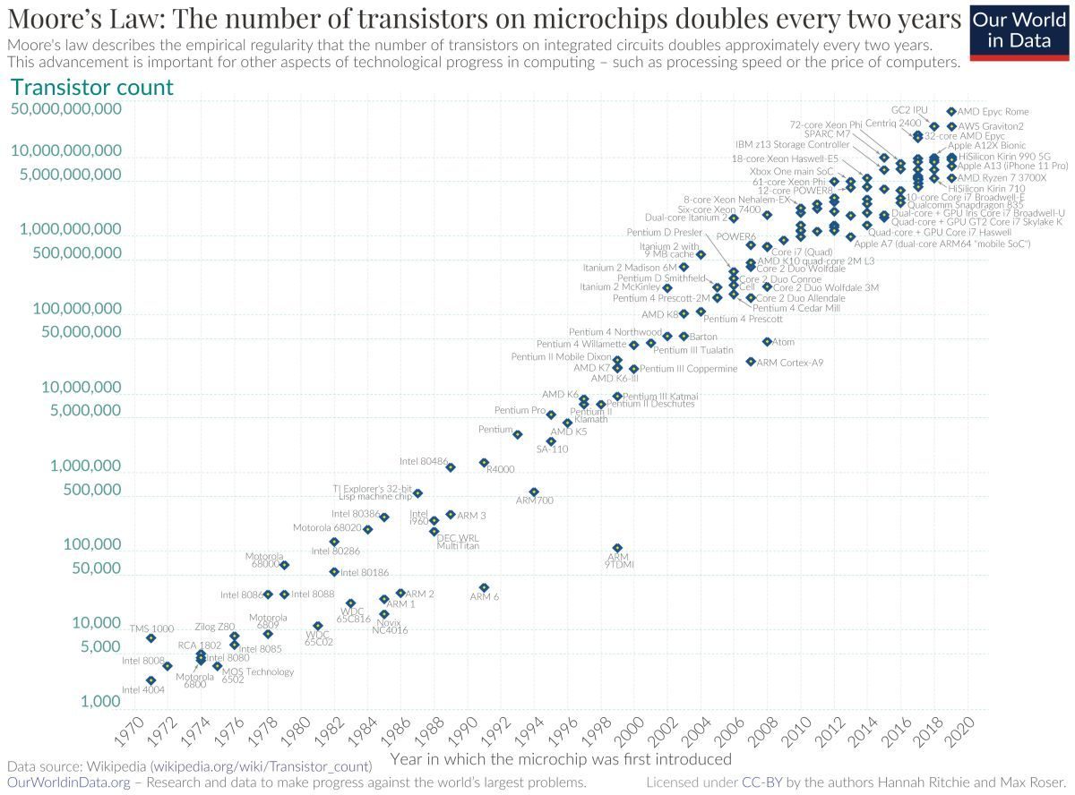
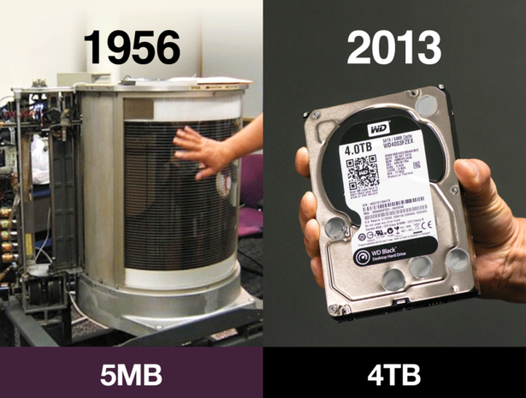
Denormalization is okay
Notes:
To get the full power of DDD, you need to let go of normalisation. Storage is no longer a problem that used to be in 70s when the relational data model was designed.
The modern problem is CPU/Compute. Make it easier on your application and database to find the most used data
Let go of the urge to have a single copy of data. Optimise the data structure so that you can pull the data for your access pattern in a single query. If this means that you need to copy data in mutiple places? So be it. It is not that costly problem to pay attention to.

Slide 14
relationships exist in noSQl
Myth : NoSQL = No Relationships
Relationships look a little different here
Implement an example model and you will get used to this paradigm.
CustomerID | CustomerName | Age
1 | Harry James Potter | 31
ID | C_ID | Address | Country
1 | 1 | Godrics Hollow, 1122 | UK
2 | 1 | Hogwarts Castle, 1442 | UK
OrderID | OrderItem | Qty
1 | Wand | 1
Notes:
Make it more visual – Show SQL Diagram and NoSQL Diagram for the same example.

Slide 15
1:M Relationship
PK | SK
CUSTOMER#Harrypotter | ORDER#657 | Name | Address
 |  | Harry James Potter | { “home”:{“street”:”Godrics hallow”,”postCode” :”1122”, “country” :”UK”}, “work”: {“street”:”hogwartz castle”,”postCode” :”1442” ,“country” :”UK”} }

Slide 16
RETHINKING Capacity
Serverless database
Decoupled storage and Compute layers
Deals with capacity in RCUs and WCUs
If unsure of capacity,
Start with on-demand mode, measure up for a few days
Switch to provisioned mode once you have a benchmark

Slide 17

trade-OFF/s

Slide 18
Not ACI(D) Compliant
Atomic – complex data types required
Consistent – Eventually consistent
Isolation – Some workarounds
Durability – Data copied to 3 nodes
OLTP heavy
Purpose built
Loose the flexibility of SQL (PartiQL as workaround)
Additional App responsibility
Data Integrity
Locking
Update data in multiple targets
Notes:
Talk a sentence on ACID and then add.

Slide 19
Summary – To get the best of DDB
Plan ahead, write down your access patterns
Denormalise, align your data structure with the request form
Think of compute and storage as isolated layers
Don’t be afraid to hand over additional responsibility to your backend
Notes:
Add a summary slide

Slide 20
Thank You!

