Slide 1
Introduction
Risk-adaptive navigation for a SLAM-enabled AGV
What?
How?
a navigation layer that adapts behavior when localization integrity degrades
Risk scalar
q ∈ [0,1]
MPPI
(planner)
Compute an online risk scalar
Schedule MPPI costs and speed limits based on risk
Bias motion toward locally informative structure under high risk
Notes:
[Sources]
- Thesis proposal draft (user-provided PDF).
[/Sources]

Slide 2
Research Questions
Three thesis questions
Does a composite risk scalar (NIS + pose covariance) predict unsafe navigation events better than either signal alone?
RQ1
Does risk-adaptive MPPI (cost-weight and speed scheduling) reduce collisions/near-collisions while keeping reasonable efficiency vs a fixed-weight baseline?
RQ2
Under high risk, does a lightweight structure-seeking term reliably improve localization quality (e.g., reduces uncertainty / restores consistency) faster than standard recovery behaviors?
RQ3
Notes:
[Sources]
- Thesis proposal draft (user-provided PDF).
[/Sources]

Slide 3
Components
Risk Scalar (Why + What)
Why we need a risk scalar
We need a single, real-time signal that summarizes localization integrity so the planner can continuously trade off progress vs safety
Definition
Composite risk scalar:
Covariance("known unknowns")
Detects that we are in an uninformative environment(uniform corridor, open space)
q = α·q_{nis} + (1−α)·q_{cov}
q ∈ [0,1] (0 = low risk, 1 = high risk)
Normalized Innovation Squared NIS = rᵀ S⁻¹ r
NIS("unknown unknowns")
Detects sudden failures: dynamic occlusions, wheel slip, sensor degradation)
q_cov = trace(P) or |P|, smoothed and normalized → [0,1]
Notes:
[Sources]
- Robert Piché, “Online tests of Kalman filter consistency” (2014) — NIS definition and χ² consistency testing. https://trepo.tuni.fi/bitstream/handle/10024/212922/KFconsistency2015.pdf
- Thesis proposal draft (user-provided PDF).
[/Sources]

Slide 4
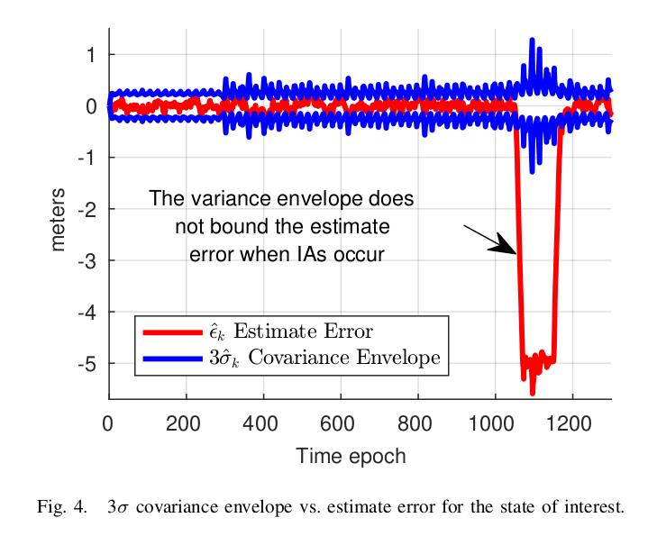
Existing Papers(only main papers included)
A Robust Framework for Failure Detection and Recovery for Terrain-relative Navigation(2013)
One of the first paper to use NIS to do diagnostic check to see if the system is lost for mobile robot
Local Nearest Neighbor Integrity Risk Evaluation for Robot Navigation(2022)
Using covariance matrices and particle spread is not sufficient for safety-critical task in SLAM.
Notes:
[Sources]
- Robert Piché, “Online tests of Kalman filter consistency” (2014) — NIS consistency testing. https://trepo.tuni.fi/bitstream/handle/10024/212922/KFconsistency2015.pdf
- J. Censi, “An accurate closed-form estimate of ICP’s covariance” (IEEE ICRA 2007) — ICP covariance/observability via Hessian. https://scispace.com/pdf/an-accurate-closed-form-estimate-of-icp-s-covariance-51qc58jk7j.pdf
- ROS Wiki: amcl — particle cloud and pose with covariance. https://wiki.ros.org/amcl
- Cartographer ROS docs: tuning + scan matching scores. https://google-cartographer-ros.readthedocs.io/en/latest/tuning.html
- Example learned reliability/covariance estimation for scan matching (recent deep-learning approach). https://arxiv.org/html/2509.18954v1
[/Sources]

Slide 5
Existing / Alternative Risk Signals
Common options (what they capture)
NIS / innovation test
Particle spread (AMCL)
Detects statistical inconsistency (outliers, divergence); can be thresholded via χ².
Uses particle cloud dispersion; sensitive to resampling and map ambiguity.
Scan-match Hessian eigenvalues / condition
Learned reliability models (CNN/RNN)
Measures observability / degeneracy of scan alignment (e.g., corridors → weak constraints).
Predicts localization quality from raw scans/images/history; needs data + domain transfer care.
Pose covariance (EKF/graph)
Cartographer scan matching score
Tracks estimated uncertainty growth; can stay “calm” during unmodeled failures.
Heuristic alignment score used in tuning; depends on configuration and environment.
Thesis approach: combine complementary signals (inconsistency + uncertainty) into a single, planner-facing risk scalar.
Notes:
[Sources]
- Robert Piché, “Online tests of Kalman filter consistency” (2014) — NIS consistency testing. https://trepo.tuni.fi/bitstream/handle/10024/212922/KFconsistency2015.pdf
- J. Censi, “An accurate closed-form estimate of ICP’s covariance” (IEEE ICRA 2007) — ICP covariance/observability via Hessian. https://scispace.com/pdf/an-accurate-closed-form-estimate-of-icp-s-covariance-51qc58jk7j.pdf
- ROS Wiki: amcl — particle cloud and pose with covariance. https://wiki.ros.org/amcl
- Cartographer ROS docs: tuning + scan matching scores. https://google-cartographer-ros.readthedocs.io/en/latest/tuning.html
- Example learned reliability/covariance estimation for scan matching (recent deep-learning approach). https://arxiv.org/html/2509.18954v1
[/Sources]

Slide 6
Testing the Risk Scalar
Failure scenarios
What we log
Evaluate across controlled stressors:
NIS / innovation statistic
Pose covariance proxy (trace(P) or |P|)
Scan-match Hessian eigenvalues / condition number
Composite risk scalar q(t)
Ground-truth events in sim: collision / near-collision / large pose error
Feature-poor corridors / open areas (low observability)
Dynamic occlusions (people/forklifts), partial scan dropouts
Wheel slip / odometry corruption
Scan-matching perturbations (bad initial guess, repeats)
Narrow passages near obstacles (high consequence)
How we score detection
Detection delay: time from event onset → q crossing threshold
Early warning: near-collision flagged before minimum distance violation
ROC/AUC for classifying “unsafe” episodes (q vs NIS vs covariance vs eigenvalues)
Ablations: q_nis only, q_cov only, full q
Nominal
Degradation
Near-miss
Recovery
We test whether q rises earlier and more reliably than individual signals.
Notes:
[Sources]
- Robert Piché, “Online tests of Kalman filter consistency” (2014) — NIS as an online consistency diagnostic. https://trepo.tuni.fi/bitstream/handle/10024/212922/KFconsistency2015.pdf
- J. Censi, “An accurate closed-form estimate of ICP’s covariance” (IEEE ICRA 2007) — relationship between scan-matching Hessian and observability/covariance. https://scispace.com/pdf/an-accurate-closed-form-estimate-of-icp-s-covariance-51qc58jk7j.pdf
[/Sources]

Slide 7
Risk-Adaptive MPPI
Risk-adaptive MPPI (proposed)
Uses q(t) to *schedule* cost weights and speed constraints.
As q ↑ : safer, slower, more structure-seeking behavior emerges.
J = w_{goal(q)}·J_{goal} + w_{obs(q)}·J_{obs} + w_{info(q)}·J_{info}
Speed scheduling: v_max(q) ↓ as q ↑ (and similarly for ω_max)
Example scheduling map
Pipeline
q low: w_goal↑, v_max↑
q high: w_obs↑, w_info↑, v_max↓
SLAM → (NIS, P) → q(t) → MPPI weights + speed → cmd_vel

Slide 8
Prior Work: Risk-Aware Variants of MPPI
Examples of how “risk” has been incorporated into MPPI-style control
RA-MPPI (CVaR over rollout costs): biases updates toward safer trajectories under uncertainty.
CC-MPPI (covariance steering / distribution control): constrains or shapes rollout dispersion to prevent divergence.
Risk-aware traversability MPPI: uses probabilistic terrain/traversability risk as a cost term for planning.
Dynamic Risk-Aware MPPI in crowds: uses collision probability / chance-constraint-like rejection of risky samples.

Slide 9
Scenarios
Scenarios | Covariance (q_{cov}) | Innovation (q_{NIS}) | Risk Scalar (q) | MPPI Behaviors
Big Empty Space | ↑ | = | ↑ | steer toward walls / shelving edges (higher structure)
Long Corridor | ↑ | = | ↑ | chooses actions that move toward intersections / richer geometry when available.
Dynamic Occlusion | = | ↑ | ↑ | Slows down, avoids obstacles and searches for richer geometry
Wheel Slip | = | ↑ | ↑ | Slows down, avoids obstacles and searches for richer geometry
Featured Space | ↓ | ↓ | ↓ | finds shortest path to reach the goal

