Slide 1

Stock Chat Assistant Project

Slide 2
Project Purpose
- Django-based platform for investors & analysts
- Manage portfolios, get recommendations, chat about stocks

Slide 3
Key Features
- Role-based dashboards (Investor, Analyst)
- Portfolio management
- Stock chatbot for real-time queries

Slide 4
Chatbot — User Experience
- Chat interface in chat_box.html
- Users ask stock questions (e.g., “AAPL price?”)
- Instant, dynamic responses (HTMX, AJAX)

Slide 5
Chatbot — Backend Logic
- chat_api view in core/views.py
- Parses message, extracts ticker
- Calls fetch_and_plot_stock for data
- Uses get_chat_advice for smart replies
- Stores chat history in session

Slide 6
Chatbot — Flow Diagram
Backend extracts ticker
Fetches stock data
Updates chat history
Generates advice
User types message

Slide 7
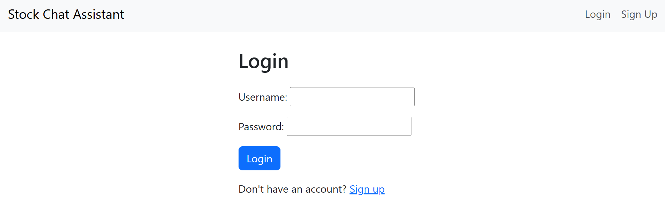
Snapshots :

Slide 8
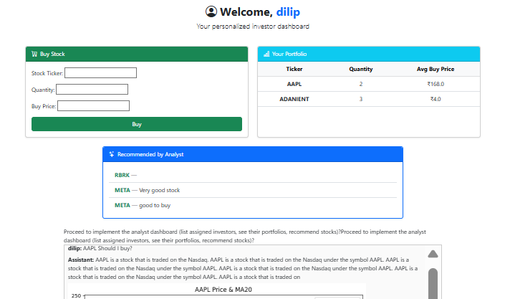
Snapshots :
Investor Portfolio :

Slide 9
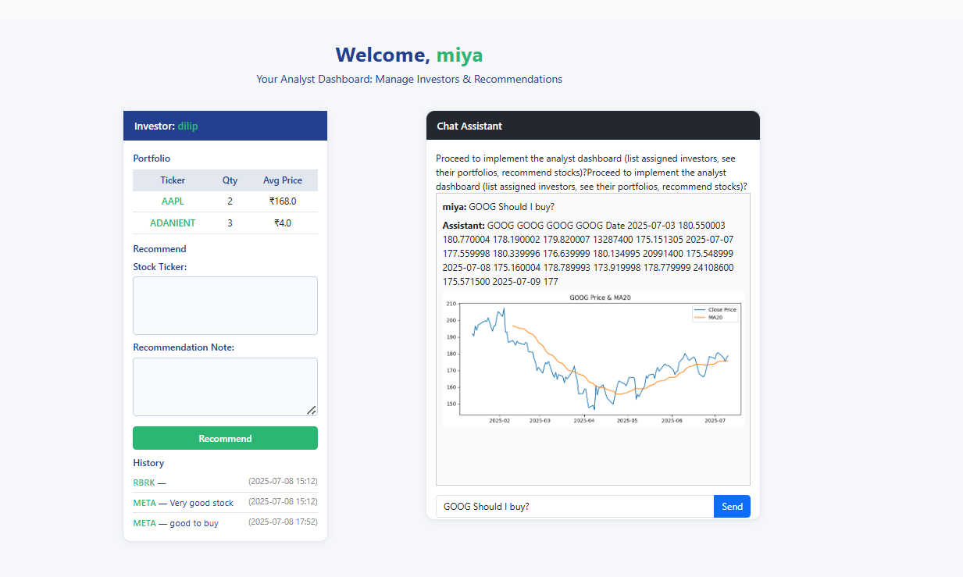
Snapshots :
Analyst Portfolio :

Slide 10
Technologies Used
- Django (backend, admin, sessions)
- HTMX (dynamic chat updates)
- yfinance for stock data

Slide 11
Advantages
- Easy-to-use chat for stock info
- Role-based, secure access
- Extensible for more features

Slide 12
Recommendations & Next Steps
- Integrate yfinance for live stock data
- Enhance chatbot with LLM/AI for smarter answers
- Consider real-time chat (WebSockets)

