Slide 1
Datacenter Networks
CPSC 433/533, Spring 2021 Anurag Khandelwal

Slide 2
Recap
What is a data center network?
Scale, service-model, application characteristics
What makes it different?
Characteristics, goals (w.r.t. internet), degrees of freedom
How do we achieve goals by exploiting freedom?
Topology redesign, L2/L3 redesign, L4 redesign

Slide 3
Recap
What is a data center network?
Scale, service-model, application characteristics
What makes it different?
Characteristics, goals (w.r.t. internet), degrees of freedom
How do we achieve goals by exploiting freedom?
Topology redesign, L2/L3 redesign, L4 redesign
We will look at some approaches, not all

Slide 4
How do we achieve DCN goals?
Network architecture design [Done]:
rearchitect network topology to achieve full-bisection b/w
DC as a giant switch => Clos/fat-tree topologies
L2/L3 design:
Via modifications to LS/DV + ECMP
New addressing / routing / forwarding for new topology
L4 design [Today]:
transport protocol design to meet DCN goals

Slide 5
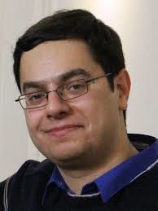
How do we achieve DCN goals?
L4 design:
Transport protocol design (w/ Fat-Tree)
Many slides courtesy of Mohammad Alizadeh, MIT

Slide 6
What’s “ideal” ?
What is the best measure of performance for a data center transport protocol?
Latency of each packet in the flow?
Number of packet drops?
Link utilization?
Average queue length at switches?
When the flow is completely transferred?
What does the application/user care about?

Slide 7
Flow Completion Time (FCT)
Time from when flow started at the sender, to when all packets in the flow were received at the receiver

Slide 8
FCT with TCP
TCP-DropTail: TCP with “drop-tail” queues at switches (drops packets at the tail of the queue)

Slide 9
Recall: “Elephants” and “Mice”
Microsoft [Alizadeh 2010]
Web search (north-south), data mining (east-west)
<100KB
>10MB
55% of flows
3% of bytes
5% of flows
35% of bytes

Slide 10
FCT with TCP
Problem: the mice are delayed by the elephants

Slide 11
Solution: use priorities! [pFabric, Sigcomm 2013]
Packets carry a single priority number
priority = remaining flow size (e.g., #bytes un-ACKed)
Switches
very small queues (e.g., 10 packets)
send highest priority / drop lowest priority packet
Servers
Transmit/retransmit aggressively (at full link rate)
Drop transmission rate only under extreme loss (timeouts)

Slide 12
FCT

Slide 13
Why does pFabric work?
Consider problem of scheduling N jobs at a queue
J_{1,} J₂, … , J_{n} with duration T₁, T₂, …T_{n} respectively
How do you minimize average job completion time?
“Shortest Job First” (SJF) scheduling
Pick job with minimum T_{i} ; de-queue and run ; repeat
I.e., job that requires minimum runtime has max priority
Solution for a network of queues is NP-hard
Setting priority = remaining flow size is a heuristic to approximate SJF

Slide 14
Questions?

Slide 15
Network Management & Software Defined Networks
Slides thanks to Scott Shenker, one of the pioneers of SDN

Slide 16
Goal for rest of the discussion
Provide the “why” of software-defined networking
Deeper understanding of the problem
An exercise in architectural thinking
To build a principled approach towards a solution
Only a high level of the “what”
Enough that some of you will want to know more
Take advanced networking course or do research!

Slide 17
What is Network Management?
Recall the two “planes” of networking
Data plane: forwarding packets
Based on local forwarding state
Control plane: computing that forwarding state
Involves coordination with rest of system
Broad definition of “network management”:
Everything having to do with the control plane

Slide 18
Original goals for the control plane
Basic connectivity: route packets to destination
Local state computed by routing protocols
Globally distributed algorithms
Inter-domain policy: find policy-compliant paths
Done by globally distributed BGP
For long time, these were the only relevant goals!
What other goals are there in running a network?

Slide 19
Isolation
L2 broadcast protocols often used for discovery
Useful but unscalable and invasive
Want multiple logical LANs on a physical network
Retain usefulness, cope with scaling, provide isolation
Use VLANs (virtual LANs) tags in L2 headers
Controls where broadcast packets go
Gives support for logical L2 networks
Routers connect these logical L2 networks

Slide 20
Access Control
Operators want to limit access to various hosts
“Don’t let laptops access backend database machines”
This can be imposed by routers using ACLs
ACL: Access Control List
Example entry in ACL: <header template; drop>
If not port 80, drop
If source address = X, drop

Slide 21
Traffic Engineering
Want to avoid persistent overloads on links
Choose routes to spread traffic load across links
Example:
Adjusting weights in OSPF
Done with centralized computation
Take snapshot of topology and load
Compute appropriate OSPF state
Send to network

Slide 22
Network management has many goals
Achieving these goals is job of the control plane…
…which currently involves many mechanisms
Globally distributed: routing algorithms
Manual/scripted configuration: ACLs, VLANs
Centralized computation: Traffic engineering

Slide 23
Bottom Line
Many different control plane mechanisms
Each designed from scratch for their intended goal
Encompassing a wide variety of implementations
Distributed, manual, centralized,…
Network control plane is a complicated mess!

Slide 24
Questions?

Slide 25
Making Network Operators Cry: A Two Step Process

Slide 26
Step 1: Large datacenters
100,000s machines; 10,000s switches
This is pushing the limits of what we can handle...

Slide 27
Step 2: Multiple tenancy
Large datacenters host many customers
Each customer gets their own logical network
Customer should be able to set policies on this network
ACLs, VLANs, etc.
If there are 1000 customers, that adds 3 orders of magnitude
This goes way beyond what we can handle

Slide 28
Network Operators Are Now Weeping
Ad hoc control for millions of networked entities
And something goes wrong
Try debugging that…
What is the key problem here?
Complexity
We need a simpler, more systematic design
How do we achieve this?

Slide 29
An Example Transition: Programming
Machine languages: no abstractions
Had to deal with low-level details
Mastering complexity was crucial
Higher-level languages: OS and other abstractions
File system, virtual memory, abstract data types, ...
Modern languages: even more abstractions
Object orientation, garbage collection,...
Abstractions key to extracting simplicity

Slide 30
What About Network Abstractions?
Consider the data and control planes separately
Different tasks, so naturally different abstractions

Slide 31
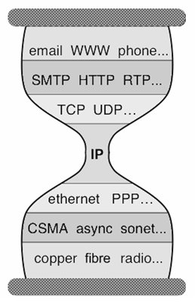
Abstractions for Data Plane: Layers
Applications
…built on…
Reliable (or unreliable) transport
…built on…
Best-effort global packet delivery
…built on…
Best-effort local packet delivery
…built on…
Physical transfer of bits

Slide 32
The Importance of Layering
Decomposed delivery into basic components
Independent, compatible innovation at each layer
Clean “separation of concerns”
Leaving each layer to solve a tractable problem
Responsible for the success of the Internet!
Rich ecosystem of independent innovation
Think about it….
Original architecture has handled many order-of-magnitude changes in speed, size, scope, diversity

Slide 33
Control Plane Abstractions
?

Slide 34
Many Control Plane Mechanisms
Variety of goals, no modularity:
Routing: distributed routing algorithms
Isolation: ACLs, VLANs, Firewalls,…
Traffic engineering: adjusting weights, MPLS,…
Control Plane: mechanism without abstraction
Too many mechanisms, not enough functionality

Slide 35
Questions?

Slide 36
Finding Control Plane Abstractions

Slide 37
How do you find abstractions?
You first decompose the problem….
…and define abstractions for each sub-problem
So what is the control plane problem?

Slide 38
Computing forwarding state
Consistent with low-level hardware/software
Which might depend on vendor
Based on entire network topology
Because many control decisions depend on topology
For all routers/switches in network
Every router/switch needs forwarding state

Slide 39
Our current approach
Design one-off mechanisms that solve all three
Introduces a lot of complexity
Think back to the DCN operator

Slide 40
Separate Concerns with Abstractions
Be compatible with low-level hardware/software
Need an abstraction for general forwarding model
Make decisions based on entire network
Need an abstraction for network state
Compute configuration of each physical device
Need an abstraction that simplifies configuration

Slide 41
Separate Concerns with Abstractions
Be compatible with low-level hardware/software
Need an abstraction for general forwarding model
Make decisions based on entire network
Need an abstraction for network state
Compute configuration of each physical device
Need an abstraction that simplifies configuration

Slide 42
Abs#1: Forwarding Abstraction
Express intent independent of implementation
Don’t want to deal with proprietary HW and SW
OpenFlow is current proposal for forwarding
Standardized interface to switch
Configuration in terms of flow entries: <header, action>
Design details concern exact nature of:
Header matching
Allowed actions

Slide 43
Two Important Facets to OpenFlow
Switches accept external control messages
Not closed, proprietary boxes
Standardized flow entry format
So switches are interchangable

Slide 44
Separate Concerns with Abstractions
Be compatible with low-level hardware/software
Need an abstraction for general forwarding model
Make decisions based on entire network
Need an abstraction for network state
Compute configuration of each physical device
Need an abstraction that simplifies configuration

Slide 45
Abs#2: Network State Abstraction
Abstract away various distributed mechanisms
Abstraction: global network view
Annotated network graph provided through an API
Implementation: “Network Operating System”
Runs on servers in network (“controllers”)
Information flows both ways
Information from routers/switches to form “view”
Configurations to routers/switches to control forwarding

Slide 46
Network Operating System
Think of it as a centralized link-state algorithm
Switches send connectivity info to controller
Controller computes forwarding state
Via some control program that uses the topology as input
Controller sends forwarding state to switches
Controller is replicated for resilience
System is only “logically centralized”

Slide 47
Software Defined Network (SDN)
Traditional Control Mechanisms
Network of Switches and/or Routers
routing, access control, etc.
Control Program
Distributed algorithm running between neighbors
Complicated task-specific distributed algorithm
Global Network View
Network OS

Slide 48
Major Change in Paradigm
Control program:
Network configuration is a function of the global view
Control mechanism now program using NOS API
Not a distributed protocol, just a graph algorithm

Slide 49
Separate Concerns with Abstractions
Be compatible with low-level hardware/software
Need an abstraction for general forwarding model
Make decisions based on entire network
Need an abstraction for network state
Compute configuration of each physical device
Need an abstraction that simplifies configuration

Slide 50
Abs#3: Specification Abstraction
Control mechanism expresses desired behavior
Whether it be isolation, access control, or QoS
It should not be responsible for implementing that behavior on physical network infrastructure
Requires configuring the forwarding tables in each switch
Proposed abstraction: abstract view of network
Abstract view models only enough detail to specify goals
Will depend on task semantics

Slide 51
Simple Example: Access Control
A
Abstract Network
View
B
A
Global
Network View
B

Slide 52
Software Defined Network
Abstract Network View
Virtualization Layer
Control Program
Global Network View
Network OS

Slide 53
Clean Separation of Concerns
Control program: express goals on abstract view
Driven by Operator Requirements
Virt. Layer: abstract view ⬅➔ global view
Driven by Specification Abstraction for particular task
NOS: global view ⬅➔ physical switches
Controller API: driven by Network State Abstraction
Switch interface: driven by Forwarding Abstraction

Slide 54
SDN: Layers for the Control Plane
Control Program
Abstract Network View
Virtualization Layer
Global Network View
Network OS

Slide 55
Access Control Application
Control program decides who can talk to who
Pass this information to SDN platform
Appropriate ACL flow entries are added to network
In the right places (based on the topology)
The control program that decides who can talk to whom doesn’t care what the network looks like!

Slide 56
Takeaway
SDN is not a revolutionary technology…
…just a way of organizing network functionality
But that’s all the Internet architecture is….
The Internet architecture isn’t clever, but it is deeply wise
SDN isn’t clever, but hopefully it is wise….

Slide 57
Future of Networking: A Systems Perspective

Slide 58
Goals of this Discussion
We have already seen some of the recent directions
Datacenter networks, with protocol innovations across L2-L5
Software defined networks, rearchitecting the control plane
The remainder of this discussion:
How a systems researcher sees the future of networking
Don’t worry, this won’t be on the exam ☺

Slide 59
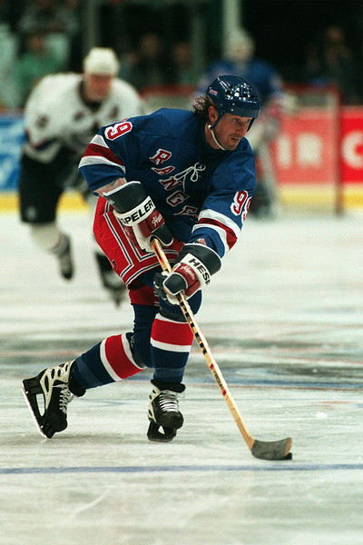
“Skate where the puck's going, not where it's been”
– Walter Gretzky

Slide 60
So where is the puck going?

Slide 61
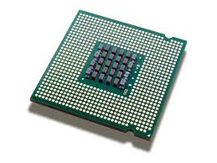
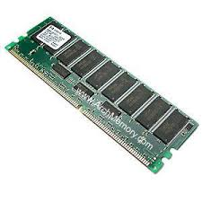
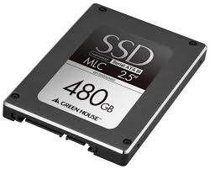
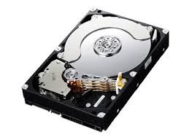
Typical Server Node
CPU
Memory Bus
RAM
PCI
SSD
Ethernet
SATA
HDD

Slide 62
Typical Server Node: Yearly Improvements
30%
CPU
15%
30%
30-32%
Memory Bus
RAM
>30%
15-20%
PCI
SSD
33-40%
Ethernet
20%
SATA
HDD
So what does this mean?

Slide 63
Growth Rates
Network b/w growth (33-40% per year) outpacing:
CPU (30-32%)
memory bus (15% per year)
PCIe (15-20% per year)
SATA (20% per year)
Current speeds:
Network b/w: 12.5GB/s
Memory bus: 80GB/s
PCIe: 16 GB/s
SATA: 600 MB/s

Slide 64
A Couple of Implications
Network stack processing will become a bottleneck
CPU speed growth vs. network speed growth
Accessing SSD locally will be slower than accessing remote memory
PCIe bus speed growth vs. network speed growth

Slide 65
Network Stack Processing
Existing OS network stacks designed for 1 Gbps
Example:
Typical TCP processing: ~3.2 Gbps per core
With low-level optimizations: ~9-12 Gbps per core
TCP on a 40 Gbps link: > 3 cores per server
TCP on a 100 Gbps link: > 8 cores per server
This is not economically sustainable…
A core used for n/w stack is a core stolen from “useful” processing by applications/customers

Slide 66
How do we fix this?
Research trend: kernel bypass
Packet rates: ~90k pkts/s (1 Gbps), ~9M pkts/s (100 Gbps)
Traversing the kernel stack is too expensive
Bypass the kernel completely
Where do the protocol implementations go?
User-space for lightweight applications, or…
Research trend: hardware offload
Implement TCP (+other protocols) on specialized h/w
Lots of interesting challenges

Slide 67
Remote memory faster than SSDs
Consider 4kB page, 100Gbps link, 1 switch hop
Zero queueing delay
Baseline: 4.78 us
OS: 1.9us, Data copy: 2us, Switching: 0.48us, Propagation Delay: 0.08us, Transmission Delay: 0.32us
How can we avoid OS overhead?
Research Trend: RDMA

Slide 68
Traditional DMA
Server
1
CPU
CPU issues DMA request
DMA controller copies data from SSD to RAM
Controller interrupts CPU when done
CPU can now access memory
3
4
DMA Controller
RAM
2
SSD
Note: CPU and CPU <-> memory bus are free during DMA

Slide 69
RDMA
Server
CPU issues RDMA request
Local NIC sends RDMA request to remote NIC, which performs DMA & sends data back. Local NIC copies data to RAM
Local NIC interrupts CPU when done
CPU can now access memory
1
CPU
3
4
NIC
RAM
2
CPU
NIC
Note: CPU and CPU <-> memory bus are free during RDMA (both local & remote)
RAM
Remote Server
Note: OS is bypassed on both ends

Slide 70
Remote memory faster than SSDs
Consider 4kB page, 100Gbps link, 1 switch hop
Zero queueing delay
Baseline: 4.78 us
OS: 1.9us, Data copy: 2us, Switching: 0.48us, Propagation Delay: 0.08us, Transmission Delay: 0.32us
With RDMA: 2.88us
Can reduce data copy overheads with NIC support
Brings latency down to 1.88us!
~10x of local memory, 1/10x of local SSD

Slide 71
What are the challenges?
This assumes zero queueing delay…
Transport protocol design to minimize queueing delay
Recall pFabric; Other protocols: DCTCP, pHost, …
RDMA requires lossless ethernet
Via ethernet flow control or priority flow control (PFC)
Lossless networks: very active area of research

Slide 72
Taking it one step further: Resource Disaggregation
DRAM
DRAM
…
CPU
DRAM
DRAM
Server#1
CPU
Server#N
CPU
SSD
SSD
CPU
DRAM
Network fabric
CPU
SSD
Network fabric
TPU
SSD
SSD
GPU
Traditional Datacenter
Datacenter with Resource Disaggregation
Disaggregated Computer
Instead of a network of computers
Benefits?
Resource utilization, upgradeability, fault-tolerance

Slide 73
My Current Research Focus
How can we design OS for disaggregated computer?
Where does the OS logic run?
Idea: Put key OS functionalities in network fabric
Why?
Network has all the visibility…
SDN design to modularize & layer OS functionality
e.g., Address translation = data plane; memory allocation = control plane, etc.
Remind you of something?
Forwarding = data plane; route computation = control plane

Slide 74
Questions?

