Slide 1





CARNEGIE MELLON UNIVERSITY
SCHOOL OF COMPUTER SCIENCE
Automated Data Science Workflow System
From Sequential LLM Pipelines to Intelligent Multi-Agent Orchestration
PRESENTER
CONTEXT
Anurag Kumar Jha
Data Science Final Project
anuragkj@andrew.cmu.edu
November 24, 2025

Slide 2








Project Overview
CMU Data Science Final Project
VISION
Two-Phase Approach
"Create an intelligent agent that automates end-to-end data science pipeline from data preprocessing to model training and reporting."
LLM-Based Pipeline
Key Objectives
1
Sequential intelligent decision making for standard workflows
Eliminate Manual Tasks
Automate repetitive steps in data analysis and cleaning
Prevent Common Pitfalls
Safeguard against data leakage and poor model selection
Multi-Agent System
Accessibility
2
Collaborative specialized agents with quality control loops
Make advanced data science accessible to non-experts
Professional Reporting
Generate reproducible, publication-quality research reports
Made with Genspark
Made with Genspark
Automated Data Science Workflow System
Slide 2

Slide 3




Problem Statement
The Data Science Workflow Challenge
Current Pain Points
🔄
Repetitive Preprocessing
Manual cleaning, encoding, and scaling steps performed repeatedly
🐛
Common Errors
Subtle pitfalls like data leakage and improper train/test splits
⏱️
Time-Consuming Tuning
Why It Fails
Manual model selection and hyperparameter optimization is slow
"Traditional workflows are brittle, prone to human error, and create bottlenecks that slow down innovation."
📊
Manual Visualization
Report generation and chart creation requires significant effort
🧠
Deep Expertise Required
Requires domain knowledge at every step, creating a barrier to entry
Made with Genspark
Made with Genspark
Automated Data Science Workflow System
Slide 3

Slide 4








Why This Problem Matters
Relevance & Beneficiaries
Who Benefits?
Market Context
Students & Researchers
Enables rapid prototyping and experimentation without getting bogged down in routine code.
$14.5B
Business Analysts
AutoML Market by 2030
Provides self-service analytics capabilities requiring minimal coding expertise.
PROJECTED GROWTH
Small Organizations
Citizen Data Scientists
Democratizes access to machine learning solutions without expensive dedicated data teams.
Rapidly growing demand for tools empowering non-experts
Data Scientists
Automates routine tasks, allowing focus on complex problem-solving and innovation.
Workflow Quality
Critical need for reproducible, explainable AI processes
Made with Genspark
Automated Data Science Workflow System
Slide 4

Slide 5









Related Work & Motivation
CMU Data Science Final Project
Existing AutoML Solutions
SYSTEM
APPROACH
LIMITATIONS
EXPLAINABILITY
TPOT
Genetic Programming
No automated cleaning; limited to model selection; computationally expensive
Auto-sklearn
Bayesian Optimization
Doesn't handle complex preprocessing decisions; constrained search space
H2O AutoML
Ensemble Methods
"Black box" nature; limited transparency on internal choices
DataRobot
Commercial Platform
Expensive licensing; proprietary/closed source; hard to customize
Gap in Literature
Current solutions excel at model selection but fail at intelligent data preparation and reasoning transparency.
Disjointed Workflow
Missing Reasoning
Low Interpretability
No end-to-end system integrating cleaning with modeling logic
Lack of semantic understanding of data characteristics
Decisions are opaque to human users ("why did it do that?")
Made with Genspark
Made with Genspark
Automated Data Science Workflow System
Slide 5

Slide 6






Contribution of Proposed Solution
CMU Data Science Final Project
Key Novel Contributions
Bridging the gap between automated tools and intelligent research
LLM-Guided Decision Making
Data Leakage Prevention
Context-aware choices for imputation, encoding, and model selection
Built-in safeguards with strict fit/transform patterns
Early train/test splitting enforcement
Detailed reasoning for every decision (explainability)
Multi-Agent Architecture
Complete Automation
Specialized agents with quality control loops
From raw CSV to publication-ready research report
Adaptive workflow based on data characteristics
Includes hypothesis generation, code, visualizations, and references
Made with Genspark
Automated Data Science Workflow System
Slide 6

Slide 7



01
Part 1: LLM-Based Pipeline Approach
CMU Data Science Final Project
LLM-Based Pipeline Approach
From raw CSV data to trained models using explainable LLM decisions and leakage-safe preprocessing mechanisms.
Sequential Logic
Intelligent Decisions
Automated Reporting
Made with Genspark
Made with Genspark
Automated Data Science Workflow System
Slide 7

Slide 8

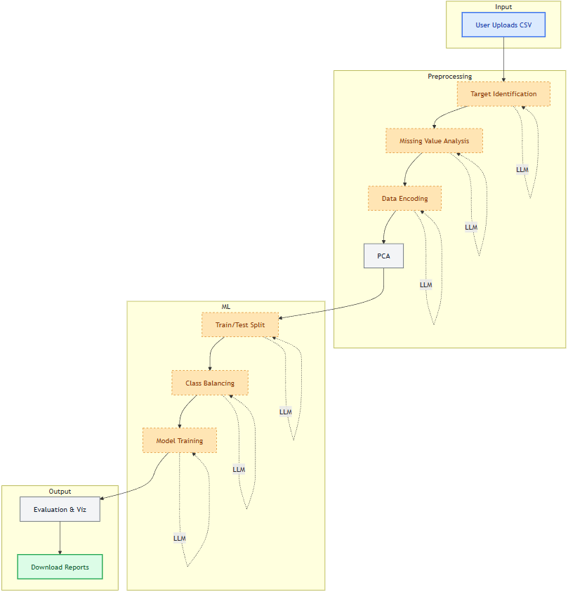
LLM Pipeline Architecture
LLM Pipeline Architecture
CMU Data Science Final Project
Made with Genspark
Made with Genspark
Automated Data Science Workflow System
Slide 8

Slide 9




Technical Stack - Pipeline Approach
CMU Data Science Final Project
LLM Framework
Data Processing
OpenAI GPT Models
Core Libraries
GPT-4 (gpt-4-1106-preview) & GPT-3.5 (gpt-3.5-turbo)
pandas, numpy
LangChain
Machine Learning
Prompt engineering, chain orchestration, and output parsing
scikit-learn
Data Quality
imbalanced-learn
Visualization & UI
Model Support
Plotting Libraries
CLASSIFICATION
matplotlib, seaborn, plotly
LogisticRegression, SVC, RandomForest, XGBoost, GradientBoosting
Interactive Dashboard
REGRESSION
Streamlit based UI for real-time interaction and display
LinearRegression, Ridge, Lasso, ElasticNet, RandomForest
CLUSTERING
KMeans, DBSCAN, GaussianMixture, Hierarchical
Made with Genspark
Made with Genspark
Automated Data Science Workflow System
Slide 9

Slide 10

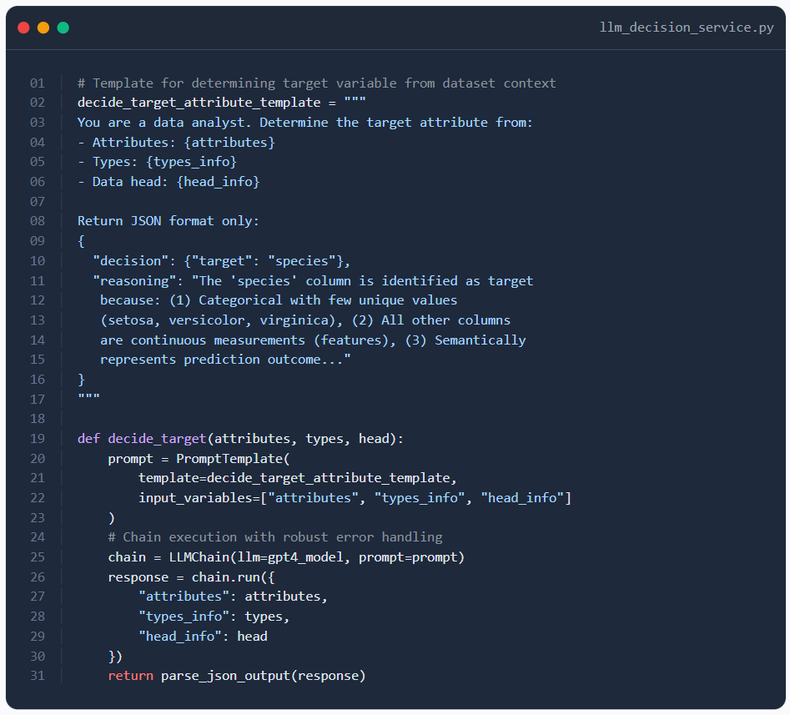

LLM Decision-Making Process
LLM Decision Making
CMU Data Science Final Project
Prompt Strategy
"""
03
04
05
- Types: {types_info}
06
- Data head: {head_info}
07
08
Return JSON format only:
09
{
10
"decision": {"target": "species"},
11
"reasoning": "The 'species' column is identified as target
12
because: (1) Categorical with few unique values
13
(setosa, versicolor, virginica), (2) All other columns
14
are continuous measurements (features), (3) Semantically
15
represents prediction outcome..."
16
}
17
"""
18
19
def
decide_target
(attributes, types, head):
20
prompt = PromptTemplate(
21
template=decide_target_attribute_template,
22
input_variables=[
"attributes"
,
"types_info"
,
"head_info"
]
23
)
Structured JSON Output
24
# Chain execution with robust error handling
25
chain = LLMChain(llm=gpt4_model, prompt=prompt)
26
response = chain.run({
27
"attributes"
: attributes,
28
"types_info"
: types,
29
"head_info"
: head
30
})
31
return
parse_json_output(response)
Enforces machine-readable format for reliable parsing in the pipeline
Reasoning Requirement
Forces LLM to explain "why" (explainability) before making a choice
Context Injection
Dynamic insertion of data types, head, and attributes
Why this matters?
Standard AutoML tools use hard-coded heuristics (e.g., "if columns > 100, use PCA"). This system uses semantic understanding:
"This column contains ID numbers, not features - drop it."
Made with Genspark
Made with Genspark
Automated Data Science Workflow System
Slide 10

Slide 11
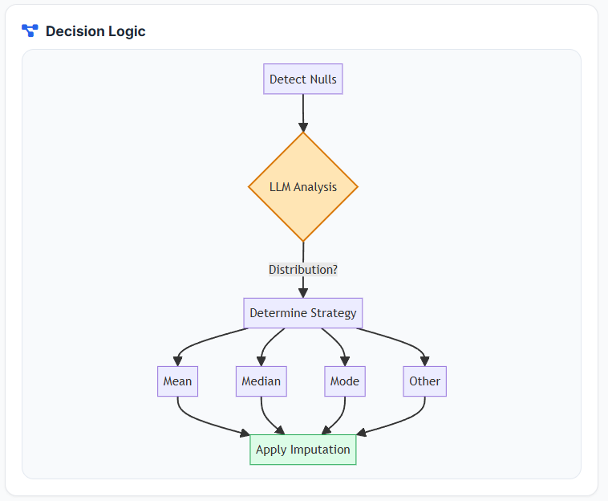
LLM Decision-Making Process
LLM: Handle Missing Values
CMU Data Science Final Project
"""
03
04
05
- Types: {types_info}
06
- Data head: {head_info}
07
08
Return JSON format only:
09
{
10
"decision": {"target": "species"},
11
"reasoning": "The 'species' column is identified as target
12
because: (1) Categorical with few unique values
13
(setosa, versicolor, virginica), (2) All other columns
14
are continuous measurements (features), (3) Semantically
15
represents prediction outcome..."
16
}
17
"""
18
19
def
decide_target
(attributes, types, head):
20
prompt = PromptTemplate(
21
template=decide_target_attribute_template,
22
input_variables=[
"attributes"
,
"types_info"
,
"head_info"
]
23
)
24
# Chain execution with robust error handling
25
chain = LLMChain(llm=gpt4_model, prompt=prompt)
26
response = chain.run({
27
"attributes"
: attributes,
28
"types_info"
: types,
29
"head_info"
: head
30
})
31
return
parse_json_output(response)
Made with Genspark
Made with Genspark

Slide 12
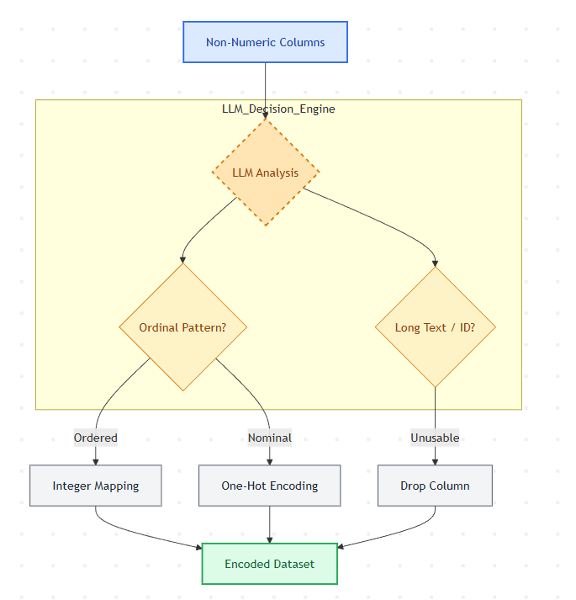
LLM Decision-Making Process
LLM: Encoding Strategy
CMU Data Science Final Project
"""
03
04
05
- Types: {types_info}
06
- Data head: {head_info}
07
08
Return JSON format only:
09
{
10
"decision": {"target": "species"},
11
"reasoning": "The 'species' column is identified as target
12
because: (1) Categorical with few unique values
13
(setosa, versicolor, virginica), (2) All other columns
14
are continuous measurements (features), (3) Semantically
15
represents prediction outcome..."
16
}
17
"""
18
19
def
decide_target
(attributes, types, head):
20
prompt = PromptTemplate(
21
template=decide_target_attribute_template,
22
input_variables=[
"attributes"
,
"types_info"
,
"head_info"
]
23
)
24
# Chain execution with robust error handling
25
chain = LLMChain(llm=gpt4_model, prompt=prompt)
26
response = chain.run({
27
"attributes"
: attributes,
28
"types_info"
: types,
29
"head_info"
: head
30
})
31
return
parse_json_output(response)
Made with Genspark
Made with Genspark

Slide 13

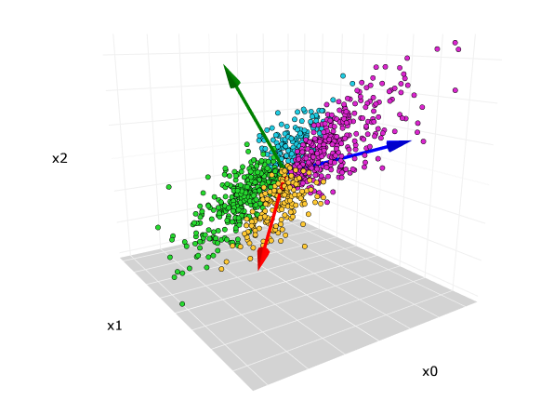

LLM: PCA Decision Logic
Pipeline Stage 3: PCA Decision Logic
CMU Data Science Final Project
Decision Logic
,
):
04
scaler =
StandardScaler
()
05
numeric_df = df.select_dtypes(include=[np.number])
06
scaled_data = scaler.fit_transform(numeric_df)
07
08
# 2. Fit PCA to determine explained variance
09
pca =
PCA
()
10
pca.fit(scaled_data)
11
12
# 3. Find components needed for 95% variance
13
cumulative_variance = np.cumsum(pca.explained_variance_ratio_)
14
# np.where returns indices where condition is true
15
n_components = np.where(cumulative_variance >= cumulative_variance_threshold)[
0
][
0
] +
1
16
17
# 4. Check if reduction is significant (>10%)
18
original_dims = df.shape[
1
]
19
dim_reduction_ratio =
1
1
Standardization First
- (n_components / original_dims)
20
21
perform_pca = dim_reduction_ratio >= min_dim_reduction_ratio
22
23
return
perform_pca, n_components
24
25
# Usage Example:
26
# If original dims=10, components needed=9 -> ratio=0.1 -> PCA=True
27
# If original dims=10, components needed=10 -> ratio=0.0 -> PCA=False
Data must be scaled (mean=0, var=1) before PCA to prevent magnitude bias.
2
Variance Threshold
Target retention of 0.95 (95%) of original information.
3
Efficiency Check
Only apply PCA if dimensions are reduced by at least 10%.
Why this check?
Applying PCA indiscriminately reduces interpretability. If 95% variance requires keeping 99% of features, PCA adds complexity without benefit. The pipeline intelligently skips PCA in such cases.
Made with Genspark
Made with Genspark
Automated Data Science Workflow System
Slide 13

Slide 14
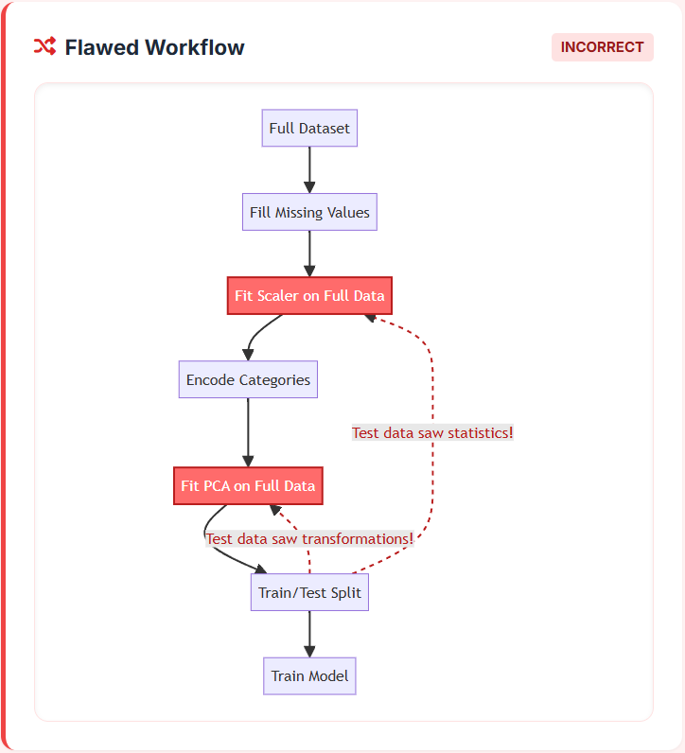
Data Leakage
Pipeline Stage 3: PCA Decision Logic
CMU Data Science Final Project
,
):
04
scaler =
StandardScaler
()
05
numeric_df = df.select_dtypes(include=[np.number])
06
scaled_data = scaler.fit_transform(numeric_df)
07
08
# 2. Fit PCA to determine explained variance
09
pca =
PCA
()
10
pca.fit(scaled_data)
11
12
# 3. Find components needed for 95% variance
13
cumulative_variance = np.cumsum(pca.explained_variance_ratio_)
14
# np.where returns indices where condition is true
15
n_components = np.where(cumulative_variance >= cumulative_variance_threshold)[
0
][
0
] +
1
16
17
# 4. Check if reduction is significant (>10%)
18
original_dims = df.shape[
1
]
19
dim_reduction_ratio =
1
- (n_components / original_dims)
20
21
perform_pca = dim_reduction_ratio >= min_dim_reduction_ratio
22
23
return
perform_pca, n_components
24
25
# Usage Example:
26
# If original dims=10, components needed=9 -> ratio=0.1 -> PCA=True
27
# If original dims=10, components needed=10 -> ratio=0.0 -> PCA=False
Made with Genspark
Made with Genspark

Slide 15
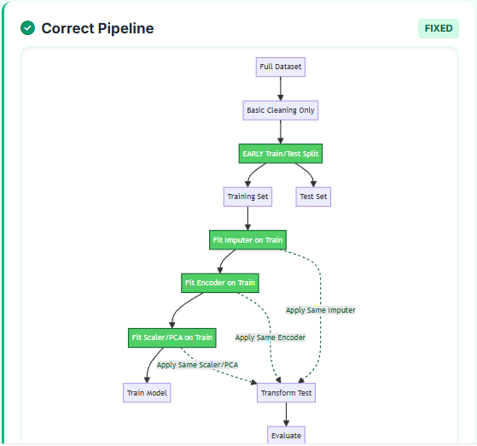
Fixed
Pipeline Stage 3: PCA Decision Logic
CMU Data Science Final Project
,
):
04
scaler =
StandardScaler
()
05
numeric_df = df.select_dtypes(include=[np.number])
06
scaled_data = scaler.fit_transform(numeric_df)
07
08
# 2. Fit PCA to determine explained variance
09
pca =
PCA
()
10
pca.fit(scaled_data)
11
12
# 3. Find components needed for 95% variance
13
cumulative_variance = np.cumsum(pca.explained_variance_ratio_)
14
# np.where returns indices where condition is true
15
n_components = np.where(cumulative_variance >= cumulative_variance_threshold)[
0
][
0
] +
1
16
17
# 4. Check if reduction is significant (>10%)
18
original_dims = df.shape[
1
]
19
dim_reduction_ratio =
1
- (n_components / original_dims)
20
21
perform_pca = dim_reduction_ratio >= min_dim_reduction_ratio
22
23
return
perform_pca, n_components
24
25
# Usage Example:
26
# If original dims=10, components needed=9 -> ratio=0.1 -> PCA=True
27
# If original dims=10, components needed=10 -> ratio=0.0 -> PCA=False
Made with Genspark
Made with Genspark

Slide 16

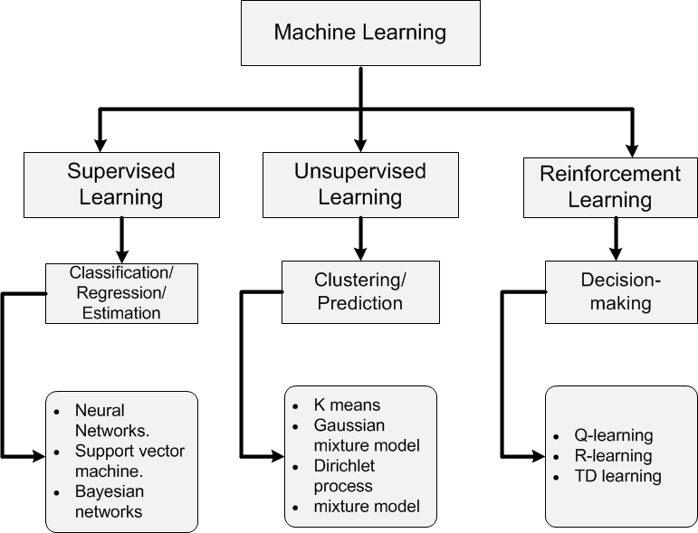




LLM: Choosing Algorithms
Model Selection with LLM
CMU Data Science Final Project
Intelligent Algorithm Choice
JSON Parsed Output
1. Logistic Regression
04
- Description: {description_info}
05
- Unique Values: {nunique_info}
06
07
Task: Select 3 classification models from:
08
1:LogisticRegression, 2:SVC, 3:GaussianNB,
09
4:RandomForestClassifier, 5:AdaBoostClassifier,
10
6:XGBClassifier, 7:GradientBoostingClassifier
11
12
Return JSON with reasoning for each:
13
{
14
"decisions": {"model1": 1, "model2": 4, "model3": 6},
15
"reasoning": {
16
"model1": "LogisticRegression: Linear baseline...",
17
"model2": "RandomForest: Handles non-linear...",
18
"model3": "XGBoost: State-of-art performance..."
19
},
20
"overall_reasoning": "Strategy: Selected diverse..."
21
}
22
"""
23
24
# Application Logic
25
models = json.loads(llm.invoke(prompt))
26
for
m_id
in
models[
"decisions"
].values():
27
train_and_evaluate(model_map[m_id])
Selected as an interpretable baseline to establish a performance benchmark for linear relationships.
2. Random Forest
Chosen for ability to handle non-linear interactions and robustness to outliers in the dataset.
3. XGBoost
Selected for state-of-the-art performance on tabular data and capability to handle class imbalance.
Overall Strategy Reasoning
Structured Output
Constraint Checking
Explainability
"Selected diverse model families (Linear, Bagging, Boosting) to ensure comprehensive evaluation coverage and reduce bias."
Ensures parseable JSON
Limits choices to list
Mandatory reasoning field
Made with Genspark
Made with Genspark
Automated Data Science Workflow System
Slide 16

Slide 17









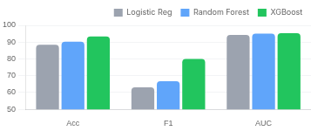
Result Analysis
Pipeline Approach: Results
CMU Data Science Final Project
Auto
Speed
Explain
Safety
Cost Efficiency
99.9% Savings
0-Code Analysis
5-10 Minutes
Full Transparency
Leakage Proof
End-to-end workflow without manual coding.
Rapid execution vs hours of manual work.
Reasoning for preprocessing & models.
Built-in fit/transform safeguards.
AUTOMATED
MANUAL
$0.02
$150+
per run
3 hrs
Experimental Results (5 Datasets)
GPT-4 for strategy + GPT-3.5 for tasks optimizes cost/quality.
Dataset & Info
Balancing
Logistic Reg.
Random Forest
XGBoost
Survey Lung Cancer
SMOTE
88.5% Acc
90.2% Acc
93.4% Acc
Total: 447 | Train: 386 | Test: 61
F1: 0.63 | AUC: 0.94
F1: 0.67 | AUC: 0.95
F1: 0.80 | AUC: 0.95
Iris Flowers
None
100% Acc
100% Acc
96.7% Acc
Lung Cancer Model Comparison
Total: 150 | Train: 120 | Test: 30
F1: 1.0
F1: 1.0
F1: 0.97
Titanic
SMOTE
79.3% Acc
83.2% Acc
81.6% Acc
Total: 891 | Train: 712 | Test: 179
F1: 0.74
F1: 0.78
F1: 0.76
WineQT
SMOTE
58.5% Acc
67.2% Acc
64.6% Acc
Total: 1143 | Train: 914 | Test: 229
F1: 0.56
F1: 0.65
F1: 0.62
Housing Data
None
0.72 R²
0.86 R²
0.89 R²
Logistic Regression
Random Forest
XGBoost
Total: 506 | Train: 404 | Test: 102
RMSE: 4.8
RMSE: 3.4
RMSE: 2.9
Slide 19

Slide 18








Issues
Limitations of Pipeline Approach
CMU Data Science Final Project
Identified Drawbacks & Critical Issues
ISSUE
DESCRIPTION
IMPACT ON WORKFLOW
Linear Flow
Sequential execution with no backtracking mechanism
Can't refine early decisions based on later results
No Quality Control
No validation of intermediate outputs or steps
Errors propagate downstream unchecked
Limited Context
Each stage isolated; LLM unaware of full pipeline state
Decisions don't consider holistic workflow goals
Single LLM Calls
One decision per stage; "fire and forget" logic
No iterative improvement or self-correction
No Research Phase
Missing literature review and hypothesis generation
Lacks domain context and scientific rigor
Brittle Parsing
JSON parsing failures crash entire pipeline stages
System fragility on unexpected LLM outputs
No Code Validation
Generated code not checked for logic/security flaws
Risk of subtle bugs and data leakage
Made with Genspark
Made with Genspark
Automated Data Science Workflow System
Slide 20

Slide 19





02
Part 2: Multi-Agent Foundation
CMU Data Science Final Project
Multi-Agent Foundation
Transitioning from linear single-LLM pipelines to coordinated teams of specialized agents working in collaboration.
Specialization
Collaboration
Quality Loops
Made with Genspark
Made with Genspark
Automated Data Science Workflow System
Slide 21

Slide 20





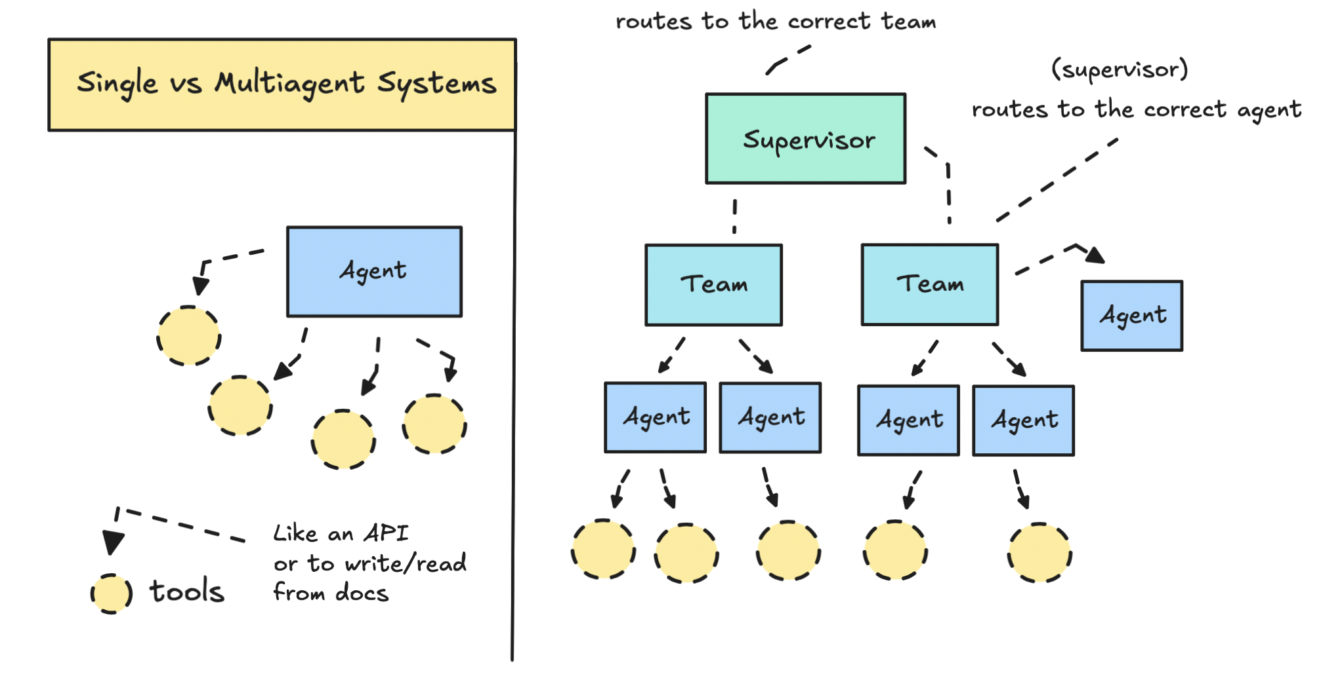
What Are Multi-Agent Systems?
Multi Agentic System
CMU Data Science Final Project
Specialization
Collaboration
Coordination
Modularity
Each agent masters a specific domain (e.g., code generation, search) rather than being a generalist.
Agents work together, sharing intermediate outputs to solve complex problems iteratively.
A supervisor or router agent orchestrates workflow, ensuring tasks flow logically.
Easy to add, modify, or replace individual agents without breaking the entire system.
Made with Genspark
Made with Genspark
Automated Data Science Workflow System
Slide 22

Slide 21

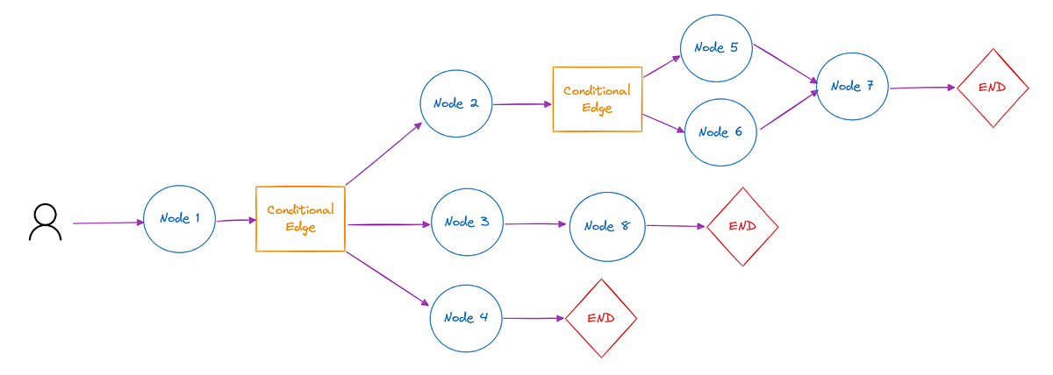




LangGraph
LangGraph Fundamentals
CMU Data Science Final Project
State
Shared data structure passed between agents. Maintains context, message history, and current artifacts across the entire workflow.
05
class
State
(TypedDict):
06
# Conversation history & context
07
messages: Sequence[BaseMessage]
08
sender:
str
09
10
# Research artifacts
11
hypothesis:
str
12
code_state:
str
13
visualization_state:
str
14
report_section:
str
15
16
# Quality control flags
17
needs_revision:
bool
18
feedback:
str
19
20
# Node function example
21
def
hypothesis_node
(state: State) -> State:
22
# Agent logic here...
23
return
{
24
"hypothesis"
: new_hypothesis,
25
"sender"
:
"hypothesis_agent"
26
}
Node
Processing unit representing an agent or function. Takes the current state as input and returns an updated state.
Edge
Connections defining workflow transitions. Can be static (fixed sequence) or conditional (routing logic).
Router
GRAPH ARCHITECTURE
Decision logic that determines the next node based on LLM output or state conditions (e.g., "If error, go to Review").
Node
State
Router
Edge
Node
Agent
Logic
Agent
Made with Genspark
Made with Genspark
Automated Data Science Workflow System
Slide 23

Slide 22
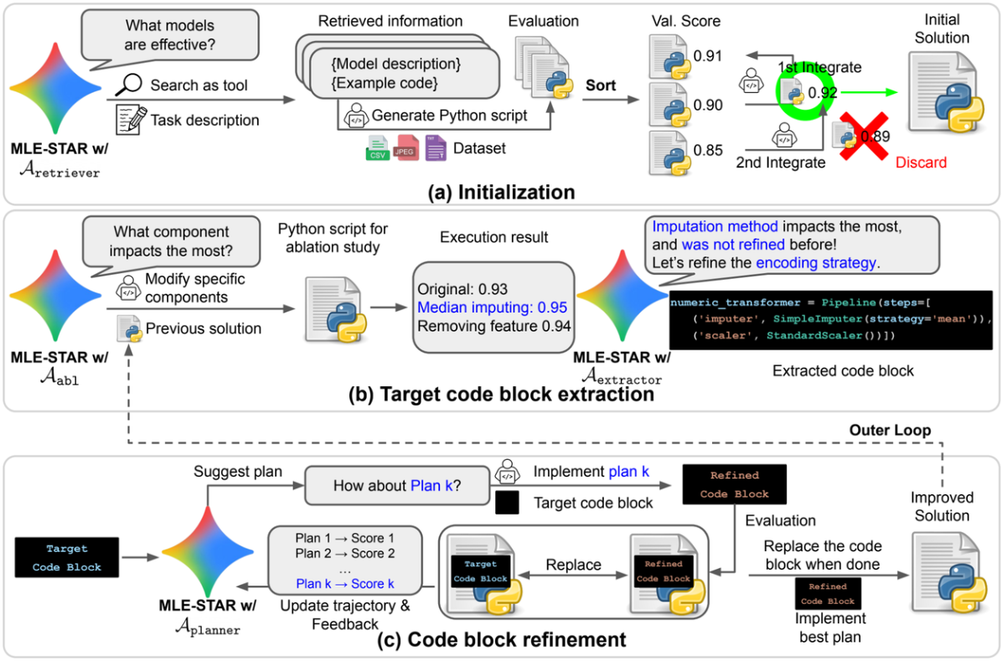
Inspiration: MLE Star
Pipeline Stage 3: PCA Decision Logic
CMU Data Science Final Project
,
):
04
scaler =
StandardScaler
()
05
numeric_df = df.select_dtypes(include=[np.number])
06
scaled_data = scaler.fit_transform(numeric_df)
07
08
# 2. Fit PCA to determine explained variance
09
pca =
PCA
()
10
pca.fit(scaled_data)
11
12
# 3. Find components needed for 95% variance
13
cumulative_variance = np.cumsum(pca.explained_variance_ratio_)
14
# np.where returns indices where condition is true
15
n_components = np.where(cumulative_variance >= cumulative_variance_threshold)[
0
][
0
] +
1
16
17
# 4. Check if reduction is significant (>10%)
18
original_dims = df.shape[
1
]
19
dim_reduction_ratio =
1
- (n_components / original_dims)
20
21
perform_pca = dim_reduction_ratio >= min_dim_reduction_ratio
22
23
return
perform_pca, n_components
24
25
# Usage Example:
26
# If original dims=10, components needed=9 -> ratio=0.1 -> PCA=True
27
# If original dims=10, components needed=10 -> ratio=0.0 -> PCA=False
https://arxiv.org/abs/2506.15692
Made with Genspark
Made with Genspark

Slide 23



03
Part 3: Multi-Agent System
CMU Data Science Final Project
My Multi-Agent System
Full intelligent orchestration with 9 specialized agents and automated quality control loops.
Specialized Experts
Iterative Refinement
Robust Validation
Made with Genspark
Made with Genspark
Automated Data Science Workflow System
Slide 26

Slide 24
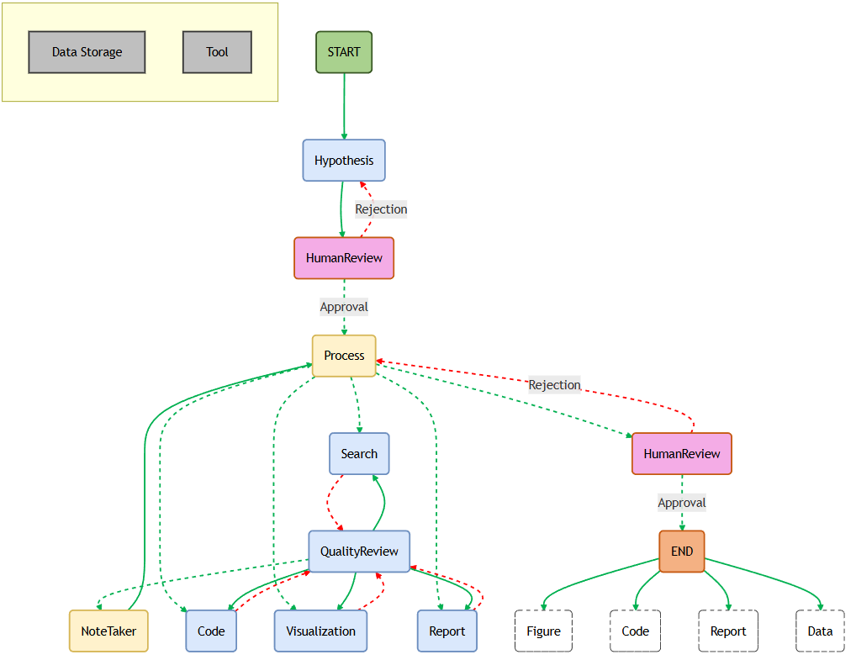
Architecture
Pipeline Stage 3: PCA Decision Logic
CMU Data Science Final Project
,
):
04
scaler =
StandardScaler
()
05
numeric_df = df.select_dtypes(include=[np.number])
06
scaled_data = scaler.fit_transform(numeric_df)
07
08
# 2. Fit PCA to determine explained variance
09
pca =
PCA
()
10
pca.fit(scaled_data)
11
12
# 3. Find components needed for 95% variance
13
cumulative_variance = np.cumsum(pca.explained_variance_ratio_)
14
# np.where returns indices where condition is true
15
n_components = np.where(cumulative_variance >= cumulative_variance_threshold)[
0
][
0
] +
1
16
17
# 4. Check if reduction is significant (>10%)
18
original_dims = df.shape[
1
]
19
dim_reduction_ratio =
1
- (n_components / original_dims)
20
21
perform_pca = dim_reduction_ratio >= min_dim_reduction_ratio
22
23
return
perform_pca, n_components
24
25
# Usage Example:
26
# If original dims=10, components needed=9 -> ratio=0.1 -> PCA=True
27
# If original dims=10, components needed=10 -> ratio=0.0 -> PCA=False
Made with Genspark
Made with Genspark

Slide 25
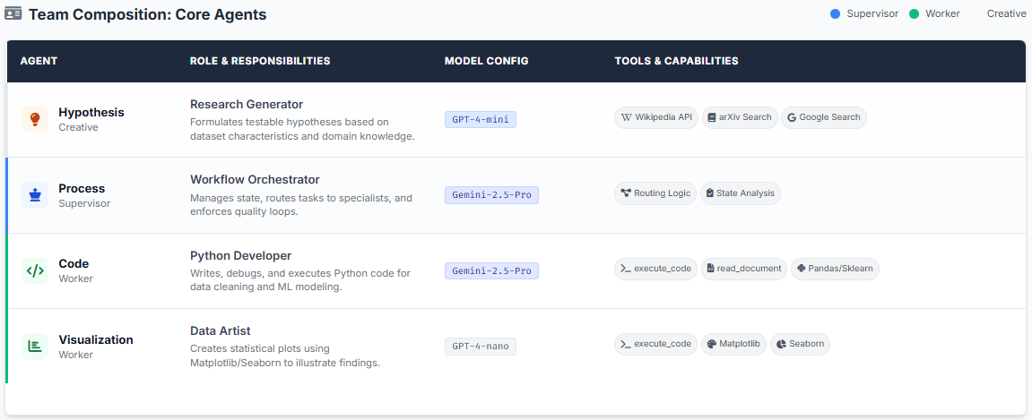
Agent Profiles: Specialists(1/2)
Pipeline Stage 3: PCA Decision Logic
CMU Data Science Final Project
,
):
04
scaler =
StandardScaler
()
05
numeric_df = df.select_dtypes(include=[np.number])
06
scaled_data = scaler.fit_transform(numeric_df)
07
08
# 2. Fit PCA to determine explained variance
09
pca =
PCA
()
10
pca.fit(scaled_data)
11
12
# 3. Find components needed for 95% variance
13
cumulative_variance = np.cumsum(pca.explained_variance_ratio_)
14
# np.where returns indices where condition is true
15
n_components = np.where(cumulative_variance >= cumulative_variance_threshold)[
0
][
0
] +
1
16
17
# 4. Check if reduction is significant (>10%)
18
original_dims = df.shape[
1
]
19
dim_reduction_ratio =
1
- (n_components / original_dims)
20
21
perform_pca = dim_reduction_ratio >= min_dim_reduction_ratio
22
23
return
perform_pca, n_components
24
25
# Usage Example:
26
# If original dims=10, components needed=9 -> ratio=0.1 -> PCA=True
27
# If original dims=10, components needed=10 -> ratio=0.0 -> PCA=False
Made with Genspark
Made with Genspark

Slide 26
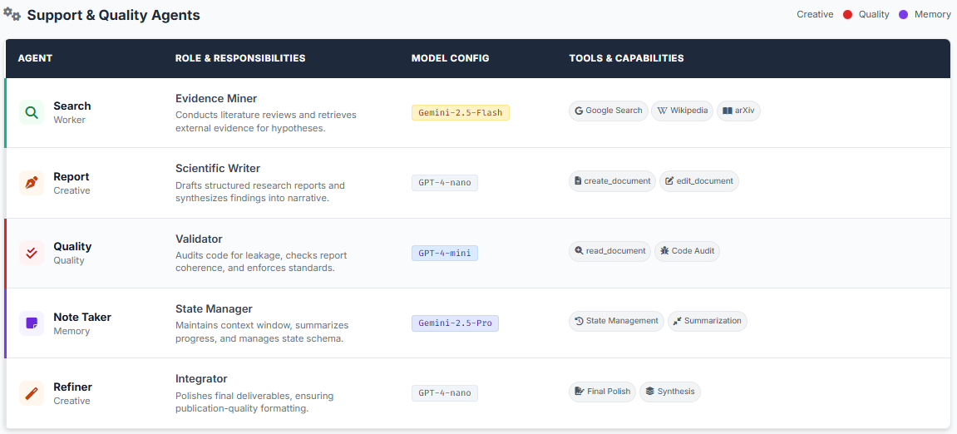
Agent Profiles: Specialists(2/2)
Pipeline Stage 3: PCA Decision Logic
CMU Data Science Final Project
,
):
04
scaler =
StandardScaler
()
05
numeric_df = df.select_dtypes(include=[np.number])
06
scaled_data = scaler.fit_transform(numeric_df)
07
08
# 2. Fit PCA to determine explained variance
09
pca =
PCA
()
10
pca.fit(scaled_data)
11
12
# 3. Find components needed for 95% variance
13
cumulative_variance = np.cumsum(pca.explained_variance_ratio_)
14
# np.where returns indices where condition is true
15
n_components = np.where(cumulative_variance >= cumulative_variance_threshold)[
0
][
0
] +
1
16
17
# 4. Check if reduction is significant (>10%)
18
original_dims = df.shape[
1
]
19
dim_reduction_ratio =
1
- (n_components / original_dims)
20
21
perform_pca = dim_reduction_ratio >= min_dim_reduction_ratio
22
23
return
perform_pca, n_components
24
25
# Usage Example:
26
# If original dims=10, components needed=9 -> ratio=0.1 -> PCA=True
27
# If original dims=10, components needed=10 -> ratio=0.0 -> PCA=False
Made with Genspark
Made with Genspark

Slide 27






Hypothesis Agent
Research Question Generation
System Prompt Excerpt
GPT-4-mini
Agent Output Example
Housing Price Analysis
As an expert in data analysis, formulate hypotheses based on the provided data.
🔬 Research Hypothesis
"Housing prices can be predicted with >85% accuracy using ensemble methods. Key predictive features include location (neighborhood), property size (GrLivArea), and age (YearBuilt)."
# Requirements:
1. Formulate precise, testable hypotheses
2. Outline steps to test hypotheses
3. Verify feasibility via literature
Proposed Approach
4. Provide supporting references
1
Feature Engineering: Transform location data and interaction terms (Size × Quality)
2
Preprocessing: Handle missing values in 'LotFrontage' and 'GarageYrBlt'
Knowledge Tools
3
Model Selection: Compare RandomForest, XGBoost, and GradientBoosting
Wikipedia API, Google, Arxiv
4
Validation: 5-fold Cross-Validation to prevent overfitting
Made with Genspark
arXiv Search
Made with Genspark
Multi-Agent System Architecture
Academic References
Slide 29
Academic papers & SOTA

Slide 28



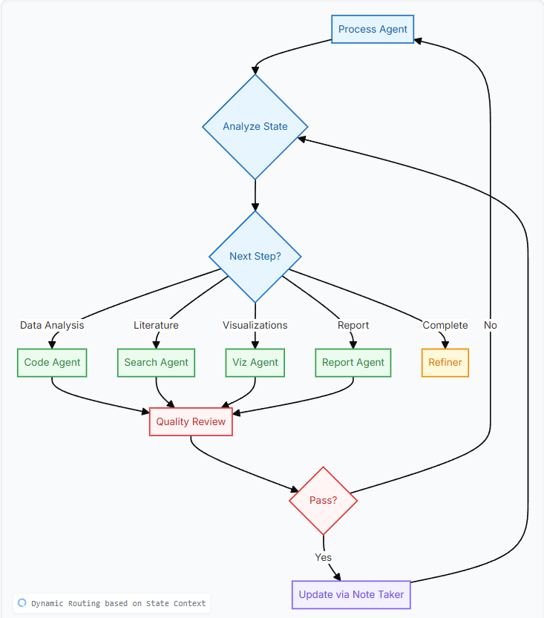



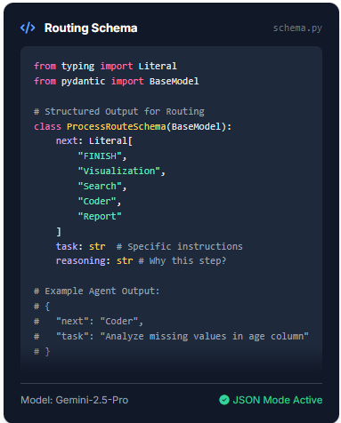
Process Agent: Supervisor
Process Agent - The Supervisor
CMU Data Science Final Project
Orchestration & Routing Logic
Workflow Flowchart
Supervisor Role
The Process Agent acts as the central brain of the multi-agent system. It doesn't execute tasks directly but intelligently delegates work based on the current research state.
Determines next optimal step
Enforces Quality Control loops
Reads context from Note Taker
Routing Schema
class
ProcessRouteSchema
(BaseModel):
next
: Literal[
"FINISH"
,
"Visualization"
,
"Search"
,
"Coder"
,
"Report"
]
task
:
str
# Specific instructions
reasoning
:
str
# Why this step?
# Example Agent Output:
# {
# "next": "Coder",
# "task": "Analyze missing values in age column"
# }
Made with Genspark
Made with Genspark
Automated Data Science Workflow System
Slide 30

Slide 29

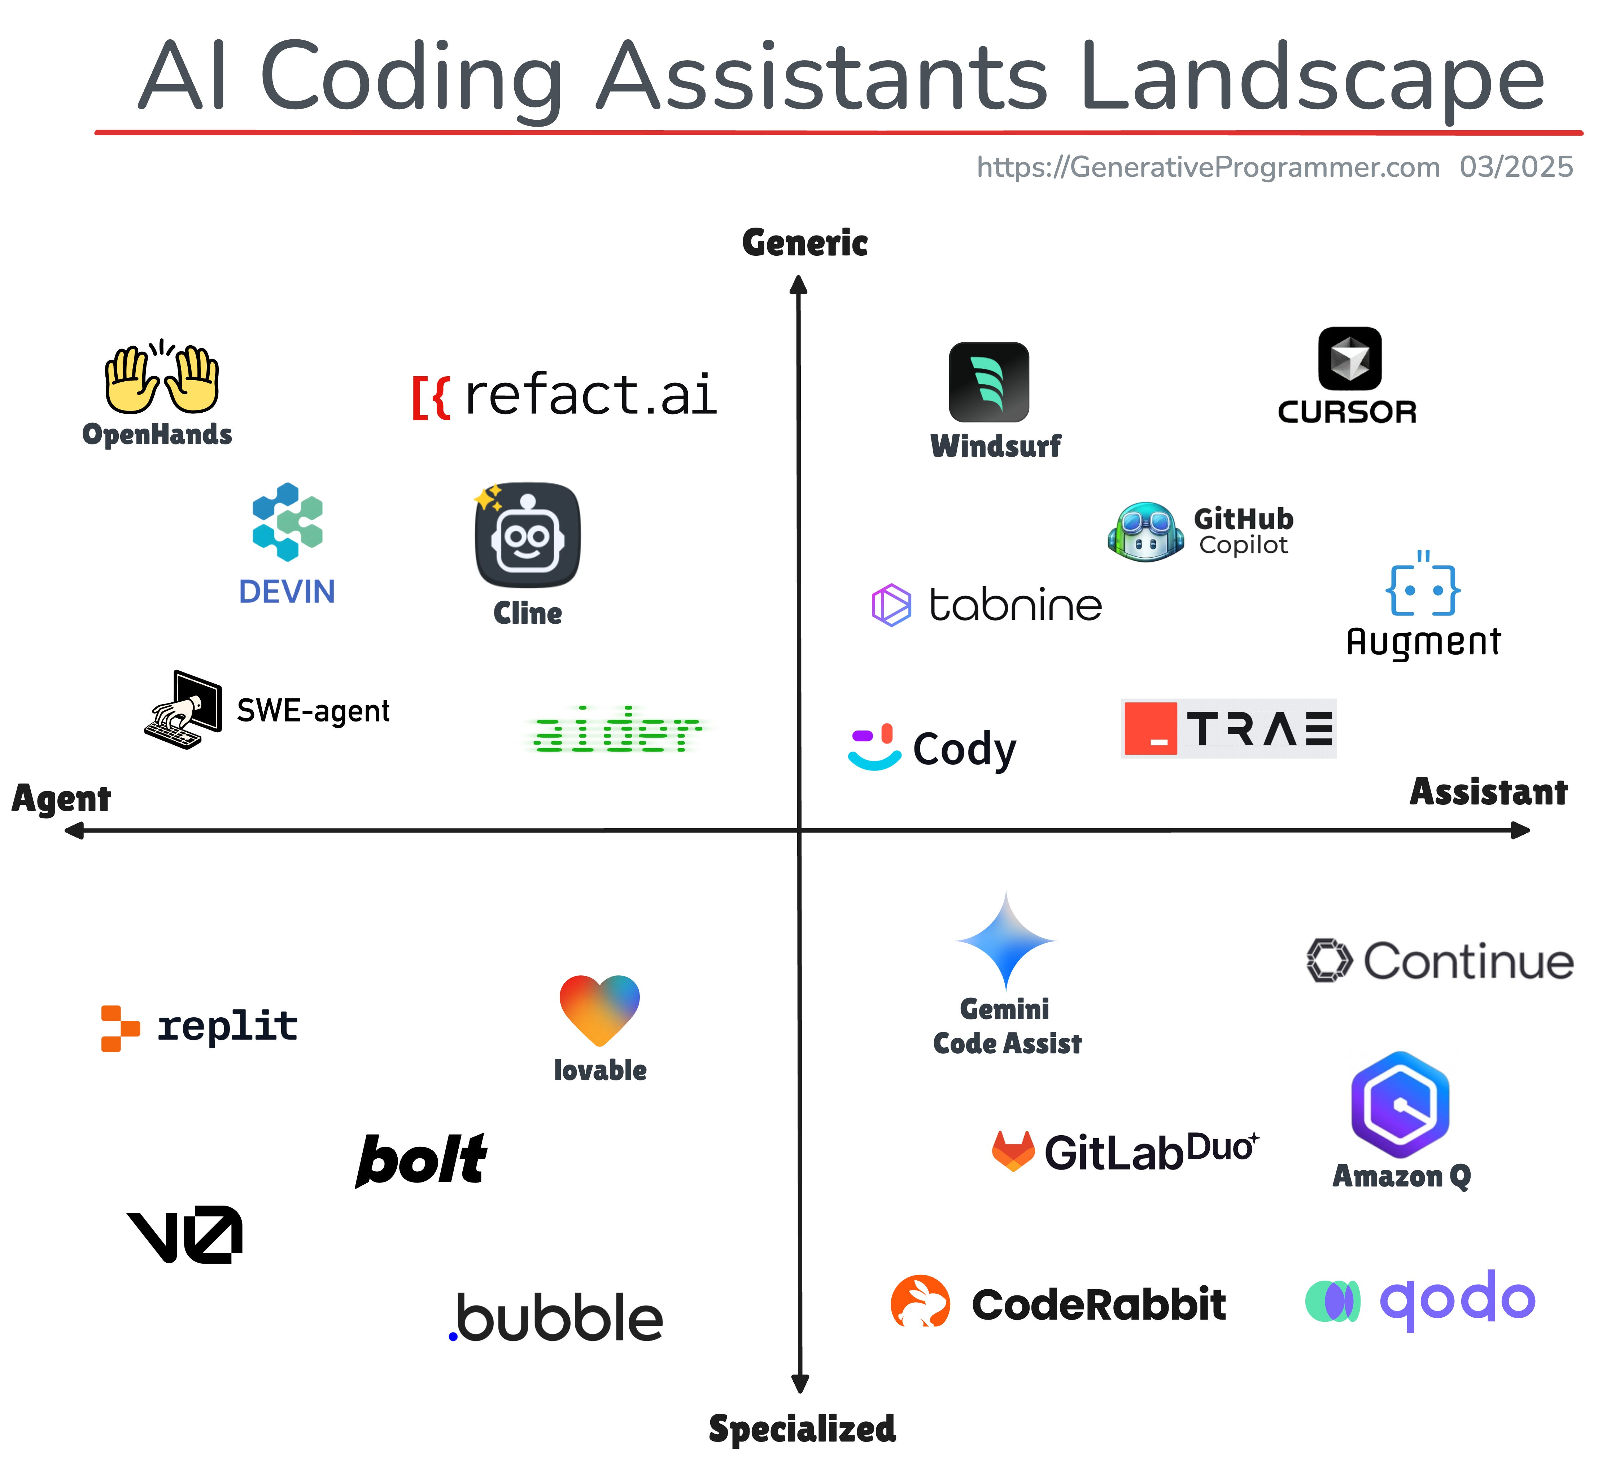





Coding Agent
Code Agent: Python Developer
CMU Data Science Final Project
Core Responsibilities
import
SimpleImputer
04
05
# Load dataset
06
df = pd.read_csv(
'./data/housing.csv'
)
07
X, y = df.drop(
'price'
, axis=1), df[
'price'
]
08
09
# 1. EARLY SPLIT - Prevents data leakage!
10
X_train, X_test, y_train, y_test = train_test_split(
11
X, y, test_size=
0.2
, random_state=
42
12
)
13
14
# 2. FIT ON TRAIN ONLY
15
# Imputer learns statistics (median) from training set only
16
imputer = SimpleImputer(strategy=
'median'
)
17
X_train_imputed = imputer.fit_transform(X_train)
18
19
# 3. TRANSFORM TEST
20
# Apply the same learned statistics to test set
21
X_test_imputed = imputer.transform(X_test)
22
23
# Save preprocessed data for next agent
24
pd.DataFrame(X_train_imputed).to_csv(
'./data/train_prep.csv'
)
25
pd.DataFrame(X_test_imputed).to_csv(
'./data/test_prep.csv'
)
26
27
print
(
"Data processing complete. Artifacts saved."
Leakage Prevention
)
Enforces strict train/test separation before any preprocessing
Clean Implementation
Writes PEP 8 compliant, readable, and modular Python code
Executable Outputs
Ensures code runs without errors in isolated environments
ML Best Practices
Handles imbalance, missing values, and encoding correctly
Anti-Leakage Protocol
The Code Agent is explicitly instructed to split data before fitting any transformers. Transformers are fit ONLY on training data, then applied to test data.
Automated Data Science Workflow System
Slide 31

Slide 30


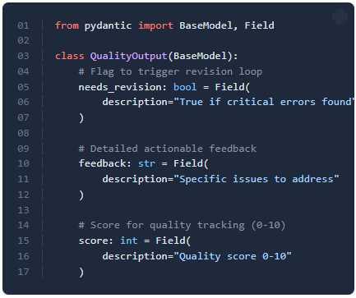




Quality Review Agent
Quality Review Agent
CMU Data Science Final Project
Output Validation System
agents/quality.py
REVISION REQUIRED
Session ID: #A892-QC
Structured validation schema ensuring rigorous quality control before outputs are accepted.
Critical Issue: Data Leakage Detected
The generated code fits the StandardScaler on the entire dataset before splitting into train/test sets. This violates the fundamental principle of keeping the test set unseen.
(BaseModel):
04
# Flag to trigger revision loop
05
needs_revision:
"True if critical errors found"
07
)
08
09
# Detailed actionable feedback
10
feedback:
str
= Field(
11
description=
"Specific issues to address"
12
)
13
14
# Score for quality tracking (0-10)
15
score:
int
= Field(
16
description=
"Quality score 0-10"
17
)
23
scaler.fit_transform(X) # BEFORE split
28
X_train, X_test = train_test_split(X) # TOO LATE
Required Corrections
Please implement the following changes to fix the leakage:
Move Splitting: Perform train_test_split before any scaling or transformation.
Fit on Train Only: Use scaler.fit_transform(X_train) to learn parameters from training data only.
Transform Test: Apply the learned scaler to test data using scaler.transform(X_test).
Validation Scope
SENDING BACK TO CODE AGENT...
Code Quality: PEP 8, Data Leakage, Error Handling
Visuals: Labels, Legends, Aspect Ratio, Color Blindness
Report: Citations, Logic Flow, Academic Tone
Made with Genspark
Made with Genspark
Automated Data Science Workflow System
Slide 32

Slide 31
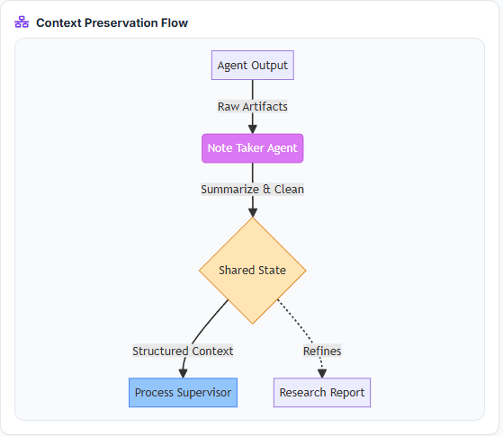

Note Taker Agent – State Management
Pipeline Stage 3: PCA Decision Logic
CMU Data Science Final Project
,
):
04
scaler =
StandardScaler
()
05
numeric_df = df.select_dtypes(include=[np.number])
06
scaled_data = scaler.fit_transform(numeric_df)
07
08
# 2. Fit PCA to determine explained variance
09
pca =
PCA
()
10
pca.fit(scaled_data)
11
12
# 3. Find components needed for 95% variance
13
cumulative_variance = np.cumsum(pca.explained_variance_ratio_)
14
# np.where returns indices where condition is true
15
n_components = np.where(cumulative_variance >= cumulative_variance_threshold)[
0
][
0
] +
1
16
17
# 4. Check if reduction is significant (>10%)
18
original_dims = df.shape[
1
]
19
dim_reduction_ratio =
1
- (n_components / original_dims)
20
21
perform_pca = dim_reduction_ratio >= min_dim_reduction_ratio
22
23
return
perform_pca, n_components
24
25
# Usage Example:
26
# If original dims=10, components needed=9 -> ratio=0.1 -> PCA=True
27
# If original dims=10, components needed=10 -> ratio=0.0 -> PCA=False
Made with Genspark
Made with Genspark

Slide 32

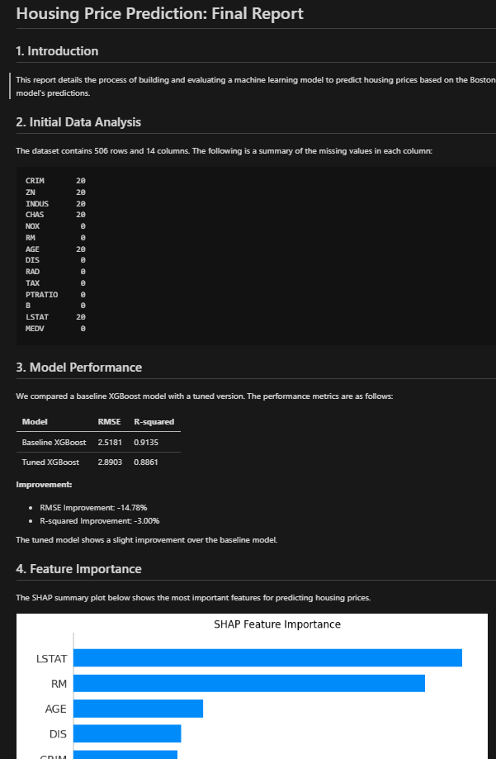

Refiner Agent: Publication
Refiner Agent - Publication Quality
CMU Data Science Final Project
Synthesis Strategy
list
glob
(
"*.md"
))
04
png_files =
list
(storage_path.
glob
(
"*.png"
))
05
06
materials = []
07
08
# 2. Read content and prepare synthesis context
09
for
md_file
in
md_files:
10
content = md_file.
read_text
()
11
materials.
append
(
f"SECTION: {md_file.name}\n{content}"
)
12
13
for
png_file
in
png_files:
14
materials.
append
(
f"IMAGE_REF: {png_file.name}"
)
15
16
# 3. Refiner agent synthesizes everything into final report
17
print
(
f"Synthesizing {len(materials)} artifacts..."
)
18
19
refined_report = agent.
invoke
({
20
"messages"
: [
21
HumanMessage
(
22
content=
f"Compile these materials into a final research report:\n{materials}"
23
)
24
]
25
})
26
27
return
{
Artifact Aggregation
"report_final"
: refined_report.content}
Scans working directory to collect all intermediate outputs (markdown reports, PNG charts)
Context Integration
Combines code, visuals, and text sections into a unified document structure
Academic Polish
Transforms fragmented agent notes into cohesive, publication-ready prose
From Fragmentation to Cohesion
Individual agents produce disjointed outputs (hypothesis, analysis code, charts). The Refiner acts as the "Editor-in-Chief", using GPT-4-nano to smooth transitions and unify the narrative voice into a final research report.
Made with Genspark
Made with Genspark
Automated Data Science Workflow System
Slide 34

Slide 33

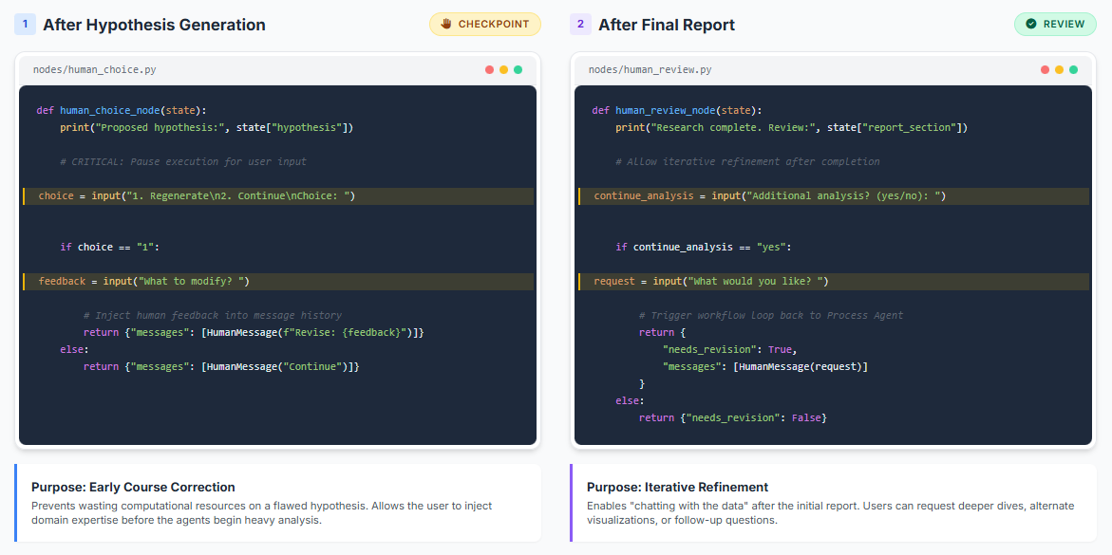




Human-in-the-Loop Integration
Human in the loop
CMU Data Science Final Project
workflow.intervention_nodes
REVIEW
(
):
(
(
):
(
, state[
"report_section"
])
# Allow iterative refinement after completion
(
=
(
)
:
:
=
(
)
input
(
)
{
return
{
"needs_revision"
:
True
,
"messages"
{
:
}
User Control
Early Correction
Feedback Loop
Slide 36
User maintains agency over critical direction
Fix misunderstandings before high-cost compute
Output quality improves with user guidance
Made with Genspark
Made with Genspark

Slide 34





04
Part 4: Results & Comparison
CMU Data Science Final Project
Results & Comparison
Evaluation of pipeline vs. multi-agent approaches across quantitative metrics and quality dimensions.
Performance Metrics
Quality Assessment
Case Study Analysis
Made with Genspark
Made with Genspark
Automated Data Science Workflow System
Slide 41

Slide 35














Approach Comparison
Approach Comparison
CMU Data Science Final Project
analysis.benchmark.pipeline_vs_agent
Phase 1: LLM Pipeline
Phase 2: Multi-Agent System
Architecture
Sequential, linear flow
Graph-based, adaptive
Decision Making
Single LLM call per stage
Collaborative, iterative
Quality Control
None (errors propagate)
Built-in review loops
Flexibility
Fixed workflow steps
Dynamic routing
Context Retention
Minimal (between stages)
Full (Note Taker agent)
Research Depth
None (analysis only)
Literature review + Hypothesis
Output Quality
Good (Standard)
Excellent (Refined/Publication)
Error Recovery
Manual intervention required
Automatic retry with feedback
Explainability
Per-stage reasoning
Complete narrative & citations
Cost / Analysis
~$0.02
~$0.10 - $0.50
Execution Time
5 - 10 minutes
15 - 30 minutes
Made with Genspark
Made with Genspark
Multi-Agent Wins: 9/11 Categories
Trade-off: Quality vs Cost/Time
Slide 42

Slide 36



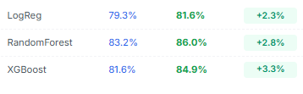


Comparison: Pipeline vs Multi-Agent
Result Comparison (Not consistent as LLM based techniques)
CMU Data Science Final Project
analysis.quantitative_results.all_datasets
Lung Cancer
+3.8% avg
Iris Flowers
Perfect
Titanic
+2.8% avg
Classification (Accuracy)
Classification (Accuracy)
Classification (Accuracy)
Model
Pipeline
Agent
Lift
Model
Pipeline
Agent
Lift
Model
Pipeline
Agent
Lift
LogReg
88.5%
95.1%
+6.6%
LogReg
100%
100%
-
81.6%
+2.3%
RandomForest
90.2%
96.7%
+6.5%
RandomForest
100%
100%
-
RandomForest
83.2%
86.0%
+2.8%
XGBoost
93.4%
97.2%
+3.8%
XGBoost
96.7%
100%
+3.3%
XGBoost
81.6%
84.9%
+3.3%
Wine Quality
+4.1% avg
Housing Data
+0.08 avg
Classification (Accuracy)
Regression (R² Score)
Model
Pipeline
Agent
Lift
Model
Pipeline
Agent
Lift
LogReg
58.5%
61.1%
+2.6%
LinearReg
0.68
0.78
+0.10
RandomForest
67.2%
71.6%
+4.4%
RandomForest
0.87
0.91
+0.04
XGBoost
64.6%
69.0%
+4.4%
XGBoost
0.89
0.93
+0.04
Pipeline
Multi-Agent
Multi-Agent System consistently outperforms Pipeline approach across all datasets and model types
Slide 43

Slide 37





Multi-Agent System: Detailed Results
Multi Agent Approach: Results
CMU Data Science Final Project
+8.2% Avg
Quality
Research
Robust
Output Quality
Publication Ready
Accuracy Boost
Report Completeness
Hypothesis Quality
Code Quality
Better feature engineering & selection.
18-35 academic citations per report.
Context-aware scientific formulation.
Leakage prevention via expert review.
Citations per Report
18-35 sources
Context Retention
50+ interactions
Enhanced Performance Metrics (5 Datasets)
Code Reliability
95% Pass Rate
Dataset
Metric
Logistic Reg.
Random Forest
XGBoost
Multi-agent collaboration produces depth comparable to expert analysis.
Survey Lung Cancer
Accuracy
95.1%
96.7%
97.2%
Significant Boost
F1 Score
0.82
0.85
0.91
AUC
0.97
0.98
0.99
Iris Flowers
Accuracy
100%
100%
100%
Perfect Score
F1 Score
1.0
1.0
1.0
Titanic
Accuracy
81.6%
86.0%
84.9%
Better Imputation
Comparison
+2.3% vs Pipe
+2.8% vs Pipe
+3.3% vs Pipe
WineQT
Accuracy
61.1%
71.6%
69.0%
Complex Feature Eng.
Comparison
+2.6% vs Pipe
+4.4% vs Pipe
+4.4% vs Pipe
Housing Data
R² Score
0.78
0.91
0.93
Regression Task
RMSE
4.2
2.8
2.5
Automated Data Science Workflow System
Slide 44

Slide 38










Qualitative Assessment: Report Quality
Report QUality
CMU Data Science Final Project
evaluation.output.report_structure
Structure & Content Comparison
Output Quality
SECTION
PIPELINE APPROACH
MULTI-AGENT SYSTEM
Pipeline Report
Introduction
Basic problem statement only
Contextualized
Analysis Results
Includes lit review context
The model achieved an accuracy of 96%. The confusion matrix shows...
Hypothesis
None
Well-Researched
Testable & specific
[Auto-Generated Plot]
Methodology
List of tools used
Justified Choices
Explains "Why this model?"
Multi-Agent Report
PUBLICATION READY
Results
Raw metrics tables
Metrics + Interpretation
Predicting Housing Prices: A Machine Learning Approach
Analysis of findings
Abstract: Recent studies (Smith et al. 2023) demonstrate ensemble methods...
Visuals
Auto-generated plots
Designed & Captioned
1. Introduction
Context-aware charts
The real estate market's complexity necessitates advanced predictive models...
Discussion
None
Synthesized
Fig 1. Feature Importance Distribution
Relates back to hypothesis
References
None
Comprehensive
15-30 academic sources
Made with Genspark
Made with Genspark
7/7 Sections Improved
Academic Standard Met
Slide 44

Slide 39

















Challenges & Solutions
Challenges and solutions
CMU Data Science Final Project
project.retrospective.issues
LLM Hallucination
Cross-Validation & Quality Review
Inventing non-existent references
Validation via multiple sources & specialized agent
JSON Parsing Failures
Robust Parsing & Retry
Invalid format crashing pipelines
Regex extraction + auto-retry mechanism
Token Limits Exceeded
History Trimming & Summarization
Long context windows overflowing
Selective context retention + Note Taker summaries
Inconsistent Code Quality
Review Loops & Standards
Subtle bugs and style violations
Standardized prompts + iterative code review
Cost Management
Strategic Model Selection
Expensive GPT-4 calls adding up
Tiered models (GPT-4-mini vs GPT-4-Turbo)
Slow Execution
Parallelism & Caching
Challenges and solutions
Sequential processing bottlenecks
Future parallel agents + result caching
Tool Call Failures
Error Handling Strategies
API timeouts or errors
Comprehensive try-catch blocks & fallbacks
Made with Genspark
Made with Genspark
7 Major Challenges Addressed
Robust Production System
Slide 48

Slide 40




05
Part 5: Conclusions & Future Work
CMU Data Science Final Project
Conclusions & Future Work
Summary of contributions, validation results, and strategic next steps for the research.
Key Findings
Roadmap Ahead
Broader Impact
Made with Genspark
Made with Genspark
Automated Data Science Workflow System
Slide 49

Slide 41












Limitations & Future Work
Improvements
CMU Data Science Final Project
project.roadmap.v2
CURRENT CONSTRAINTS
FUTURE ENHANCEMENTS
Performance Overhead
ENHANCEMENT AREA
PLANNED IMPROVEMENT
IMPACT
STATUS
Multi-agent system significantly slower than pipeline approach.
Speed
Parallel Agent Execution
3x Latency Reduction
In Dev
15-30 mins
High Cost
Run Coding, Search, and Viz agents concurrently
Scope
Expanded Data Support
Universal Applicability
Planned
Data Scope
Pipelines for Time Series, NLP, and Computer Vision
Currently optimized for structured tabular data (CSV) only.
Intelligence
Meta-Learning Optimizer
Self-Improving Core
Planned
Agents learn from past analysis mistakes
Time Series
NLP
<100k Rows
Collaboration
Multi-User Teams
Lab Integration
Q3 2025
Shared state for human researchers + AI agents
Customization
Fixed agent workflow graph limits user intervention.
Cloud API & IDE Plugins
Developer Adoption
Deployment
Jupyter Notebook & VS Code extensions
Q4 2025
Limited algorithm hyperparameter tuning
Cannot swap agent roles dynamically
Made with Genspark
Made with Genspark
Roadmap Version 2.0
Next Release: Jan 2026
Slide 51

Slide 42







Contact Information
Get in touch or explore the code
Thank
EMAIL
You
anuragkj@andrew.cmu.edu
GITHUB
github.com/anuragkj/DS_Final_Project
Anurag Kumar Jha
DOCUMENTATION
Data Science Final Project
anuragkj.github.io/project-docs
Carnegie Mellon University
Acknowledgments
Special thanks to our supporters
Professor Leo for guidance and feedback throughout the research process.
Questions?
CMU Data Science Program for providing computational resources and academic support.
Happy to discuss methodology, architecture,
or implementation details.
Open Source Community especially the teams behind LangChain, LangGraph, and OpenAI for their transformative tools.
Made with Genspark
Made with Genspark
Automated Data Science Workflow System
Slide 55

