Slide 1


Design and Simulation of an Automatic Street Light Control System Using Combinational Logic
Presented by
M Sai Vidyanandh 260030579
V Sai Spoorthi 2620030569
V pranathi 2620030670
G Bharath 2620030574
G manideep 2620090053

Slide 2
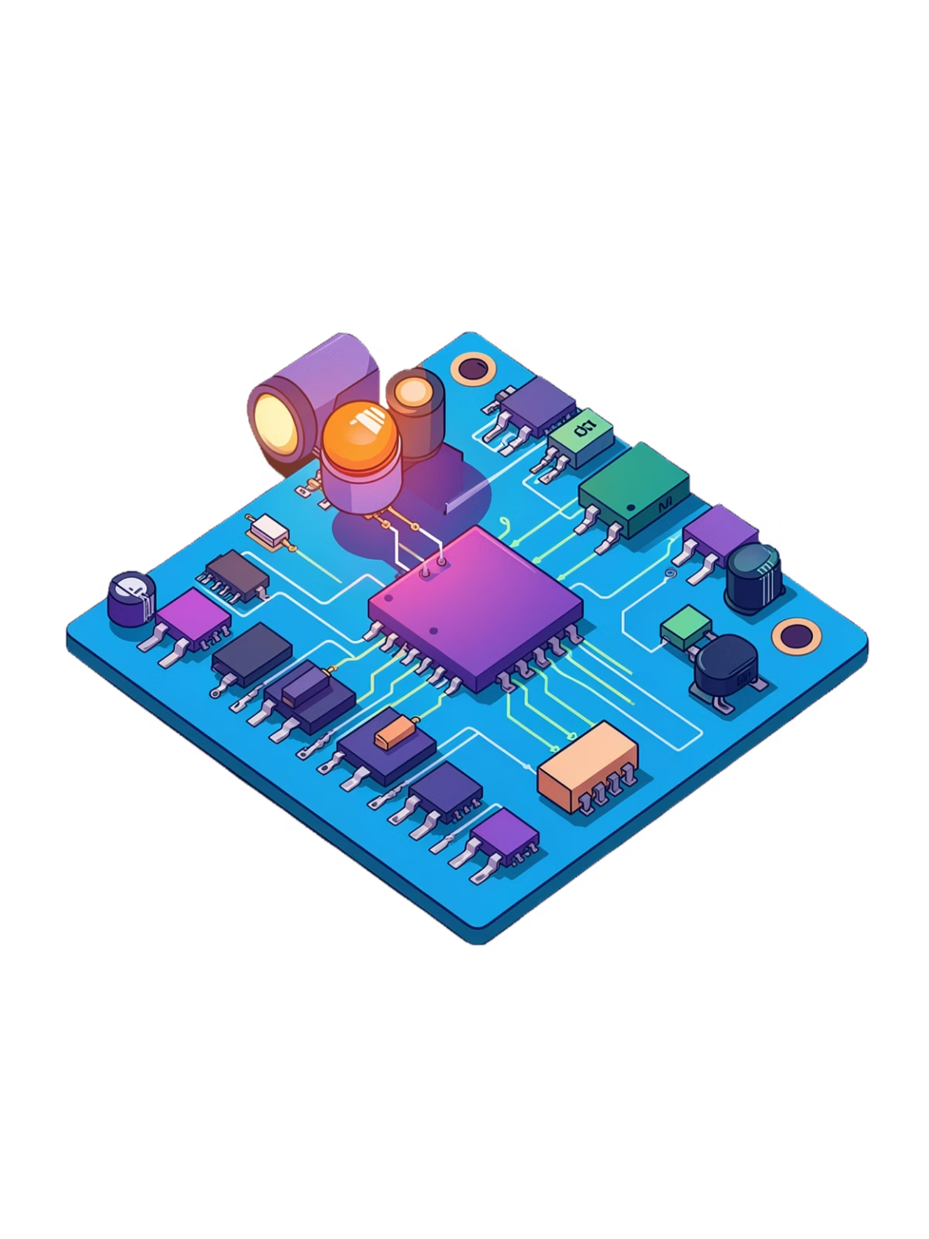
Abstract
Concept
Inputs
Automatic street light control using combinational logic gates to reduce energy waste
Ambient light intensity (LDR) and motion detection drive the control signal
Tool
Impact
Designed and simulated in Logisim using AND, OR, and NOT logic gates
40–50% energy savings compared to manual control systems

Slide 3
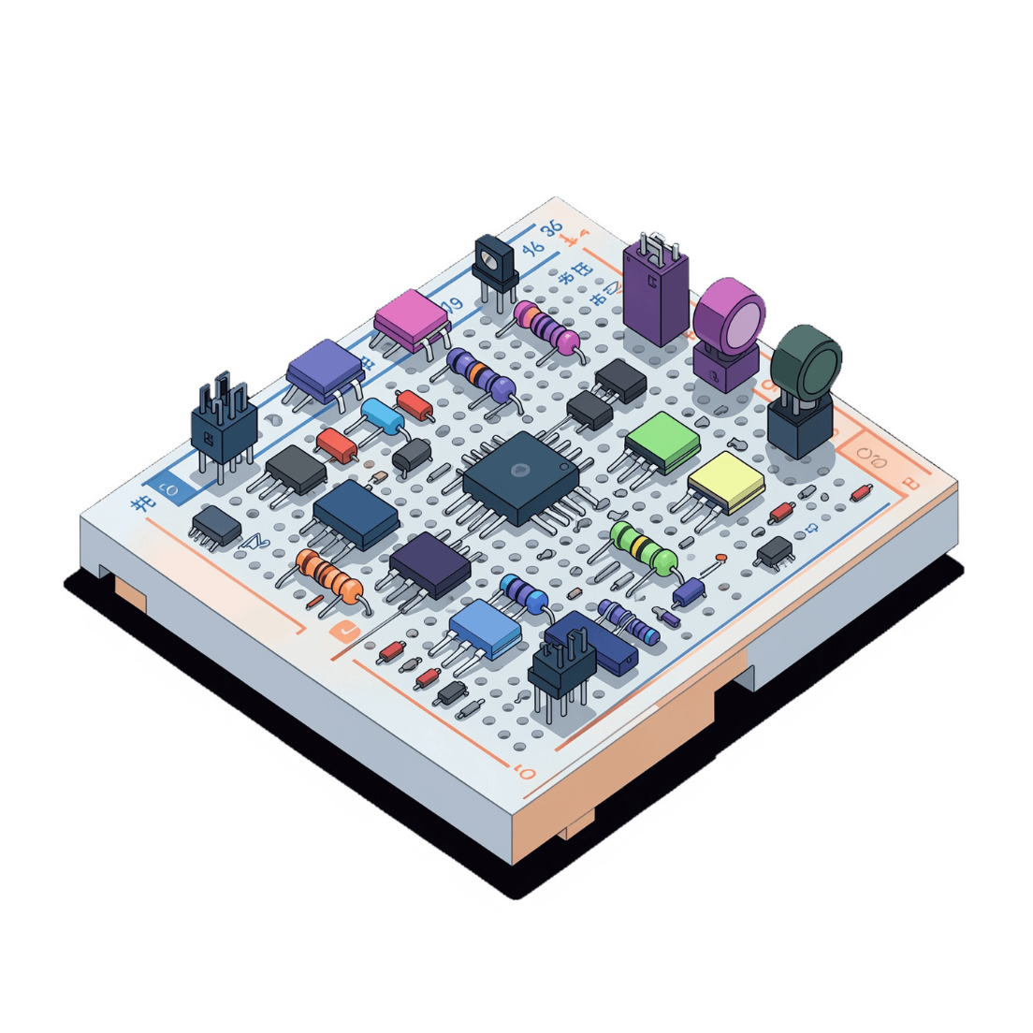
Hardware and Software Requirements
Simulation Tools
Logisim — digital circuit design and simulation
Hardware Components
Logic gates: AND, OR, NOT, NAND
LDR sensor and motion sensor
LED indicator and relay module
Breadboard, jumper wires, resistors, capacitors
Power Supply
5V DC for logic circuits
12V DC for street light load

Slide 4
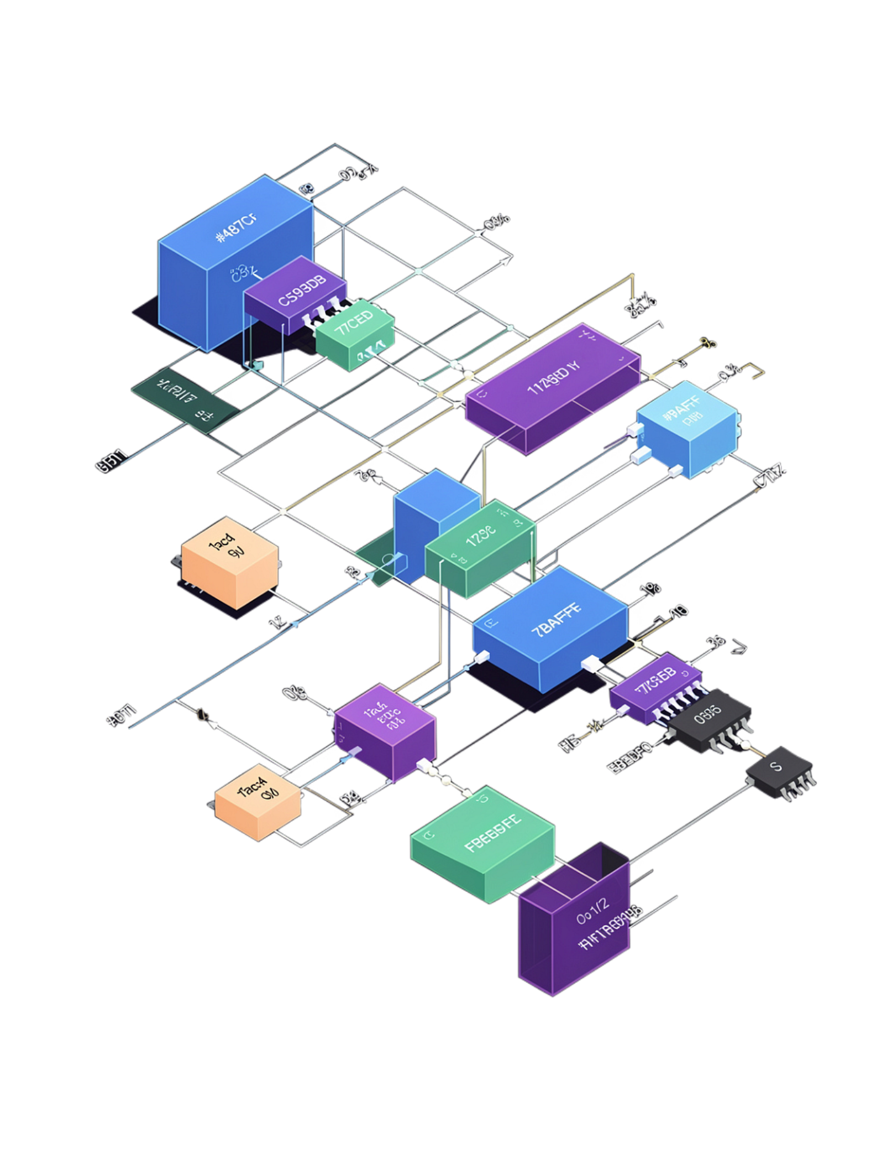
CHAPTER 1
Design and Implementation
Exploring the system architecture, truth table, and Logisim circuit design.

Slide 5
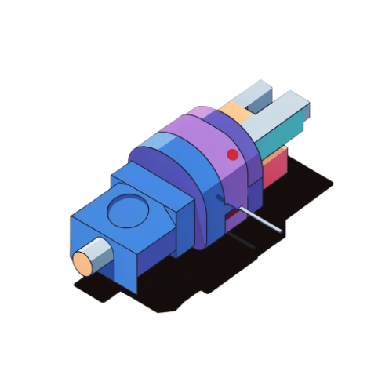

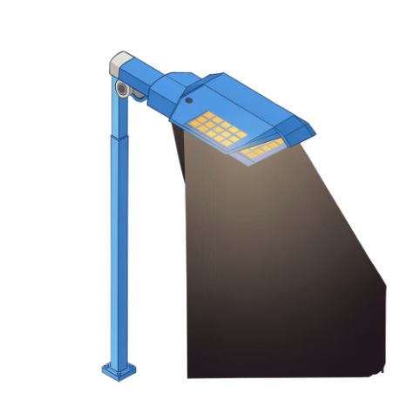
System Overview and Inputs
Light Sensor
Motion Sensor
Output Signal
Detects ambient light intensity
Detects vehicle or pedestrian movement
Street light control signal
Outputs 1 when dark
Outputs 0 when bright
1 = Light ON
0 = Light OFF
Outputs 1 when motion detected
Outputs 0 when idle

Slide 6
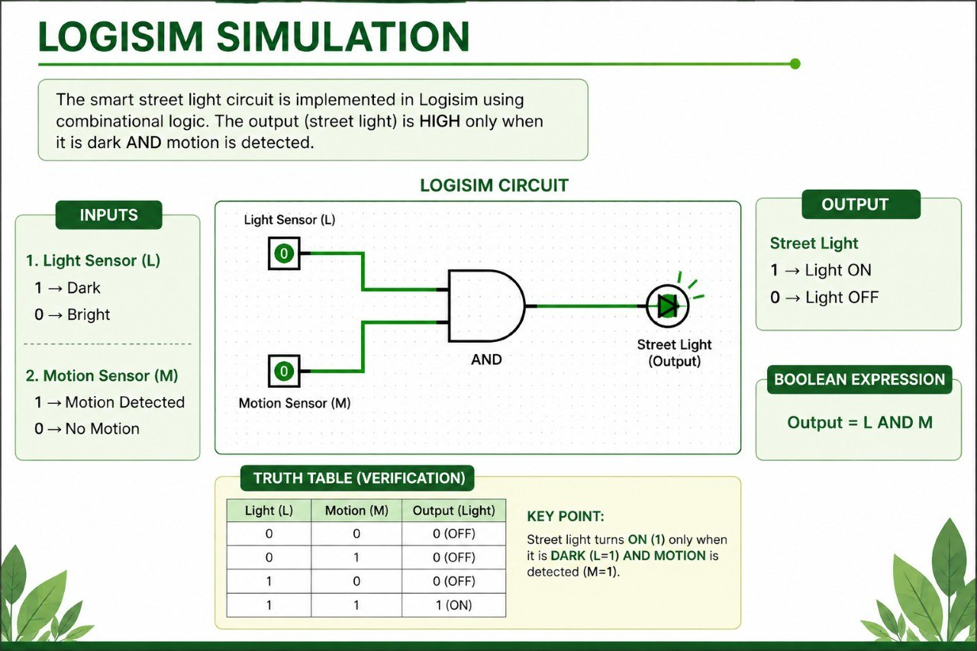

Slide 7

Truth Table and Boolean Logic
Light sencor | Motion | Output (Light)
0 | 0 | 0 — OFF
0 | 1 | 0 — OFF
1 | 0 | 0 — OFF
1 | 1 | 1 — ON
Key Conditions
Light turns ON only when dark AND motion is detected
Light stays OFF when bright, regardless of motion
Light stays OFF at night when no motion is present
Boolean Expression: Output = LDR AND Motion

Slide 8

Circuit Design in Logisim
Implementation Steps
1
Motion Input
Motion sensor connected to AND gate (positive logic)
2
AND Gate Output
LDR Input
AND Gate
Relay Module
Street Light
Drives the relay module to control the street light
3
LED Indicator
Visual status indicator for light state in simulation

Slide 9



Working Principle
Day Mode
Night — No Motion
Night — Motion Detected
LDR = 0 (bright)
AND output = 0
Light stays OFF
LDR = 1, Motion = 0
AND output = 0
Light stays OFF
LDR = 1, Motion = 1
AND output = 1
Light turns ON ✅

Slide 10

CHAPTER 2
Results and Testing
Verifying all test cases, measuring performance, and confirming energy efficiency outcomes.

Slide 11
Simulation Results
4
<1ms
50%
Test Cases
Response Time
Energy Saved
All verified in Logisim simulation
Combinational logic, zero propagation delay
Compared to always-on manual systems
Power Consumption Breakdown
Component | Power
Logic Circuit | 50 mW
LED Street Light Load | 60 W

