Slide 1
Data Visualization Project Final Update

Slide 2
Effective Use of Textual Queues to Find Shift in Political Views of Indian Voters
BY: Anurag Kumar,
Likith Narukurthi,
Satyaki Roy Chowdury

Slide 3
Problem Statement
The main purpose of this project is to investigate different types of textual queues and their visualization on visualization of data when used in chart – caption pairs related to Indian Elections from 1977 to 2019.
Here we try to find out which type of textual queue could help a larger group of people and what type of information should they hold. Eg: Captions, Titles, Annotations, etc.

Slide 4
Data Set
Links
https://www.kaggle.com/datasets/awadhi123/indian-election-dataset?resource=download
https://www.kaggle.com/datasets/rachittechnology/2019-indian-general-electio

Slide 5
Plan of Action
Clean and combine the useful aspects of the datasets. (Completed)
Perform basic EDA to get an understanding and create charts. (Completed)
Produce Chart – Caption pairs for a human study to understand the effectiveness of the textual queues to conduct an evaluation.(In-Progress)

Slide 6
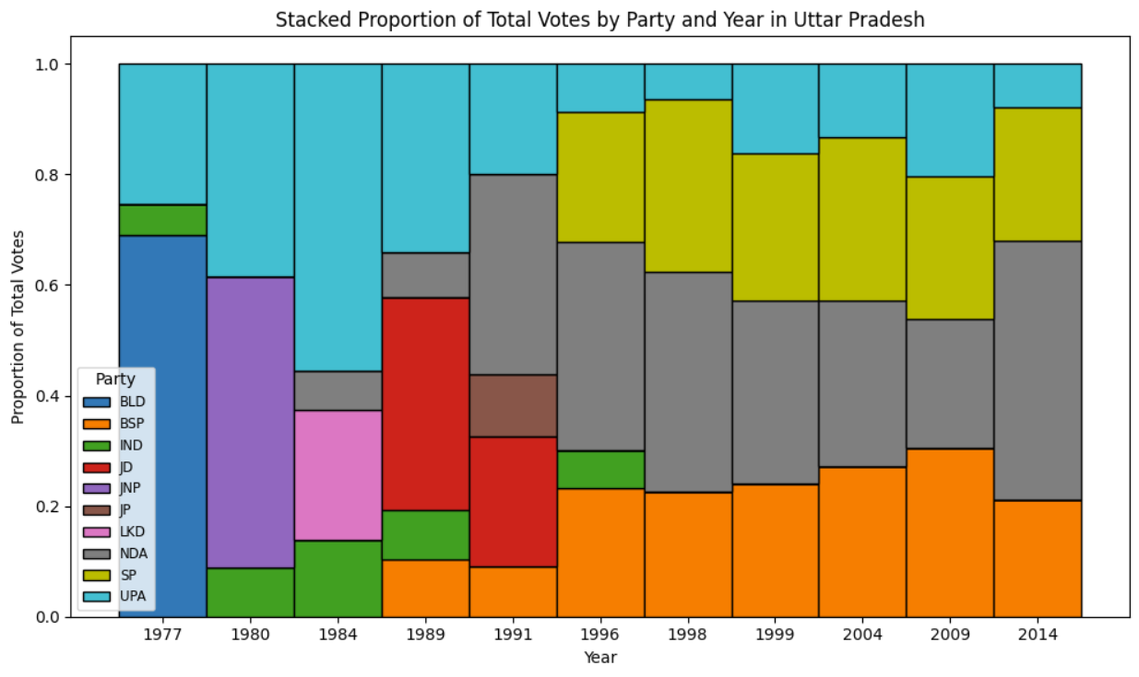
Experimental Design and Evaluation
Check the degree of effect the caption has on the understanding of the chart.
We intend to study this by conducting 3 experiments:
Show a labeled graph without caption on a certain political trend and ask to predict the trend on a different chart.
Show a labeled graph with a caption on certain political trend and ask to predict the trend on a different chart.
Show a labeled graph with a wrong caption on certain political trend and ask to predict the trend on a different chart.
We want to study the how often people are wrong in predicting the trend.

Slide 7
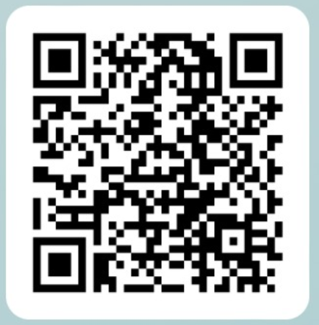
Evaluation Survey Form
Please fill
in the form.

Slide 8
References
M. A. Hearst. Show it or tell it? text, visualization, and their combination. Commun. ACM, 66(10):68–75, sep 2023. doi: 10.1145/3593580
D. H. Kim, S. Choi, J. Kim, V. Setlur, and M. Agrawala. Emphasis-checker: A tool for guiding chart and caption emphasis. IEEE Transactions on Visualization and Computer Graphics, 30(1):120–130, Jan.2024. doi: 10.1109/tvcg.2023.3327150
D. H. Kim, V. Setlur, and M. Agrawala. Towards understanding how readers integrate charts and captions: A case study with line charts. In Proceedings of the 2021 CHI Conference on Human Factors in Computing Systems, CHI ’21. ACM, May 2021. doi: 10.1145/3411764. 3445443
A. Lundgard and A. Satyanarayan. Accessible Visualization via Natural Language Descriptions: A Four-Level Model of Semantic Content. IEEE Transactions on Visualization & Computer Graphics (Proc. IEEE VIS), 2022. doi: 10.1109/TVCG.2021.3114770

