Slide 1
HAREMADHAV

Slide 2
TANKCODERS(Team No. 42)
NIKHIL CHANDWANI , ANURAG KUSHWAHA, NEELESH GUPTA , KAMLESH MANI BHAIRAM

Slide 3
Problem Statement
Simple E-commers Inventory Management-Microsoft Azure

Slide 4
Solution Statement
Our e-commerce platform is designed to provide a user-friendly and cost-effective solution for local vendors looking to expand their reach and increase sales through online channels. By creating a virtual marketplace that brings together a wide variety of local businesses and their products, we aim to offer consumers a one-stop-shop for all their needs while supporting the growth and success of local businesses . Our platform will provide vendors with an easy-to-use interface that allows them to list their products, manage their inventory, and fulfill orders seamlessly. We will also provide marketing and promotional tools to help vendors increase visibility and drive sales, such as targeted advertising and email campaigns . To ensure the highest level of customer satisfaction, we will implement a secure and reliable payment system and offer fast and reliable shipping options. By providing a convenient and reliable online shopping experience for both vendors and customers, we believe our e-commerce platform will help drive economic growth and support the local community.

Slide 5
Tech Stacks
DOT NET
PHP
MYSQL
C sharp
.

Slide 6
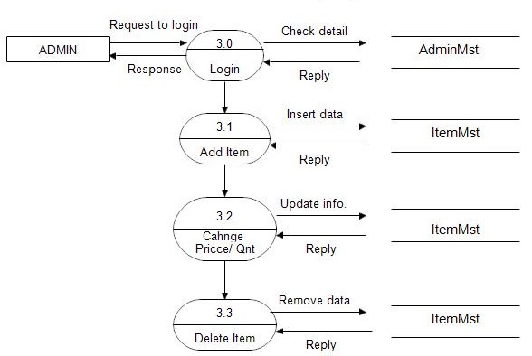
Data Flow Daigram
.

Slide 7
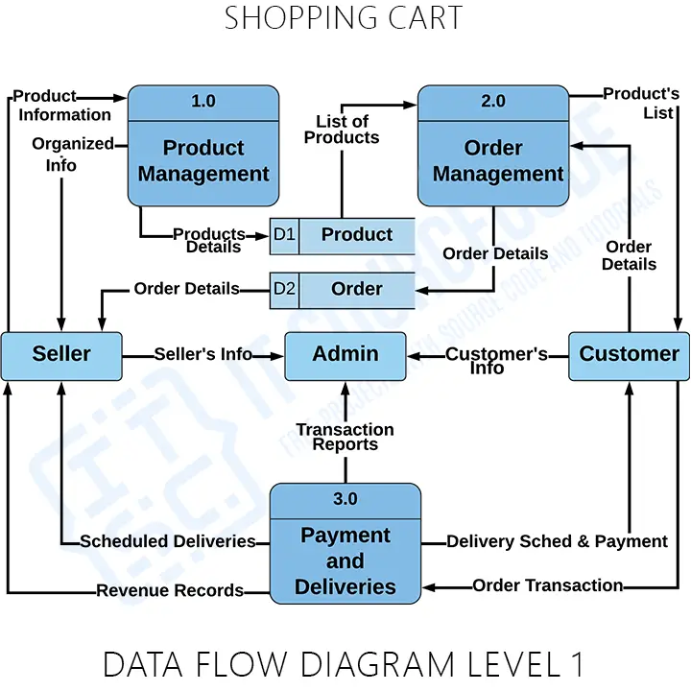
DFD-2
.

Slide 8
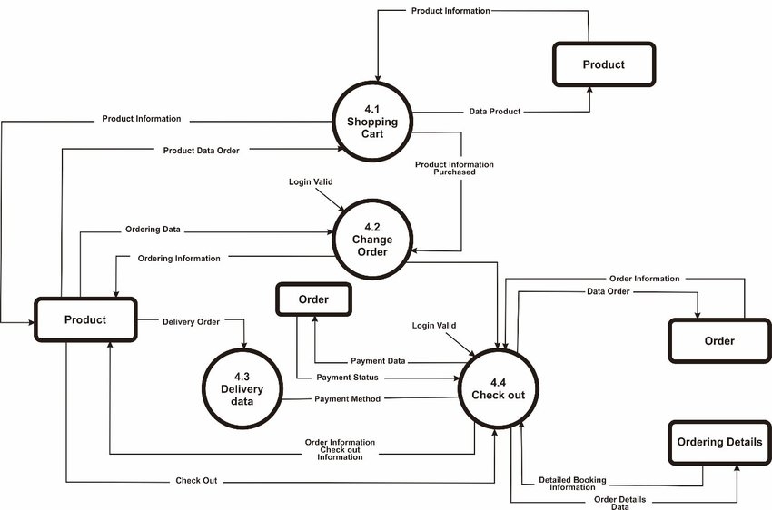
DFD-3
.

Slide 9
Future Scope of the project
The future of e-commerce websites looks very promising. With the increasing trend of online shopping, the e-commerce industry is expected to grow exponentially in the coming years.
AR and VR technologies can be used by our e-commerce websites to allow customers to preview products in a more immersive way.
As customers become more demanding, same-day delivery is likely to become the norm rather than the exception. E-commerce websites will need to partner with logistics providers to offer faster and more efficient delivery options.
Further we will go for an mobile application using flutter..

