Slide 1

“A Study to predict Heart Diseases and the factors causing them”

Slide 2

BANA 6620 GROUP PROJECT 1. Ruthvik Reddy P 2. Namratha Reddy K 3. Vaishnavi Yeluri 4. Anurag Lahon

Slide 3
Overview of the Dataset
Python Packages
Handling missing data
Data Understanding and EDA
Feature Selection
Modeling and Evaluation

Slide 4

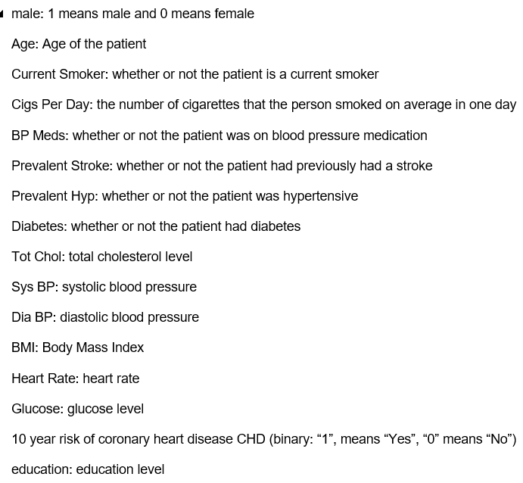
Data Set
The dataset provides the patients’ information.
The classification goal is to predict whether the patient has 10-year risk of future coronary heart disease (CHD).
4238 rows and 16 columns.
Each attribute variable is a potential risk factor. There are both demographic, behavioral and medical risk factors.
Source : https://www.kaggle.com/

Slide 5
Python Packages
Pandas
Numpy
Seaborn
Matplotlib
Scikit-learn
Statsmodels
Plotnine

Slide 6
Handling Missing Data
There are missing values in education, cigsPerDay , BPMeds , totChol , BMI, heartrate, glucose columns.
Filling the missing values with foreward and backward fill.
Forward filling means fill missing values with previous data. Backward filling means fill missing values with next data point.
Not using the mean for missing value as there are categorical features which can’t take the mean.

Slide 7
Data Understanding and EDA
Categorical columns: male,education,currentSmoker,BPMeds,prevalentsStroke,prevalentHyp,diabetes and TenYearCHD.
Quantitative columns: age, cigsPerDay, totChol, sysBP, diaBP, BMI, heartrate and glucose.
TenYearCHD is the response variable while other features are predicator variable.

Slide 8

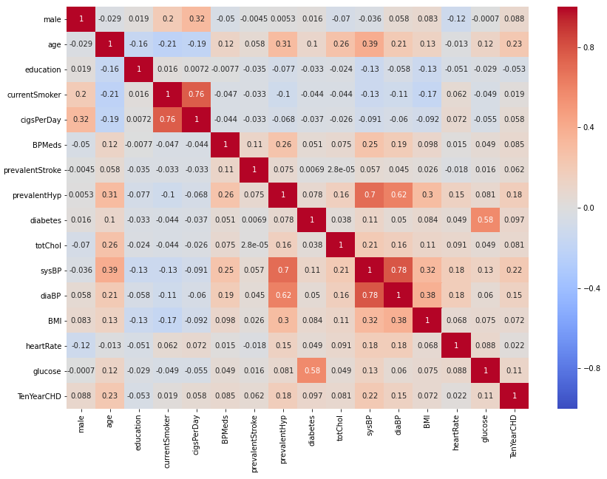



Correlation
Data Understanding and EDA

Slide 9
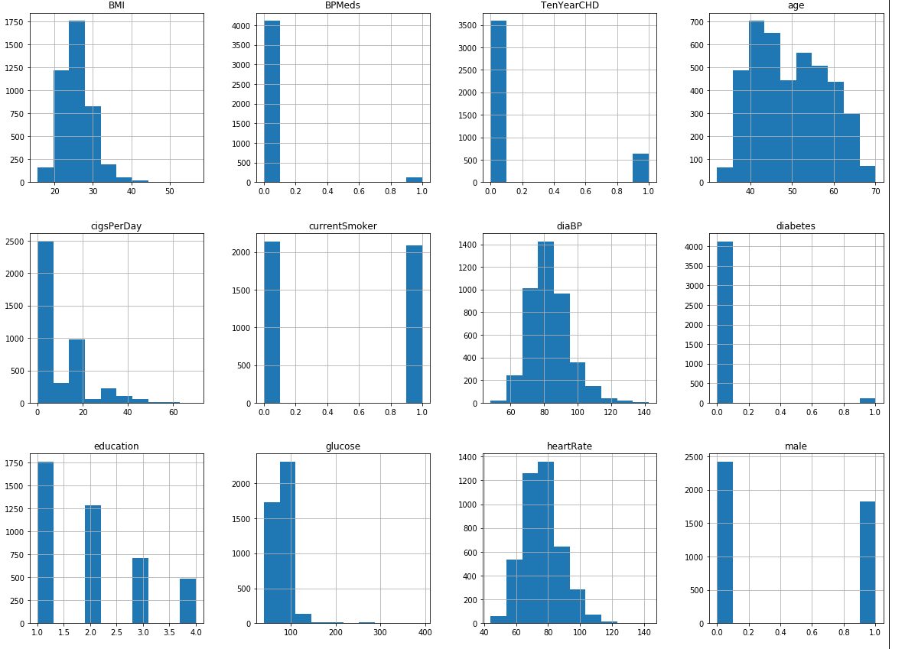
Histogram of the data:
Data Understanding and EDA

Slide 10
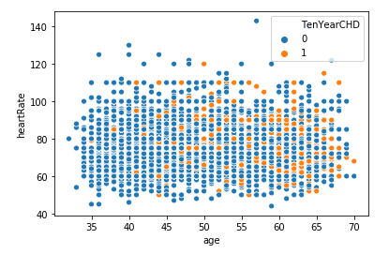
Scatter plot between Age and heart Rate: Maximum number of heart diseases are found in age group above 50 years.
Data Understanding and EDA

Slide 11
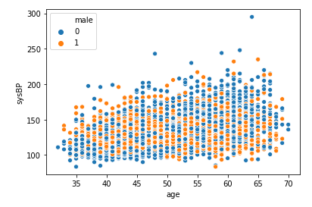
Scatter plot between age and sysBP with hue as male: Men tend to have high systolic blood pressure (above 190). thus, it is possible that men are more likely to get heart disease.
Data Understanding and EDA

Slide 12
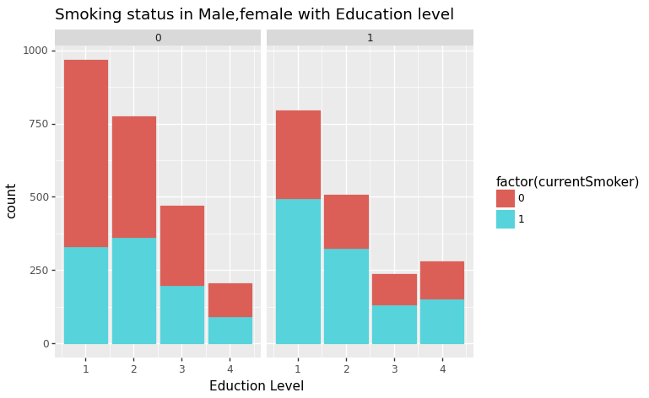
Education and smoking habit: The trend in male and female are slightly different. In male, low-level of education have higher number of smokers as compared to female. The number of smokers decreases as the level of education increases.
Data Understanding and EDA

Slide 13
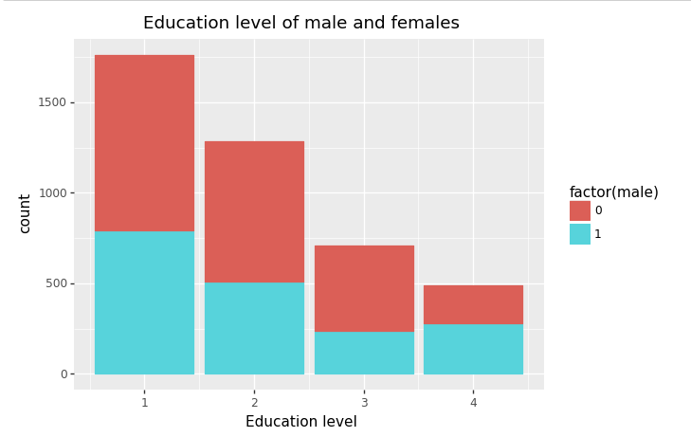
Smoking habits with Education level and male, female:
Almost all the categories of education level have same level of both the genders except level 3.
Data Understanding and EDA

Slide 14
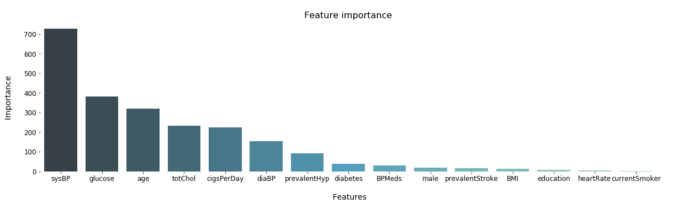
Feature Selection: Selecting the top 10 features for our modelling.

Slide 15
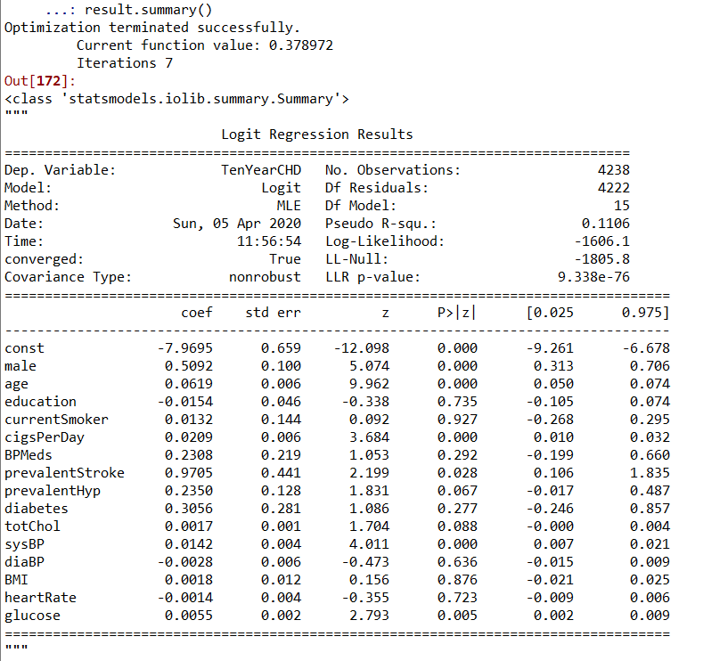
Results of the Statistical Logit Model on all the features

Slide 16
Training and Testing Data set
Eliminate unwanted columns.
Choosing top 10 important features.
We have divided the data into testing data and training data in the ratio of 20:80. Our training dataset consists of 3390 rows and 10 most important and relevant features while our testing dataset consists of 848 rows with the most important features.

Slide 17
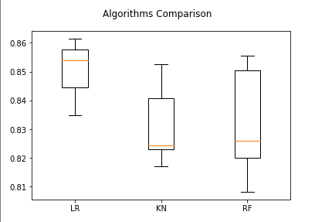
Modeling and Evaluation
Before making prediction on the testing data set and to decide which model to use it is better to do cross validation on training dataset.
Commonly used in applied machine learning to compare and select a model for a given predictive modeling problem .
The Logistic Regression performs better than other models.

Slide 18
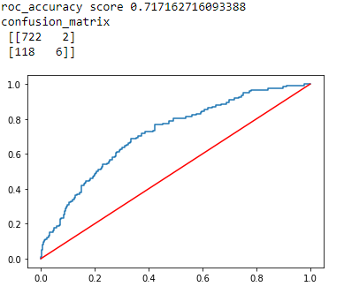
Comparing different classifiers on testing dataset:
Logistic Regression:
Predict heart diseases with accuracy of 85.84%.
ROC score of 0.71.ROC score close to 1 indicates good score and otherwise 0.

Slide 19
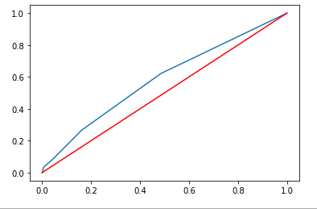
Modeling and Evaluation
K Neighbors Model:
Predict heart diseases with accuracy of 82.66%.
ROC score of 0.58.ROC score close to 1 indicates good score and otherwise 0.

Slide 20
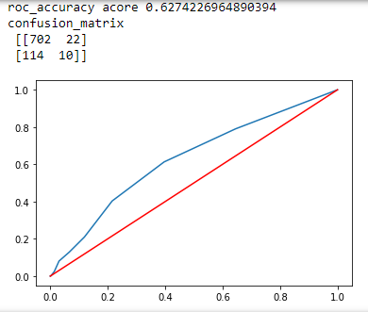
Modeling and Evaluation
Random Forest Model:
Predict heart diseases with accuracy of 83.96%.
ROC score of 0.62.ROC score close to 1 indicates good score and otherwise 0.

Slide 21
Modeling and Evaluation
For the given dataset, Logistic Regression performs better on testing dataset than KNN classifier and Random Forest Classifier.
The Logistic Regression model accuracy is 85.84 %. So, the model does a good job in predicting whether the patient has 10-year risk of future coronary heart disease (CHD).
The accuracy of Logistic Regression is 85.84% and the model is not overfitting or underfitting.

Slide 22
Thank You

