Slide 1

.
FACE MASK DETECTION
R.R.INSTITUTE OF MODERN TECHNOLOGY,LUCKNOW
SUBMITED BY:- SUBMITED TO:-
ANURAG MADHESIA (1836113007) Mr. MANISH MAURYA
COURSE: B.TECH
BRANCH: I.T.
YEAR: 4th

Slide 2
INTRODUCTION
The spread of COVID-19 has resulted in more than 1,841,000 global deaths and more than 351,000 deaths in the INDIA by Dec. 31, 2020. The spread of virus can be avoided by mitigating the effect of the virus in the environment, or preventing the virus transfer from person to person by practicing physical distance and wearing face masks. WHO defined physical distancing as keeping at least six feet or two meters distance from others and recommended that keeping the physical distance and wearing a face mask can significantly reduce transmission of the COVID-19 virus.

Slide 3
DATASET
A part of the dataset of face masks was obtained from Kaggle . There are two type of dataset one for with mask faces and another without mask. These dataset will be used to train the model. There are 1915 images of with mask faces and 1918 images of without mask faces total of 3833 images. 80 percentage of dataset will be used to train the model and rest 20 percentage will be used to test the model to get its accuracy.

Slide 4
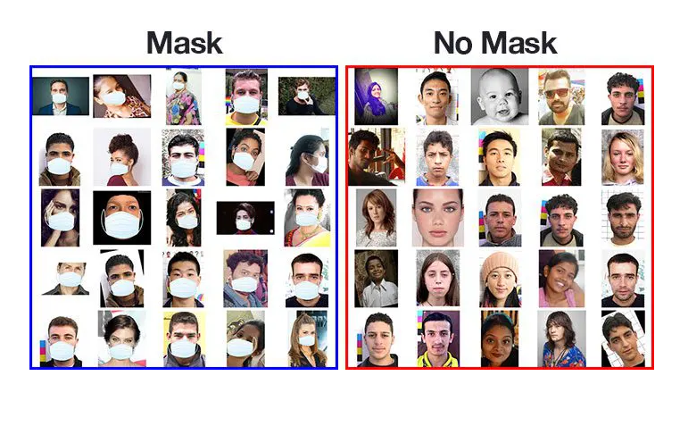
IMAGES OF DATASET

Slide 5
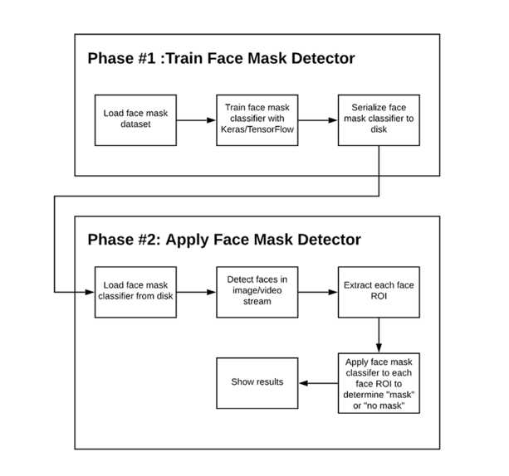
FACE MASK DETECTOR PHASES

Slide 6
In order to train a custom face mask detector, we need to break our project into two distinct phases, each with its own respective sub-steps :
Training: Here we’ll focus on loading our face mask detection dataset from disk, training a model (using Keras/TensorFlow) on this dataset, and then serializing the face mask detector to disk
Deployment: Once the face mask detector is trained, we can then move on to loading the mask detector, performing face detection, and then classifying each face as with_mask or without_mask

Slide 7
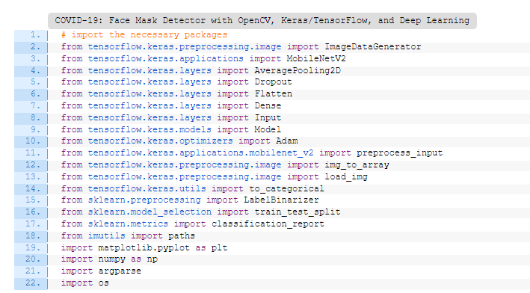

Slide 8
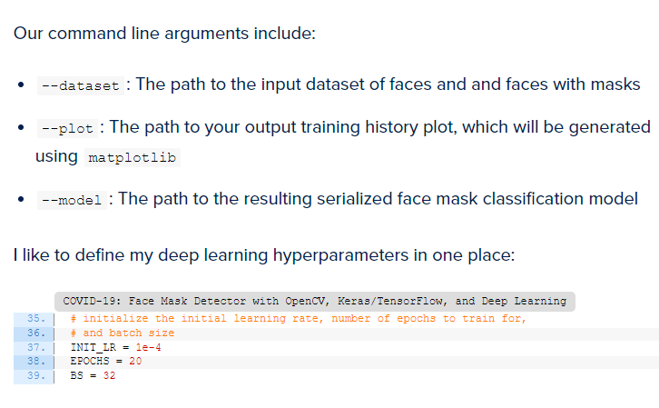

Slide 9
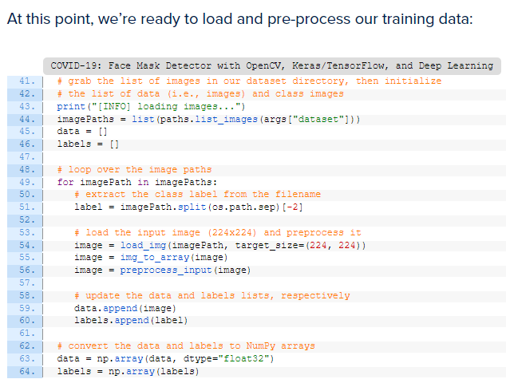

Slide 10
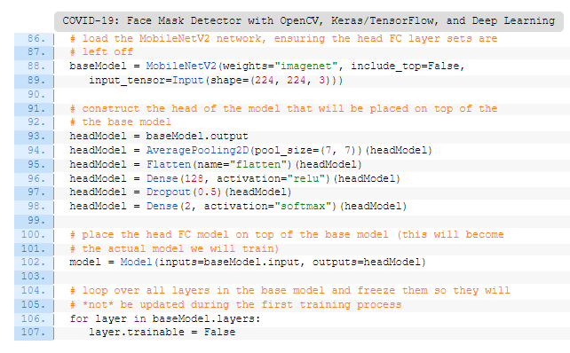

Slide 11
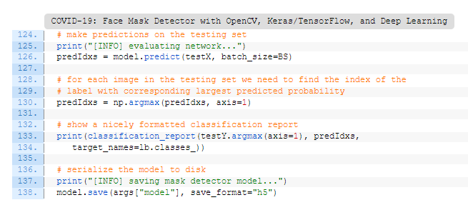

Slide 12
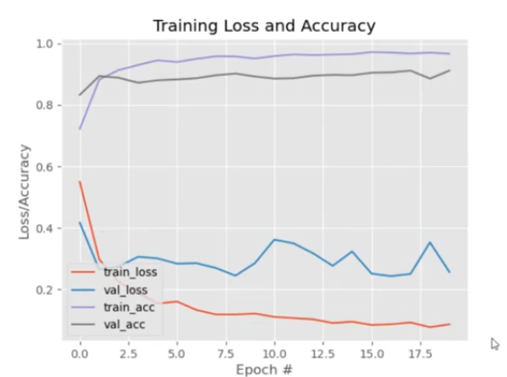

Slide 13
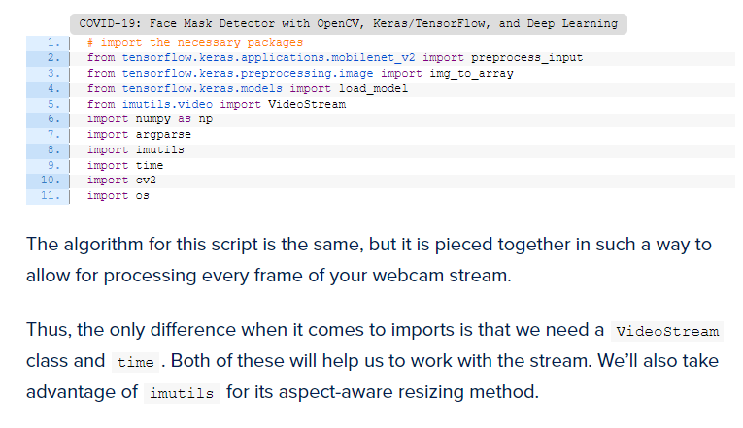

Slide 14
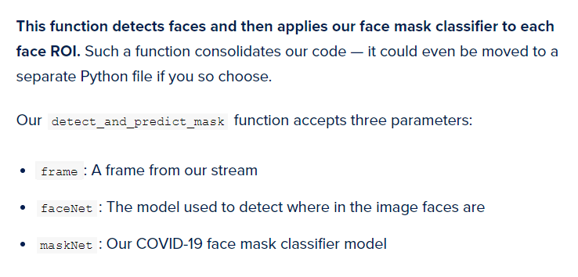

Slide 15
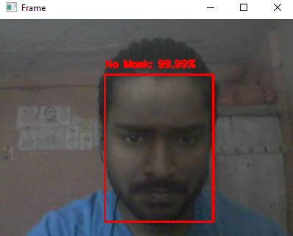
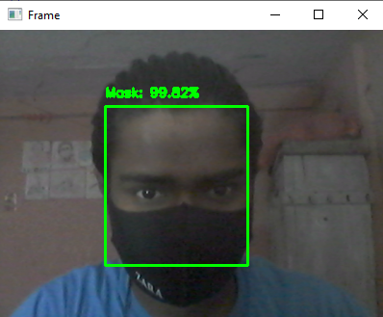
Face with no mask
Face with mask

Slide 16
CONCLUSION
This paper developed a model to detect face mask wearing and physical distancing among construction workers to assure their safety in the COVID-19 pandemic. The paper found a facemask dataset including images of people with mask, without mask, and incorrect mask wearing. To increase the training dataset, 1,000 images with different types of mask wearing were collected and added to the dataset to create a dataset with 1,853 images. A Faster R-CNN Inception ResNet V2 network was chosen among different models that yielded the accuracy of 99.8% for face mask detection. For physical distance detection, the Faster R-CNN Inception V2 was used to detect people and a transformation matrix was used to remove the effect of the camera angle on actual distance. The Euclidian distance converted the pixels of the transformed image to people’s real distance. The model set a threshold of six feet to capture physical distance violation. Transfer learning was used for training models

Slide 17


