Slide 1

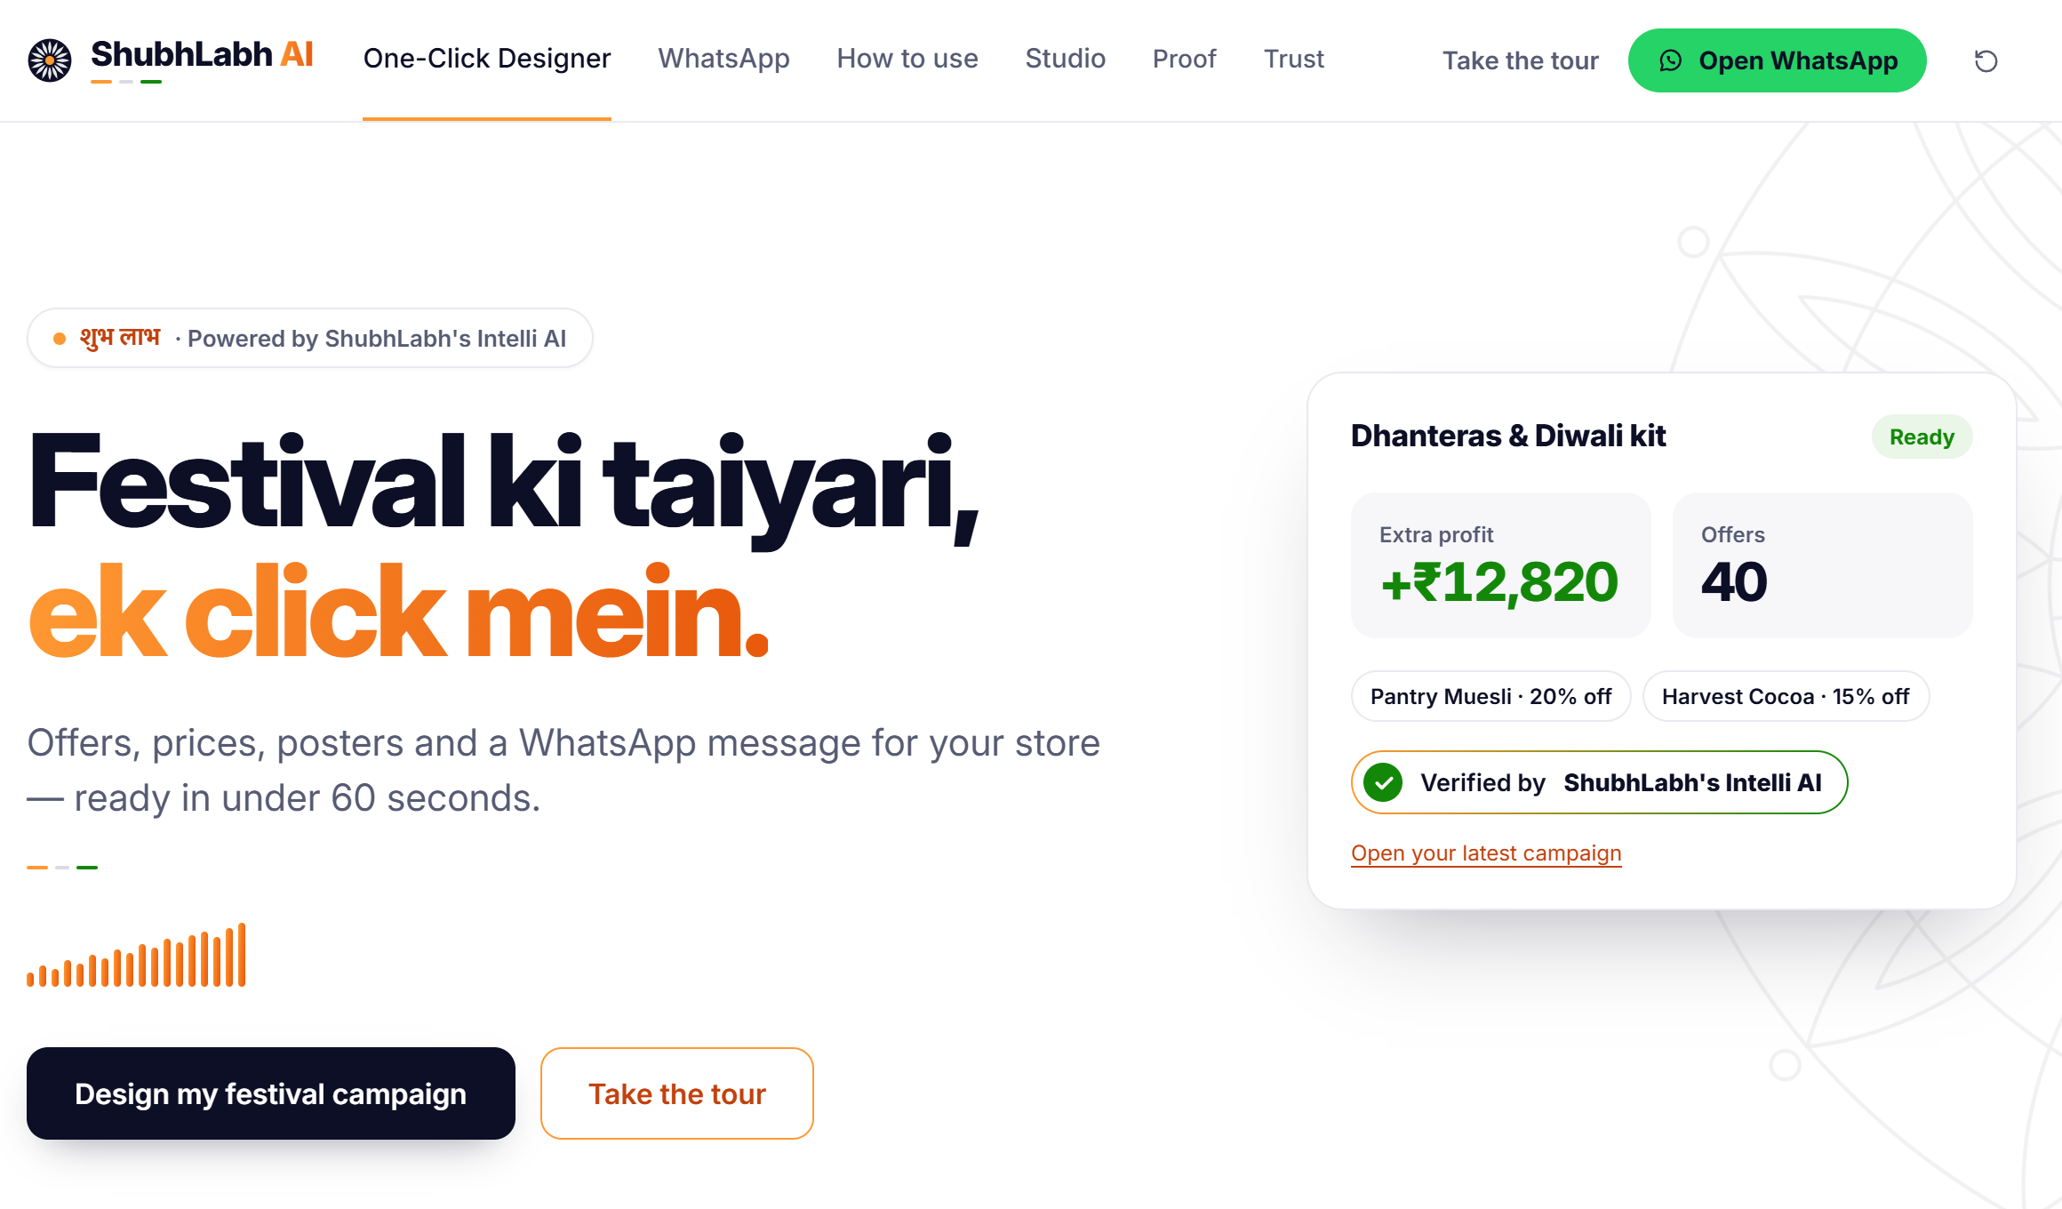
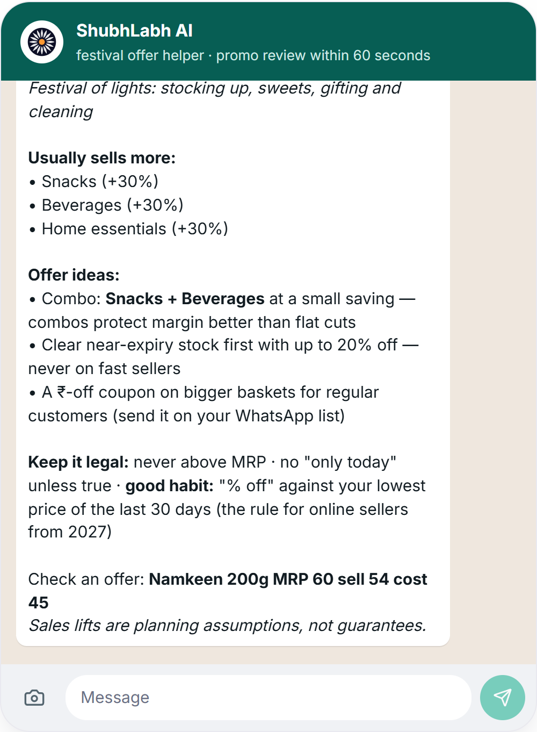



ET AI Hackathon 2026 · Problem 3 · AI Promotion Planner for Indian Retail
Pitch Deck · October 2026
F3 + D3
all 9 required features + D3 multimodal depth
ShubhLabh AI
India's smartest one-click AI promo planner
Ab sirf laabh hi laabh · अब सिर्फ़ लाभ ही लाभ
One AI promotion engine, three ways in: a One-Click Campaign Designer for grocery chains, Promo Studio for full control, and ShubhLabh on WhatsApp for India's kirana owners.
The app is already live. Use it without any installation:
https://shubhlabh-ai.replit.app
Status
Built by
Live, working product
Anurag Manik
First run may take 4–5 minutes to complete for the One‑Click Designer and Promo Studio.
WhatsApp replies instantly: message +1 415 523 8886 with 'join bright‑blanket'.
F3 + D3 · all 9 features · live on WhatsApp
AI Solution Architect – HP
Notes:
ShubhLabh AI is India's smartest one-click AI promo planner, built for ET AI Hackathon Problem 3. The claim up front: F3 plus D3 — all nine required features work end to end in the live product, and it reads real, messy Indian retail evidence: shelf tags, flyers, app screenshots, WhatsApp images and PDFs. A category manager picks a festival, drops in whatever evidence she has, and gets a campaign for every city, verified by ShubhLabh's Intelli AI, in under 2 minutes. A kirana owner just messages our WhatsApp number — he does not need the website. Ab sirf laabh hi laabh. The app is already live at shubhlabh-ai.replit.app, no installation needed; the first run may take 4 to 5 minutes for the One-Click Designer and Promo Studio, and WhatsApp replies instantly: message +1 415 523 8886 with 'join bright-blanket'.

Slide 2


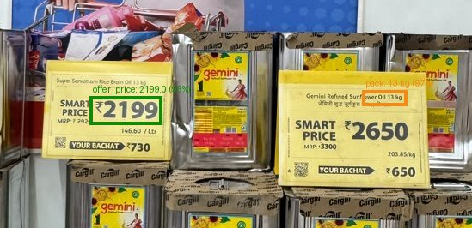
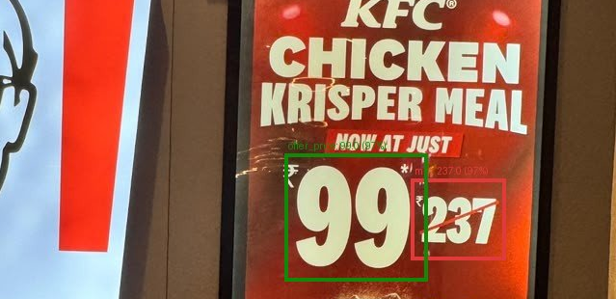
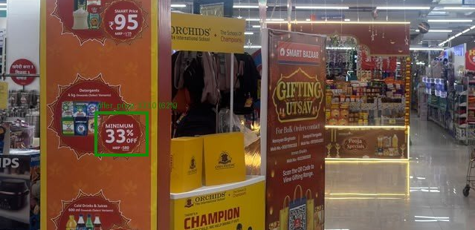

Team introduction · verified on real data
Built by one person.
Verified on real Indian store photos.
AM
Anurag Manik
REAL STORE CHECK · SAME PIPELINE AS THE PRODUCT
Hand-verified · 10 Oct 2026
Photos & videos from real Indian stores
AI Solution Architect – HP
19 real photos + 2 videos (12 keyframes) from a mall hypermarket, QSR menu boards, apparel and electronics displays, all sent over WhatsApp. Only values at 0.90 confidence or above are auto-accepted; the rest go to a person.
anuragmanik7@gmail.com
91%
14 / 14
80% → 91%
$0.09
BUILT END TO END, SOLO
of auto-accepted fields correct — 20 of 22 hand-checkable fields
offer prices correct
after a consistency check these photos taught us
model cost for all 31 inputs · 22 with prices · 45 extra items read
Backend: the agent, solver, guard pack and WhatsApp channel
React UI: One-Click Designer, Promo Studio, guided tour
Evidence pipeline: two reads + OCR, Chronos-2 forecasts
Proof: 784 automated tests, red-team runs, real-store checks
Super Sarvottam Rice Bran Oil 13 kg: MRP ₹2,929 → ₹2,199
KFC Krisper Meal ₹237 → ₹99
Caught by review: “33% off” read as ₹333, sent to a person
Labelled test set, live re-run (61 files): 100% of auto-accepted fields correct on all 6 input types — shelf-tag photos, festival flyers, quick-commerce screenshots, WhatsApp scheme images, text-PDF and scanned price lists (slide 9).
ShubhLabh AI · Ab sirf laabh hi laabh
02
Notes:
Team of one. I am Anurag Manik, AI Solution Architect at HP; I built the backend, the agent and solver, the React UI, the evidence pipeline and the WhatsApp channel, and I wrote the 784 tests. Before I show the product, the proof that it works on real data: 19 photos and 2 videos shot in real Indian stores and sent over WhatsApp, read by the same pipeline as the product. Of the auto-accepted fields that were legible, 20 of 22 were right — 91 per cent — and every offer price, 14 of 14. A 'minimum 33% off' sign misread as ₹333 went to a person, not into a plan. On our labelled set of 61 files, a live re-run put 100 per cent of auto-accepted fields right on all six input types. A field check, not a benchmark — and it is real.

Slide 3


Problem statement
Festivals decide the year —
and most promotions lose money
₹6.05 lakh cr
~91%
59%
22%
Diwali 2025 trade, +25% on 2024 · 85% of it through traditional retail
of India's US$658 bn grocery market is sold through 12–13 million kiranas
of trade promotions lose money (72% in the US)
of companies can measure promotion spend per event · 81% run compliance by hand
— CAIT, Oct 2025
— Redseer, 2026 · Invest India
— McKinsey, 2019 (citing Nielsen)
— Strategy& (PwC) · POI, 2026
FIVE PAIN POINTS
P1
Evidence is scattered and messy
P2
Planning is slow and unproven
P3
Quick commerce resets prices daily
P4
Compliance risk is now real
P5
The kirana has no planner at all
Schemes, competitor prices and HQ rules arrive as WhatsApp forwards, shelf photos, flyers and PDFs. Nobody reads them all, and one hidden instruction can mislead an AI.
Weeks of spreadsheets per scheme, no forecast, and no proof an offer will pay before it goes live.
Ten-minute apps run 20–25% off MRP city by city; chains and kiranas must answer in hours, on margins of 10–12%.
Fake “% off”, drip pricing and MRP breaches carry penalties; from 1 Jan 2027 every online price cut must show the 30-day low.
12–13 million shops sell ~91% of India's grocery with no analyst, no tool and no app they would install.
500 M+ WhatsApp users in India — Meta
22% can measure spend per event — Strategy&
Elara Capital, 2025 · KPMG, 2026
CCPA fines on 9 platforms, Aug 2026 · E‑Commerce (Amdt) Rules, 2026
Redseer, 2026 · Invest India
WHAT THAT MEANS FOR ONE BRAND
Decided blind — in spreadsheets, days too late
A ₹500-crore consumer brand puts ~₹100 crore a year into promotions. If 59% of those events lose money, crores ride on gut feel every festival.
ShubhLabh AI · Ab sirf laabh hi laabh
03
Notes:
Festivals are when Indian retail makes its money: Diwali alone was six lakh crore rupees of trade last year, 85% of it through traditional retail, and nine-tenths of grocery still moves through kiranas. Yet McKinsey, citing Nielsen, finds 59% of trade promotions lose money, and only one in five companies can even measure spend per event. Five reasons: evidence is scattered across WhatsApp forwards, photos and PDFs; planning is slow and unproven; quick commerce resets prices every day; compliance risk is now real, with dark-pattern fines and the 30-day-low rule from January 2027; and the kirana has no planner at all. For a five-hundred-crore consumer brand that is a hundred crore a year decided on gut feel.

Slide 4


Proposed solution · Powered by agentic AI
One-Click Designer · speed, for chains
Promo Studio · full control, for category & promo managers
WhatsApp · for kiranas
One AI engine, three ways in —
every pain point answered
P1
Messy evidence
Reads anything
D3
Shelf-tag photos, flyers, app screenshots, WhatsApp schemes, PDFs, CSVs. Two independent reads + OCR; doubtful fields go to a person; hidden instructions quarantined.
P2
Slow, unproven planning
One click in under 2 minutes, or full control in Promo Studio
Hero USP 1
One-Click: festival template → Chronos-2 forecast → agent designs offers → Intelli AI verifies each one → kit. Promo Studio: your own brief, every offer's checks, sign-off tiers, live what-ifs.
P3
Daily price resets
Forecasts and reacts
Live ops
Demand per product × city with P10–P90; competitor prices read from photos; live events (competitor cut, stock drop, budget cut) replan mid-festival with a diff.
P4
Compliance risk
Verifies every rupee
Guard pack
Never above MRP · honest % off against the 30-day low · same price for everyone · dark-pattern lint · checked by ShubhLabh's Intelli AI, with a confidence score.
P5
No planner for kiranas
ShubhLabh on WhatsApp
Hero USP 2
Message +1 415 523 8886 or scan the QR: festival tips, an offer check with margin and break-even, a competitor price-tag photo read. English or Hinglish. No app, no login — you don't need the website.
AI designs. ShubhLabh's Intelli AI verifies every rupee. A person approves. Built for WhatsApp — where India's kiranas already are.
ShubhLabh AI · Ab sirf laabh hi laabh
04
Notes:
Same five pain points, in order, and one engine with three ways in: the One-Click Designer for speed, built for chains; Promo Studio for full control, built for category and promo managers who want to customise everything; and WhatsApp for kiranas. Messy evidence — we read it, twice, and quarantine anything that looks like an instruction. Slow planning — one click, under 2 minutes, from festival template to a finished kit; or, for detailed promo planning, Promo Studio, where the manager writes her own brief, opens every offer's checks, signs off by tier and asks what-ifs. Daily price resets — we forecast demand per product and city, and we replan live when a competitor cuts, stock drops or HQ cuts the budget. Compliance — ShubhLabh's Intelli AI verifies every rupee before anyone sees it. And the kirana gets the same engine on WhatsApp, live today, with nothing to install. The whole thing is powered by agentic AI, and a person approves every plan.

Slide 5


Architecture · Powered by agentic AI
Six layers: evidence in, verified offers out
1
Inputs
Brief in English or Hinglish
Shelf‑tag photos · flyers · app screenshots · WhatsApp images
HQ policy & price‑list PDFs
Sales · stock · competitor CSV / Excel
WhatsApp messages from kiranas
anything the team has
2
Reading & verification
Vision read — gpt‑4.1‑mini, strict JSON, no tools
RapidOCR local read + parser
Agree + locate → confidence · ≥ 0.90 auto‑accept, else a person
Injection quarantine · PII redaction
Brief compiler → typed constraints
two reads must agree
3
Forecasting & optimisation
Chronos‑2 demand forecast per product × city · P10–P90
Price response calibrated on 4.85M real records
Candidates: markdown · coupon · bundle
OR‑Tools CP‑SAT solver + recovery ladder
Monte Carlo risk check · 200 scenarios
deterministic code
4
Intelli AI verification
Never above MRP
Honest % off vs 30‑day low
Same price for everyone
Margin floor · stock · budget
Dark‑pattern lint
Number check
Verification record per offer
AGENT ORCHESTRATOR · LAYERS 2–5
every offer, every rupee
5
Approval
Approval tiers · senior sign‑off above ₹15,000 worst case or 20% depth
Ask‑human mid‑run
Live‑event triage → replan with a diff
Full audit trail · versioned plans
a person in the lead
6
Channels
One‑Click: campaign kit · calendar · channels · English + Hindi copy · banners
Promo Studio: plan · every check · sign‑off · live replans
WhatsApp: replies via an n8n automation
Approved price feed (JSON) · exports
where the plan goes
AGENT ORCHESTRATOR · gpt-4.1-mini with function calling, across layers 2–5
STACK
Chooses the next tool and logs why · recovers (solver time-out → prune → split → fallback; model down → rules policy) · asks the manager when a brief contradicts itself · can never approve its own plan
FastAPI · SQLAlchemy · PostgreSQL (SQLite on a laptop) · React · n8n for WhatsApp · OpenAI with a hard spend cap · works rules-only without a key
ShubhLabh AI · Ab sirf laabh hi laabh
05
Notes:
Six layers, top to bottom. Evidence comes in as whatever the team has — a brief in Hinglish, shelf photos, flyers, policy PDFs, CSVs, WhatsApp messages. Layer two reads it twice: a vision read by gpt-4.1-mini in strict JSON with no tools, and a local OCR read; the two must agree and locate the value, or the field goes to a person. Hidden instructions are quarantined before any model sees them. Layer three is deterministic code: Chronos-2 forecasts demand, a price-response model calibrated on 4.85 million real records prices the candidates, OR-Tools CP-SAT picks the portfolio and a Monte Carlo check stress-tests it on 200 scenarios. Layer four is ShubhLabh's Intelli AI, the guard pack that verifies every rupee. Layer five is a person — approval tiers, ask-human, live triage. Layer six is the three ways in: the One-Click kit, Promo Studio and the WhatsApp replies. The agent orchestrates layers two to five, recovers from failures, and can never approve its own plan.

Slide 6









AI models & technologies used
Each model does one job — and is measured at it
Model / technology
What it does in ShubhLabh
Why this one
Measured
OpenAI gpt-4.1-mini
Vision read of evidence (strict JSON, no tools) and targeted re-reads of doubtful fields; compiles briefs into constraints; agent tool choice; live-event triage; copy and explanations
Fast and low-cost with function calling; every call logged; hard daily spend cap
≈ $0.011 model cost per AI plan · 100% of auto-accepted fields correct on the 61‑file labelled set
Chronos-2
time-series foundation model (local CPU)
Demand forecast per product × city with P10–P90 over a 14-day horizon; discount and promo activity as known covariates
Zero-shot: no training on the store; runs on a CPU, no GPU
WAPE 36.4% vs 40.0% seasonal naive · 600 real series
RapidOCR
ONNX, local
Second, independent read of every image and scan; locates each value on the page (boxes)
Free and offline; the model read and the OCR read must agree before auto-accept
Real store photos: 20 of 22 auto-accepted fields correct · offer prices 14 / 14
OR-Tools CP-SAT solver
Chooses offers under budget, stock, margin floor, cannibalisation and city rules; recovery ladder hint → prune → split → fallback
Exact optimisation, not a heuristic; every result re-validated independently of the model
120 SKUs × 3 cities, 848 candidates: P95 1.34 s
Monte Carlo risk check
Runs plan, flat 10%, conservative and no-promotion on the same 200 scenarios; P10 / P50 / P90 and downside probability
Independent of the solver; selection and reporting on separate scenario seeds
Plan 2.0× a flat 10% off · at least ₹10,201 nine times in ten
Price-response model
Elasticity and promo-activity lift behind every candidate price and every forecast scenario
Calibrated on real retail demand, not assumptions
4.85M records · 898 stores · 18 cities · 62% smaller loss than flat 10% in a back‑test
ShubhLabh's Intelli AI
verification layer
Our own in-house AI agent. In the background it re-checks every calculation on every offer: MRP, honest % off vs the 30-day low, margin, break-even and budget, plus copy lint and injection quarantine. It then gives a confidence score: a 90% chance of at least ₹X extra profit, from the 200-scenario risk check.
Every published offer is verified by ShubhLabh's Intelli AI, with a confidence score
190 / 190 red-team cases caught across 7 guards · 0 false alarms
Agentic orchestration
Tool calls with strict schemas; picks the next tool and logs why; recovers from solver time-outs and model outages; asks a person when unsure
Powered by agentic AI, with a person approving every plan
Rules-only policy with no key · 784 automated tests
STACK
FastAPI · SQLAlchemy · PostgreSQL (SQLite on a laptop) · React + Vite · n8n automation for WhatsApp · NumPy · scikit-learn · pytest (784 tests) · Python
ShubhLabh AI · Ab sirf laabh hi laabh
06
Notes:
Each model has one job, and each is measured at it. gpt-4.1-mini reads evidence in strict JSON with no tools, compiles briefs into constraints, chooses the agent's tools, triages live events and writes copy — about one cent of model cost per plan, under a hard daily cap. Chronos-2, a time-series foundation model running on a CPU, forecasts demand zero-shot and beats the seasonal baseline on 600 real series. RapidOCR is the independent second read. OR-Tools CP-SAT chooses the offers; a Monte Carlo check stress-tests them on 200 scenarios; the price-response model is calibrated on 4.85 million real records. ShubhLabh's Intelli AI verifies every rupee — 190 of 190 red-team cases caught. And the agent orchestrates it all, falling back to a rules-only policy when there is no key. FastAPI, PostgreSQL, React and n8n underneath.

Slide 7






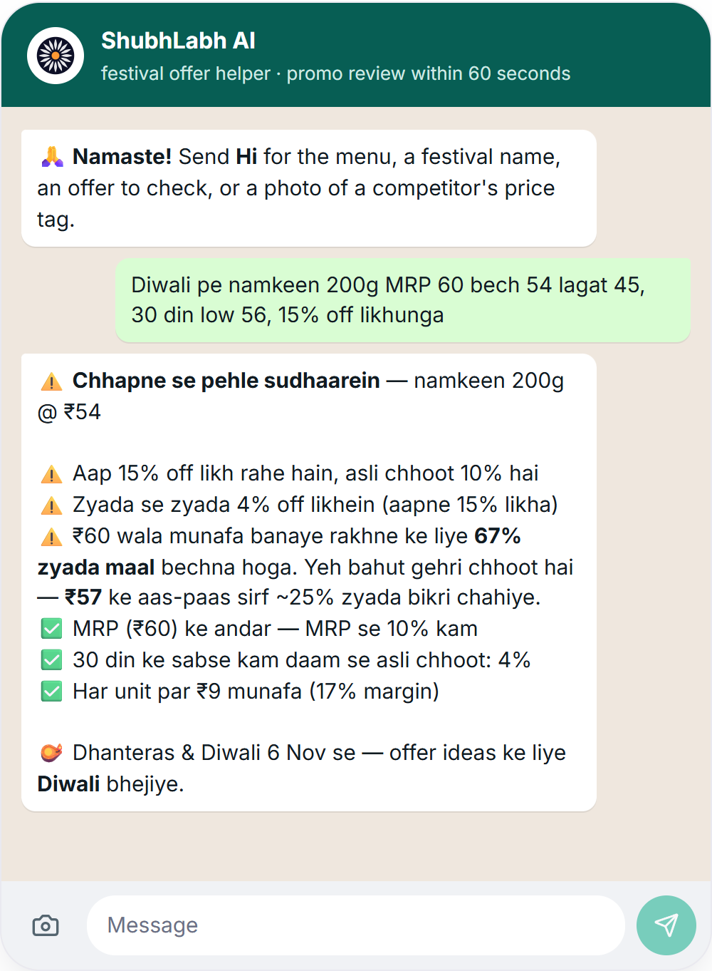
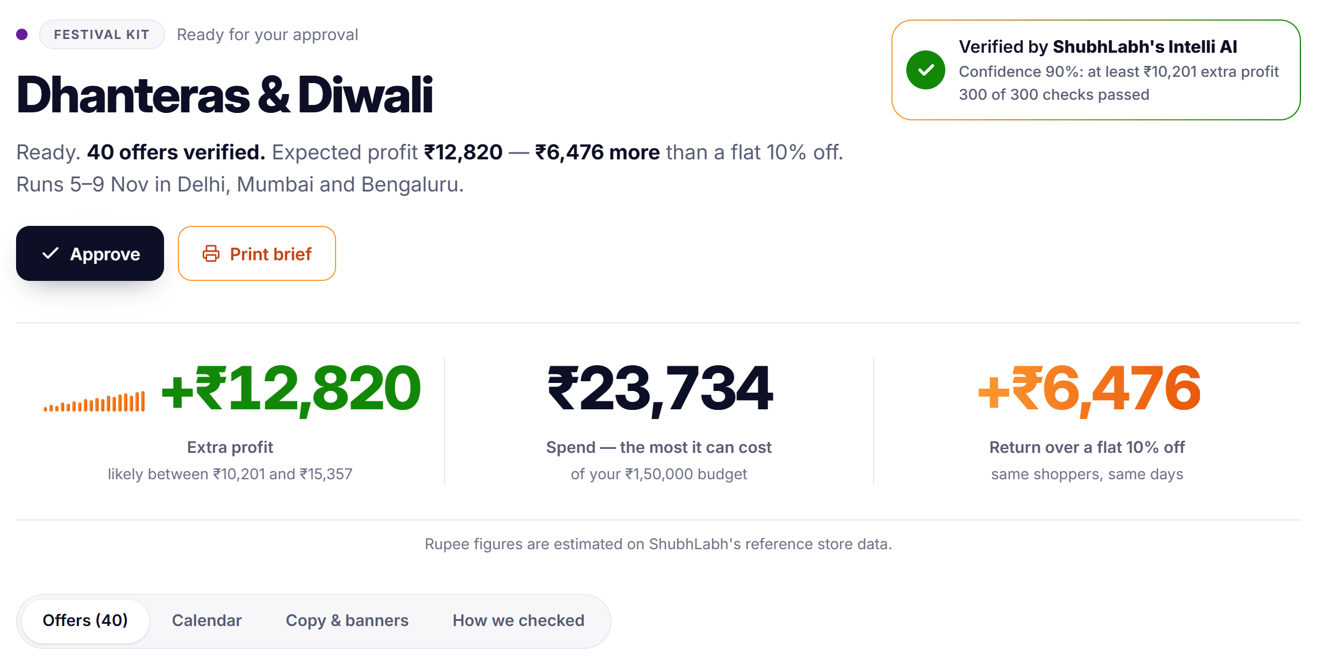
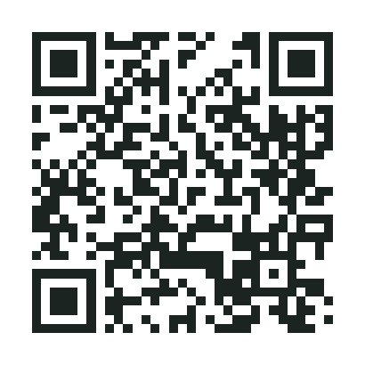
Product Demo
Live: shubhlabh-ai.replit.app
Under 2 minutes
One click. Full control. One message.
ONE-CLICK DESIGNER · SPEED, FOR CHAINS
Pick a festival
Drop in anything
Press Design
Verified kit · <2 min
SHUBHLABH ON WHATSAPP · LIVE
1
Message +1 415 523 8886 — or scan the QR
2
Send “join bright-blanket” — typed in for you by the Open WhatsApp button
3
Then send an offer, a festival or a price-tag photo
Offer check: MRP · honest % off · margin · break-even
Scan to try it now
You don't need the website.
Dhanteras & Diwali · Delhi · Mumbai · Bengaluru · +₹12,820 extra profit · 2.0× a flat 10% off · 40 offers verified by ShubhLabh's Intelli AI · 300 of 300 checks passed · estimated on ShubhLabh's reference store data (rules-only run)
English or Hinglish
No app, no login
Zero training: a guided tour on the first visit and three How-to guides with ~70-second Hinglish videos. The full walkthrough video is in the submission.
Phone numbers never stored
Hidden instructions quarantined
Full control in Promo Studio → next slide: brief, evidence, agent run, plan & approve, live ops, ask
Only ever replies, never messages first
ShubhLabh AI · Ab sirf laabh hi laabh
07
Notes:
Three ways in, one engine. The One-Click Designer is for speed, for chains. Pick Dhanteras & Diwali — dates, cities and lifts pre-fill from twelve templates — drop in whatever the team has, press Design. In under 2 minutes it reads the documents, forecasts with Chronos-2, lets the agent design offers, has ShubhLabh's Intelli AI verify each one, and writes the kit: ₹12,820 of extra profit, 2.0 times a flat ten-percent discount, 40 offers, 300 of 300 checks passed, estimated on ShubhLabh's reference store data. A booby-trapped competitor PDF in that run had its hidden instruction quarantined before any model read it. For detailed promo planning, category and promo managers use Promo Studio, where they customise everything — the next slide: write the brief in your own words; it is compiled into exact constraints and read back to you; review the evidence; watch the agent work, step by step; open every offer's checks, each verified by ShubhLabh's Intelli AI; approve with sign-off tiers, so a big-liability plan needs senior sign-off; then replan live and ask what-ifs. And for kiranas, ShubhLabh is live on WhatsApp: message the number — the button or the QR types 'join bright-blanket' for him — and send an offer like 'Atta 5kg MRP 280 sell 250 cost 230'. He gets the MRP rule, the honest percentage off against his 30-day low, the margin, and how many more packs he must sell to break even. English or Hinglish, nothing to install, and he never needs the website.

Slide 8
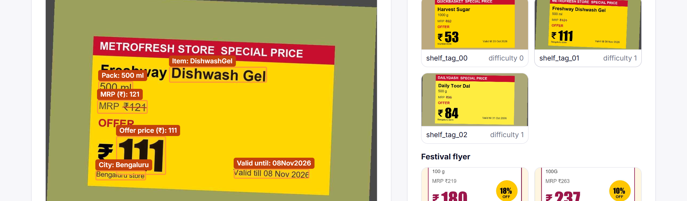
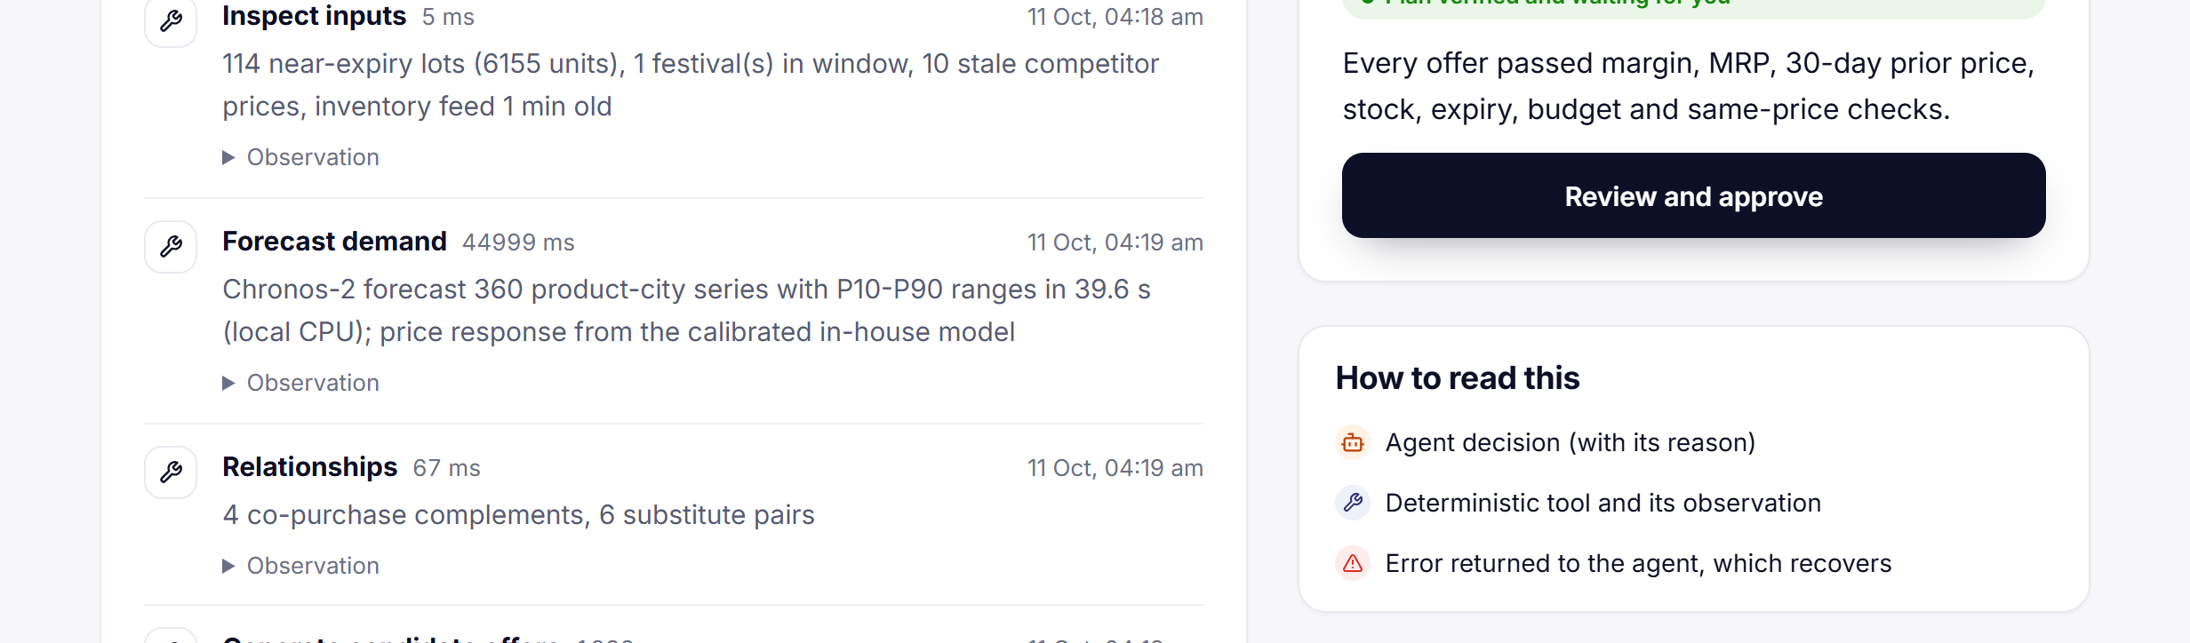
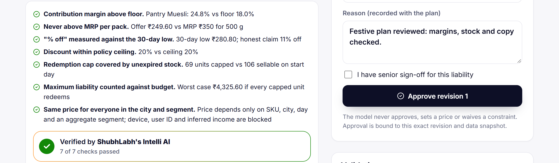
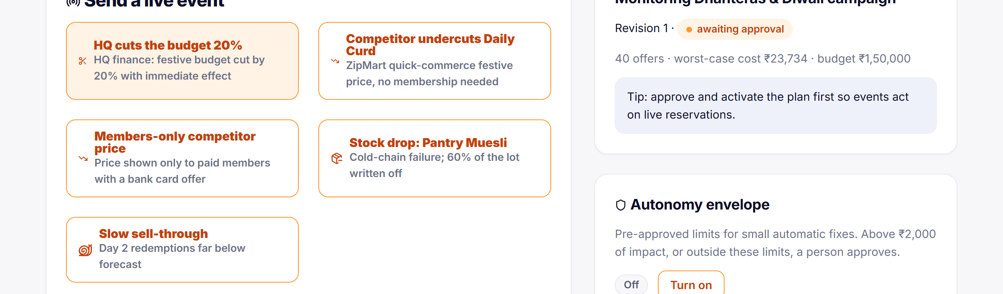
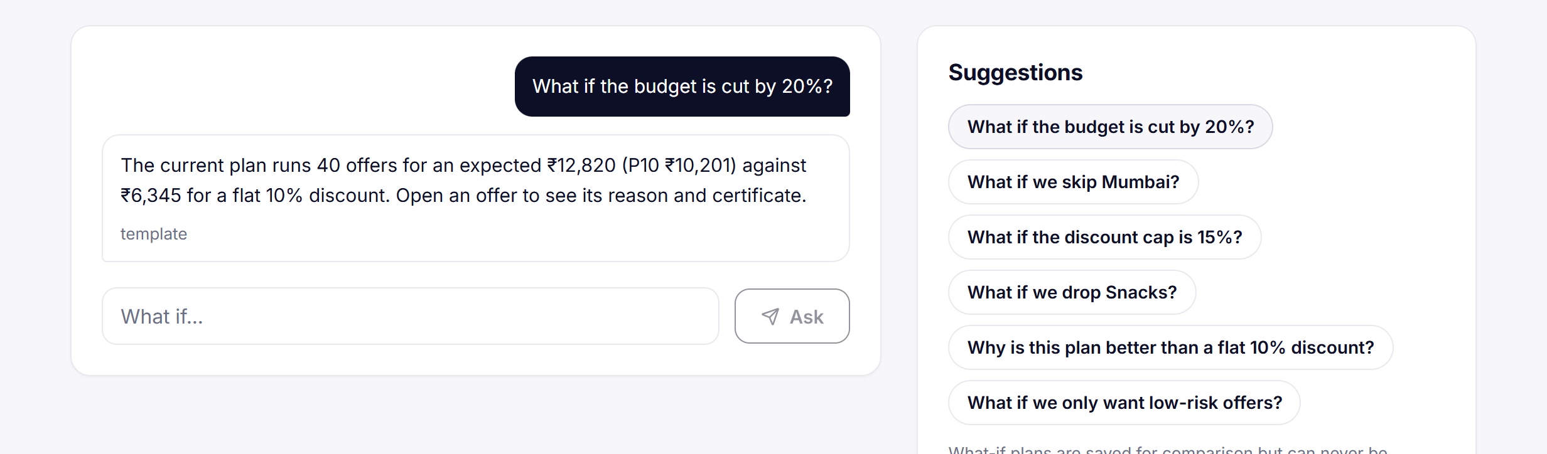
Promo Studio · for category & promo managers
Promo Studio: full control, every step verified
1
Brief
2
Evidence
3
Agent run
YOUR WORDS → EXACT CONSTRAINTS
Budget
Discount cap
Margin floor
Cities
Categories
Mechanisms
Days
Read back to you before anything runs
Write it in plain English or Hinglish. It is compiled into exact constraints and read back to you before anything runs.
Shelf photos, flyers, app screenshots, PDFs, CSVs. Two reads must agree, with a box on every value read; doubtful fields go to a person; hidden instructions quarantined.
Watch the agent work step by step, with every tool call, decision and recovery logged.
4
Plan & approve
5
Live ops
6
Ask
Offers by city and segment. Open each offer's checks, verified by ShubhLabh's Intelli AI. Senior sign-off tiers; nothing goes live without approval.
Competitor undercut, stock drop or HQ budget cut → replan with a diff, then approve.
What-ifs in plain words: cut the budget, cap the discount, drop a category, skip a city, with before and after.
ShubhLabh AI · Ab sirf laabh hi laabh
08
Notes:
Promo Studio is the key for detailed promo planning: the category or promo manager customises everything, and every step is verified. One, the brief: write it in plain English or Hinglish; it is compiled into exact constraints — budget, discount cap, margin floor, cities, categories, mechanisms, days — and read back before anything runs. Two, evidence: shelf photos, flyers, app screenshots, PDFs and CSVs; two reads must agree, every value read gets a box on the image, doubtful fields go to a person and hidden instructions are quarantined. Three, the agent run: watch the agent work step by step, with every tool call, decision and recovery logged. Four, plan and approve: offers by city and segment; open each offer's checks, verified by ShubhLabh's Intelli AI; a big-liability plan needs senior sign-off, and nothing goes live without approval. Five, live ops: a competitor undercut, a stock drop or an HQ budget cut triggers a replan with a diff, which you approve. Six, ask: what-ifs in plain words — cut the budget, cap the discount, drop a category, skip a city — with before and after.

Slide 9




What we do differently
Built for Indian retail, not adapted to it
Solution
Indian festival
templates
Reads WhatsApp
& shelf photos
Every offer
verified
(MRP · 30-day low)
One-click
campaign
Hindi /
Hinglish
Works for a
kirana on
WhatsApp
Enterprise promo suites
Global, ₹-crore licences
BI dashboards & Excel
Today's default
Marketplace & q-commerce seller tools
Platform-locked
Generic AI chatbots
Unverified answers
ShubhLabh AI
WHY IT IS HARD TO COPY
Two independent reads must agree before any price is used
Every offer verified by Intelli AI — not a dashboard, not a chatbot answer
Price response calibrated on 4.85M real retail records
Comparison by category from publicly available product information, October 2026.
ShubhLabh AI · Ab sirf laabh hi laabh
09
Notes:
What we do differently. Enterprise suites are built for global retailers and cost crores; Excel is today's default; marketplace tools lock you to one platform; chatbots give answers nobody can verify. ShubhLabh is built for Indian retail: festival templates, WhatsApp and shelf photos as inputs, Hindi and Hinglish, one click, and a door for the kirana. Three things are hard to copy: two reads must agree before a price is used; ShubhLabh's Intelli AI verifies every offer; and the price response is calibrated on 4.85 million real records.

Slide 10








Requirement coverage
F3 + D3
All 9 required features — plus D3
all 9 features · multimodal depth
Product selection
Promotion mechanism
Discount & strategy
D3 · Multimodal depth
Screens 120 SKUs to the best 20, with reasons
Markdown, coupon or bundle per product and city
Depth, timing, audience, city — each verified
LIVE RE-RUN · AUTO-ACCEPTED FIELDS CORRECT
Shelf-tag photos
100%
Festival flyers
100%
Cannibalisation
Product relationships
Inventory constraints
Quick-commerce screenshots
100%
WhatsApp scheme images
100%
Substitute effects charged to every offer
AI suggests pairs; data confirms them
Stock, batches, expiry; near-expiry first
Text-PDF price lists
100%
Scanned price lists
100%
61 labelled files · coverage 100% · two reads + OCR · boxes on values read from images · doubtful fields go to a person
Geographic customisation
Competitor awareness
Test before launch
85%+ raw field accuracy
with no model key (rules-only; then every field goes to a person)
A different plan per city
Prices read from photos, compared per 100 g
Plan vs flat 10% vs none, 200 scenarios
Every feature runs end to end in the live product · every published offer verified by ShubhLabh's Intelli AI · plus WhatsApp for kiranas
Real store photos (slide 2): 20 of 22 hand-checkable auto-accepted fields correct (91%) · offer prices 14 of 14 · a hidden instruction in a competitor PDF quarantined before any model read it.
ShubhLabh AI · Ab sirf laabh hi laabh
10
Notes:
F3 plus D3, proved. All nine required features run end to end in the live product: product selection screens 120 SKUs to the best 20 with reasons; markdown, coupon or bundle per product and city; depth, timing and audience verified; cannibalisation charged to every offer; relationships suggested by AI and confirmed by data; stock, batches and expiry respected; a different plan per city; competitor prices read from photos; and every plan tested against a flat 10% and no promotion on 200 scenarios. D3: on a live re-run of our 61-file labelled set, every auto-accepted critical field was correct on all six input types with full coverage — price-list reads are scored against the row they name, adopted with the live run; first-row scoring would give 82% text-PDF and 83% scanned-PDF precision. With no model key the pipeline still reads at 85%-plus raw accuracy and sends every field to a person. And on real store photos, 20 of 22 hand-checkable fields were right.

Slide 11



Business impact
2.0× the extra profit of a flat discount —
and not one offer above MRP
Diwali campaign · extra profit on the same 200 forecast scenarios
<2 min
2.0×
typically, from one click to a verified campaign
the extra profit of a flat 10% discount
Measured in the product · 44–92 s in four of five runs
Estimated on ShubhLabh's reference store data
1,410
0
near-expiry units cleared in one campaign
offers above MRP or with a fake “% off”
At least ₹10,201 nine times in ten · 1,410 near-expiry units cleared · costs at most ₹23,734 of a ₹1,50,000 budget. Estimated on ShubhLabh's reference store data (rules-only run); price response calibrated on 4.85M real retail records.
Estimated · less waste, fewer write-offs
Verified by ShubhLabh's Intelli AI · 190/190 red-team cases caught
DOOR 1 · CHAINS
DOOR 2 · KIRANAS
Shadow pilot first (nothing goes live) → one festival end to end in 2–3 cities → always-on weekly plans. Revenue: SaaS per store per month + campaign credits.
Free offer checks and festival tips on WhatsApp, sponsored by FMCG brands and distributors who already run schemes to kiranas; premium plans. ≈ $0.011 of AI cost per plan keeps it free.
ShubhLabh AI · Ab sirf laabh hi laabh
11
Notes:
Impact in rupees, minutes and risk. On the same 200 forecast scenarios the Diwali plan earns ₹12,820 of extra profit against ₹6,345 for a flat 10% discount — two times — at least ₹10,201 nine times in ten, with 1,410 near-expiry units cleared and a worst case of ₹23,734 on a ₹1,50,000 budget. All of it estimated on ShubhLabh's reference store data, with price response calibrated on 4.85 million real retail records. Typically under 2 minutes from one click to a verified campaign, and zero offers above MRP or with a fake percentage off, because ShubhLabh's Intelli AI verifies every one. The business: chains start with a shadow pilot where nothing goes live, then one festival, then always-on, paid per store plus campaign credits; kiranas get it free on WhatsApp, sponsored by the brands and distributors who already run schemes to them — at about one cent of AI cost per plan.

Slide 12






Scalability · Future roadmap
Light, cheap to scale — next: every Indian store
SCALABILITY · MEASURED ON THE DEPLOY AUDIT (11 OCT 2026)
Multi-tenant PostgreSQL
Light, no GPU
Solver headroom
Cheap AI, capped
Ready for a crowd
Fast and tested
A workspace per chain or shop; the full test suite passes on PostgreSQL 17
~1 GB RAM with Chronos-2 on CPU; one VM runs forecasting, OCR and the solver
120 SKUs × 3 cities, 848 candidates, solved in P95 1.34 s
≈ $0.011 of model cost per plan, under hard daily and total spend caps
Rate limits per client and per WhatsApp sender; CSRF and CSP on every route
Kit in ~40 s with Chronos-2, 6.5 s without · 784 automated tests
LIVE TODAY
NEXT 3 MONTHS
3–6 MONTHS
6–12 MONTHS
One-Click Campaign Designer · 12 festival templates
Shadow pilots with 2–3 grocery chains — nothing goes live
POS / billing / ERP connectors — sales, stock and MRP sync, no CSVs
Scheduled always-on weekly plans, auto-briefed from last week's sales
Promo Studio · full control from brief to sign-off, live what-ifs
Pilots with FMCG brands and distributors who sponsor kirana plans
More Indian languages: Tamil, Telugu, Bengali, Marathi, Kannada, Gujarati
Outcome loop: redemptions and sales feed the next plan
ShubhLabh on WhatsApp · +1 415 523 8886
A chain's or store's own WhatsApp Business number
Regional festivals — Onam, Durga Puja, Eid, Ganesh Chaturthi, Raksha Bandhan — and more cities
Background job queue so the engine runs across several servers
English + Hindi copy · Hinglish chat
Live-event replanning with a diff
Recalibrate price response on Indian pilot outcomes
Voice notes on WhatsApp
PostgreSQL · approval tiers · full audit trail
Ab sirf laabh hi laabh.
Anurag Manik · AI Solution Architect – HP
Scan to try it on WhatsApp
“join bright-blanket” typed in for you
अब सिर्फ़ लाभ ही लाभ
anuragmanik7@gmail.com
Live: shubhlabh-ai.replit.app · F3 + D3 · repository in the submission
ShubhLabh AI · Ab sirf laabh hi laabh
12
Notes:
Scalability first, with numbers from the deploy audit. Every chain or shop lives in its own workspace on PostgreSQL, and the full test suite passes on PostgreSQL 17. The engine needs about a gigabyte of RAM with Chronos-2 on a CPU and no GPU. The solver handles 120 SKUs across three cities and 848 candidates in under a second and a half at the 95th percentile. AI costs about one cent per plan under hard caps. Rate limits are set for a crowd, and the One-Click kit is ready in about 40 seconds, with 784 automated tests behind it. Growth is data, not code: new festivals, cities and SKU lists are templates and CSVs. Then the roadmap. What is live today is in the first column, so nothing here is dressed up as future: the One-Click Designer, Promo Studio for full control from brief to sign-off, ShubhLabh on WhatsApp, English and Hindi copy, live replanning, and approval tiers with a full audit trail. Next three months: shadow pilots with two or three grocery chains where nothing goes live, pilots with the FMCG brands and distributors who would sponsor kirana plans, a chain's or store's own WhatsApp Business number, and recalibrating the price response on Indian pilot outcomes. Three to six months: POS, billing and ERP connectors; more Indian languages; regional festivals and more cities. Six to twelve months: always-on weekly plans, an outcome loop from redemptions, a job queue across several servers, and voice notes on WhatsApp. Ab sirf laabh hi laabh — thank you. Scan the code and try it on WhatsApp right now.

