Slide 1
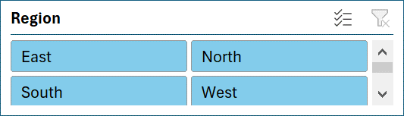
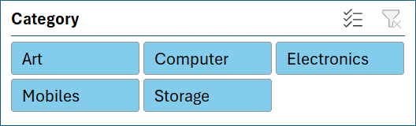
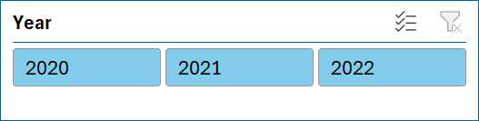
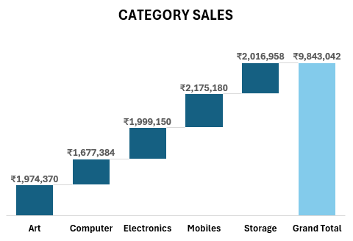
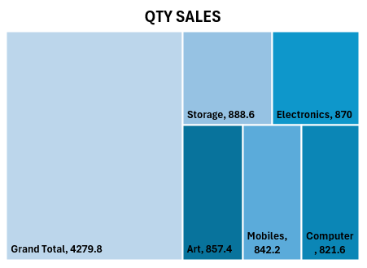
Dynamic Dashboard
SALES
ORDERS
QTY
PROFIT
QUARTERLEY SALES
₹ 9,843,042
981
4279.8
₹ 984,304
FILTERS

