Slide 1
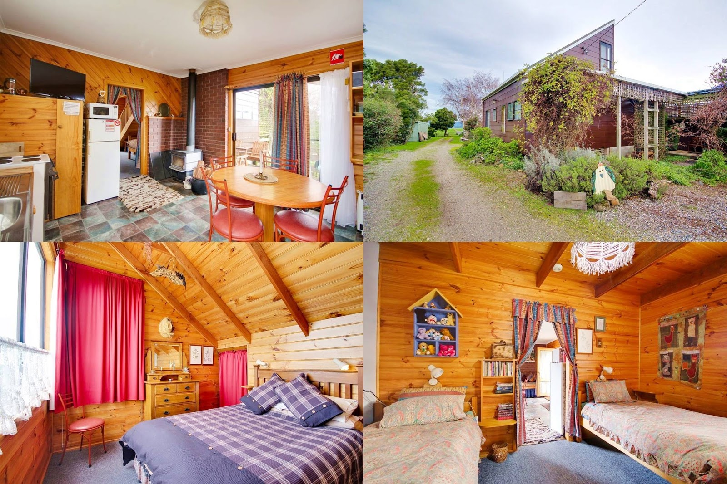

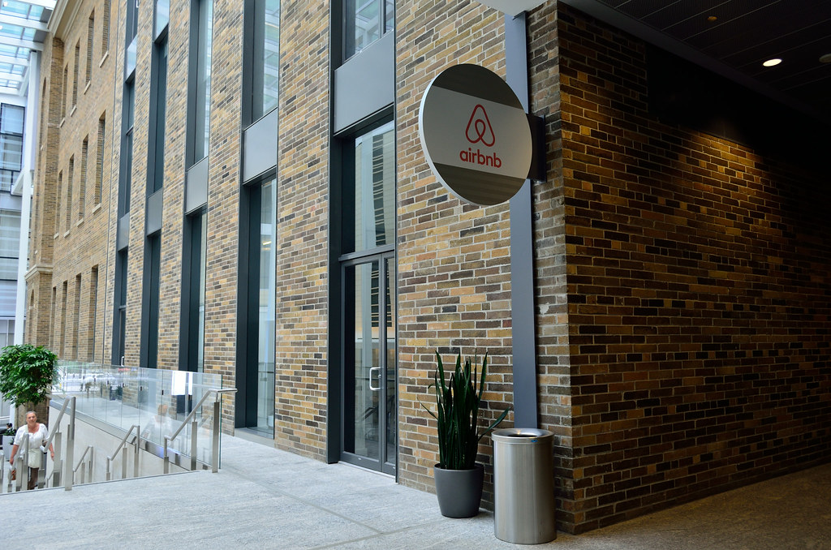


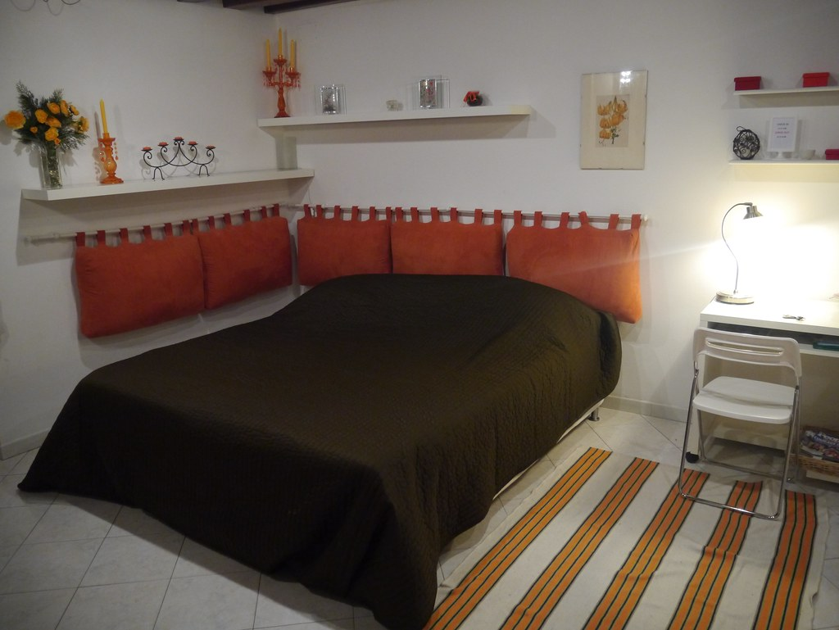
Airbnb began in 2008 when two designers who had space to share hosted three travelers looking for a place to stay. Now, millions of Hosts and guests have created account to enjoy each other's unique view of the world.
This Photo by Unknown Author is licensed under CC BY-SA
This Photo by Unknown Author is licensed under CC BY

Slide 2
DATA DOCUMENTATION
ABOUT DATASET
Data contains 50 Columns, 7581 Rows.
Data Source GitHub repository
Data Contains Travelers Details, Host Details, Accommodation details, Reviews.
Data Transformation, Data Cleaning in SQL
Data Cleaning are removed unwanted Columns, Change Column name, Change Date format, Remove duplicate details.
Data Analyzing
Total Availability in 30, 60, 90, 365 days.
Analyze which Room type most of visitors use.
Find Price list, Most Verification methods are use.
Calculate Accommodation details like Bedrooms types.
Calculate Review ratings about Property.
Calculate dirty ratings.

Slide 3
CODE DOCUMENTAION
use Airbnb
SELECT * FROM listings;
/* Change data type */
alter table listing salter column ID float;
alter table listings alter column Listing_URL varchar(100);
alter table listings alter column Scrape_URL float;
alter table listings alter column Source varchar(50);
alter table listings alter column Host_ID int;
alter table listings alter column Host_Name varchar(50);
alter table listings alter column Host_Location varchar(50);
alter table listings alter column Host_Response_Rate float;
alter table listings alter column Host_Acceptance_Rate float;
alter table listings alter column Host Verifications varchar(50);
alter table listing salter column Latitude float;
alter table listing salter column Longitude float;
alter table listing salter column Accommodations int;
alter table listing salter column Property_Type varchar(80);
alter table listing salter column Room_Type varchar(80);
alter table listing salter column Bedrooms varchar(50);
alter table listing salter column Beds int;
alter table listing salter column Price float;
alter table listing salter column Availability varchar(50);
alter table listing salter column Availability_30 int;
alter table listing salter column Availability_60 int;
alter table listing salter column Availability_90 int;
alter table listing salter column Availability_365 int;
alter table listing salter column First_Review date;
alter table listing salter column Last_Review date;
/* Change date Format */
select * From listings;
SELECT CONVERT(date, First_Review, 110) AS First_Reviewfrom listings;
SELECT CONVERT(date, Last_Review, 110) AS Last_Reviewfrom listings;
SELECT CONVERT(date, Host_Since, 110) AS Host_Reviewfrom listings;
SELECT CONVERT(date, Scrape_URL, 'MM-DD-YYYY') AS Scrape_URLfrom listings;

Slide 4
DATA ANALYSING
use Airbnb
SELECT * From listings;
/* Data Analysing*/
1. Total Availibility in 30 days, 60 days, 90 days, 365 days?
SELECT SUM(Availability_30) as Availibility_30from listings;
SELECT SUM(Availability_60) as Availability_60from listings;
SELECT SUM(Availability_90) as Availability_90from listings;
SELECT SUM(Availability_365) as Availability_365from listings;
2. Find dirty Reviews are short listed by Host side
SELECT Host_ID, host_url, Host_Name, COUNT(*) AS Num_Dirty_Reviews FROM listings INNER JOIN listings_xlnm#_FilterDatabase ON listings.ID = listings.id
GROUP BY Host_ID, Host_URL, host_name
ORDER BY Num_Dirty_Reviews DESC;
3.Which Neighbourhood group there is a maximum number of properties?
SELECT MAX(Neighbourhood) as Neighbourhood FROM listings;
4. Which host has maximum number of properties listed?
SELECT Room_Type, COUNT(*) AS Num_of_RoomType FROM listings
GROUP BY Host_ID
ORDER BY Num_of_RoomType;
5. What is the average price in different listed properties listed?
SELECT AVG(price) as price FROM listings;
6. What is the most preferred having room type in the every neighborhood groups?
SELECT max(Room_Type) from listings;
7. Total availability of properties having different room types?
SELECT Room_Type
COUNT (availability) FROM listings
GROUP BY room_type;

Slide 5
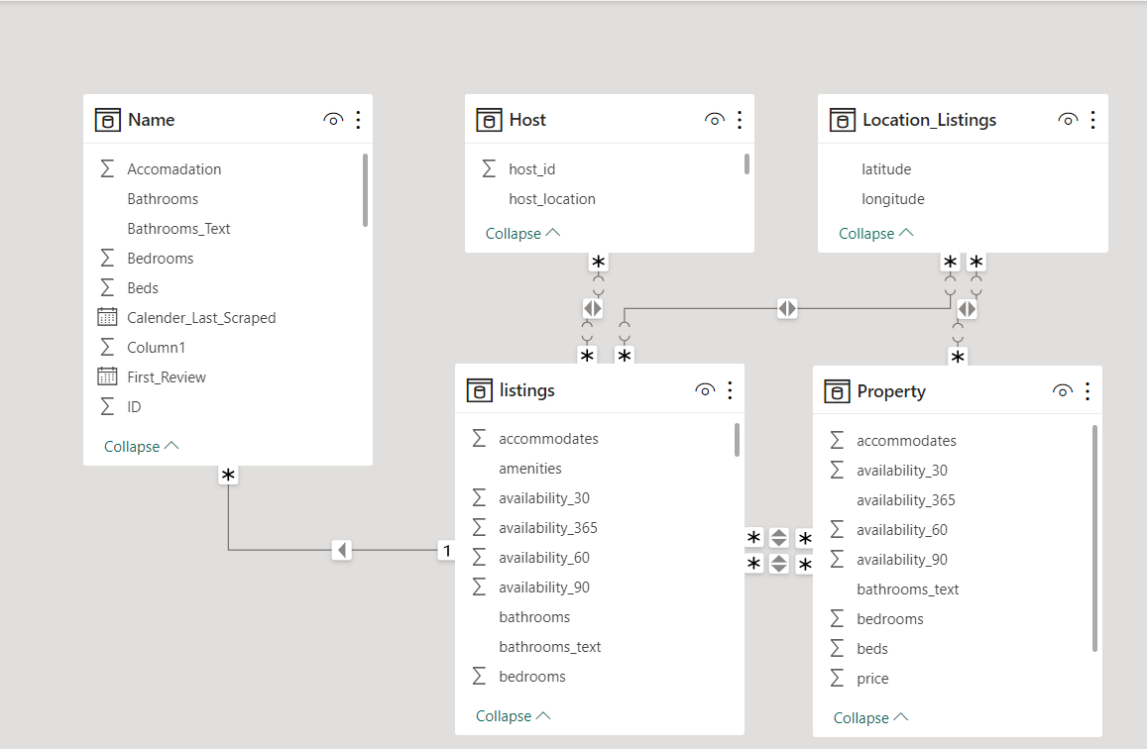
DATA MODELING

Slide 6
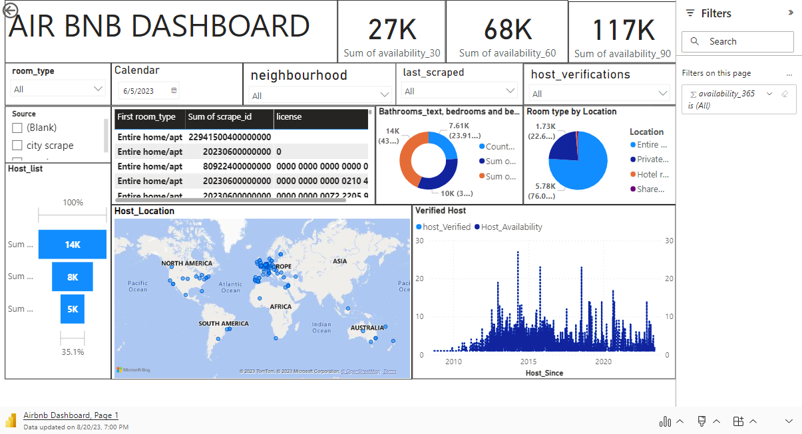
REPORT

Slide 7
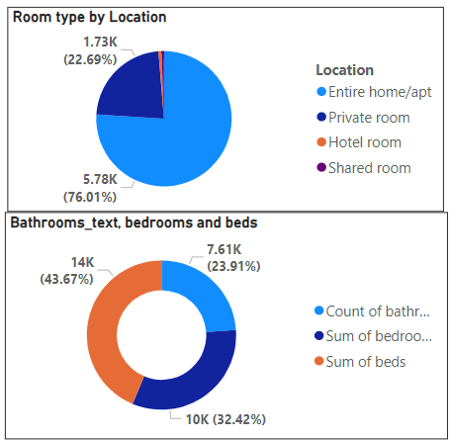
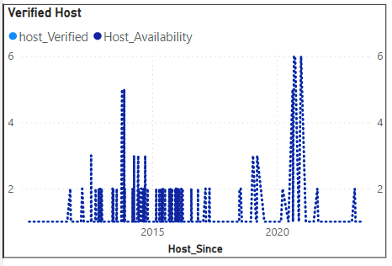
Entire home/apt had the highest room at 5783, followed by Private room, Shared room, Hotel room.
Entire home/apt are account for 76.01% of room type.
All metrics remained relatively constant between Wed-Sep-2008 and Mon-Jun-2023
All metrics trend between Wed, sep-24-2008 and Wed-05-2023 each increasing 100%
All metrics trend between Saturday, July-23-2011 and Thursday, Mar-02-2023 each increasing by 500%.

Slide 8
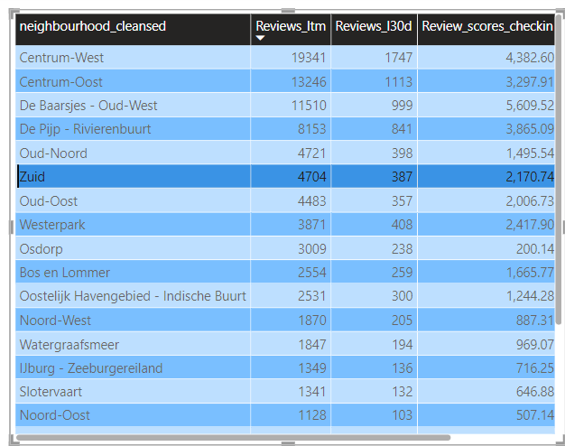
In Centrum-West and Oost most of the reviews and Check-in are more from other area.
Check-in Value difference of 1% from others areas and Check-in.
SUMMARY FINDINGS
1. Entire Home/apt had highest Room type at 5741 followed by Private, Shared, Hotel room.
2. Entire Home/apt accounted for 78.88% Room Type.
3. All metrics remained relatively constant on 24-May-2023.

