Slide 1

TCP Congestion control using CUBIC Algorithm

Slide 2
TCP CONGESTION
TCP uses a congestion window and a congestion policy that avoid congestion.
If the receiver or the network cannot receive/deliver the data as fast as it is created by the sender then it must tell the sender to slow down.
Receiver and network together decide the size of sender’s congestion window.

Slide 3
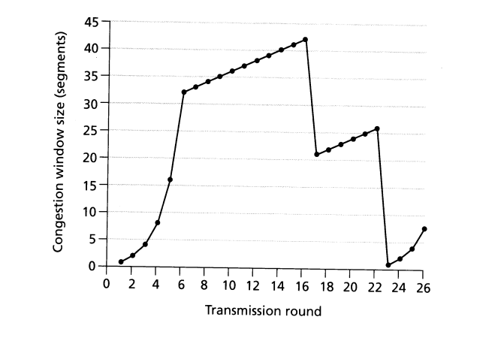
AIMD BASED ALGORITHM
Additive Increase Multiplicative Decrease is an approach used to utilize a bottleneck link.
Congestion window’s size grows linearly when there is no congestion.
The size reduces exponentially when congestion is detected.
They have slow response times in fast and long-distance networks.

Slide 4
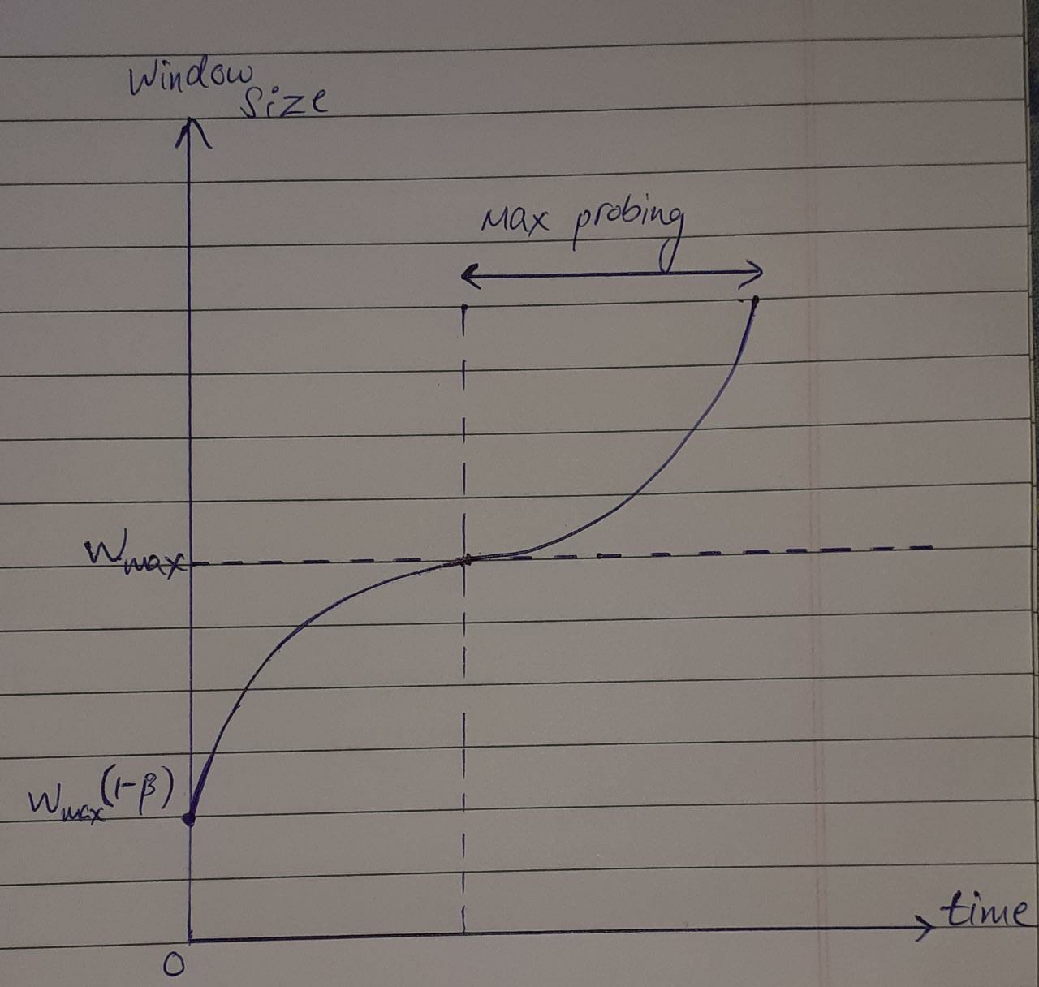

CUBIC CONGESTION CONTROL
CUBIC doesn’t have a strict constant increase of cwnd.
The window increases towards a target which depends on the maximum window size reached before the last packet loss.
W(t) = C|(t – K)|³ + W_{max}
(t is elapsed time from last window reduction)
K = $\sqrt[3]{\frac{Wmaxβ − cwnd}{C}}$

Slide 5
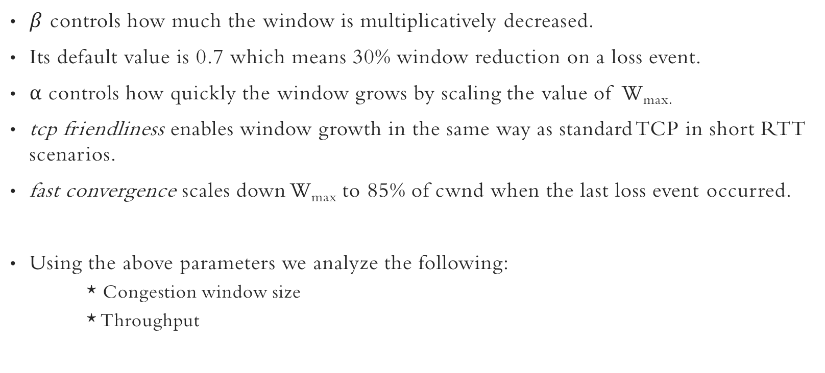
CONTROL PARAMETERS
$β$ controls how much the window is multiplicatively decreased.
Its default value is 0.7 which means 30% window reduction on a loss event.
α controls how quickly the window grows by scaling the value of W_{max.}
tcp friendliness enables window growth in the same way as standard TCP in short RTT scenarios.
fast convergence scales down W_{max} to 85% of cwnd when the last loss event occurred.
Using the above parameters we analyze the following:
* Congestion window size
* Throughput

Slide 6
SYSTEM DIAGRAM
Servers (N)
Each server has a TCP session with the client.
Data
Switch
Bottleneck
(Bandwidth B)
Client
Drop-Tail Queue
.
.
.
The goal is that each session gets an average rate of B/N.
This is not possible with β = 1.

Slide 7
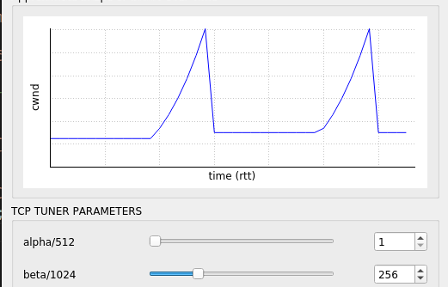
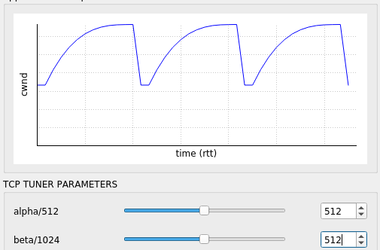
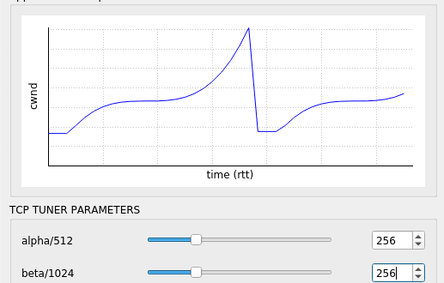
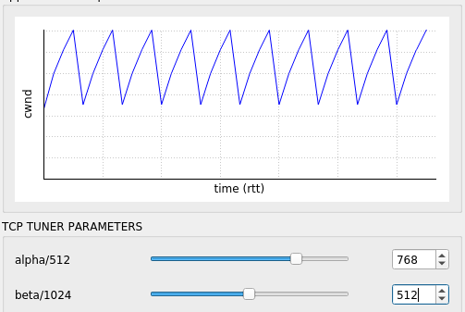
Congestion window size

Slide 8
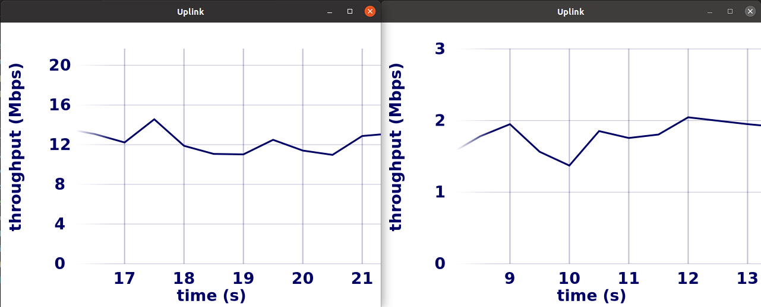
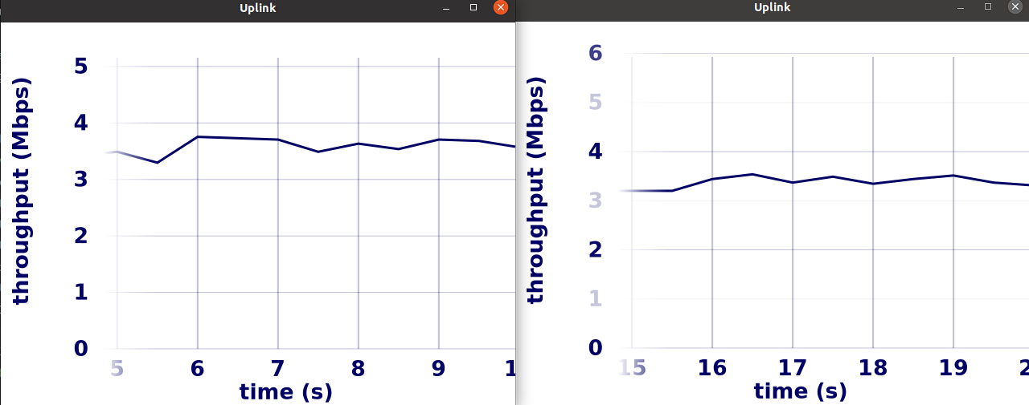
Throughput OF BOTTLENECK LINK
Throughput of two TCP flows sharing a bottleneck link.
β = 1, i.e, no multiplicative decrease So the flow which starts earlier
monopolizes the link.
β = 0.25, i.e, with multiplicative decrease So there is fair utilization of the bottleneck link
by both the flows due to window reduction.

