Slide 1

TCP Congestion control using MULTIPATH CUBIC Algorithm

Slide 2
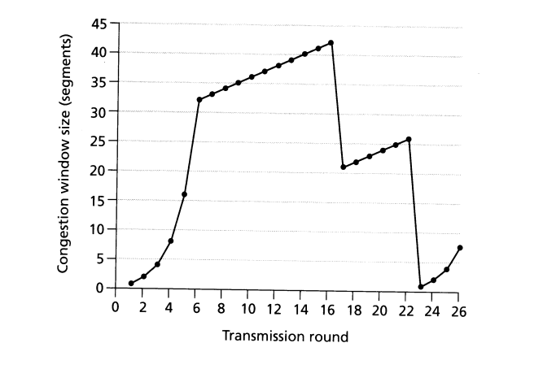
AIMD BASED ALGORITHM
Additive Increase Multiplicative Decrease is an approach used to utilize a bottleneck link.
Congestion window’s size grows linearly when there is no congestion.
The size reduces exponentially when congestion is detected.
They have slow response times in fast and long-distance networks.

Slide 3
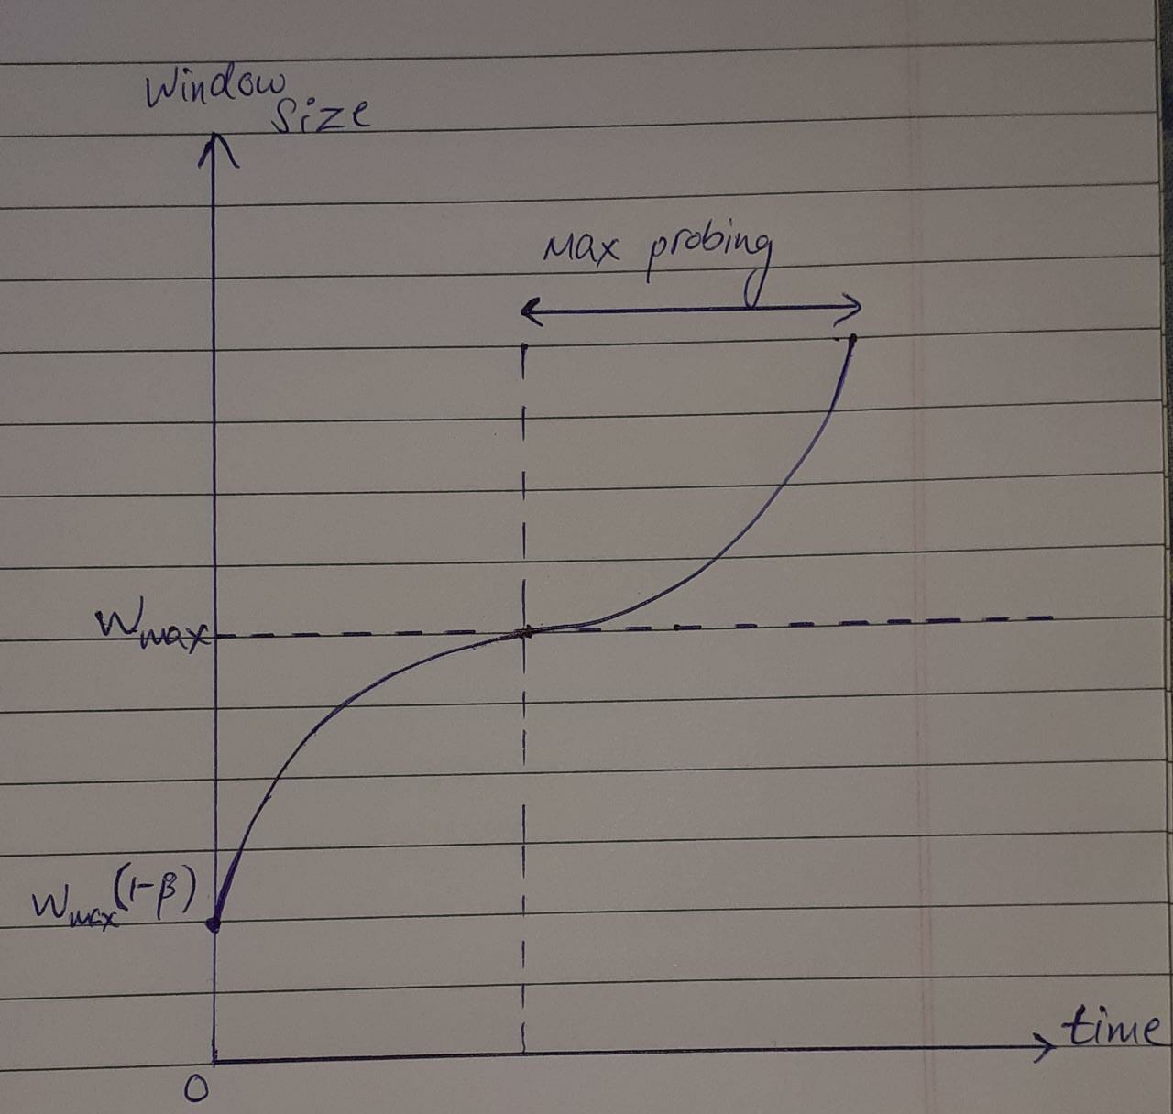

CUBIC CONGESTION CONTROL
CUBIC doesn’t have a strict constant increase of cwnd.
The window increases towards a target which depends on the maximum window size reached before the last packet loss.
$W(t)=C\left(t−K\right)3+Wmax$
(t is elapsed time from last window reduction)
$K= \sqrt[3]{\frac{Wmaxβ − cwnd}{C}}$

Slide 4
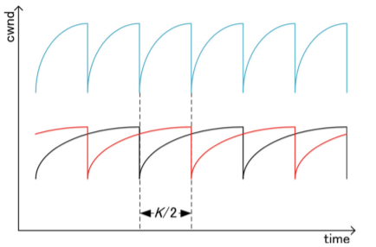
MULTIPATH CUBIC CONGESTION CONTROL
Suppose two CUBIC TCP subflows go through a bottleneck link and there are some packet losses due to congestion.
Total congestion window size is shown by blue line.
Total window size is also a cubic function and the cycle is ½ of one subflow.
Period between two packet losses will be 2K instead of K in order for total cwnd of MPTCP with two subflows to be comparable with a single CUBIC flow.
Balanced cwnd behaviour for two CUBIC TCP flows

Slide 5

cwnd of one mpCUBIC subflow is given by
$W\left(t\right)=\frac{1}{D}\left(C^{′}\left(\frac{t}{2} −K\right)+Wmax\right)$
K and W_{max} are the parameters used in CUBIC TCP
At t = 0, W is $(1−β)$ times the value just before the packet loss, i.e.
$W\left(0−\right)\left(1−β\right)=W(0+)$
⇒ $\left(C^{′}\left(−\frac{1}{2}K\right)3+2Wmax\right)\left(1−β\right)=C^{′}\left(−K\right)3+C^{′}\left(−\frac{1}{2}K\right)3+2Wmax$
⇒ $C^{′}= \frac{2}{1+ \frac{1}{8}β}C$

Slide 6

At t = 2K, W is equal to the maximum value of the conventional CUBIC, i.e., W_{max}
$W\left(2K −0\right)=Wmax$
⇒ $\frac{1}{D}\left(C^{′}\left(−\frac{1}{2}K\right)3+2Wmax\right)=Wmax$
$\text{⇒} D=\frac{2}{1+ \frac{1}{8}β}$
Therefore the equation of cwnd of an mpCUBIC subflow is given by:
$W\left(t\right)=C\left(\frac{t}{2} −K\right)3+\frac{Wmax}{16}(8+ β)$

Slide 7
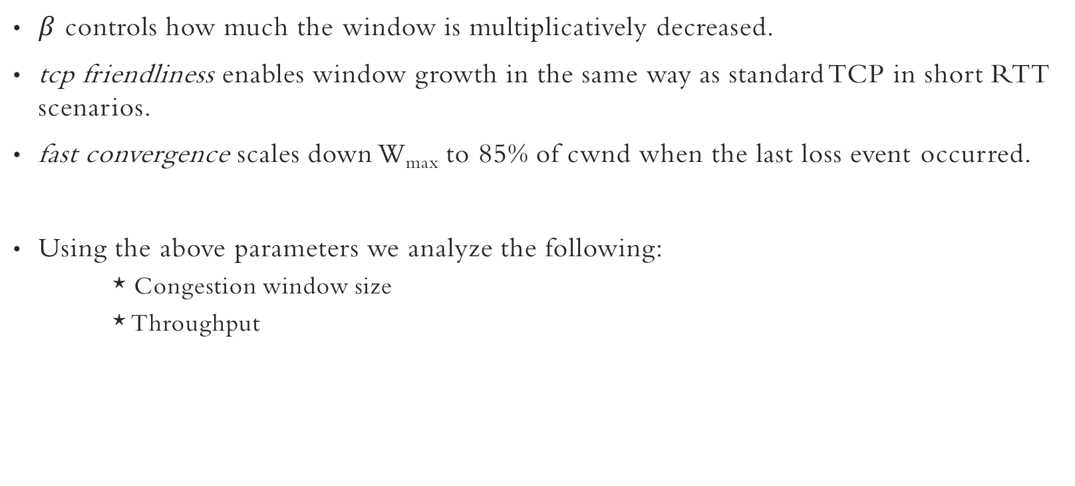
CONTROL PARAMETERS
$β$ controls how much the window is multiplicatively decreased.
tcp friendliness enables window growth in the same way as standard TCP in short RTT scenarios.
fast convergence scales down W_{max} to 85% of cwnd when the last loss event occurred.
Using the above parameters we analyze the following:
* Congestion window size
* Throughput

Slide 8
SYSTEM DIAGRAM
Servers (N)
Each server has a TCP session with the client
Data
Switch
Bottleneck
(Bandwidth B)
Client
Drop-Tail Queue
.
.
.

Slide 9
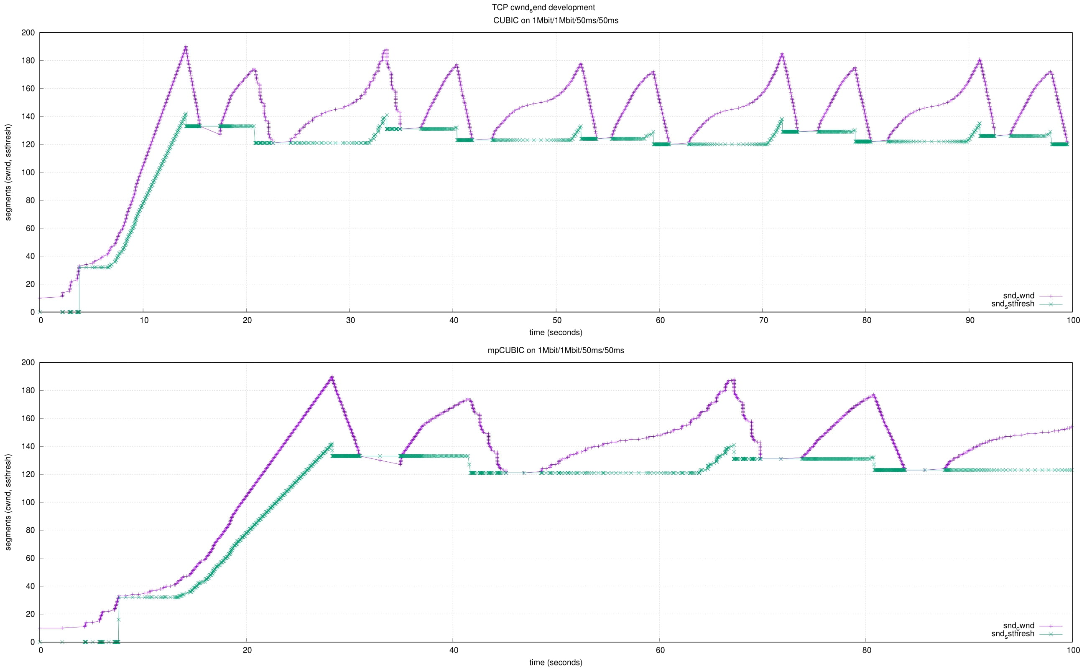
Congestion window size
cwnd
ssthresh
CUBIC
mpCUBIC

Slide 10
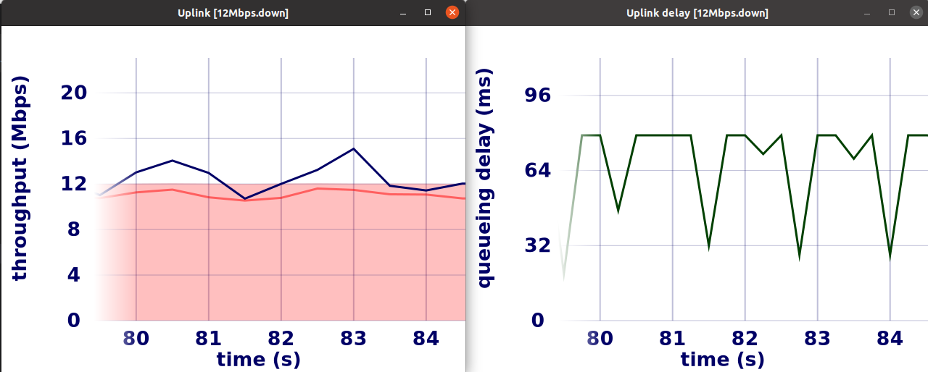
Throughput and delay
mpCUBIC TCP flow on a 12Mbps uplink

Slide 11
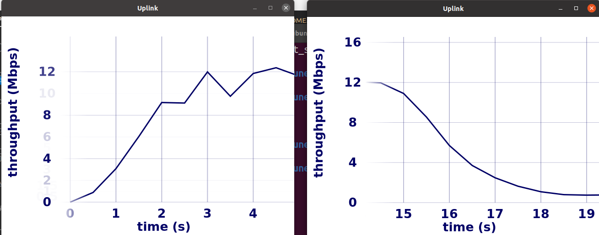
Throughput OF BOTTLENECK LINK
mpCUBIC TCP client
CUBIC TCP client

