Slide 1
DATA MANAGEMENT BY FILTERS AND TREES
GROUP 16
106119014 – Anurag Goyal
106119058 – Kartikey Agarwal
106119046 – Hari Hara Sudhan

Slide 2

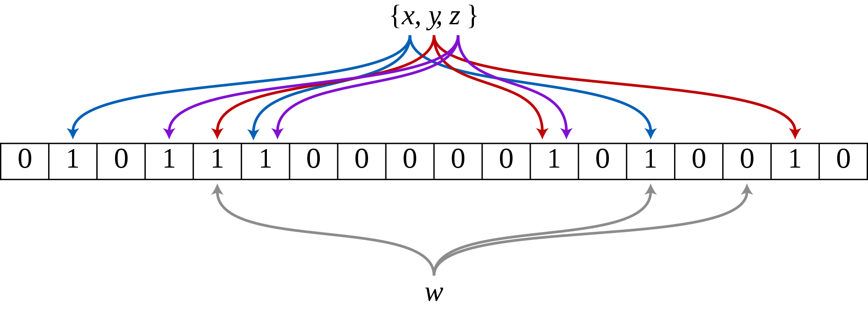
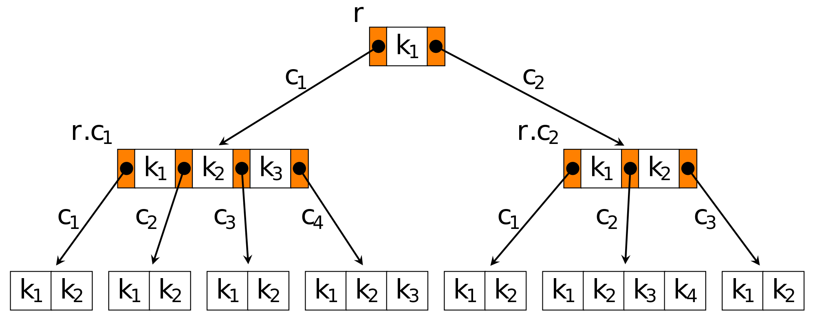
PROBABILISTIC FILTERS AND MULTIWAY TREES
Set membership tests by Probabilistic Filters
Bloom Filters
Cuckoo Filters (low and high load)
Structured storing of data by Multiway Trees
B Trees (RAM based)
B+ Trees (RAM and disk based)

Slide 3
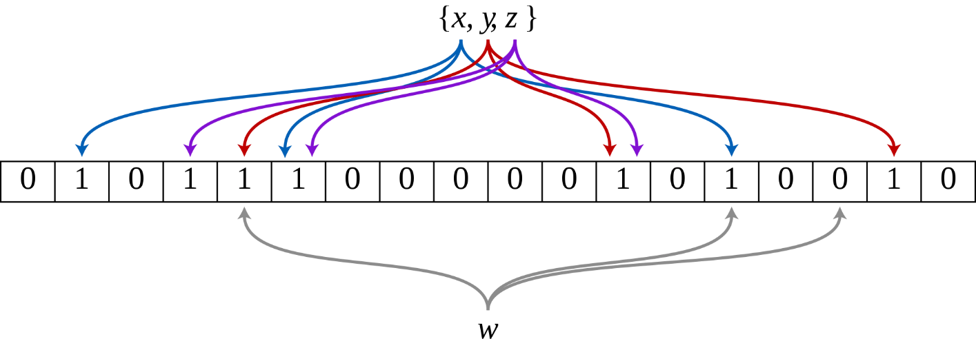
BLOOM FILTERs
A Bloom filter is a memory efficient probabilistic data structure. It is used for determining the existence of an element in a set.
It can only tell whether an element is “strictly not” or “maybe there” in the set.
It maintains a bit array of Boolean type of a predetermined size.
Element insertion is done by using a hash function to determine the locations of interest in the array.

Slide 4
BLOOM FILTERs – OPERATIONS
Bloom Filters allow two kinds of operations :
Insertion - O(1) time complexity
Lookup - O(1) time complexity
Deletion is not allowed because deleting an element would mean overwriting the corresponding bit array elements to zero. There is a chance that doing it would delete multiple other elements too from the filter.

Slide 5


BLOOM FILTERS - applications
1. Distributed Storage Systems
For such systems organize their data in tables that reside on the disk and are structured as key-value maps.
Locating the right table without checking explicitly on the disk, a Bloom filter is maintained in the RAM for each table.
2. Web Caches
Bloom filters are used to determine which web content is to be cached. They are used to keep track of all the URLs accessed by users. A web object is cached only when it is being accessed a second time.
The result is a significant reduction in disk write workload and saving of cache space which increases the cache hit rates.

Slide 6
CUCKOO FiLTERS
A Cuckoo filter is also a memory efficient probabilistic data structure like Bloom filter. It is used for determining the existence of an element in a set.
It maintains multiple arrays of the same size called as ‘buckets’.
The false positive probability in determining set membership depends only on the choice of fingerprinting technique.
The more elements are added, the greater the probability of false positives becomes.

Slide 7
cuckoo FILTERs – OPERATIONS
Cuckoo Filters allow three kinds of operations :
Insertion - O(1) amortized time complexity
Lookup - O(1) time complexity
(Amortized for high load cuckoo filter)
Deletion - O(1) time complexity
(Amortized for high load cuckoo filter)
Insertion in low and high load along with lookup and deletion in high load cuckoo filters can take undeterministically longer times if the operation triggers a relocation chain. But the average time remains O(1).

Slide 8
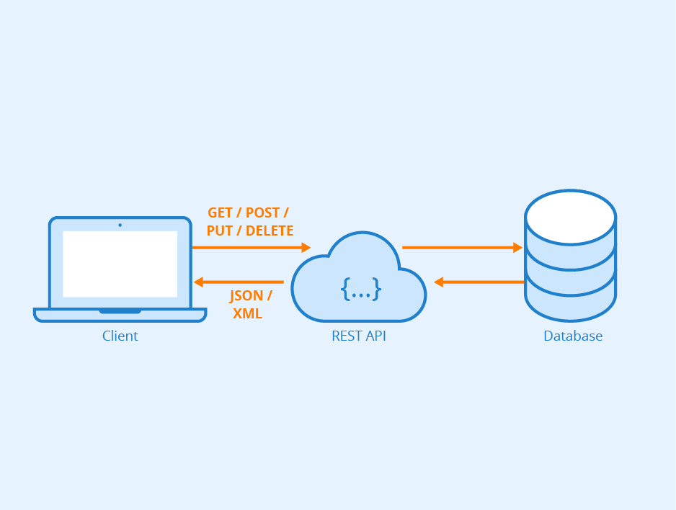
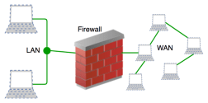
cuckoo fILTERS - applications
1. Remote REST Services
Any API call with a binary answer such as “this address is invalid” uses a cuckoo filter and eliminates over 90% of duplicate queries.
2. Firewalls in Virtual Network Functions
Cuckoo filters allow writing of rule sets in the form of hash tables that can store an extensive collection of rule sets and effective match network packets with those rules.
The hash table in Cuckoo filter can be trained for the required parameters and the parameters in the incoming packets can be match with high speed and accuracy.
3. Loop Detection in Software Defined Networking
Cuckoo filters have a unique property that detects if the filter is full and relocated keys. If the keys get displaced for the entire round that means a forwarding loop has been detected efficiently

Slide 9
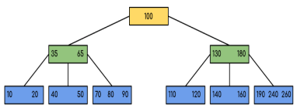
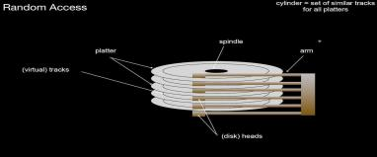
B Trees
B Tree is a self-balancing search tree.
To understand the use of B Trees, we must think of the huge amount of data that cannot fit in the main memory. When the number of keys is high, the data is read from disk in the form of blocks.
Disk access time is very high compared to the main memory access time. The main idea of using B Trees is to reduce the number of disk accesses.
Most of the tree operations (search, insert, delete, max, min … etc.) require O(h) number of disk accesses where h is the height of the tree.
The height of B Tree is kept low by putting maximum possible keys in a B Tree node.

Slide 10
B Trees – OPERATIONS
B Trees allow three kinds of operations :
Insertion - O(log N) time complexity
Searching - O(log N) time complexity
Deletion - O(log N) time complexity
(N is the number of elements present in the tree)
Insertion might need node splitting if overflow occurs.
Searching is similar to searching in BST.
Deletion might need merging with an adjacent node.

Slide 11
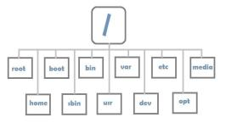

B TREES - applications
1. Filesystems
B Tree is used in filesystems to allow quick random access to an arbitary block in a particular file.
B Tree algorithms are efficient for accessing blocks of stored information which is then copied into main memory for processing.
In the worst case, they are designed to do dynamic set operations in O(log N) time because of their high ‘branching factor’.
2. Database Management Systems
Large databases are kept on the disk drives. The time taken to read a record on a disk drive far exceeds the time needed to compare keys once the record is available.
B Tree is used to index the data and provides faster access to the actual data stored on the disks since, the access to value stored in a large database that is stored on a disk is a very time-consuming process.
Searching an un-indexed and unsorted database containing N key values needs O(N) running time in worst case. However, if we use B Tree to index this database then it will be searched in O(log N) time in worst case.

Slide 12
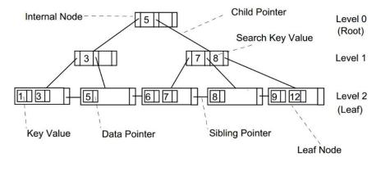
B+ TREES
A B+ Tree can be viewed as a B Tree in which each node contains only keys (not key-value pairs) and to which additional level is added at the bottom with linked leaves.
The difference is that in B+ Trees only leaf nodes contain the actual key values. The non-leaf nodes of the B+ Tree contain router values. Routers are entities of the same type as the key values, but they are not the keys stored in the search structure.
They are only used to guide the search in the tree. In classical B Trees, the key values are stored in both leaf and non-leaf nodes of the tree.

Slide 13
B+ Trees – OPERATIONS
B+ Trees allow three kinds of operations :
Insertion - O(log N) time complexity
Searching - O(log N) time complexity
Deletion - O(log N) time complexity
(N is the number of elements present in the tree)
Insertion might need node splitting if overflow occurs and always occurs at the leaf nodes.
Search elements are present in the leaf nodes.
Deletion might need merging with an adjacent node.

Slide 14

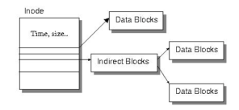
B+ TREES - applications
1. Large Scale Data Storage
The primary value of a B+ Tree is in storing data for efficient retrieval in a blockoriented storage context, in particular, filesystems.
This is primarily because unlike binary search trees, B+ Trees have very high fanout which reduces the number of I/O operations required to find an element in the tree.
2. Metadata Indexing
The ReiserFS, NSS, XFS, JFS, ReFS and BFS filesystems all use B+ Trees for metadata indexing. BFS uses B+ Trees for storing directories also.
NTFS uses B+ Trees for directory and security-related metadata indexing. EXT4 uses extent trees (a modified form of B+ Tree) for file extent indexing.
APFS uses B+ Trees to store mappings from filesystems object IDs to their locations on disk, and to store filesystem records

