Slide 1
Deep Learning
Lecture 13
Recurrent Networks
Prof. Dr. Rainer Herrler
Phone: 09721/ 940-8710
Email: rainer.herrler@fhws.de
Pictures from Wikipedia / Pixabay
Some Pictures generated with Stable Diffusion

Slide 2
Recurrent Neural Networks
RNNs are dealing with Sequences of data
Sequences are collections of elements, where
Elements can be repeated
Order matters
Sequences can be of variable (up to infinite) length
Examples
Audio signals of variable length for captioning / transscription
Stock prediction
Text e.g for translation
How did we process text in ML SS2022?

Slide 3
Situation with the NN’s so far….
Input had fixed length.
Order of features was not relevant (almost)
Output had fixed length
For some Tasks sequence is essential
Example, where “bag of words” is failing:
“I saw her duck” “Duck! I saw her.”

Slide 4
Overview on recursive networks
RNN - Basic Idea of recurrent networks
LSTM - Advanced version addressing the problems of RNN
GRU - Alternative design to LSTM

Slide 5
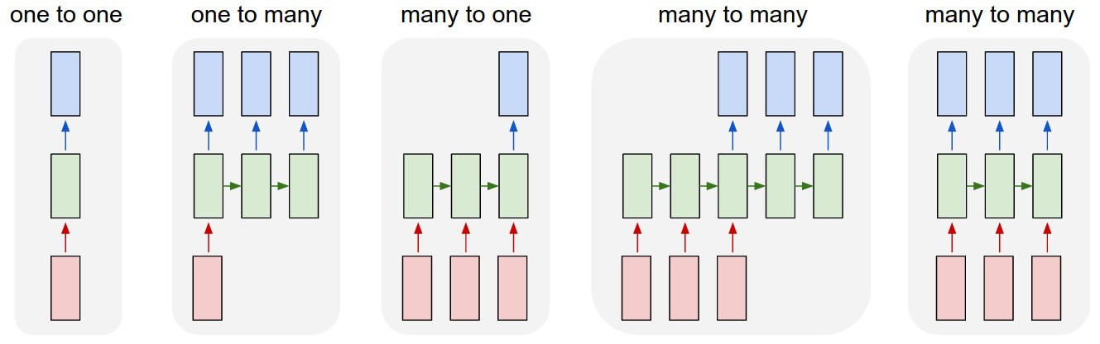
Examples variable Inputs and outputs
Image Source: http://karpathy.github.io/2015/05/21/rnn-effectiveness/
Text Classification
Stock price
prediction
Image captioning
Translation

Slide 6
Basic recurrent inference
A recurrent layer has
Some additional inputs
where it gets what he
returned as an output
the timestep before.
Time t = 1
x₁
a₁
y₁
x₂
a₂
Weights are also
given for these
recurrent connections!
Time t = 2
x₁
a₁
y₁
Initial Value is 0.
x₂
a₂

Slide 7
Basic recurrent backpropagation
Backpropagation goes
Also back in time. This
Is similar to very deep networks and leads to the vanishing gradients problem
Time t = 1
x₁
a₁
x₂
a₂
Time t = 2
x₁
a₁
x₂
a₂
Time t = 3
x₁
a₁
y₁
x₂
a₂

Slide 8
Problems of recurrent neural networks
In theory RNN are powerfully enough to take a long context of samples into account, but in practice its very hard to train these models.
Problem 1: Vanishing gradients, weights cannot be efficiently updated over the long sequence
Problem 2: In a consequence they cannot store a long context efficiently
Problem 3: Slow training process. The training has to be performed sequentially and cannot parallelization is not possible.
The first two problems are addressed by LSTMs, the next development stage of RNN’s

Slide 9
LSTM
Long term short term memory
Inventors Sepp Hochreiter and Jürgen Schmidhuber in 1997
In german this would translate to “Langes Kurzzeitgedächtnis”
The network was specifically designed to be able to remember important things longer.
This allowed to realize deeper recurrent neural networks and allowed applications like language understanding to improve a lot.

Slide 10











The LSTM Architecture
$$h_{t}$$
$$c_{t−1}$$
$$c_{t}$$
x
+
$$tanh$$
x
x
$$h_{t−1}$$
$$σ$$
$$σ$$
$$tanh$$
$$σ$$
$$h_{t}$$
$$x_{t}$$

Slide 11
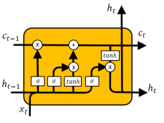
Role of the different components
States of the LSTM
Cell State (upper rail)
The cell state is the long term memory of the LSTM Cell.
It has influence on current and future output
Hidden State (lower rail)
The hidden state is the short term memory of the cell.
It triggers forgetting, memorizing and output
Gates of the LSTM
Forget Gate (Blue)
The forget gate controls if the long term memory should be erased
Input Gate (Green)
The input gate controls if and how the long term memory should be updated
Output Gate (Rot)
The output gate controls the current output and next short term memory
Application in Keras
Available as a Layer type
Most important parameter: Number of units

Slide 12

LSTM Example
DL_034_LSTM

Slide 13
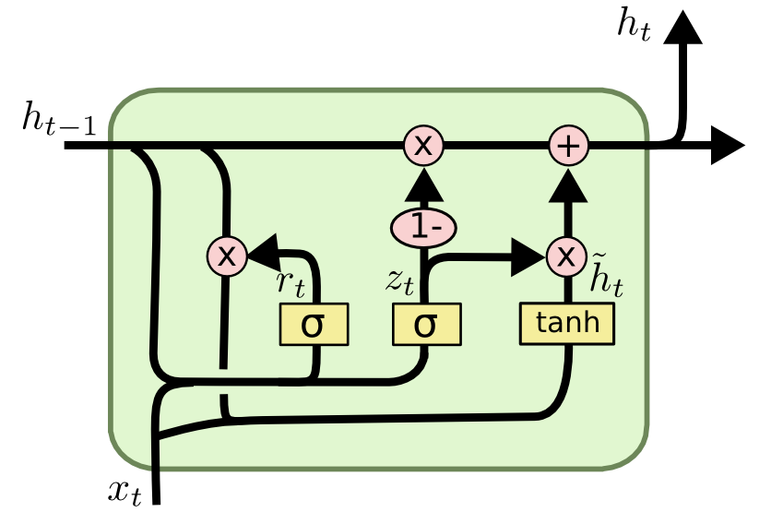
GRU
Gated recurrent unit
Comparison to LSTM
Similar Gating Mechanisms but fewer parameter
No Output Gate
Less popular than LSTM but perfom similar on some tasks
Gates of the GRU
Reset Gate (Blue)
Determines which parts of the long term memory should be kept
Update Gate(Green)
The input gate controls if and how the long term memory should be updated
In Keras available as a layer type:
tf.keras.layer.GRU
http://dprogrammer.org/rnn-lstm-gru

Slide 14









GRU
Gated recurrent unit
$$h_{t}$$
$$h_{t−1}$$
x
+
$$r_{t}$$
-1
$${\tilde{h}}_{t}$$
x
$$z_{t}$$
x
$$σ$$
$$σ$$
$$tanh$$
$$x_{t}$$

Slide 15
Summary on recurrent layers
RNN
In theory they are able to reason over past inputs but they are difficult to train
Don’t play a big role in practice but are a good introduction to recurrent layers
LSTM
Advanced version addressing the problems of RNN. The architecture uses gates to explicitly model an efficient memorizing process
Still they need a lot of time for training and training has to be done sequentially needing a lot of CPU time.
Still it is hard for LSTM models to work with a very long context
GRU
Alternative design also using a gating technique
Performs similar to LSTMs

Slide 16
Recap Slides

Slide 17
That was the initial plan for this Semester:
We want to get familiar in building neural networks with state of the art frameworks
We learn how to create different network structures and when they are useful:
Recurrent Networks
Autoencoder Networks
Convolutional Neuronal networks
…
We learn how to find and use existing trained models
We learn how to fine tune existing models for own tasks
We learn how to train models with GPU’s or TPU’s in the cloud.
…

Slide 18
State of the art frameworks!
Notes:
Cntk Microsoft

Slide 19
Framework Questions:
How are Tensorflow and Keras related ?
What important classes do we need to create and train networks ?

Slide 20
Cloud Training. What were your experiences?

Slide 21
In which context did we mention the following AI researchers
Yann Le Cun
Geoffrey Hinton
François Chollet
Fei Fei Li
Sepp Hochreiter
Notes:
https://medium.com/@jan_marcel_kezmann/40-ai-researchers-to-follow-in-2022-acdafca36159#900e

Slide 22
Loss and Score
What is the difference ?
What are they needed for ?
Mention Examples:
Describe the input for each:

Slide 23
Our Tool Environment
What is anaconda?
Two ways to install python packages
What is juypter notebook

Slide 24


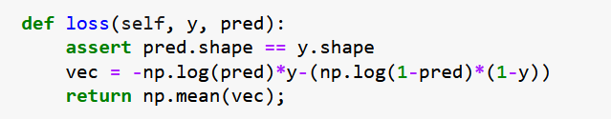
To which Objects could this code belong

Slide 25
Model creation
What different ways to create Keras models did we use?
What is done during model compilation?
Notes:
Compilation : Optimizer, Loss , weight initialization, metrics
Everything needed to craete the computational graph

Slide 26
Model training
What is done in a training loop ?
How is it usually initiated in Keras?
What are important parameters for the loop?

Slide 27
Model evaluation
How did we evaluate models in Scikit learn?
How to evaluate models in Keras
Notes:
Compilation : Optimizer, Loss , metrics

Slide 28
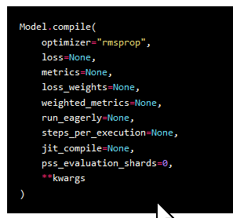
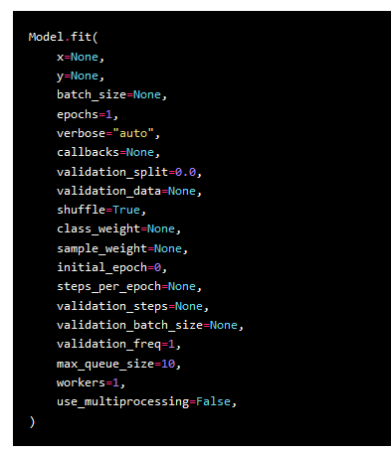

Slide 29
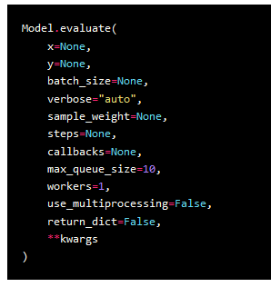
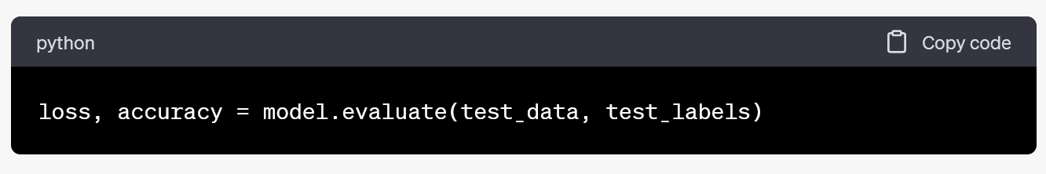

Slide 30
Model inference
How can we do inference in Keras ?

Slide 31







Backpropagation
$$x$$
$$q$$
$$+$$
$$y$$
$$f$$
$$∗$$
$$z$$
How do we call this graphical structure formula ?

Slide 32



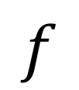





Values from forward propagation
Values from Backpropagation
$$x$$
$$\frac{∂L}{∂x}=\frac{∂L}{∂z}⋅\frac{∂z}{∂x}$$
$$\frac{∂z}{∂x}$$
$$z$$
________________
$$f$$
$$\frac{∂z}{∂y}$$
$$\frac{∂L}{∂z}$$
$$y$$
______________
$$\frac{∂L}{∂y}=\frac{∂L}{∂z}⋅\frac{∂z}{∂y}$$
______________

Slide 33
How to choose?
The batchsize ?
The Number of Epochs ?
The last layer activation function ?

Slide 34
How can we initialize weights before training ?
Theoretical Methods
How to do it in Keras ?
Notes:
At the layers ? Each layer individually, kernel_initializer='Constant',

Slide 35
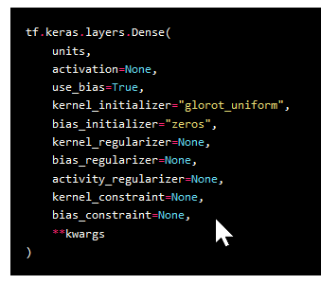
https://towardsdatascience.com/weight-initialization-for-neural-networks-does-it-matter-e2fd99b3e91f

Slide 36
Dropout
What is dropout and when is it helpful ?
What different operation modes are there?

Slide 37
Optimizer
What can be your benefits if you use a different optimizer than SGD ?
How does the optimizer achieve that effect ?

Slide 38
When is one hot encoding necessary

