Slide 1


PROXIMAL SUPPORT VECTOR MACHINE CLASSIFIER
MAN-300 PROJECT
Supervisor : Prof Shiv Kumar Gupta
Anurag Porwal 19312004

Slide 2
INTRODUCTION
SVM model is basically a representation of different classes in a hyperplane in multidimensional space.
In Proximal Support Vector Machine (PSVM), instead of a standard Support Vector Machine (SVM) that classifies points by assigning them to one of two disjoint half-spaces, points are classified depending on proximity to one of two parallel planes that are pushed as far as possible. These planes are pushed apart as far as possible.
PSVM is an extremely fast and simple algorithm for generating linear or nonlinear classifier that merely requires the solution of a single system of linear equations.

Slide 3
Introduction (Cont..)
In contrast, standard SVMs solve a quadratic or a linear program (QPP, LPP) that require considerably longer computational time to get the solution.
Comparable test set correctness to that of standard SVM classifier with considerably faster time. (20.8 seconds for 2 millions points with 10 features [2])
Comparison will be done on 4 different dataset and results will be analyzed later.
Obtaining a linear or nonlinear PSVM classifier requires nothing more sophisticated than solving a single system of linear equations.

Slide 4
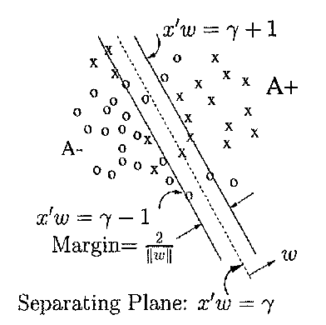
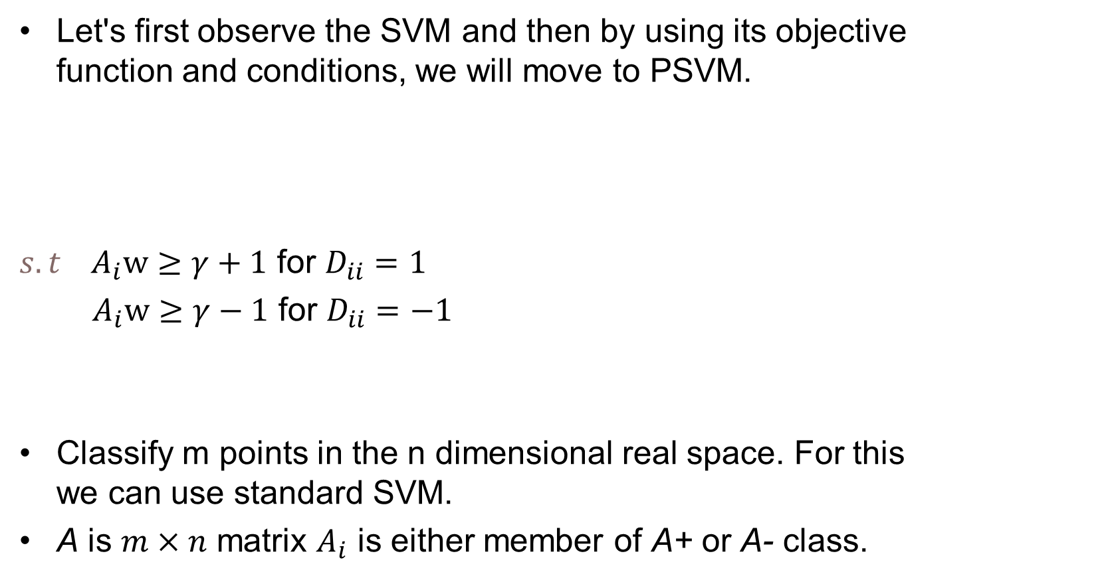

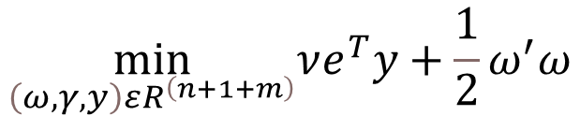
Transition from SVM to PSVM
Let's first observe the SVM and then by using its objective function and conditions, we will move to PSVM.
${s.t A}_{i}w≥γ+1$ for $D_{ii}=1$
${ A}_{i}w≥γ−1$ for $D_{ii}=−1$
Classify m points in the n dimensional real space. For this we can use standard SVM.
A is $m×n$ matrix $A_{i}$ is either member of A+ or A- class.
$$\min_{\left(ω,γ,y\right)εR^{\left(n+1+m\right)}}νe^{T}y+\frac{1}{2}ω^{′}ω$$
Fig 1
$$y≥0$$

Slide 5
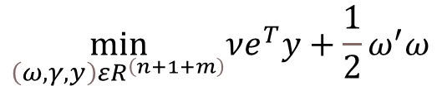
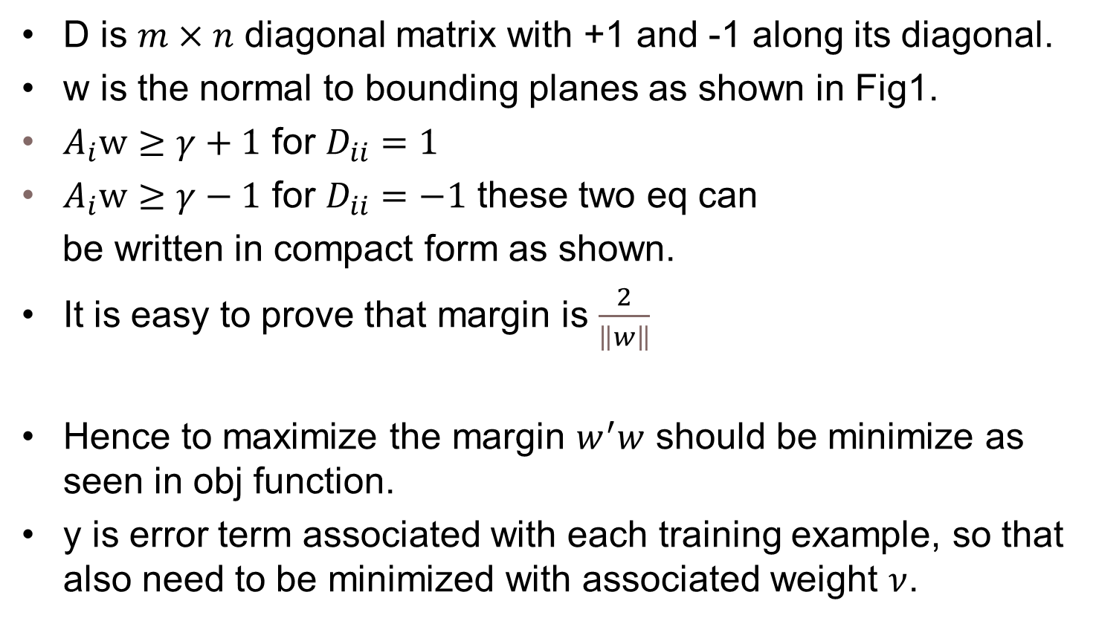


D is $m×n$ diagonal matrix with +1 and -1 along its diagonal.
w is the normal to bounding planes as shown in Fig1.
$A_{i}w≥γ+1$ for $D_{ii}=1$
$A_{i}w≥γ−1$ for $D_{ii}=−1$ these two eq can
be written in compact form as shown.
It is easy to prove that margin is $\frac{2}{\left\|w\right\|}$
Hence to maximize the margin $w^{′}w$ should be minimize as seen in obj function.
y is error term associated with each training example, so that also need to be minimized with associated weight $ν$.
$$\min_{\left(ω,γ,y\right)εR^{\left(n+1+m\right)}}νe^{T}y+\frac{1}{2}ω^{′}ω$$
$$D\left(Aw−eγ\right)+y≥ⅇ$$
$$y≥0$$

Slide 6

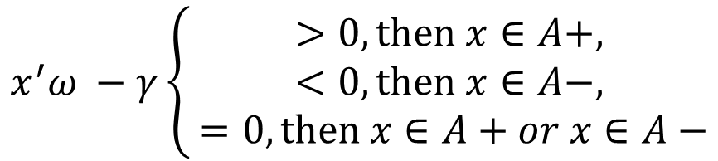
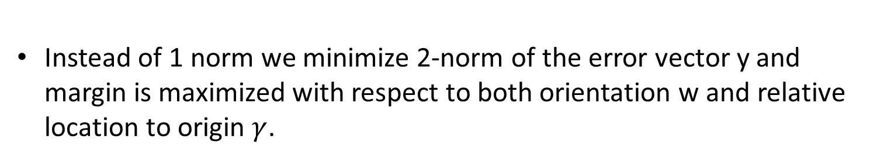
This plane act as classifier as follows:
$$x^{′}ω −γ\left\{\begin{aligned}>0, then x∈A+, \\ <0, then x∈A−, \\ =0, then x∈A+or x∈A−\end{aligned}\right.$$
Instead of 1 norm we minimize 2-norm of the error vector y and margin is maximized with respect to both orientation w and relative location to origin $γ$.

Slide 7
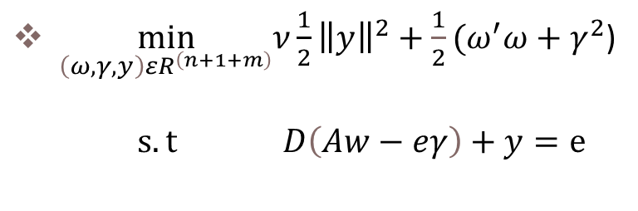
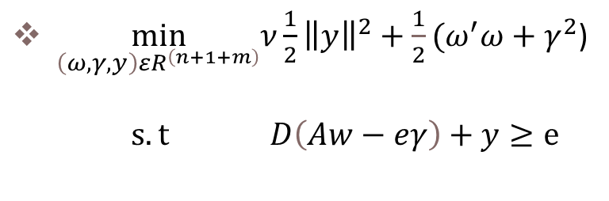
Replacing Inequality with equality to get PSVM objective function.
Key idea is to replace inequality constraint by an equality.
$\min_{\left(ω,γ,y\right)εR^{\left(n+1+m\right)}}ν\frac{1}{2}{\left\|y\right\|}^{2}+\frac{1}{2}(ω^{′}ω+γ^{2}$)
$s.t D\left(Aw−eγ\right)+y≥ⅇ$
$\min_{\left(ω,γ,y\right)εR^{\left(n+1+m\right)}}ν\frac{1}{2}{\left\|y\right\|}^{2}+\frac{1}{2}(ω^{′}ω+γ^{2}$)
$s.t D\left(Aw−eγ\right)+y=ⅇ$
Now let's discuss the consequences of doing so from next slide onwards and this is the final objective function for PSVM.

Slide 8
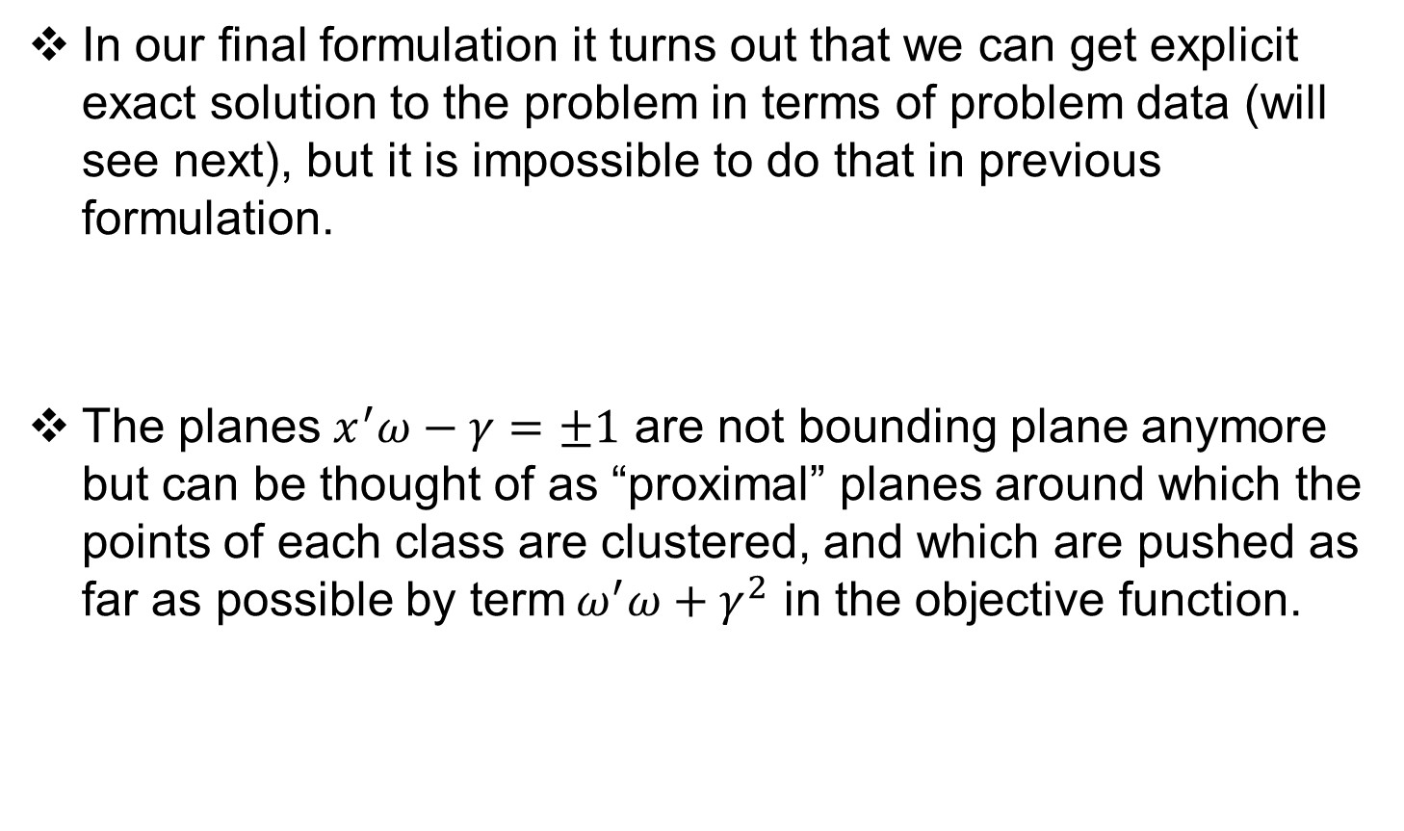
Understanding The Change
In our final formulation it turns out that we can get explicit exact solution to the problem in terms of problem data (will see next), but it is impossible to do that in previous formulation.
The planes $x^{′}ω−γ=±1$ are not bounding plane anymore but can be thought of as “proximal” planes around which the points of each class are clustered, and which are pushed as far as possible by term${ ω}^{′}ω+γ^{2}$ in the objective function.

Slide 9
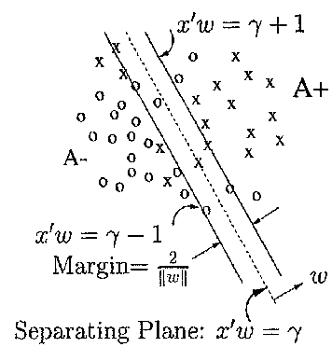
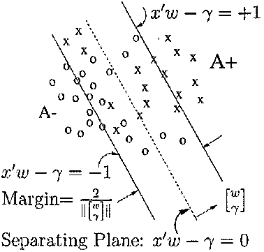
Difference between PSVM and SVM graphically
PSVM
SVM

Slide 10



Taking the Lagrangian and setting the gradients with respect to $\left(ω,γ,y,u\right)$ of L equals to 0.
$L\left(ω,γ,y,u\right)=\frac{ν}{2}{\left\|y\right\|}^{2}+\frac{.1}{2}{\left\|\left[\begin{matrix}ω \\ γ\end{matrix}\right]\right\|}^{2}−u^{′}\left(D\left(Aw−ⅇγ\right)+y−ⅇ\right)$
$∇L=0$ gives following KKT optimality conditions:
$$\begin{matrix}ω−A^{′}Du=0 \\ γ+e^{′}Du=0 \\ νy−u=0 \\ D\left(Aw−ⅇy\right)+y−e=0\end{matrix}$$
$$\begin{matrix}ω=A^{′}Du \\ γ=−e^{′}Du \\ y=\frac{u}{ν}\end{matrix}$$

Slide 11
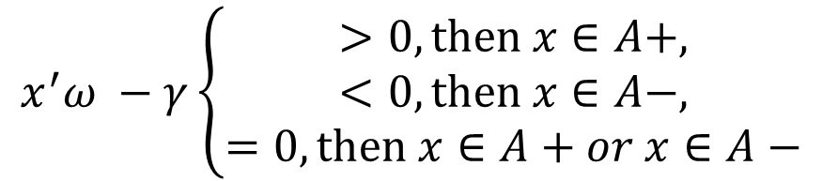
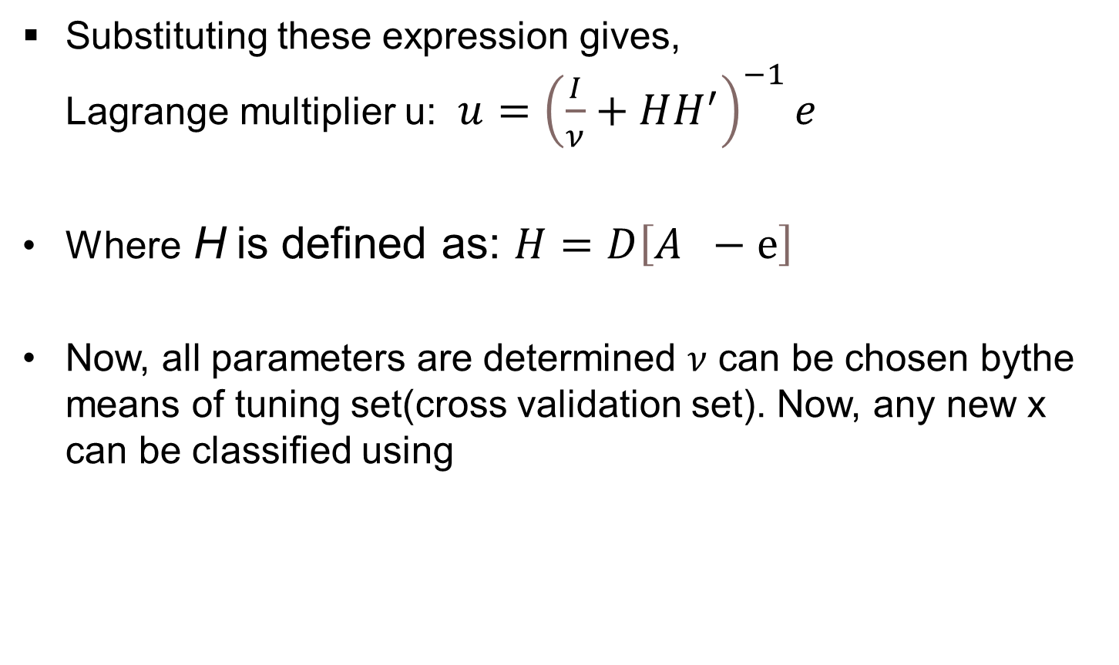
Substituting these expression gives, Lagrange multiplier u: $u={\left(\frac{I}{ν}+HH^{′}\right)}^{−1}ⅇ$
Where H is defined as: $H=D\left[A −ⅇ\right]$
Now, all parameters are determined $ν$ can be chosen bythe means of tuning set(cross validation set). Now, any new x can be classified using
$$x^{′}ω −γ\left\{\begin{aligned}>0, then x∈A+, \\ <0, then x∈A−, \\ =0,then x∈A+or x∈A−\end{aligned}\right.$$

Slide 12
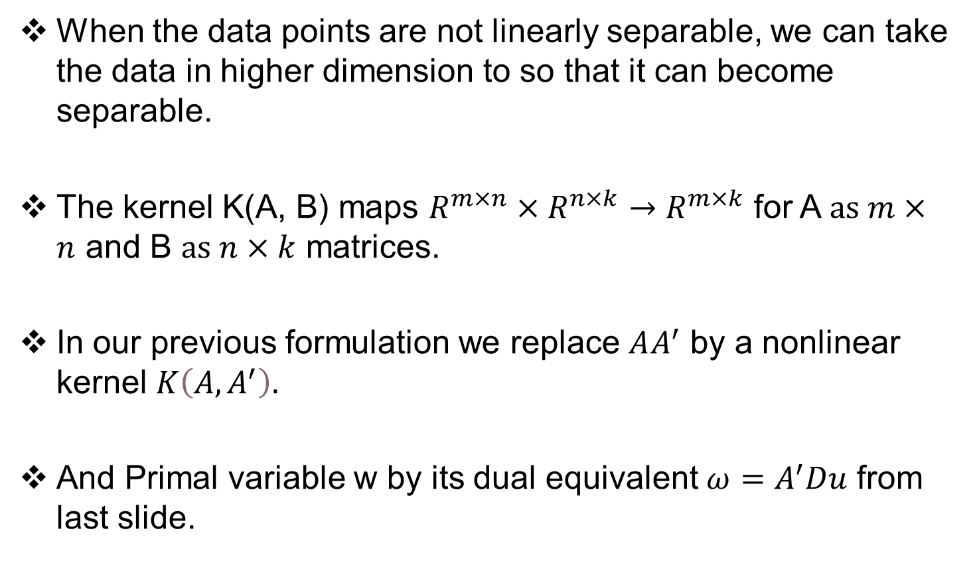
Nonlinear PSVM
When the data points are not linearly separable, we can take the data in higher dimension to so that it can become separable.
The kernel K(A, B) maps $R^{m×n}×R^{n×k}→R^{m×k}$ for A $as m×n$ and B $as n×k$ matrices.
In our previous formulation we replace $AA^{′}$ by a nonlinear kernel $K\left(A,A^{′}\right).$
And Primal variable w by its dual equivalent $ω=A^{′}Du$ from last slide.

Slide 13



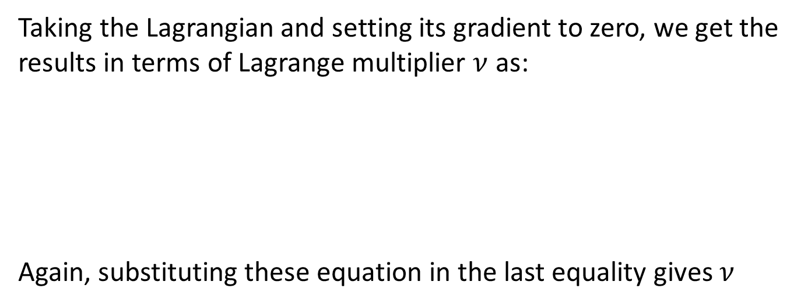
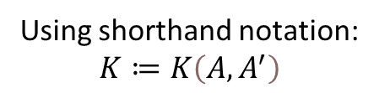
s.t
Using shorthand notation: $$K≔K\left(A,A^{′}\right)$$
Taking the Lagrangian and setting its gradient to zero, we get the results in terms of Lagrange multiplier $ν$ as:
Again, substituting these equation in the last equality gives $ν$
$$\begin{matrix}u=DK^{′}Dν \\ γ=−e^{′}Dv \\ y=\frac{v}{ν}\end{matrix}$$

Slide 14
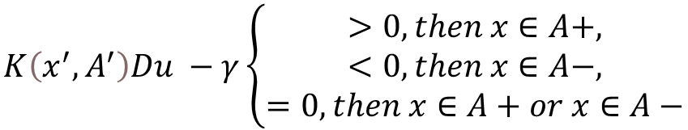
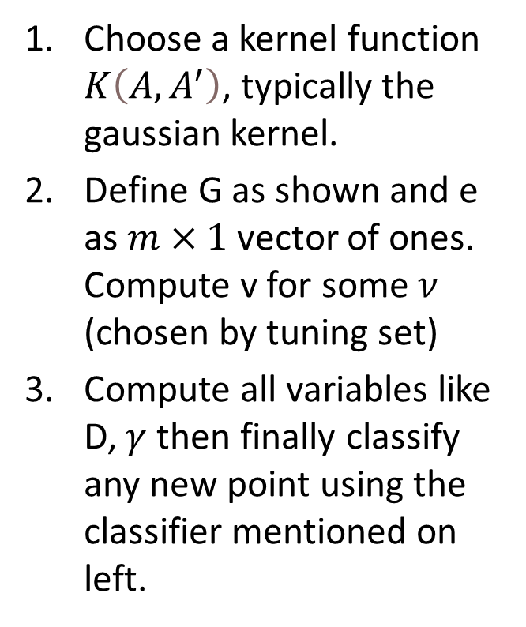
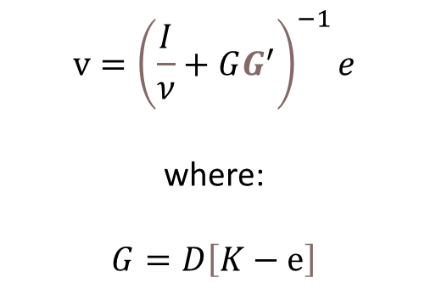
Algorithm Nonlinear Proximal SVM
$$v={\left(\frac{I}{ν}+GG^{′}\right)}^{−1}ⅇ$$
where:
$G=D\left[K−ⅇ\right]$
Choose a kernel function $K\left(A,A^{′}\right)$, typically the gaussian kernel.
Define G as shown and e as $m×1$ vector of ones. Compute v for some $ν$ (chosen by tuning set)
Compute all variables like D, $γ$ then finally classify any new point using the classifier mentioned on left.
To classify any point, we formed this non-linear classifier as follows:
$$K\left(x^{′},A^{′}\right)Du −γ\left\{\begin{aligned}>0, then x∈A+, \\ <0, then x∈A−, \\ =0,then x∈A+or x∈A−\end{aligned}\right.$$

Slide 15
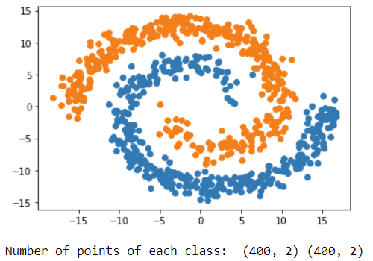
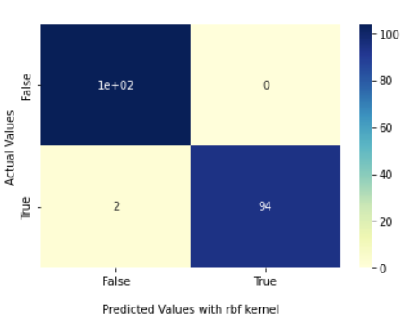
Implementation of SVM and PSVM on datasets.
First – SPIRAL DATASET
800 datapoints.
Results using SVM classifier:
with linear kernel accuracy
score: 0.74
With gaussian kernel: 0.99
Confusion matrix with Gaussian kernel

Slide 16
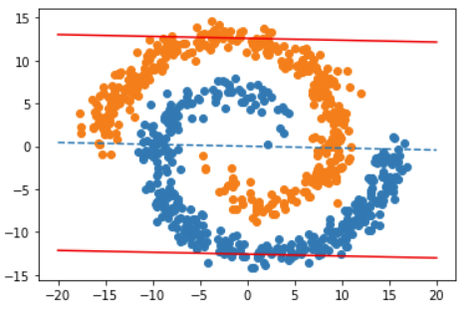
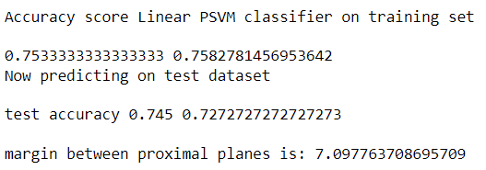
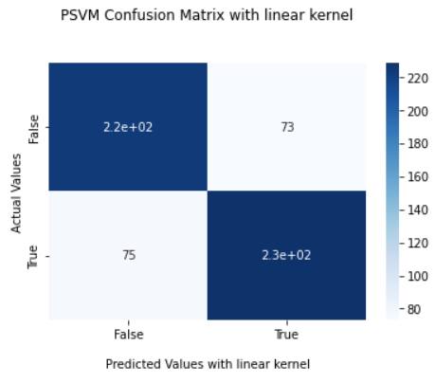
PSVM implementation on SPIRAL DATASET
Linear PSVM
Red lines denote the proximal planes, and the points are classified based on the proximity to these plane.

Slide 17
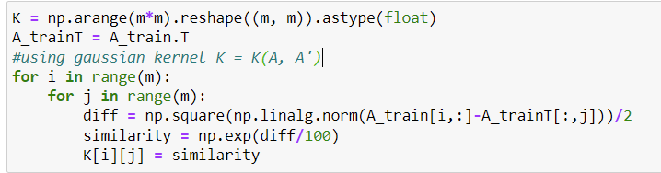
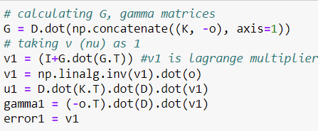
Nonlinear PSVM on SPIRAL DATASET
Step 1:
Step 2:

Slide 18
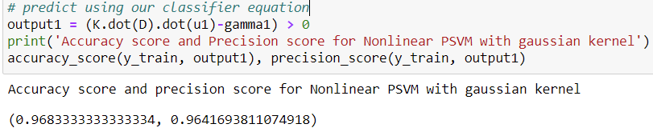
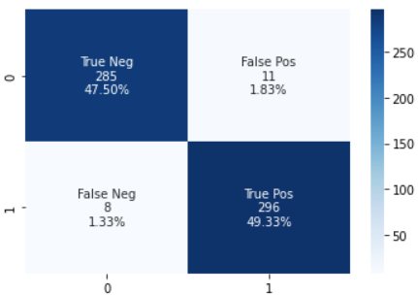
Step 3: Predict on any new points using the classifier equation
Confusion Matrix Heatmap
Here we can observe that accuracy score is pretty good and very much comparable to SVM with gaussian kernel.

Slide 19
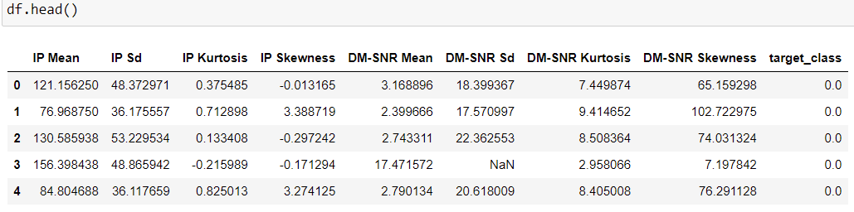
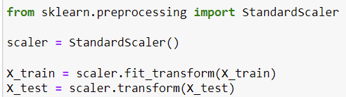
Pulsar Stars dataset [4]
Since this data set have some missing and null values. I have done some data manipulation and some standardization i.e., by removing the mean and scaling to unit variance.

Slide 20
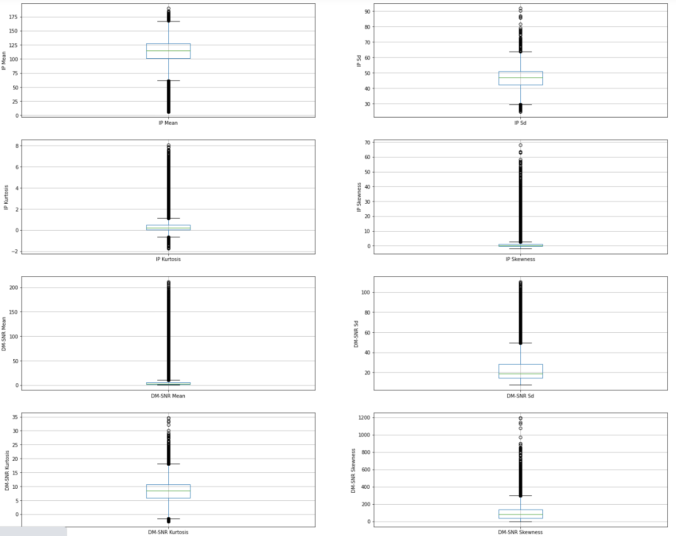
Box Plot of 8 Features.

Slide 21
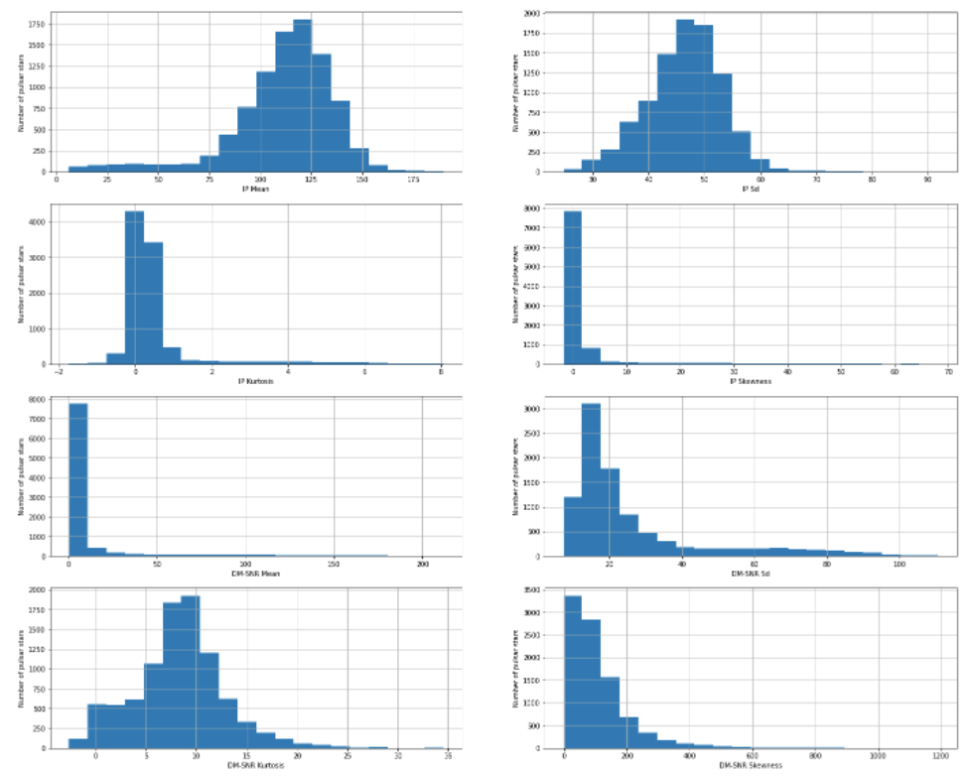
Plotting Histogram to check the distribution.

Slide 22
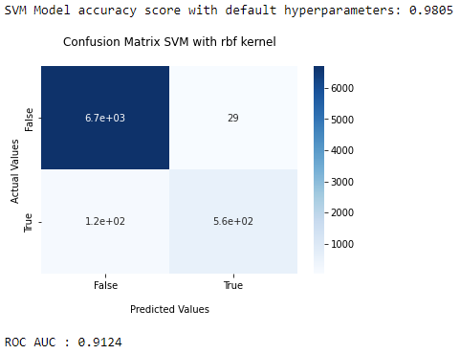
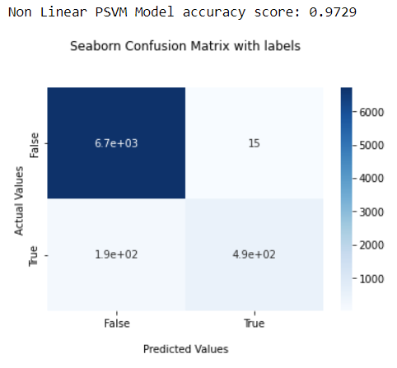
SVM vs PSVM (with Gaussian kernel) on Pulsar dataset
SVM with gaussian kernel
PSVM with gaussian kernel

Slide 23
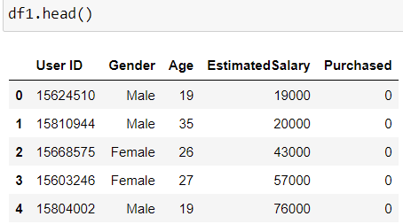
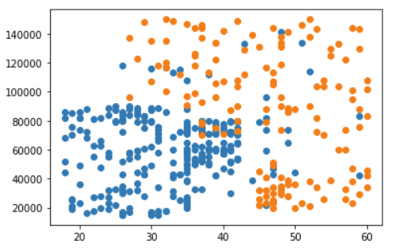
Social Network Ads Dataset [7]
Here I will use two Features Age and Estimated Salary and target value will be Purchased.
Visualization using Scatter Graph:
Horizontal axis corresponds to age and vertical axis to Salary.

Slide 24

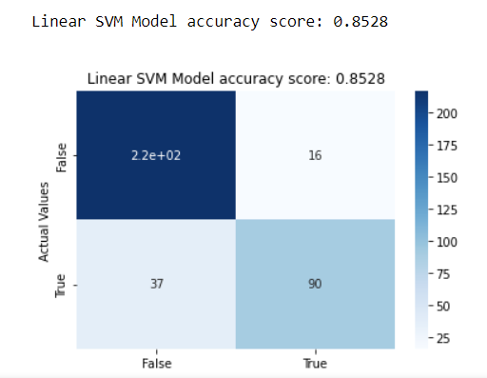
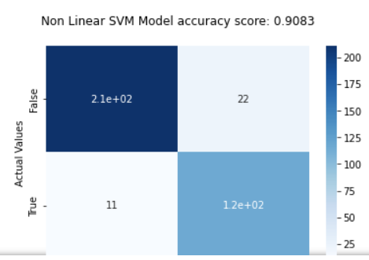
Since estimated salaries are big numbers so we standardize the data.
Results for SVM with linear and gaussian kernel:

Slide 25
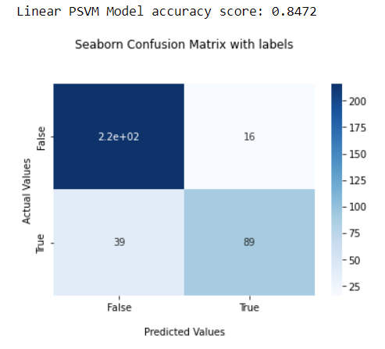
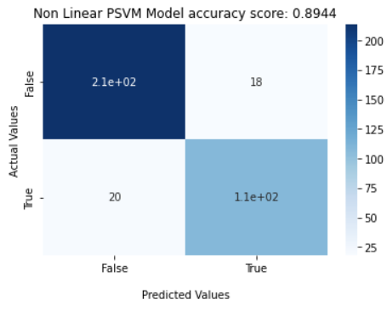
Results with Linear PSVM
Results with Gaussian PSVM

Slide 26
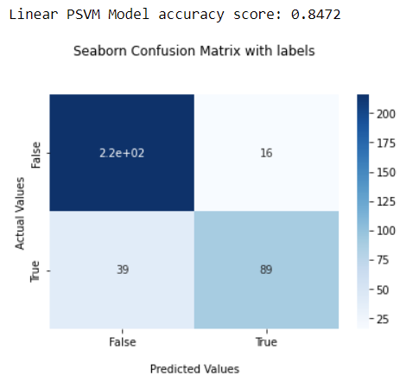

Comparison of PSVM with SVM
PSVM
SVM

Slide 27
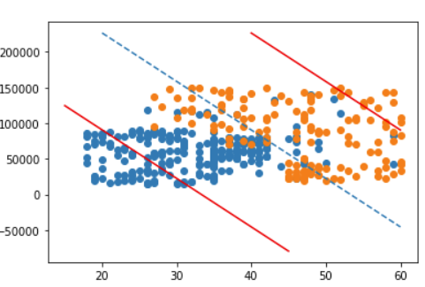
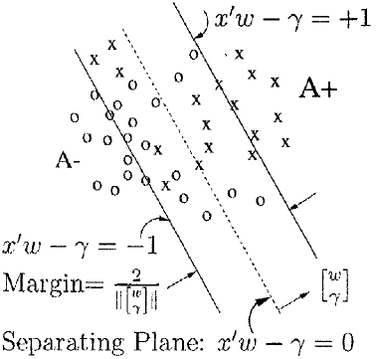
Proximal Planes

Slide 28

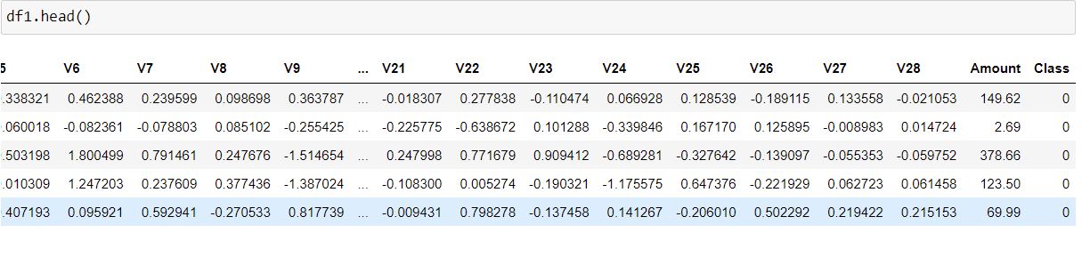

Credit Card Dataset
This dataset has total 30 features.
Dataset is unbalanced which means using this data it is might result in unwanted behavior from a supervised classifier. If a classifier were to train with this data set, trying to achieve the best accuracy possible it would most likely label every transaction as a non-fraud with accuracy over 90%.

Slide 29
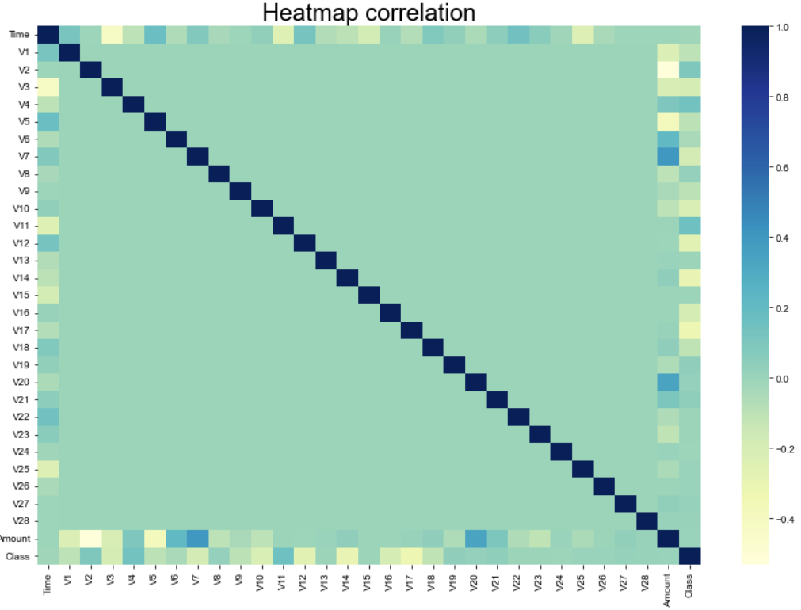
As we can notice, most of the features are not correlated with each other. This corroborates the fact that a PCA was previously performed on the data.
Hence there is no need for dimension reduction should be computed on a dataset on which PCA was computed correctly.
To overcome the unbalanced problem, I generated new dataset with equal proportion of both classes. Also, since features dimension are high to avoid overfitting, we will use linear kernel.

Slide 30


SVM model linear kernel
PSVM model linear kernel

Slide 31



Further Scope of Improvement
Sherman–Morrison–Woodbury Formula [8] :
If U and V both are $n×k$ matrices and A is $n×n$, then $I+V^{′}A^{−1}U$ will be of $k×k$ dimension and if $k<<n$in that case we need to inverse only $k×k$ matrix. Which is very time efficient.
In the context of PSVM we have a step to inverse matrix shown below to find associated Lagrange multiplier, here we can immediately use Sherman-Morrison-Woodbury formula to reduce time of algorithm taken while inversing significantly.
$u={\left(\frac{I}{ν}+HH^{′}\right)}^{−1}ⅇ$

Slide 32
Conclusion
Proximal Support Vector Machine require nothing more sophisticated than solving a simple nonsingular system of linear equation. While SVM require costly solution of linear or quadratic program (QPP, LPP).
And if Sherman Morrison formula is incorporated in the algorithm while inverting the matrix of order of input dimension, typically of the order of 100 or less time complexity can be reduced even further.
After testing PSVM on multiple dataset and comparing with SVM we can conclude that PSVM classifier obtain test set correctness comparable to that of standard SVM classifiers.

Slide 33
REFERENCES AND CITATION
Proximal support vector machine classifiers. https://doi.org/10.1145/502512.502527
O.L. Mangasrian and D.R. Musicant. Successive overrelaxation for support vector machine. ftp://ftp.cs.wisc.edu/math-prog/tech-reports/98-18.ps.
O. L. Mangasarian and D. R. Musicant. Active support vector machine classification. ftp://ftp.cs.wisc.edu/pub/dmi/tech-reports/OO-O4.ps
Pulsar Data set: https://www.kaggle.com/datasets/colearninglounge/predicting-pulsar-starintermediate
Credit Card Dataset: https://www.kaggle.com/code/pierra/credit-card-dataset-svm-classification/data
Spiral Dataset: https://gist.github.com/45deg/e731d9e7f478de134def5668324c44c5
Social Network Ads: https://www.kaggle.com/datasets/rakeshrau/social-network-ads

Slide 34
A Sherman-Morrison-Woodbury: https://arxiv.org/abs/1803.10405
Laxmi, S., Gupta, S.K. Intuitionistic Fuzzy Proximal Support Vector Machines for Pattern Classification. Neural Process Lett 51, 2701–2735 (2020). https://doi.org/10.1007/s11063-020-10222-x

Slide 35
Thank You

