Slide 1

Regression: Simple Linear Regression, Logistic Regression, Mean Square Error CSE3007 - Artificial Intelligence
GROUP 11
VIT Bhopal University
Bhopal-Indore Highway, Kothri Kalan, Sehore
Madhya Pradesh – 466114
Presented to:
Dr. S. Ananthakumaran
Associate Professor
30 -11-2023 GROUP NO-11 VIT BHOPAL UNIVERSITY 1

Slide 2
GROUP MEMBERS
RAHUL KUMAR | 21BSA10068
ANURAG PRASAD | 21BSA10075
SATYAM DEV YADUVANSHI | 21BSA10076
SHREYANSH LAVANIA | 21BSA10079
JAGRATI UPADHYAY | 21BSA10082
GROUP NO-11 VIT BHOPAL UNIVERSITY 2

Slide 3
CONTENTS
WHAT IS REGRESSION?
MOST COMMONLY USED REGRESSIONS.
LINEAR REGRESSION
ASSUMPTIONS OF LINEAR REGRESSION
APPLICATIONS OF LINEAR REGRESSION
ADVANTAGES AND DISADVANTAGES
LOGISTIC REGRESSION
ASSUMPTIONS OF LOGISTIC REGRESSION
VIT BHOPAL UNIVERSITY 3

Slide 4
CONTENTS
APPLICATIONS OF LOGISTIC REGRESSION
ADVANTAGES AND DISADVANTAGES
MEAN SQUARED ERROR
VIT BHOPAL UNIVERSITY 4

Slide 5
WHAT IS REGRESSION?
Regression is a supervised machine learning technique which is used to predict continuous values.
The ultimate goal of the regression algorithm is to plot a best-fit line or a curve between the data.
The three main metrics that are used for evaluating the trained regression model are variance, bias and error. If the variance is high, it leads to overfitting and when the bias is high, it leads to underfitting.
Based on the number of input features and output labels, regression is classified as linear (one input and one output), multiple (many inputs and one output) and multivariate (many outputs).
VIT BHOPAL UNIVERSITY 5

Slide 6
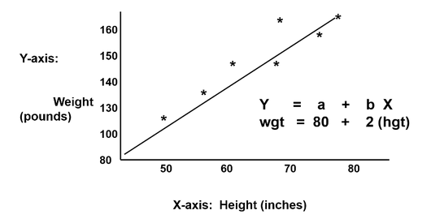
WHAT IS REGRESSION?
Imagine you have a bunch of balloons, each with a different weight written on it. You also have a measuring tape to measure their size. You blow them up and notice that bigger balloons tend to be heavier. Now, you want to create a game where you guess the weight of a balloon just by looking at its size.
That's what regression does! It's like a smart assistant in this game. You show it some balloons with both weight and size written on them (this is your training data). It then tries to find a rule that connects size and weight. It might draw a line on a graph, like this:
Now, when you show it a new balloon, it can use the line to guess its weight based on its size. The closer the balloon is to the line, the better the guess.
This is a simple example of linear regression. There are other types of regression that can handle more complex relationships, like curves and multi-dimensional data. But the idea is always the same: using existing data to learn a rule that helps predict unknown values.
VIT BHOPAL UNIVERSITY 6

Slide 7
MOST COMMONLY USED REGRESSIONS.
LINEAR REGRESSION
LOGISTIC REGRESSION
POLYNOMIAL REGRESSION
STEPWISE REGRESSION
RIDGE REGRESSION
LASSO REGRESSION
ELASTICNET REGRESSION
VIT BHOPAL UNIVERSITY 7

Slide 8
LINEAR REGRESSION
Linear regression is a supervised machine learning technique used to predict a continuous value based on one or more input variables
This is the simplest form of regression, and it assumes that there is a linear relationship between the dependent and independent variables. Linear regression is often used to predict continuous values, such as house prices, stock prices, and sales figures.
The goal of linear regression is to find a linear relationship between the dependent variable (the output we want to predict) and the independent variable(s) (the input features).
VIT BHOPAL UNIVERSITY 8

Slide 9
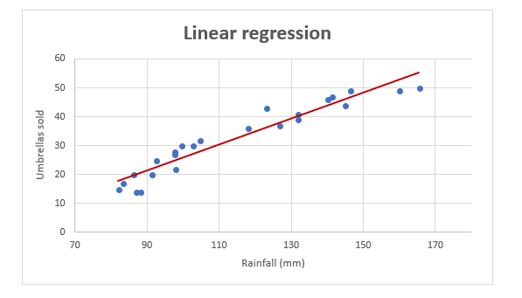
LINEAR REGRESSION
As an example, let's take sales numbers for umbrellas for the last 24 months and find out the average monthly rainfall for the same period. Plot this information on a chart, and the regression line will demonstrate the relationship between the independent variable (rainfall) and dependent variable (umbrella sales):
VIT BHOPAL UNIVERSITY 9

Slide 10
LINEAR REGRESSION
Linear regression equation
Mathematically, a linear regression is defined by this equation:
y = bx + a + ε
Where:
x is an independent variable.
y is a dependent variable.
a is the Y-intercept, which is the expected mean value of y when all x variables are equal to 0. On a regression graph, it's the point where the line crosses the Y axis.
b is the slope of a regression line, which is the rate of change for y as x changes.
ε is the random error term, which is the difference between the actual value of a dependent variable and its predicted value.
VIT BHOPAL UNIVERSITY 10

Slide 11
LINEAR REGRESSION
The linear regression equation always has an error term because, in real life, predictors are never perfectly precise. However, some programs, including Excel, do the error term calculation behind the scenes. So, in Excel, you do linear regression using the least squares method and seek coefficients a and b such that:
y = bx + a
For our example, the linear regression equation takes the following shape:
Umbrellas sold = b * rainfall + a
VIT BHOPAL UNIVERSITY 11

Slide 12
LINEAR REGRESSION
There exist a handful of different ways to find a and b. The three main methods to perform linear regression analysis in Excel are:
Regression tool included with Analysis ToolPak
Scatter chart with a trendline
Linear regression formula
VIT BHOPAL UNIVERSITY 12

Slide 13
ASSUMPTIONS OF LINEAR REGRESSION
Linear regression makes several assumptions about the data:
Linearity: There is a linear relationship between the dependent and independent variables.
Homoscedasticity: The variance of the residuals is constant across all values of the independent variable.
Independence: The residuals are independent of each other.
Normality: The residuals are normally distributed.
If these assumptions are not met, the results of linear regression may be unreliable.
VIT BHOPAL UNIVERSITY 13

Slide 14
APPLICATIONS OF LINEAR REGRESSION:
Linear regression is used for a wide variety of tasks, including:
Predicting continuous values: Predicting house prices, stock prices, sales figures, etc.
Correlation analysis: Identifying relationships between variables
Trend analysis: Identifying trends in data over time
Hypothesis testing: Testing hypotheses about relationships between variables
VIT BHOPAL UNIVERSITY 14

Slide 15
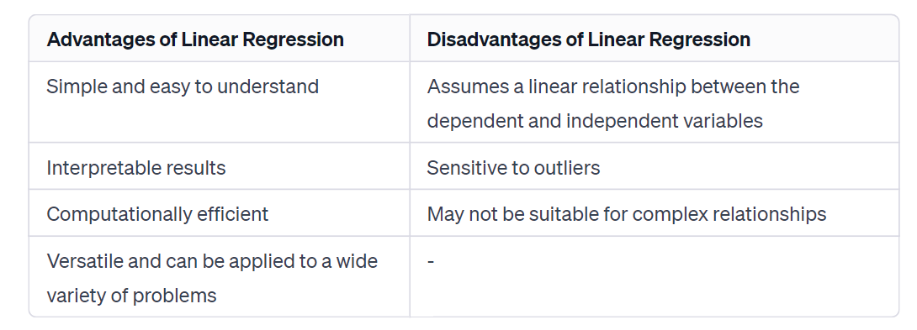
ADVANTAGES AND DISADVANTAGES
Let’s talk a look at the core advantages and disadvantages of Linear Regression:
VIT BHOPAL UNIVERSITY 15

Slide 16
LOGISTIC REGRESSION
Logistic regression is a classification algorithm used to predict a categorical dependent variable (e.g., yes/no, success/failure) based on one or more independent variables. It is a statistical method that uses a mathematical equation to model the probability of an event occurring.
Logistic regression transforms the dependent variable into a probability by applying a logistic function. The logistic function is a sigmoid function that maps any real number into the range [0, 1]. This means that the logistic function squashes any value into a probability between 0 and 1.
VIT BHOPAL UNIVERSITY 16

Slide 17
LOGISTIC REGRESSION
The logistic function is defined as:
σ(z) = 1 / (1 + exp(-z))
where z is the dependent variable. The logistic function takes any real number as input and outputs a value between 0 and 1.
VIT BHOPAL UNIVERSITY 17

Slide 18
ASSUMPTIONS OF LOGISTIC REGRESSION
Logistic regression makes several assumptions about the data:
Multicollinearity: The independent variables should not be highly correlated with each other.
Normality: The residuals should be normally distributed.
Linearity: The relationship between the dependent variable and the independent variables should be linear.
Independence: The residuals should be independent of each other.
VIT BHOPAL UNIVERSITY 18

Slide 19
APPLICATIONS OF LOGISTIC REGRESSION:
Logistic regression is used for a wide variety of tasks, including:
Predicting customer churn: Predicting whether a customer is likely to churn (stop doing business) with a company.
Fraud detection: Predicting whether a transaction is likely to be fraudulent.
Medical diagnosis: Predicting whether a patient is likely to have a particular disease.
Email spam filtering: Predicting whether an email is likely to be spam.
VIT BHOPAL UNIVERSITY 19

Slide 20
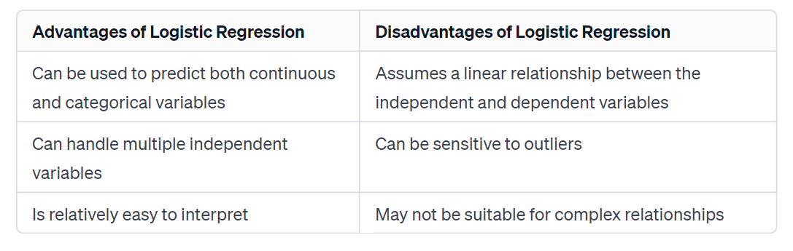
ADVANTAGES AND DISADVANTAGES
Let’s talk a look at the core advantages and disadvantages of Logistic Regression:
VIT BHOPAL UNIVERSITY 20

Slide 21
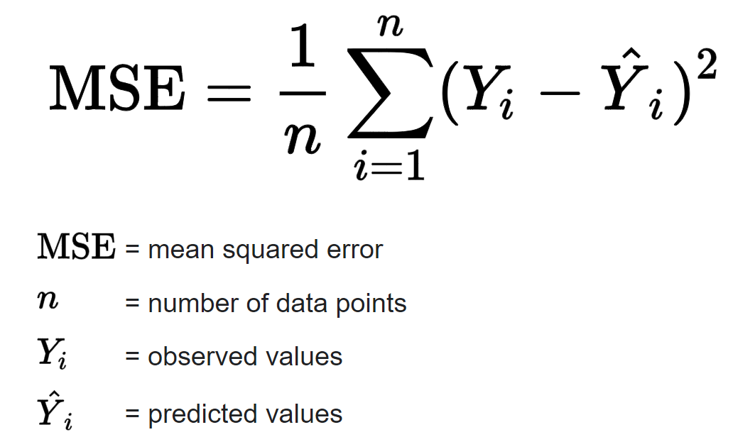
MEAN SQUARED ERROR
Mean Squared Error (MSE) is a commonly used metric in the field of artificial intelligence, particularly in regression problems. It measures the average of the squared differences between predicted and actual values
VIT BHOPAL UNIVERSITY 21

Slide 22
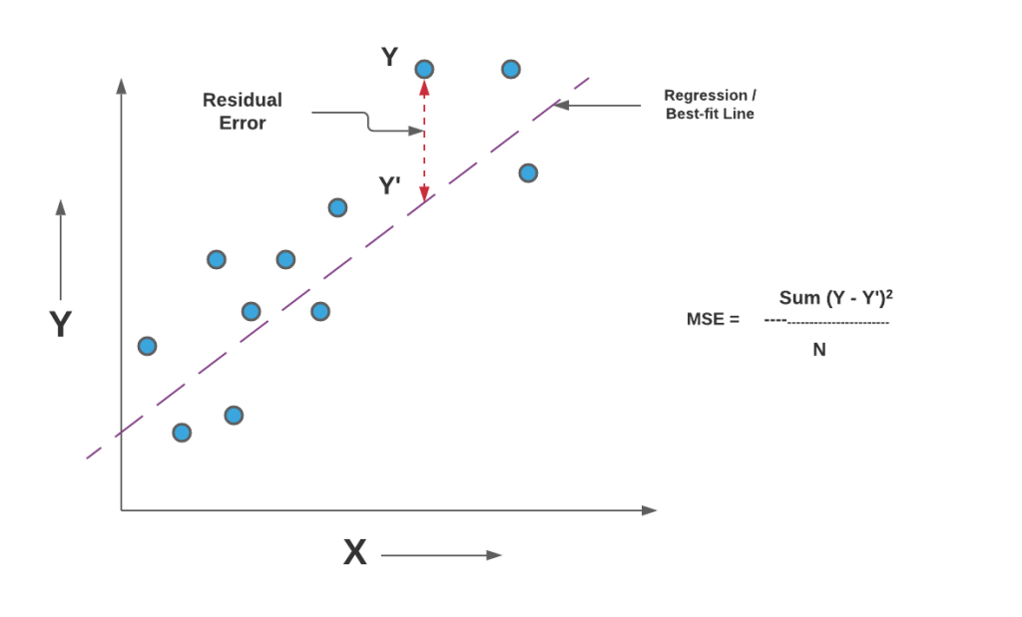
MEAN SQUARED ERROR
However, no model is perfect, and there will always be some error in the predictions. The mean squared error (MSE) is a way of measuring how much error there is in a model's predictions.
The MSE is calculated by taking the average of the squared differences between the predicted values and the actual values
VIT BHOPAL UNIVERSITY 22

Slide 23
MEAN SQUARED ERROR
.
Imagine you are trying to predict the temperature each day.
You have the actual temperatures recorded, and you make predictions.
Here are the actual temperatures (in Celsius) for five days:
Actual Temperatures: 25, 28, 22, 30, 35
Now, we make predictions:
Predicted Temperatures: 24, 27, 20, 32, 33
To calculate the MSE, we follow these steps:
VIT BHOPAL UNIVERSITY 23

Slide 24
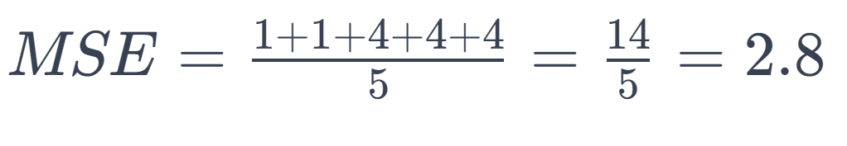
MEAN SQUARED ERROR
.
Find the Differences:
For each day, find the difference between the actual temperature and the predicted temperature.
Differences: 1, 1, 2, -2, 2
Square the Differences:
Square each of these differences to make sure they are all positive and to emphasize bigger errors.
Squared Differences: 1, 1, 4, 4, 4
Find the Average:
Add up these squared differences and find the average.
VIT BHOPAL UNIVERSITY 24

Slide 25
MEAN SQUARED ERROR
.
So, the Mean Squared Error (MSE) for our temperature predictions is 2.8.
Interpretation: On average, the squared differences between the actual temperatures and the predicted temperatures are 2.8.
The lower the MSE, the better the predictions match the actual values.
VIT BHOPAL UNIVERSITY 25

Slide 26
Thanks!
Do you have any questions?
VIT BHOPAL UNIVERSITY 26

