Slide 1
Test Metrics
Reference from : GLT Testing Services

Slide 2
What are Test Metrics?
Parameters to objectively measure the software testing process on various aspects
  Test Effort
  Test Schedule
  Test Status
  Defects
  Test Efficiency
  Test Effectiveness

Slide 3
Why do we need Test Metrics?
To quantitatively analyze the current level of maturity in testing and set goals/objectives for future
To provide means for managing, tracking and controlling the status of testing
To provide a basis for estimation (Today’s data is tomorrow’s historic data)
To objectively measure the effectiveness and efficiency of testing
To identify areas for process improvements
To give insight into the quality of the product

Slide 4
Index
Base Metrics
Project Management Metrics
Test Progress Metrics
Defects Metrics
Derived Metrics
Test Efficiency Metrics
Test Effectiveness Metrics
Group Standard Testing Metrics

Slide 5
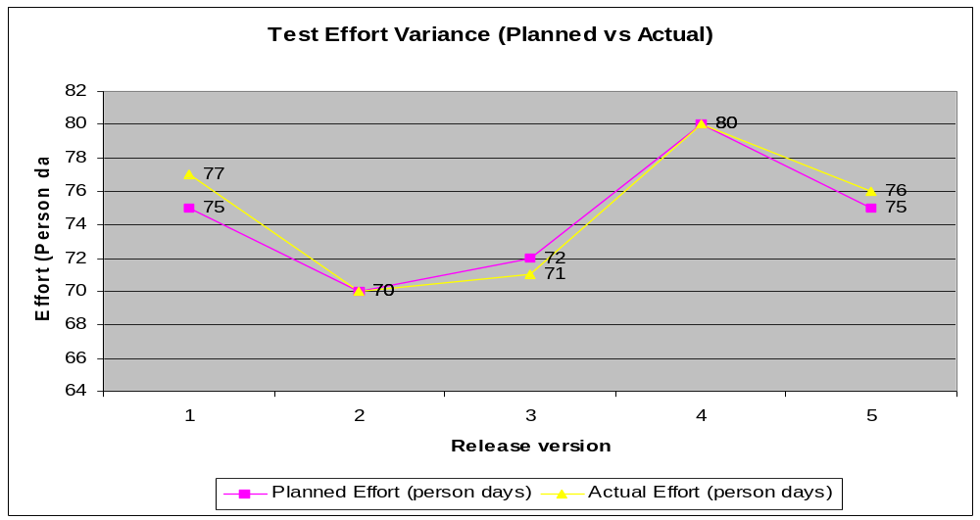
Project Management Metrics
Effort Variance
Indicates deviation of actual effort from planned effort for the project.
Where collected | Data Source | Main User | Reason for Use
All Phases | NIKU | Test Lead, Test Manager | Track progress, manage and replan tasks

Slide 6
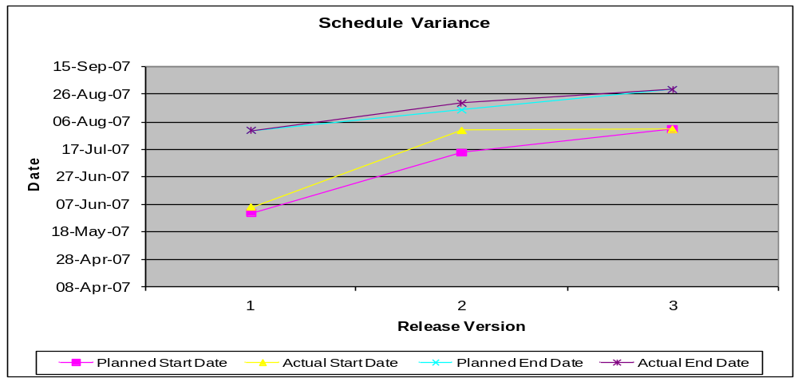
Project Management Metrics
Schedule Variance
Indicates deviation of actual schedule dates (start date and end dates) from planned schedule dates for the project.
Where collected | Data Source | Main User | Reason for Use
All Phases | NIKU | Test Lead, Test Manager | Track progress, manage and replan tasks

Slide 7
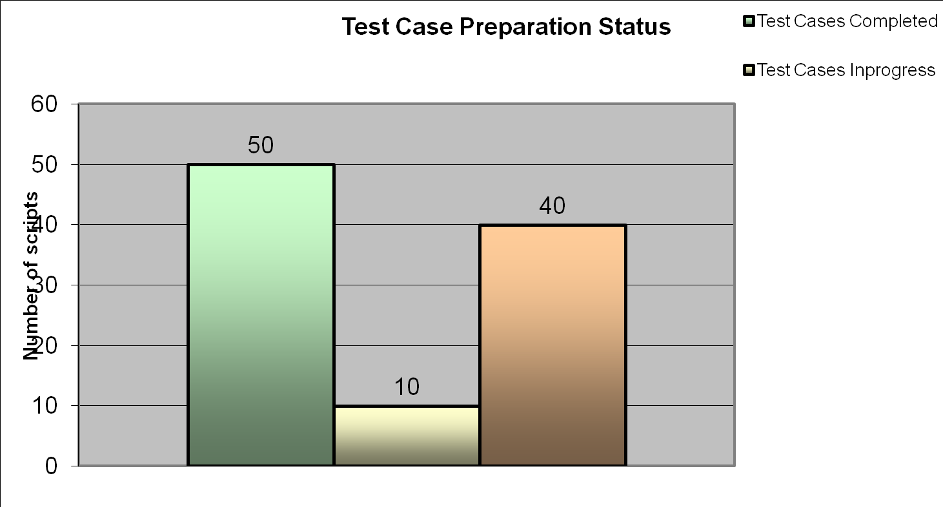
Test Progress Metrics
Test Case Preparation Status
Indicates status of test case preparation against the number of test cases planned to be written.
Where collected | Data Source | Main User | Reason for Use
Test Case Preparation Phase | Manual Tracking, QC | Test Lead, Test Manager | Track progress, manage and replan tasks

Slide 8
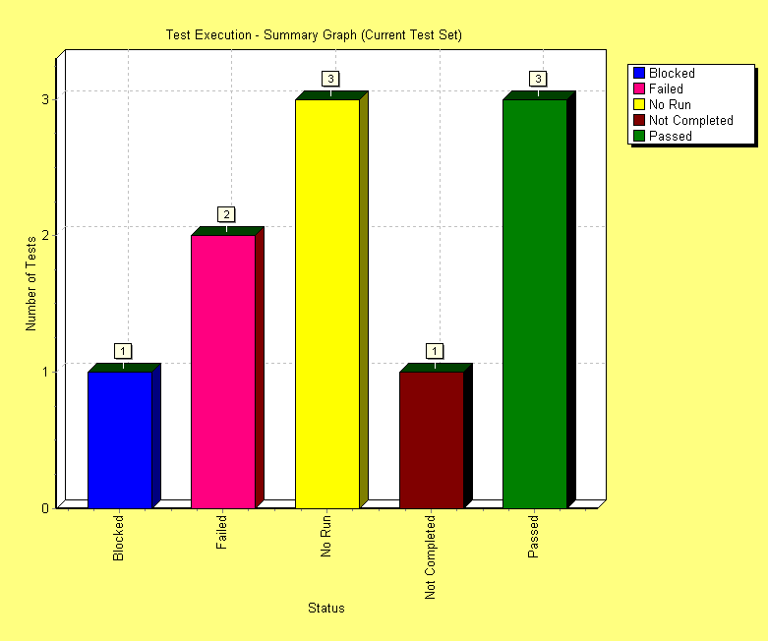
Test Progress Metrics
Test Execution Status
Indicates status of test execution against the number of test cases planned to be executed.
Where collected | Data Source | Main User | Reason for Use
Test Execution Phase | QC | Test Lead, Test Manager | Track progress, manage and replan tasks

Slide 9
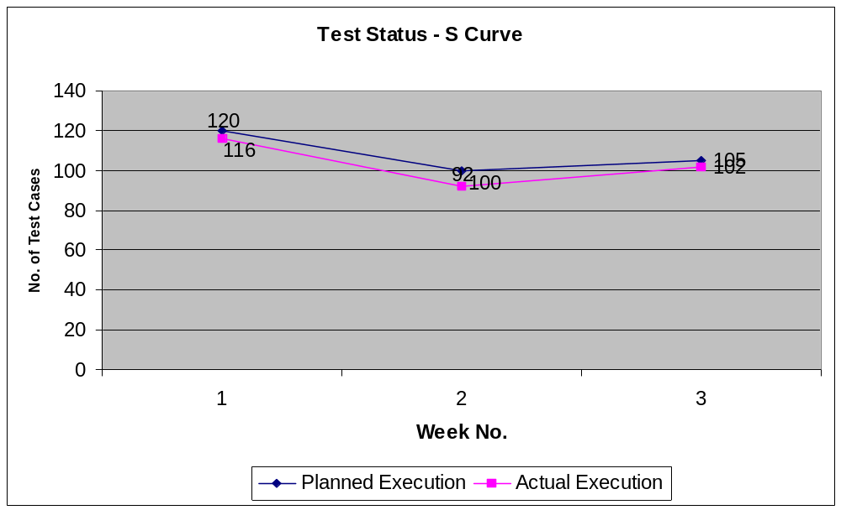
Test Progress Metrics
Planned vs Actual Execution
Where collected | Data Source | Main User | Reason for Use
Test Execution Phase | QC | Test Lead, Test Manager | Track progress, manage and replan tasks

Slide 10
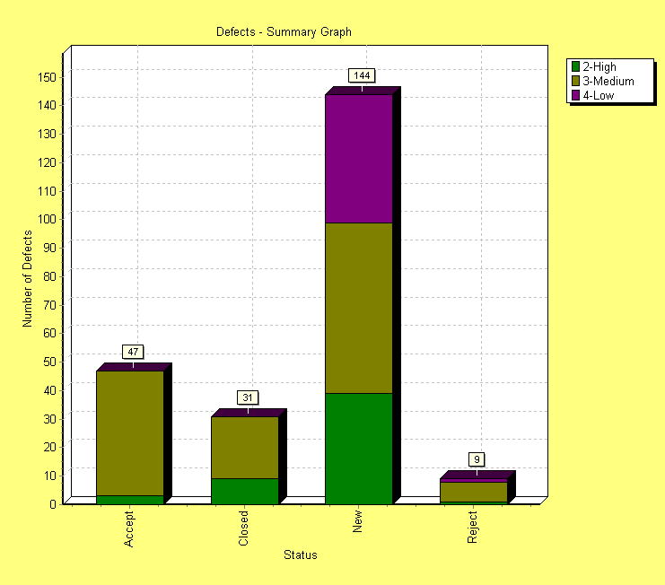
Defect Metrics
Defects Distribution by Severity/Status
Where collected | Data Source | Main User | Reason for Use
Test Execution Phase | QC | Test Lead, Test Manager | Track progress, manage and replan tasks

Slide 11
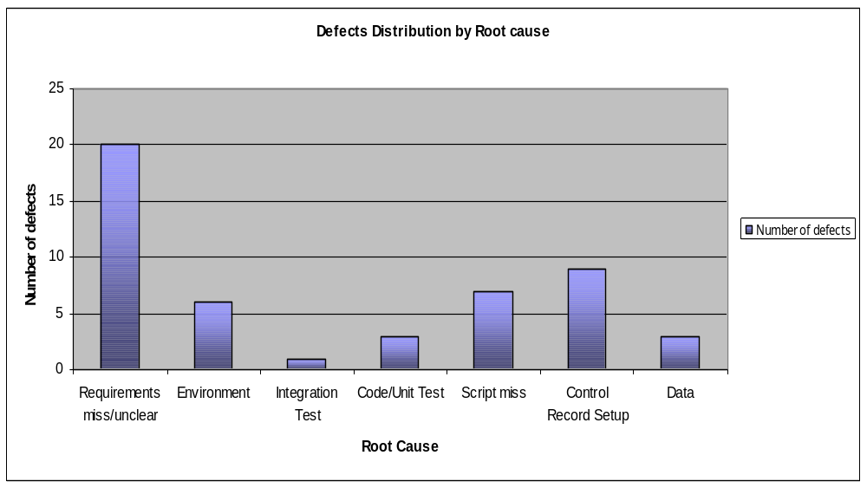
Defect Metrics
Defects Distribution by Root cause
Where collected | Data Source | Main User | Reason for Use
Test Execution Phase | QC | Test Lead, Test Manager | Process Improvement

Slide 12
Test Efficiency Metrics
Test Case Writing Productivity
Total Test Cases created / Total person days of effort involved in creating test cases
Test Case Execution Productivity
Total Test Cases executed / Total person days of effort involved in executing test cases
Where collected | Data Source | Main User | Reason for Use
Test Case Preparation Phase | QC, NIKU | Test Lead, Test Manager | Track progress, manage and replan Analyse test efficiency , Process Improvement
Where collected | Data Source | Main User | Reason for Use
Test Execution Phase | QC, NIKU | Test Lead, Test Manager | Track progress, manage and replan Analyse test efficiency , Process Improvement

Slide 13
Test Efficiency Metrics
% (Review +Rework) Effort
( A / B) X 100
where A = (Review + Rework) effort for writing test cases
B = Total effort for writing test cases (creation + review + rework)
Where collected | Data Source | Main User | Reason for Use
Test Case Preparation Phase | NIKU | Test Lead, Test Manager | Track progress, manage and replan Analyse test efficiency, Process Improvement

Slide 14
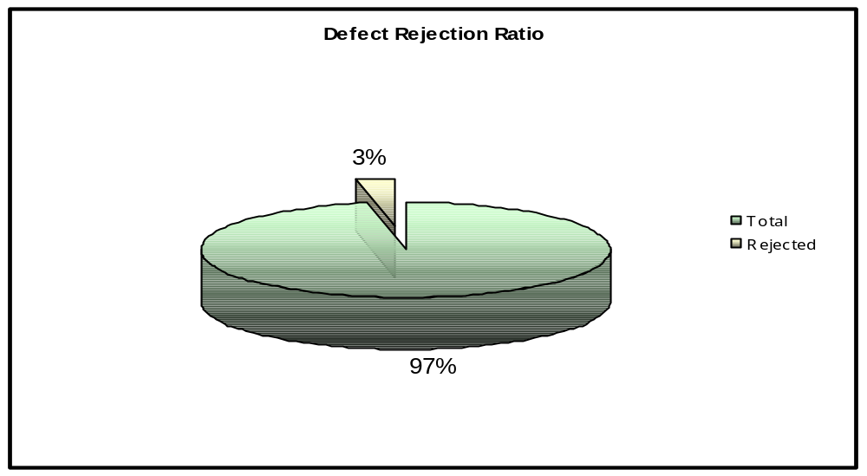
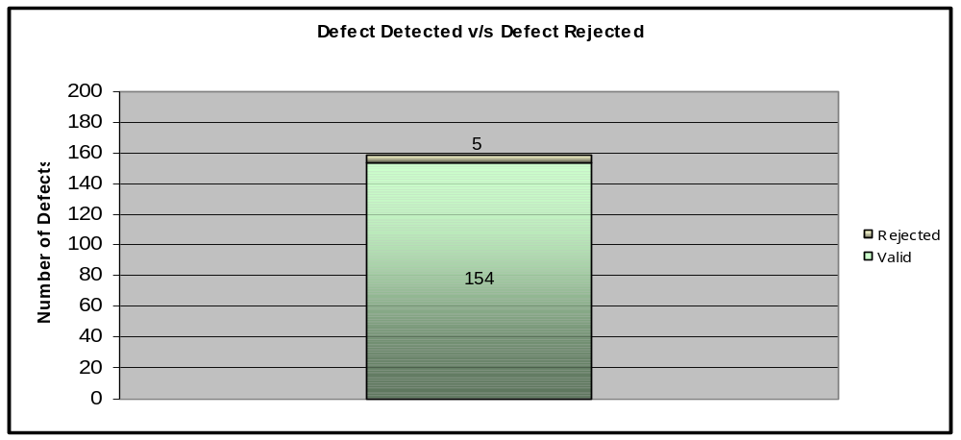
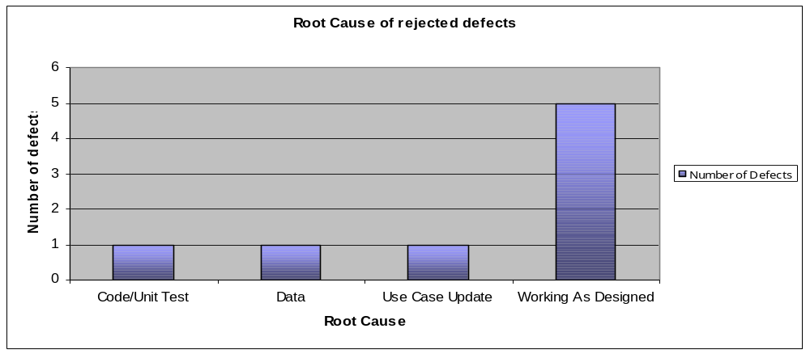
Test Efficiency Metrics
Rejected Defects
% rejected defects = (Number of defects rejected/ Total number of defects logged) X 100
Where collected | Data Source | Main User | Reason for Use
Test Execution Phase | QC | Test Lead, Test Manager | Analyse Test Efficicency, Process Improvement

Slide 15
Test Effectiveness Metrics
Defect Removal Efficiency (DRE)
% DRE (for a testing phase)
# valid defects detected in the current testing phase
(# valid defects detected in the current phase + # valid defects detected in the next testing phase)
% DRE (for all testing phases)
# valid defects detected pre-production
(# valid defects detected pre-production + # defects detected post-production)
X100
X100
Where collected | Data Source | Main User | Reason for Use
Post Test Execution Phase | QC, Defects data for next testing phase | Test Lead, Test Manager | Analyse test effectiveness, Process Improvement

Slide 16
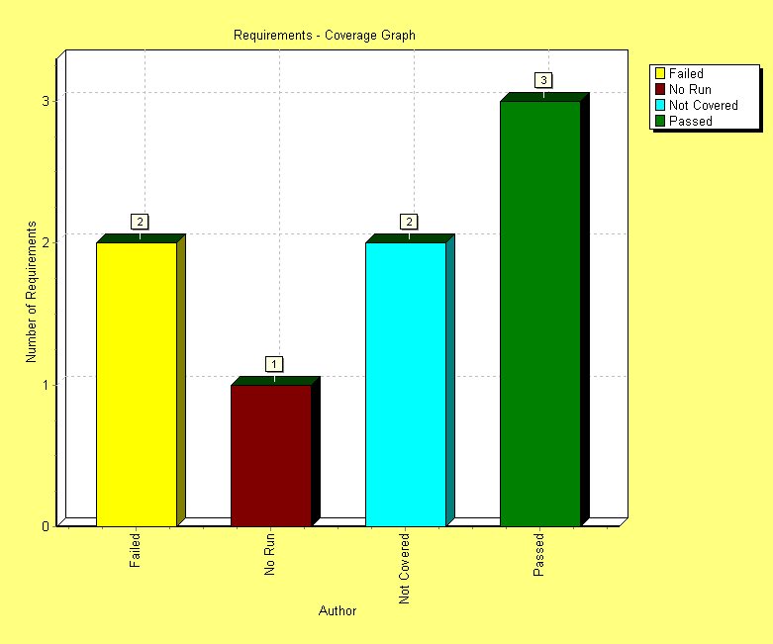
Test Effectiveness Metrics
Requirements Coverage
Indicates the distribution of requirements covered by test cases along with the status
Where collected | Data Source | Main User | Reason for Use
Test Case Preparation and Test Execution Phase | QC | Test Lead, Test Manager | Analyse test effectiveness, Process Improvement

Slide 17
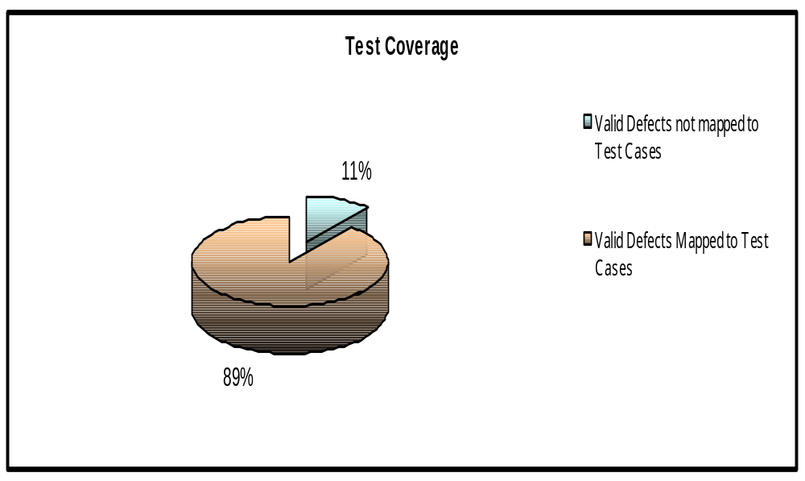
Test Effectiveness Metrics
Test Coverage
# valid defects not mapped to test cases Vs
# valid defects mapped to test cases
Where collected | Data Source | Main User | Reason for Use
Test Execution Phase | QC | Test Lead, Test Manager | Analyse test effectiveness, Process Improvement

Slide 18
Test Effectiveness Metrics
Cost of Quality
Total Testing effort (person days)/ #valid defects found
Where collected | Data Source | Main User | Reason for Use
Test Execution Phase | QC, NIKU | Test Lead, Test Manager | Analyse test effectiveness, efficiency Process Improvement

Slide 19
Group Standard Testing Metrics
Testing Effort
Actual Testing Effort / Total Project Effort (in person hours )
Where collected | Data Source | Main User | Reason for Use
All testing phases | NIKU | Test Lead, Test Manager | Measures the proportion of effort spent on testing against the whole project

Slide 20
Group Standard Testing Metrics
Test Effectiveness Indicator
A / (A + B)
where A = number of defects found in all test stages
B = number of latent defects during the first month after implementation
Where collected | Data Source | Main User | Reason for Use
All testing phases | QC, Manual submission by Testing CoE or Regional IT Quality Leads. | Test Lead, Test Manager | Measures the proportion of the number of defects discovered in all formal testing stages, i.e. SIT, UAT, NFR or performance test, OAT etc, with that discovered in the first month of production operations.

