Slide 1
Usability
titis wijayanto

Slide 2
What’s on today???
What is usability?
Why is usability important?
How measuring usability?

Slide 3

What is poor usability?
“I really like it, but I don’t use it much”
“It doesn’t do what I need it to do”
To end-users..
“Can’t it be more like Google?”
“I can’t find what I’m looking for”
“I don’t think it seems trustworthy”
“It’s very fancy, but it’s not very useful”
“I find it a bit frustrating”

Slide 4

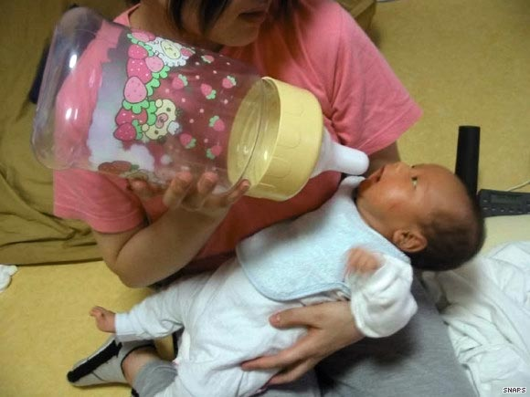

What is poor usability?

Slide 5
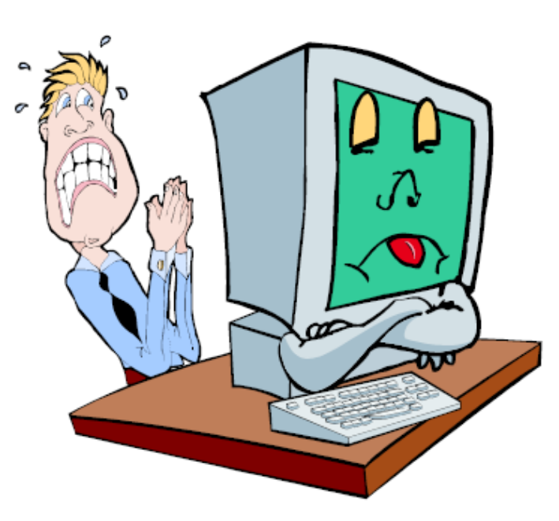
What is Usability???
“User Friendly” ???
  Is not a synonym of usability
  Avoid this expression!

Slide 6
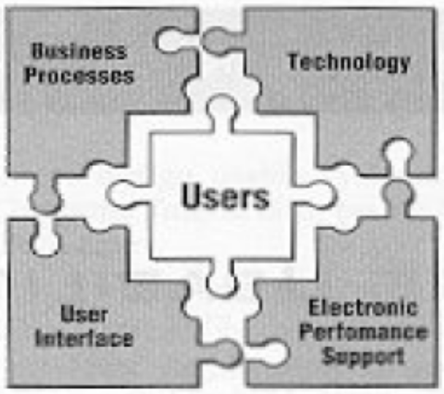
What is Usability???
It’s not about “is this product usable?”
But it’s about “how usable this product?”

Slide 7
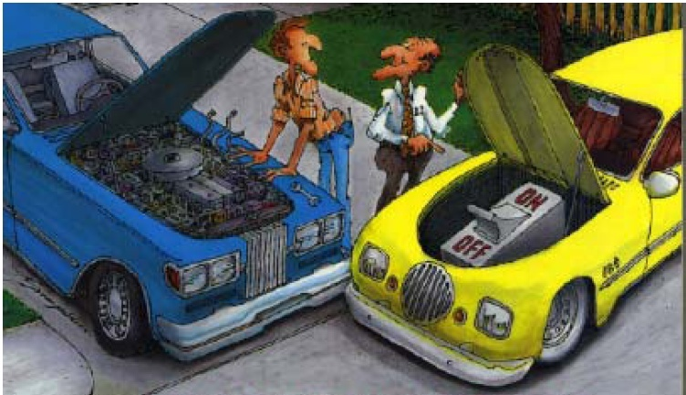
What is Usability???

Slide 8
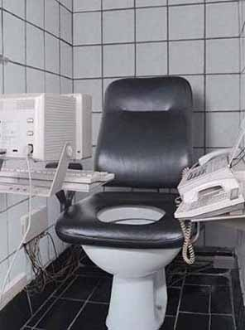
What is Usability???
“The effectiveness, efficiency, and satisfaction with which specified users achieve specified goals in particular environments.”
  source: ISO 9241-11
applies equally to both hardware and software design

Slide 9
What is Usability???
ISO 9241-11:
Effectiveness: The accuracy and completeness with which specified users achieve their own goals with the system.
Efficiency: The resources expended in relation to the accuracy and completeness of goals achieved.
Satisfaction: The comfort and acceptability of the system to the users and other people affected by its use.

Slide 10
What is Usability???
Jacob Nielson's definition:
Learnability: How easy is it for users to accomplish basic tasks the first time they encounter the design?
Efficiency: Once users have learned the design, how quickly can they perform tasks?
Memorability: When users return to the design after a period of not using it, how easily can they reestablish proficiency?

Slide 11
What is Usability???
Jacob Nielson's Definition (cont.):
Errors: How many errors do users make, how severe are these errors, and how easily can they recover from the errors?
Satisfaction: How pleasant is it to use the design?

Slide 12
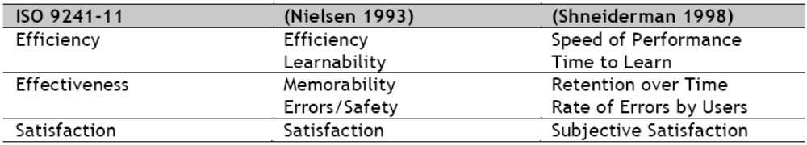
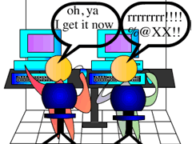
What is Usability???

Slide 13
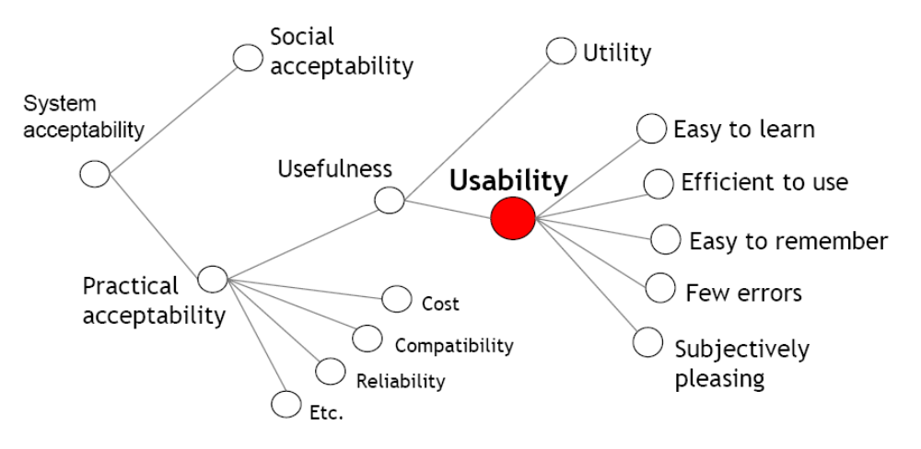
Attributes of usability

Slide 14

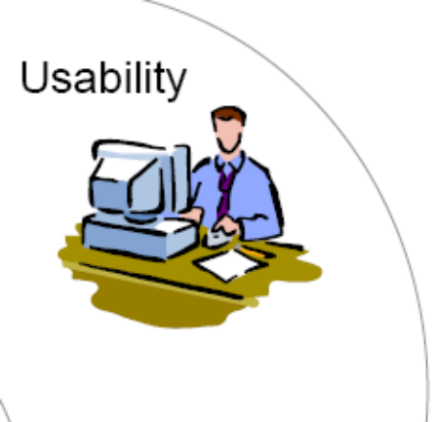

User as starting point

Slide 15

Why usability is important?
system development is expensive, and supporting a poorly designed user interface is even more expensive;
users will reject or work around systems that do not meet their needs;
design teams need to discover all problems users have in order to provide remedies;
even the best designers are not representative of the users of the system, thus teams need to understand users' perspectives and experiences with other systems;

Slide 16
Why usability is important?
usability evaluation is an inexpensive way to improve systems before they are implemented, to improve existing systems, and to choose usable systems;
business users do not have a lot of time to spend learning how to use a system;
businesses cannot train fast enough to keep pace with attrition and changing business rules;

Slide 17
Why usability is important?
people prefer a usable system with fewer features to a system with gratuitous "bells and whistles" which they have to work hard at figuring out; and
people often use systems in ways developers did not expect, and if designers find this out, they can build these features into a new system

Slide 18
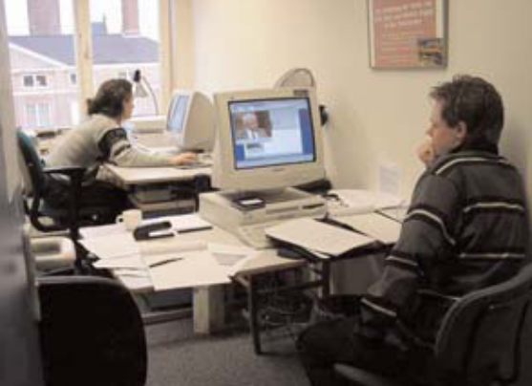
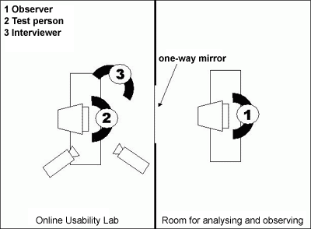
Where?
Usability testing can be done wherever it is…
  in a real work setting
  or in a usability lab

Slide 19
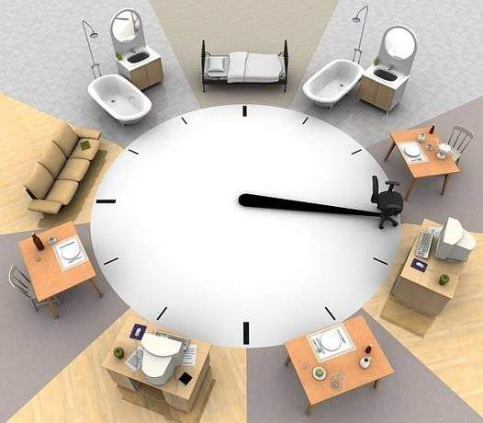
When???
During early design stages to:
  Predict product usability
  Check design teams understanding of user requirements
  Test out ideas
Later in design process:
  Identify user difficulties
  (fine tune product)
  Improve upgrade a product

Slide 20
How conducting usability evaluation?
Testing
Laboratory testing
Thinking aloud
Usability
methods
Heuristic Evaluation
Cognitive Walkthrough
Inspection
Inquiry
Focus Group
Questionnaires

Slide 21
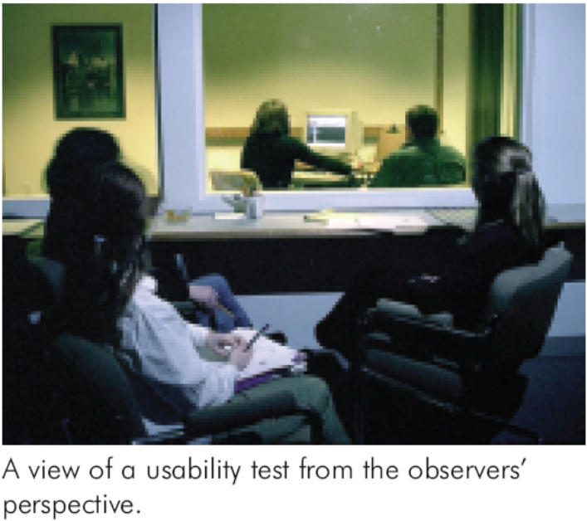
Laboratory Testing
Defined as any of those techniques in which users interact systematically with a product or system under controlled conditions, to perform a goal-oriented task in an applied scenario, and some behavioral data are collected.
User is asked to perform task → scenario based testing

Slide 22
Thinking aloud
May be the single most valuable usability engineering method.
having an end user continuously thinking out loud while using the system
participants thinking aloud as they are performing a set of specified tasks
users are usually recorded on video

Slide 23
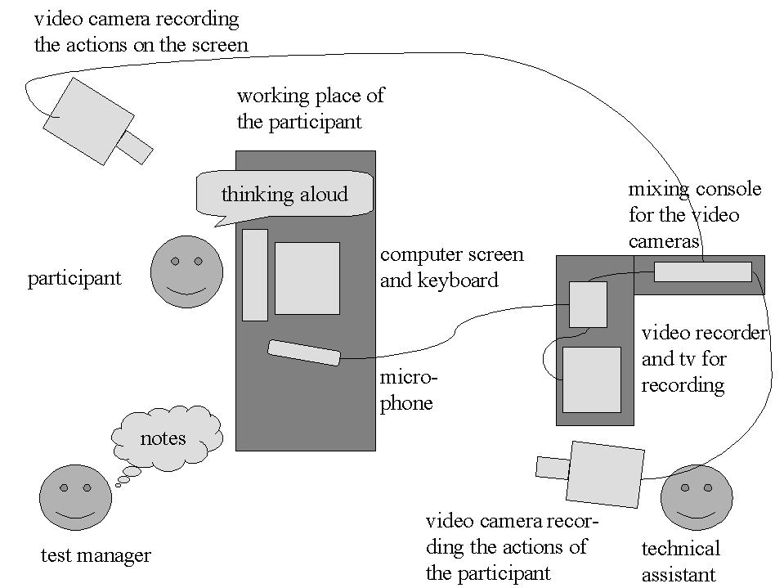
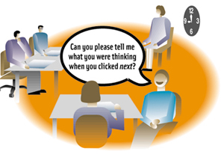
Thinking aloud

Slide 24
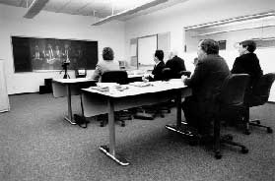
Focus Group

Slide 25

Planning a usability testing
Think about why you will be doing a usability test.
Consider the system as a whole.
Make sure the system is ready to test.
List several tasks that a user should be able to accomplish with the system.
Make a list of potential usability test subjects.
Plan for data collection.
Schedule the test.
Prepare yourself to be objective.
Don't take this "how" file with you.

Slide 26
Principles in testing
Use real users
Design real tasks
Record and report the test

Slide 27

Who are the subjects tested?
Targeted users
Use a real user!!!
Novice (beginner) vs expert user
User persona

Slide 28

Get to know your users
Talk to your users
Observe your users
Get feedback from your users
Find out…
  Who are your users (characteristics)
  What do they do (tasks)
    Current vs. desired
    Critical vs. non-critical
    User/task matrix
  How do they do it (Task Flow)
  Where do they do it (environment)

Slide 29
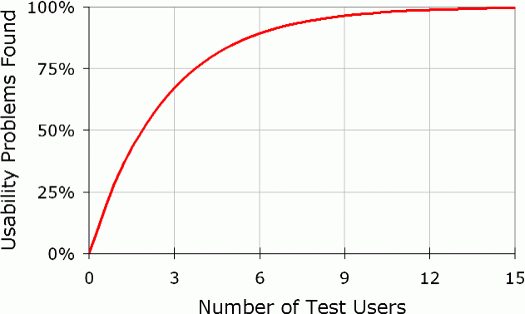
How many subjects?

Slide 30
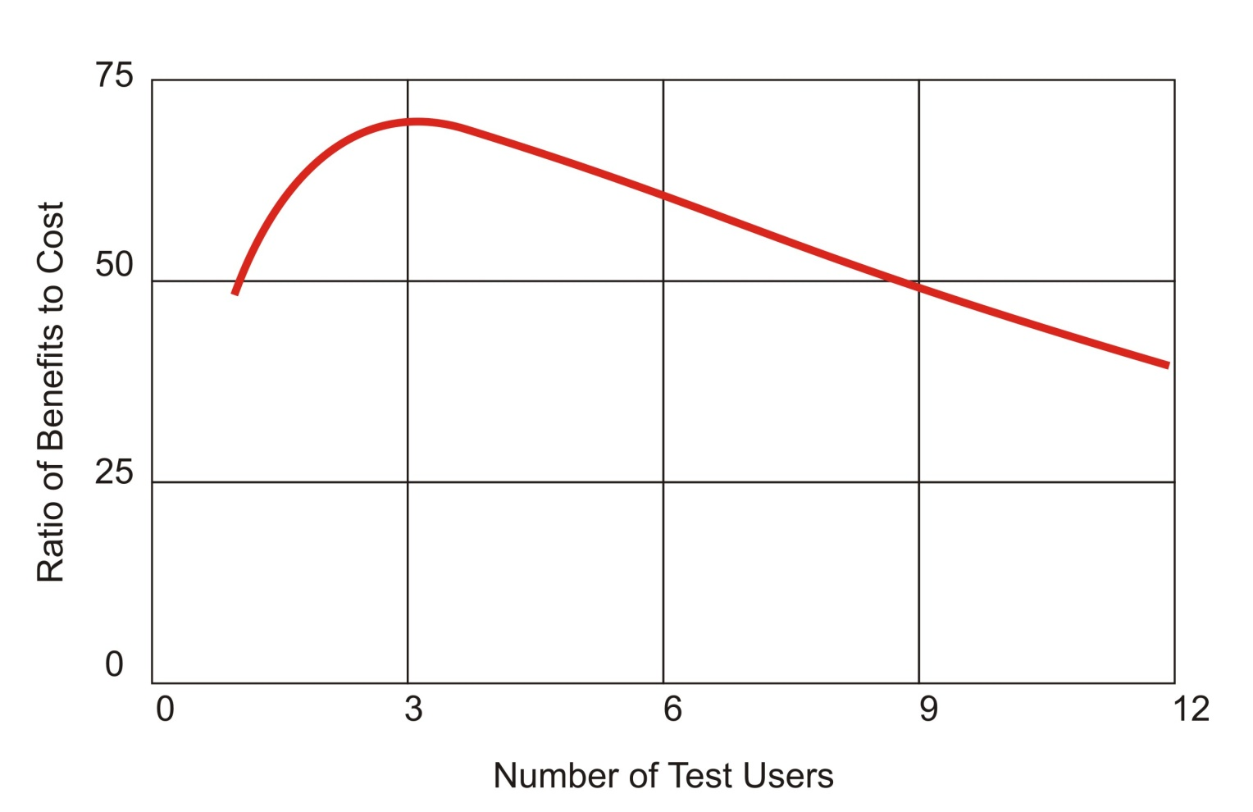
How many subjects?

Slide 31
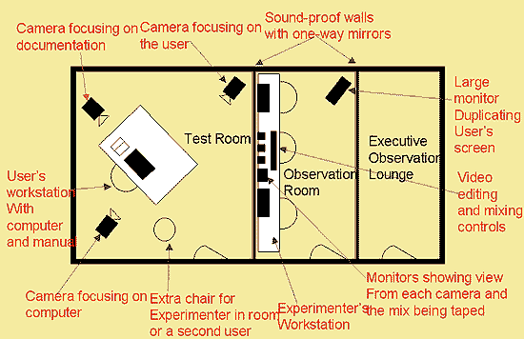
Setting up usability testing

Slide 32
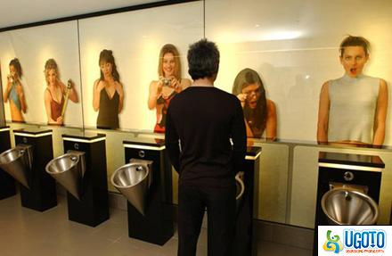
Measuring Usability
What can be measured?
  Performance measures: Counts of actions and behaviours you can see
  Subjective measures: People’s perceptions, opinions and judgments

Slide 33
Measuring usability
Effectiveness | Efficiency | User satisfaction
1. Percent task complete 2. Ratio of success to failures 3. Number of features used | 1. Time to complete task 2. Time to learn 3. Time spent on errors | 1. Rating scale for usefulness 2. Rating scale for satisfaction 3. Number of times user express frustration

Slide 34
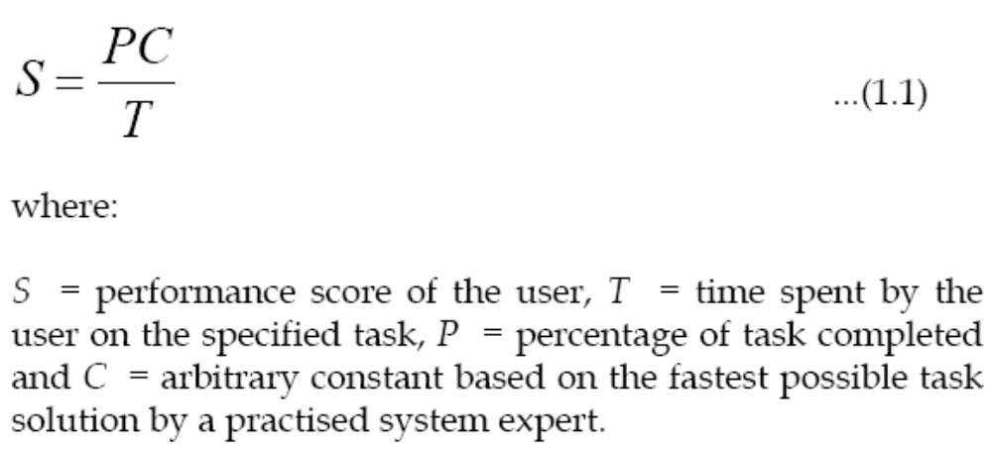
Measuring Usability
Time
  The time taken to complete a task on a computer is an obvious metric to choose. Whiteside et al (1985) have proposed the following empirical relationship:

Slide 35
Measuring Usability
Error Rate
  All users make errors. The number and type of errors made during the performance of a particular task by a user is clearly an indication of the usability of the system
Attitude Measures
  attitude of the user of a system usually has to be found by using questionnaires or interviews. These measures can cover complete system use, from learnability, to ease of use, to functionality.

Slide 36
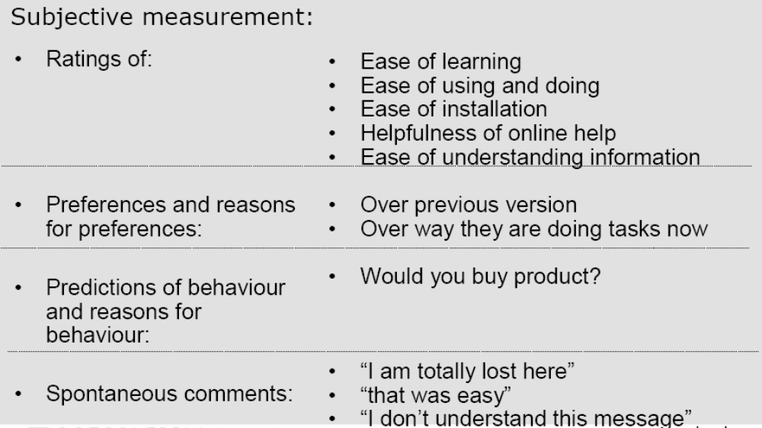
Measuring Usability

Slide 37
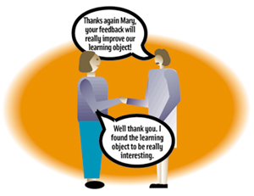
In usability testing…
Establish the context
Ask the subject to verbalize their thoughts as they perform the tasks on your list
Don't help!
Don't take it personally
Thank the subject.

Slide 38
Listen and observe!
Have fun with it!
  Enjoy being the observer.
What does "hmm" mean?
  Take it all in, even the gaps. Notice all the sounds and behaviors and comments that might be relevant. Remind the subject to verbalize and be as open with their thinking as possible.
Write everything down.
  You can translate and expand your notes later. If you are tempted to ask the subject extra questions, make a note so that you can bring them up later.
Don't interfere or ask leading questions
  Do help them to feel comfortable speaking their thoughts out loud

Slide 39

Usability Applies to all Designs
Norman presented Carelman’s coffeepot as a metaphor for the many objects that we use in our daily lives that include fundamental design flaws.

Slide 40
Usability Project
Part 1: Proposal (minggu depan)
  A short description of what you plan to evaluate (2-3 lines is enough)
  Method you plan to employ
  Names of group members
  Possible subjects for your evaluation
  Usability metrics you want to measure
Choose any software/product to evaluate as long as:
  You are at least somewhat familiar with it
  You can find at least three or more subject users who are not experts
  You can run the “thing” in an experimental manner
  Web site? Only if it has some interesting complexity
  Device? Probably OK. Game? Probably OK. Ask me later.

Slide 41
Usability Project
Part 2 - Report:
  Abstract (a short summary)
  A description of the specific software or product and its aspects that are being evaluated.
    Be sure to what the specific goals are for your evaluation! Just a subset of the system? Specific goals for this evaluation?
  Hypothesis → what you expect from the testing
  A summary of your procedures/methods
    When, where, how did you do your evaluation? (Only enough detail so I can see that you followed good procedures.)
    Also, what tasks did you ask the subject to do?
    it is OK if you include copies of the task descriptions you gave the user
  (see next page)

Slide 42
Usability Project
Part 2 - Report:
  Result Revealed from the usability testing
    Result summary (time, score, etc)
    Statistical analysis (to prove your hypothesis)
    Usability Defect
  Discussion
  Conclusion
  References (please state any reference you cited—can be book, paper, etc)

