Slide 1
Status Consumption and Intertemporal Substitution
Department of Economics
a.srivastava@pgr.reading.ac.uk

Slide 2
Conspicuous or status-related Consumption
The tendency of consumers to indicate status by using goods of a higher quality or in higher quantity than what might be considered necessary*
Veblen argued that signalling of status is innate in societies.

Slide 3
What are “needs”?
On one hand we have the view supported by Townsend that treats “needs” purely as subjective preferences
On the other extreme, there is the view that “needs” should be decided by a benign central committee
Doyal and Gough[3] define needs in terms of health and autonomy – deriving societal preconditions for them in a general theory

Slide 4
Is conspicuous consumption universal?
The public discourse often represents it as something that only serves the rich (consider the recent description of Ecclestone’s home). How true is this?
Do the rich wealthy really need status-related consumption (more than the non-rich)?
Can the poor benefit from status-related consumption?

Slide 5
Key Assumptions
A1. Rational Benefit - There is a rational benefit to be had from status consumption (otherwise consumers would stay away from it in the long-run). The consumer preferences for status are not errors in judgment.
A2. Assets can be held for long - Status-related consumption that is not considered “wealth” (i.e. most of non-durable status-related consumption) cannot be inherited (bequeathed) but all else can

Slide 6
Model for Consumer Demand
A1 ensures that all consumers benefit from expensive non-durable consumption
A2 separates long-term consumption from short-term consumption while considering the differences in start wealth of consumers
Three claims about status follow:
Claim 1: Status can come from either quality in non-durable consumption or wealth (which is durable consumption plus other long-term characteristics)
Claim 2: Assets are more expensive but a more certain provider of status
Claim 3: Fulfilment of minimum needs carries no status-advantage
Question: Would wealth or assets influence status consumption?

Slide 7
Status as Utility
Endowment effects and status-quo effects have been known to exist for a long time. Questions:
How does include them in a model for demand?
Can status be subjective?
Is status the cause or effect of status-related consumption?
Corneo et al consider a game-theoretic ranking model – where consumers participate with income and status goods. The literature on status consumption focuses on additional utility derived from visible consumption (see Ireland[2] model)
We consider status a combination of wealth (education, occupation, and long-term assets) and purchased quality

Slide 8
How does wealth affect consumption?
There is enough evidence to show that as an endowment, wealth would influence wealth –related risk-seeking (consider framing and loss aversion in prospect theory)
To motivate a model, consider three players – an academic, a sportsman and an investor in a game to double their wealth with the same starting wealth. Their expectations may look like in the table.
These expectations are subjective (both short-term and long-term) but should drive their consumption
Likelihood of doubling the starting wealth | 5y | 15y | 30y
Academic | Low | Med | Med
Sportsman | Med | High | Low
Investor | Med | High | High

Slide 9
Where does status fit in?
A higher status for the three players may be achieved with fulfilment of different financial goals – but their long-term decisions are likely to be driven by just the material wealth
Whereas the perceived status – i.e. the subjective view of the material status (under uncertainty) is more likely to influence their consumption
Status is thus constituted in this subjective probability
A utility function that formalises the preferences of the three professionals, would allow them to interpret the probability of wealth gain differently
In the behavioural economics literature, the effect of status and durable goods is often modelled with varied discounting rates [4]

Slide 10
Intertemporal substitution
PIH relies on smoothening of income i.e. those with volatile incomes tend to limit (lower permanent income).
However, PIH looks only at monetary risks – while status encompasses other risks. Consumer confidence is subject to other risks – so while PIH may generally be true, it is possible that consumers go against the usual direction
Sb with less income stability may believe in a possibility (unrealistic) of a windfall
Sb with high income stability may be fearful of a downturn (unrealistic)
A probabilistic model for status – which allows the consumer to overspend on short-term quality - should allow the behaviours in both directions
Questions:
Can this fit into the intertemporal substitution framework?
How can one model the effects of non-monetary wealth?

Slide 11












Intertemporal substitution and discounting
Recall that Intertemporal substitution setting is one where the consumer can either choose to consume now or accumulate in the future
The framework is often applied on data from savings, interest rate and consumption. The Euler Equations used in the model can be used to test hypotheses such as the random walk or PIH (see Deaton[1])
The diagram shows how the players in our game would evaluate their subjective net worth based on evaluation of a prospect - which is the doubling of wealth (more generally the target wealth or asset level)
$$t=20$$
$$t=25$$
$$t=35$$
$$t=65$$
$$A$$
$$A$$
$$A$$
$$A$$
$$\frac{A}{2}$$
$$A$$
$$\frac{A}{2}$$
$$A$$
$$\frac{A}{2}$$
$$\frac{A}{2}$$

Slide 12
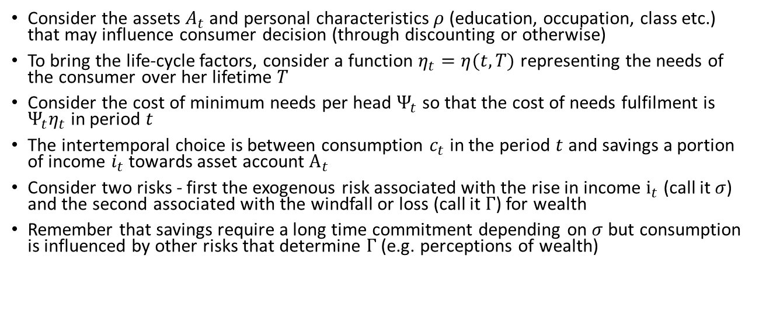
Towards a model
Consider the assets $A_{t}$ and personal characteristics $ρ$ (education, occupation, class etc.) that may influence consumer decision (through discounting or otherwise)
To bring the life-cycle factors, consider a function $η_{t}=η(t,T)$ representing the needs of the consumer over her lifetime $T$
Consider the cost of minimum needs per head $Ψ_{t}$ so that the cost of needs fulfilment is $Ψ_{t}η_{t}$ in period $t$
The intertemporal choice is between consumption $c_{t}$ in the period $t$ and savings a portion of income $i_{t}$ towards asset account $A_{t}$
Consider two risks - first the exogenous risk associated with the rise in income $i_{t}$ (call it $σ$) and the second associated with the windfall or loss (call it $Γ$) for wealth
Remember that savings require a long time commitment depending on $σ$ but consumption is influenced by other risks that determine $Γ$ (e.g. perceptions of wealth)

Slide 13
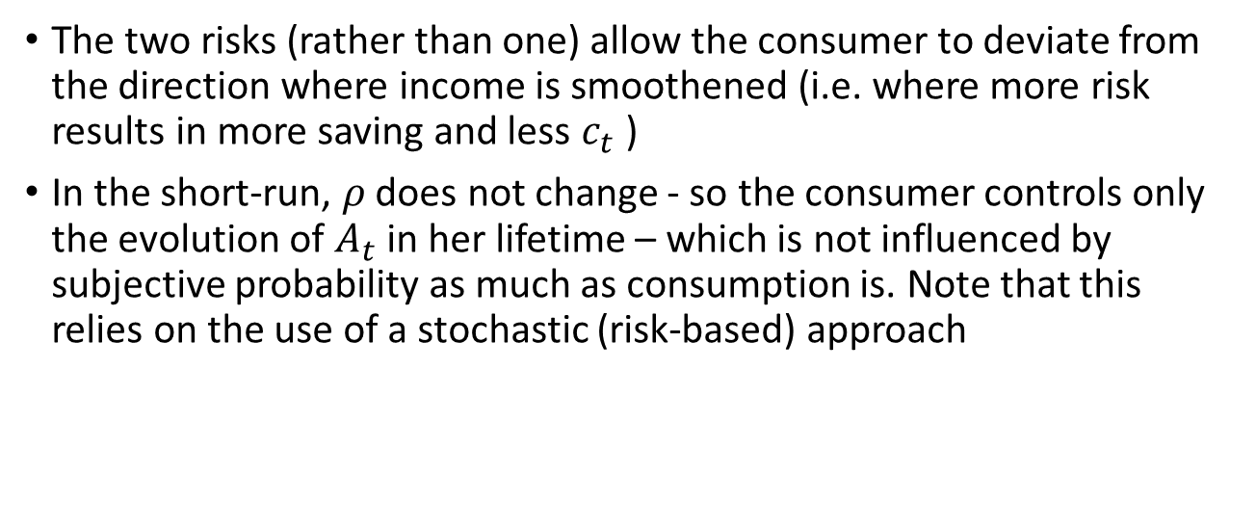
The role of two uncertainties
The two risks (rather than one) allow the consumer to deviate from the direction where income is smoothened (i.e. where more risk results in more saving and less $c_{t}$ )
In the short-run, $ρ$ does not change - so the consumer controls only the evolution of $A_{t}$ in her lifetime – which is not influenced by subjective probability as much as consumption is. Note that this relies on the use of a stochastic (risk-based) approach

Slide 14
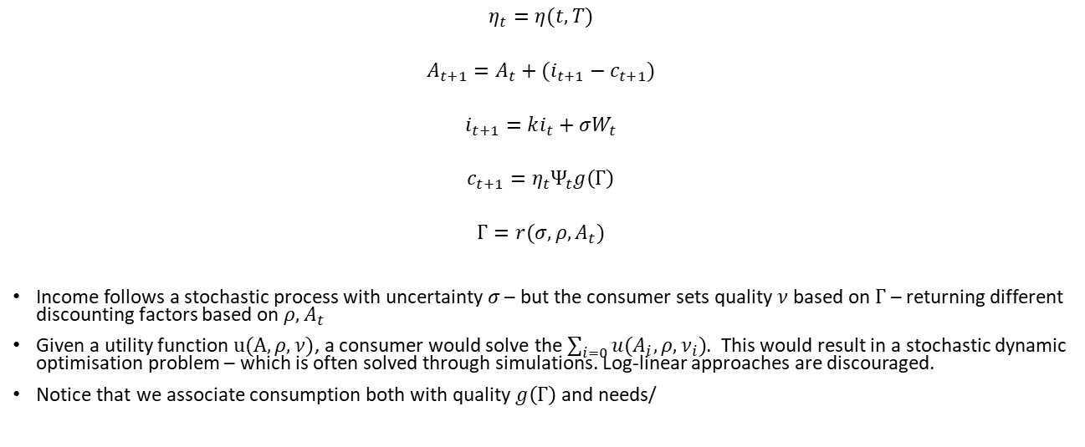
A Stochastic Model
$$η_{t}=η(t,T)$$
$$A_{t+1}=A_{t}+(i_{t+1}−c_{t+1})$$
$$i_{t+1}=ki_{t}+σW_{t}$$
$$c_{t+1}=η_{t}Ψ_{t}g\left(Γ\right)$$
$$Γ=r(σ,ρ,A_{t})$$
Income follows a stochastic process with uncertainty $σ$ – but the consumer sets quality $ν$based on $Γ$ – returning different discounting factors based on $ρ,A_{t}$
Given a utility function $u(A,ρ,ν)$, a consumer would solve the $\sum_{i=0}{u(A_{i},ρ,ν_{i})}$. This would result in a stochastic dynamic optimisation problem – which is often solved through simulations. Log-linear approaches are discouraged.
Notice that we associate consumption both with quality $g\left(Γ\right)$ and needs/

Slide 15
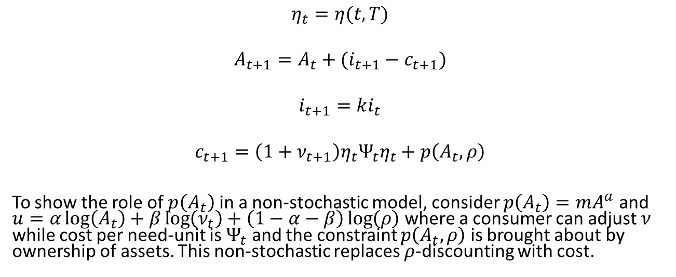
A simpler non-stochastic formulation
$$η_{t}=η(t,T)$$
$$A_{t+1}=A_{t}+(i_{t+1}−c_{t+1})$$
$$i_{t+1}=ki_{t}$$
$$c_{t+1}={\left(1+ν_{t+1}\right)η}_{t}Ψ_{t}η_{t}+p\left(A_{t},ρ\right)$$
To show the role of $p\left(A_{t}\right)$ in a non-stochastic model, consider $p\left(A_{t}\right)=mA^{a}$ and $u=α\log\left(A_{t}\right)+β\log\left(ν_{t}\right)+\left(1−α−β\right)\log\left(ρ\right)$ where a consumer can adjust $ν$ while cost per need-unit is $Ψ_{t}$ and the constraint $p\left(A_{t},ρ\right)$ is brought about by ownership of assets. This non-stochastic replaces $ρ$-discounting with cost.

Slide 16
Empirical Concerns
It is easy to determine which characteristics can be passed down to generations in the empirical data
Quality is defined with total costs on commodity (many interpretations of quality exist in the literature)
Credit plays a significant role in the current setting (directly to consumers or through governments in the LDCs) – thus requiring us to consider interest rates in the evolution of assets

Slide 17
References
A Deaton, Understanding Consumption, Clarendon Press 1993
N J Ireland, “On limiting the market for status signals,” Journal of Public Economics, 1994
L Doyal and I Gough, A Theory of Human Need, Palgrave London 1991
G Loewenstein and D Prelec, “Anomalies in Intertemporal Choice: Evidence and an Interpretation”, The Quarterly Journal of Economics, 107 (2) (May, 1992), pp. 573-597

