Slide 1
Status and consumption in the sub-Saharan Africa
Year 4 (PT) report - Anurag Srivastava
Department of Economics
a.srivastava@pgr.reading.ac.uk

Slide 2
Conspicuous consumption (recap)
The tendency of consumers to indicate status by using goods of a higher quality or in higher quantity than what might be considered necessary
Veblen argued that signalling of status is innate in societies.
More recently, Frederic Hirsch and Robert Frank have attempted to explain the role of status in consumption

Slide 3
Status consumption and Visibility
Why Conspicuous consumption is difficult to measure
What qualifies as a status good is difficult to pin down
Markets may introduce items that make assumed status goods affordable
In a panel data analysis, it is difficult to empirically distinguish taste from quality
A mathematically tractable idea used in the literature is visibility
It faces empirical issues in a time-series analysis (additive utility etc.)
It relies on consumer surveys – further limiting its use in a time-series analysis
It is much less relevant in the underdeveloped world where inequalities are higher (factors other than visible goods become conspicuous in a less equal society)

Slide 4
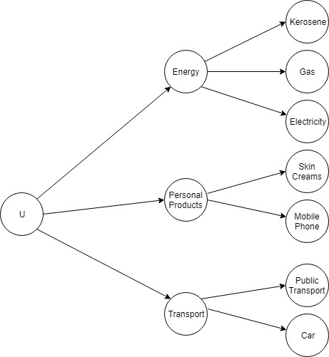
A preliminary econometric model (2018)
To alleviate some of the issues with visibility, we used invidious comparison and pecuniary emulation (ideas formulated by Veblen) to interpret high-price consumption as PE and asset purchases as IC
Two issues with the approach:
Without some limiting assumptions, the separability of demand across various groups is difficult to verify
There is not much evidence of pecuniary emulation in the data (those who are less rich don’t play catchup with the high quality consumption) - hence it cannot be assumed in the model

Slide 5
How to measure status consumption?
There is an intuitive appeal to Veblen’s ideas of pecuniary emulation and invidious comparison when you observe certain status goods
However, their measurement is less trivial to pin down when the environment of status goods is rapidly changing
The same difficulties occur when we attempt to measure - scarcity and overuse – ideas put forth by Hirsch

Slide 6
Rethinking status consumption
Verbal reasoning may sometimes be more evocative than mathematical argument … The ambiguity of words permits a proliferation of concepts.
 | – Charles Manski, J. Economics Perspectives 14(3), 2000
To escape some of such issues we pin down a model for needs of the consumer - thus shifting our focus from classification of objects to the needs of the population
We ask ourselves what the consumer gains from status consumption

Slide 7
The model for needs – a behavioural approach
A consumer hardly purchases a item that gives status utility alone.
Instead, there exists a tendency to accumulate assets and seek permanence (reduce volatility in a permanent income sense) - accompanied by a tendency to consume higher quality non-durable items. The two constitute how consumption contributes to status.
Those who consistently buy high priced items and own more expensive assets would have higher status (in the PI sense) than those who don’t.
Further, market forces would
make existing assets available for less
introduce new assets to replace old
Notes:
Status is implied

Slide 8
Long term and short-term needs in a risk-framework
We assume that by purchasing assets (or acquiring education and improving social networks) a consumer addresses her long term needs and by improving quality of non-durable consumption she addresses her short-term needs
The expenditure on quality/assets is driven by an expectation of growth in assets (or income, when it’s observable) and needs (proxied by family size, age etc.)
The substitution between assets and non-durable consumption is viewed as risk allocation by the consumer since assets (durable goods) contribute to status with more surety than higher-quality non-durable consumption
For example, a consumer with high income and a low expectation of growth could save for more assets than a consumer with low income and high expectation of growth in savings/income

Slide 9
Other Status Consumption concepts explained by the model
The intertemporal substitution problem is often solved without a consideration of the uncertainty in perception of future growth. The model attempts to use the behavioural life-cycle (Shefrin-Thaler) approach in consumption of status goods
From this risk-based needs model – a consumer can engage in both snob and bandwagon type consumption at the same time
More particularly, if the consumer has a high-status (a higher reference point) – her consumption should be risk-averse (snob-like) but if she has low-status (lower reference point), her consumption may be risk-seeking (bandwagon-like). More complex interactions would develop with substitution between quality and assets.
Visibility can be seen as a preference order for quality in the model –i.e. the consumer may maintain an order of items she may want to cut back quality on (when faced with changes in needs or in prices)

Slide 10
The departure from the visibility approach
Ireland model presents utility as an a sum of non-visible and visible-utilities where visible-items don’t provide a true utility – this is based on the Veblen’s argument that conspicuous goods are essentially “futile”
While the futility assumption simplifies the model, our argument has been that a rational consumer has no reason to engage in status consumption if she observes no utility from it. Visibility – in our view - inspects a narrower sense of status in our view
Consider the consumption on luxury watches in a population. The literature on visible consumption would treat the expenditure on selected watches as conspicuous whereas we view the purchase of a luxury watch as a long-term asset and inspect how the consumption on it would compare with other items in the category
There is a fundamental difference in our view of status consumption from Veblen’s – conspicuous consumption brings together those who newly acquire wealth with those who have had it for a long time

Slide 11
Econometric methods for a cross sectional analysis
Since the key concern for us to see whether a consumer saves for an asset or expends on quality, we use a discrete model for stochastic utility – which was popularised by McFadden (1975)
We divide the assets owned by the population surveyed in the Tanzanian LSMS data into bands – ranking from low priced to high-priced assets
The quality*, needs and demographic variables (e.g. occupation, education) are the control variables while the asset band is the dependent variable
Two further conditions are imposed for substitution:
C1. Commodity groups are either dominated by non-durable consumption or by asset not by both (this allows us to measure substitution between categories)
C2. Assets are always more expensive than non-durable consumption within a commodity group
* There are two types of goods in the model – 1. Elementary goods – where quality variation doesn’t exist and 2. Composite goods – where quality exists and it is possible to purchase a combination of poor and high quality of items (the measure of quality being a price-weighted average of quantity consumed).

Slide 12
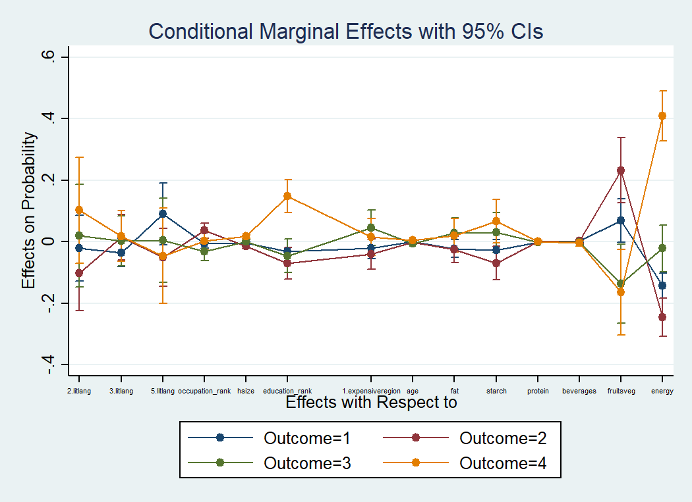
Results from a cross-sectional mprobit

Slide 13
References
T A Domencic and D McFadden, Urban Travel Demand, North-Holland Publishing Company (1975)
H M Shefrin and R H Thaler, The Behavioral life‐cycle hypothesis, Economic Inquiry 26(4), Oct 1988
C Manski, Economic Analysis of Social Interactions, Journal of Economics Perspectives 14(3) (2000)
R H Frank, Choosing the Right Pond, OUP USA (1993)
F Hirsch, Social Limits to Growth, Routledge and Kegan Paul Ltd (1977)
G Corneo and O Jeanne, Conspicuous consumption, snobbism and conformism, Journal of Public Economics(1997)

