Slide 1
Status Consumption and Intertemporal Substitution
Department of Economics
a.srivastava@pgr.reading.ac.uk

Slide 2
Conspicuous or status-related Consumption
The tendency of consumers to indicate status by using goods of a higher quality or in higher quantity than what might be considered necessary*
Veblen argued that signalling of status is innate in societies.

Slide 3
Is conspicuous consumption universal?
The public discourse often represents it as something that only serves the rich (consider the recent description of Ecclestone’s home). How true is this?
Do the rich wealthy really need status-related consumption (more than the non-rich)?
Can the poor benefit from status-related consumption?

Slide 4
Assumptions in a model for status demand
A1. Rational Benefit - There is a rational benefit to be had from status consumption (otherwise consumers would stay away from it in the long-run)
A2. Long-term Assets Status-related consumption that is not considered “wealth” (i.e. most of non-durable status-related consumption) cannot be inherited (bequeathed) and thus cannot survive over generations

Slide 5
Choices for the representative consumer
A1 ensures that all consumers benefit from expensive non-durable consumption
A2 separates consumption for long-term from short-term consumption
Claim 1: Status can come from either quality in non-durable consumption or wealth (which is durable consumption plus other long-term characteristics)
Claim 2: Assets are more expensive but a more certain provider of status

Slide 6
Status as Utility
Corneo et al consider a game-theoretic ranking model – where consumers participate with income and status goods
The literature often focuses on additional utility derived from visible consumption (see Ireland model) – this also gets around empirical issues
We consider status a combination of wealth (education, occupation, and long-term assets) and purchased quality
Can status be subjective?
Is status the cause or effect of status consumption?

Slide 7
What influences purchase of assets?
In deciding whether to purchase assets or quality, does it matter how much wealth (or long term stability of income) the consumer has?
There is ample evidence of endowment effect in the literature on consumer research
The behavioural economics literature often explains the effect of wealth on consumer choice with theories of framing and loss aversion

Slide 8
Intertemporal substitution
The poor and the rich may consider different factors for purchasing assets
The poor would need confidence (or credit) that the income and savings would rise to the price of the desired asset
The rich would need confidence that their wealth would be unaffected by a successive asset purchase
The permanent income approach relies on smoothening of income. Those with volatile incomes tend to limit (lower permanent income). But PIH only looks at monetary risks – while status encompasses other risks
Consumer confidence is thus subject to how the consumers perceive the respective risks. While PIH may be generally true, it is possible that consumers go against the usual direction:
Sb with less income stability may believe in possibility of a windfall
Sb with high income stability may be fearful of a downturn
A probabilistic model for status – which allows the consumer to overspend on short-term quality - should allow the behaviours in both directions
Can this fit into the intertemporal substitution framework?

Slide 9
Recap: Intertemporal substitution
Recall that Intertemporal substitution setting is one where the consumer can either choose to consume now or accumulate in the future
The framework is often applied on data from savings, interest rate and consumption. The Euler Equations used in the model allow for testing assumptions such as the life-cycle, Permanent Income or random-walk hypothesis (see Deaton)
We seek the intertemporal model with the effects of non-monetary wealth

Slide 10
Where does status fit in?
Consider a PhD student, a professional boxer and a banker – all have different considerations of wealth and status
Higher status for all of them would mean different things but their financial decisions would be determined by the same notion of wealth – let’s call it material status
The real probability of the ownership of the same material status varies significantly across the three professionals
Status is a subjective perception of the real probability of wealth transition
A utility function that formalises the preferences of the three professionals, would allow them to assign different weights to the probability of wealth gain in the real world
Usually one needs to make the subjective probabilities coherent for analysis

Slide 11
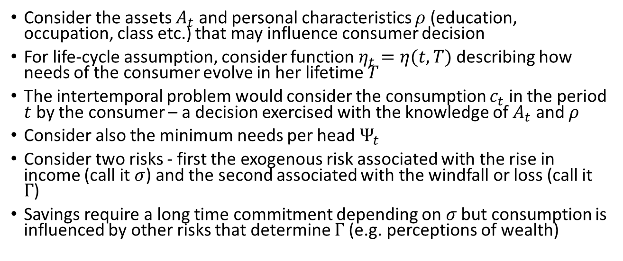
Intertemporal Substitution
Consider the assets $A_{t}$ and personal characteristics $ρ$ (education, occupation, class etc.) that may influence consumer decision
For life-cycle assumption, consider function $η_{t}=η(t,T)$ describing how needs of the consumer evolve in her lifetime $T$
The intertemporal problem would consider the consumption $c_{t}$ in the period $t$ by the consumer – a decision exercised with the knowledge of $A_{t}$ and $ρ$
Consider also the minimum needs per head $Ψ_{t}$
Consider two risks - first the exogenous risk associated with the rise in income (call it $σ$) and the second associated with the windfall or loss (call it $Γ$)
Savings require a long time commitment depending on $σ$ but consumption is influenced by other risks that determine $Γ$ (e.g. perceptions of wealth)

Slide 12
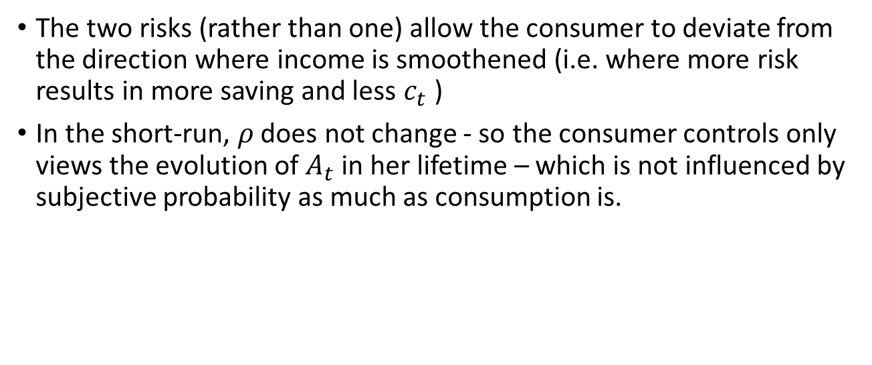
Do we need Subjective Probability
The two risks (rather than one) allow the consumer to deviate from the direction where income is smoothened (i.e. where more risk results in more saving and less $c_{t}$ )
In the short-run, $ρ$ does not change - so the consumer controls only views the evolution of $A_{t}$ in her lifetime – which is not influenced by subjective probability as much as consumption is.

Slide 13
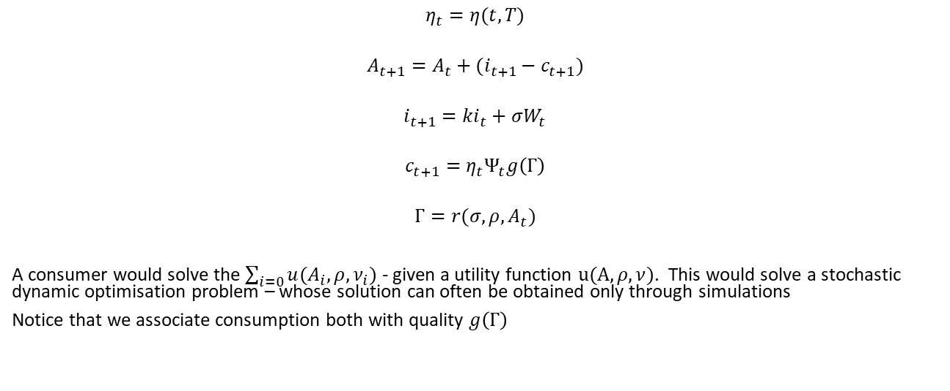
A Stochastic Model
$$η_{t}=η(t,T)$$
$$A_{t+1}=A_{t}+(i_{t+1}−c_{t+1})$$
$$i_{t+1}=ki_{t}+σW_{t}$$
$$c_{t+1}=η_{t}Ψ_{t}g\left(Γ\right)$$
$$Γ=r(σ,ρ,A_{t})$$
A consumer would solve the $\sum_{i=0}{u(A_{i},ρ,ν_{i})}$ - given a utility function $u(A,ρ,ν)$. This would solve a stochastic dynamic optimisation problem – whose solution can often be obtained only through simulations
Notice that we associate consumption both with quality $g\left(Γ\right)$

Slide 14
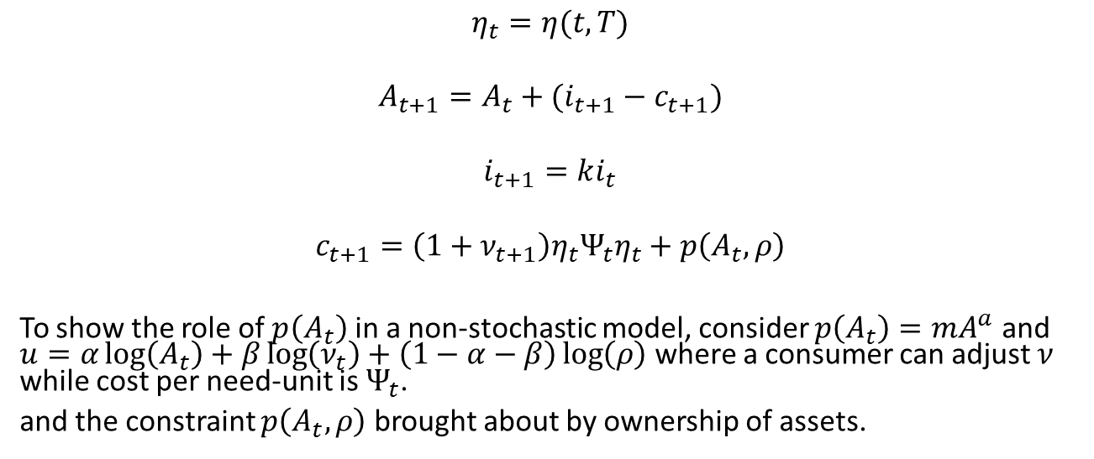
A simpler non-stochastic formulation
$$η_{t}=η(t,T)$$
$$A_{t+1}=A_{t}+(i_{t+1}−c_{t+1})$$
$$i_{t+1}=ki_{t}$$
$$c_{t+1}={\left(1+ν_{t+1}\right)η}_{t}Ψ_{t}η_{t}+p\left(A_{t},ρ\right)$$
To show the role of $p\left(A_{t}\right)$ in a non-stochastic model, consider $p\left(A_{t}\right)=mA^{a}$ and $u=α\log\left(A_{t}\right)+β\log\left(ν_{t}\right)+\left(1−α−β\right)\log\left(ρ\right)$ where a consumer can adjust $ν$ while cost per need-unit is $Ψ_{t}$.
and the constraint $p\left(A_{t},ρ\right)$ brought about by ownership of assets.

Slide 15
Empirical Issues
It is easy to determine in the empirical data – which characteristics can be passed down to generations
Quality is defined with total costs on commodity (many interpretations of quality exist in the literature)
Credit plays a significant role in the current setting (directly to consumers or through governments in the LDCs) – thus requiring us to consider interest rates in the evolution of assets

Slide 16
References
A Deaton, Understanding Consumption, Clarendon Press 1993
N J Ireland, “On limiting the market for status signals,” Journal of Public Economics, 1994

