Slide 1
Status Consumption and Intertemporal Substitution
Department of Economics
a.srivastava@pgr.reading.ac.uk

Slide 2
Conspicuous or status-related Consumption
The tendency of consumers to indicate status by using goods of a higher quality or in higher quantity than what might be considered necessary*
Veblen argued that signalling of status is innate in societies.

Slide 3
What are “needs”?
On one hand we have the view supported by Townsend that treats “needs” purely as subjective preferences
On the other extreme, there is the view that “needs” should be decided by a benign central authority
Doyal and Gough[3] define needs in terms of health and autonomy – deriving societal preconditions for them in a general theory

Slide 4
Is status demand a universal “need”?
The public discourse often represents status consumption as something that only serves the rich (consider the recent description of Ecclestone’s home). But:
Do the wealthy really need status-related consumption (more than the non-rich)?
Can the poor benefit from status-related consumption?

Slide 5
Some Assumptions
A1. Rational Benefit from status - There is a rational benefit to be had from status consumption (otherwise consumers would stay away from it in the long-run). The consumer preferences for status are not errors in judgment.
A2. Assets held longer than a lifetime - Status-related consumption that is not considered “wealth” (i.e. most of non-durable status-related consumption) cannot be inherited (bequeathed) but all else can be.

Slide 6
Towards Model for Status Demand
A1 ensures that all consumers benefit from expensive non-durable consumption
A2 separates long-term consumption from short-term consumption while considering the differences in starting wealth of consumers
Three claims about status follow:
Claim 1: Status utility can be achieved both by quality in non-durable consumption and inheritable wealth (which includes durable consumption and other long-term characteristics such as education, social identity)
Claim 2: Assets are more expensive but a more stable provider of status than non-durable consumption
Claim 3: Fulfilment of minimum needs carries no status-advantage

Slide 7
Status consumption in the literature
A game-theoretic ranking model – where consumers participate with income and status goods – has been explored in the literature – often focusing on the additional utility derived from visible consumption (see Ireland[2] model and the Corneo model[5])
Questions:
Is status cause or the effect of status-related consumption?
Would wealth or assets influence non-durable status consumption? If so, how?

Slide 8
How does wealth affect consumption?
There is enough evidence to show that endowments cause risk-aversion (consider framing and loss aversion in prospect theory)
To motivate a consumption-model, consider three players – an academic, a sportsman and an investor in a game to double their wealth with the same starting wealth. Their expectations may look like in the table.
These expectations are subjective (both short-term and long-term)
Likelihood of doubling the starting wealth at ages | 25y | 35y | 65y
Academic | Low | Med | Med
Sportsman | Med | High | Low
Investor | Med | High | High

Slide 9
How does wealth influence non-durable consumption?
The three players may achieve a fulfilment of their status goals with varied states of material wealth– but their “material wealth” is independent of their subjective view of status
The perceived status can be interpreted as a view of this material status (under uncertainty) based on the subjective probability of every player
We have thus associated risk-seeking or risk-averse behaviours to the players. Hence a utility function that formalises the preferences of the three professionals should allow them to interpret the probability of wealth gain differently.
Status is constituted both in this subjective probability and material status
In the behavioural economics literature, the effect of status and durable goods is often modelled with varied discounting rates [4]

Slide 10





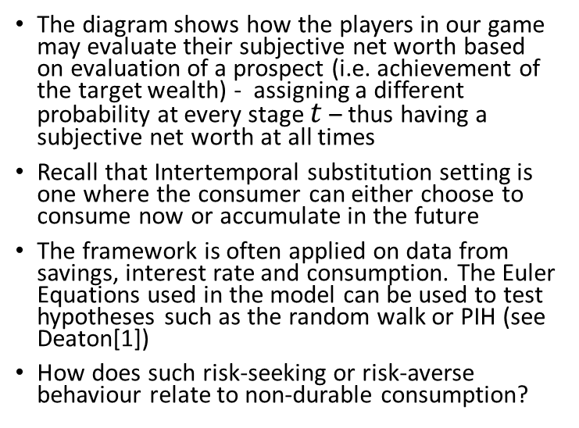







Discounting of net worth
The diagram shows how the players in our game may evaluate their subjective net worth based on evaluation of a prospect (i.e. achievement of the target wealth) - assigning a different probability at every stage $t$ – thus having a subjective net worth at all times
Recall that Intertemporal substitution setting is one where the consumer can either choose to consume now or accumulate in the future
The framework is often applied on data from savings, interest rate and consumption. The Euler Equations used in the model can be used to test hypotheses such as the random walk or PIH (see Deaton[1])
How does such risk-seeking or risk-averse behaviour relate to non-durable consumption?
$$t=20$$
$$t=25$$
$$t=35$$
$$t=65$$
$$A$$
$$A$$
$$A$$
$$A$$
$$\frac{A}{2}$$
$$A$$
$$\frac{A}{2}$$
$$A$$
$$\frac{A}{2}$$
$$\frac{A}{2}$$

Slide 11
Intertemporal substitution
Permanent Income view : PIH relies on smoothening of income i.e. those with volatile incomes tend to limit consumption (lower permanent income) - as consumption is always proportional to the PI
However, PIH explicitly ignores non-monetary risks – while status encompasses other risks. PIH may generally be true, but it is possible that consumers go against the usual direction of smoothening i.e.
Sb with less income stability may believe in a possibility (unrealistic) of a windfall
Sb with high income stability may be fearful of a downturn (unrealistic)
A probabilistic model for status – which allows the consumer to overspend on short-term quality - should allow the behaviours in both directions
With our model description - an additive utility with assets and quality would imply that more assets discourage quality. On the other hand, if a consumer matches quality to her subjective net-worth, she may increase quality

Slide 12
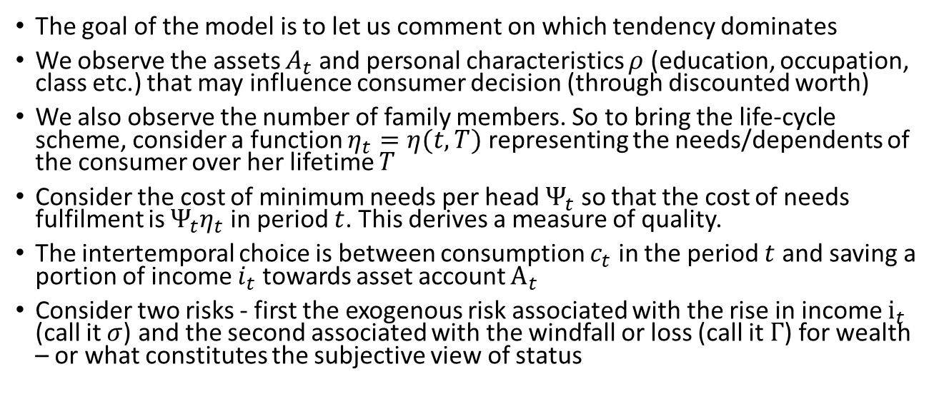
Observed variables in the model
The goal of the model is to let us comment on which tendency dominates
We observe the assets $A_{t}$ and personal characteristics $ρ$ (education, occupation, class etc.) that may influence consumer decision (through discounted worth)
We also observe the number of family members. So to bring the life-cycle scheme, consider a function $η_{t}=η(t,T)$ representing the needs/dependents of the consumer over her lifetime $T$
Consider the cost of minimum needs per head $Ψ_{t}$ so that the cost of needs fulfilment is $Ψ_{t}η_{t}$ in period $t$. This derives a measure of quality.
The intertemporal choice is between consumption $c_{t}$ in the period $t$ and saving a portion of income $i_{t}$ towards asset account $A_{t}$
Consider two risks - first the exogenous risk associated with the rise in income $i_{t}$ (call it $σ$) and the second associated with the windfall or loss (call it $Γ$) for wealth – or what constitutes the subjective view of status

Slide 13
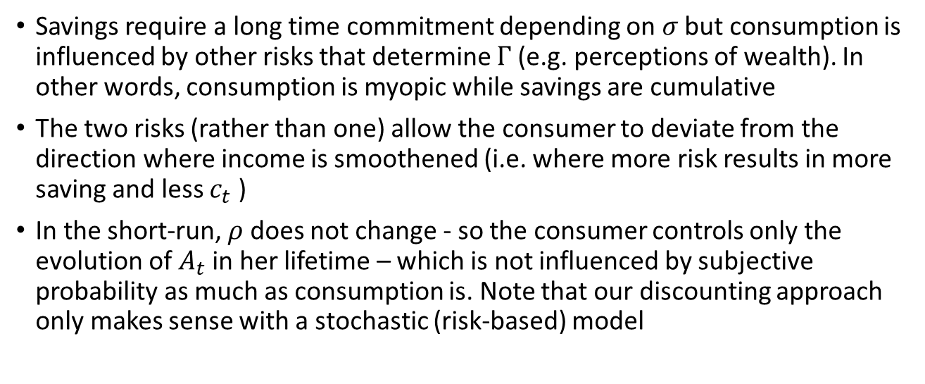
The role of two uncertainties
Savings require a long time commitment depending on $σ$ but consumption is influenced by other risks that determine $Γ$ (e.g. perceptions of wealth). In other words, consumption is myopic while savings are cumulative
The two risks (rather than one) allow the consumer to deviate from the direction where income is smoothened (i.e. where more risk results in more saving and less $c_{t}$ )
In the short-run, $ρ$ does not change - so the consumer controls only the evolution of $A_{t}$ in her lifetime – which is not influenced by subjective probability as much as consumption is. Note that our discounting approach only makes sense with a stochastic (risk-based) model

Slide 14
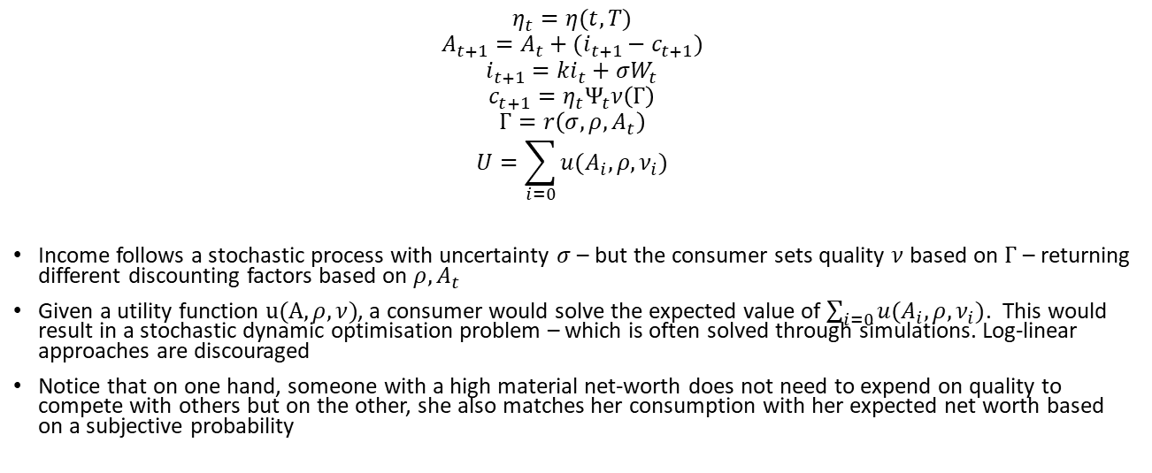
A Stochastic Model
$$η_{t}=η(t,T)$$
$$A_{t+1}=A_{t}+(i_{t+1}−c_{t+1})$$
$$i_{t+1}=ki_{t}+σW_{t}$$
$$c_{t+1}=η_{t}Ψ_{t}ν\left(Γ\right)$$
$$Γ=r\left(σ,ρ,A_{t}\right)$$
$$U=\sum_{i=0}{u(A_{i},ρ,ν_{i})}$$
Income follows a stochastic process with uncertainty $σ$ – but the consumer sets quality $ν$based on $Γ$ – returning different discounting factors based on $ρ,A_{t}$
Given a utility function $u(A,ρ,ν)$, a consumer would solve the expected value of $\sum_{i=0}{u(A_{i},ρ,ν_{i})}$. This would result in a stochastic dynamic optimisation problem – which is often solved through simulations. Log-linear approaches are discouraged
Notice that on one hand, someone with a high material net-worth does not need to expend on quality to compete with others but on the other, she also matches her consumption with her expected net worth based on a subjective probability

Slide 15
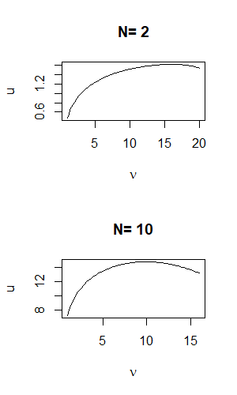
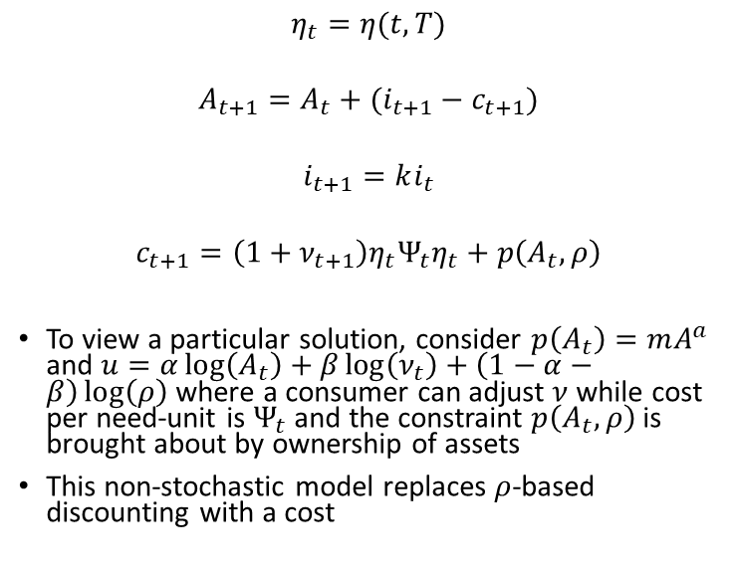
A simpler non-stochastic formulation
$$η_{t}=η(t,T)$$
$$A_{t+1}=A_{t}+(i_{t+1}−c_{t+1})$$
$$i_{t+1}=ki_{t}$$
$$c_{t+1}={\left(1+ν_{t+1}\right)η}_{t}Ψ_{t}η_{t}+p\left(A_{t},ρ\right)$$
To view a particular solution, consider $p\left(A_{t}\right)=mA^{a}$ and $u=α\log\left(A_{t}\right)+β\log\left(ν_{t}\right)+\left(1−α−β\right)\log\left(ρ\right)$ where a consumer can adjust $ν$ while cost per need-unit is $Ψ_{t}$ and the constraint $p\left(A_{t},ρ\right)$ is brought about by ownership of assets
This non-stochastic model replaces $ρ$-based discounting with a cost

Slide 16
Empirical Concerns
Quality is defined with total costs on commodity (many interpretations of quality exist in the literature)
It is easy to determine which characteristics can be passed down to generations in the empirical data
Credit plays a significant role in the current setting (directly to consumers or through governments in the LDCs) – thus requiring us to consider interest rates in the evolution of assets

Slide 17
References
A Deaton, Understanding Consumption, Clarendon Press 1993
N J Ireland, “On limiting the market for status signals,” Journal of Public Economics, 1994
L Doyal and I Gough, A Theory of Human Need, Palgrave London 1991
G Loewenstein and D Prelec, “Anomalies in Intertemporal Choice: Evidence and an Interpretation”, The Quarterly Journal of Economics, 107 (2) (May, 1992), pp. 573-597
G Corneo and O Jeanne, “Conspicuous consumption, snobbism and conformism,” Journal of Public Economics, vol. 66, pp. 55–71, 1997

