Slide 1
Status competitions under income differences
Department of Economics
a.srivastava@pgr.reading.ac.uk

Slide 2
Status Competitions – An overview
Competitions for status had been recognised by Veblen (1899).
Veblen’s ideas are now assimilated as conspicuous consumption
The idea of futility of conspicuous consumption is key to modern interpretation – notably by Frank (1987).
There are some competitions that are fuelled by uncertain investments

Slide 3
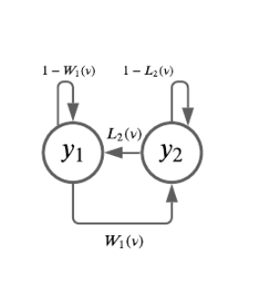
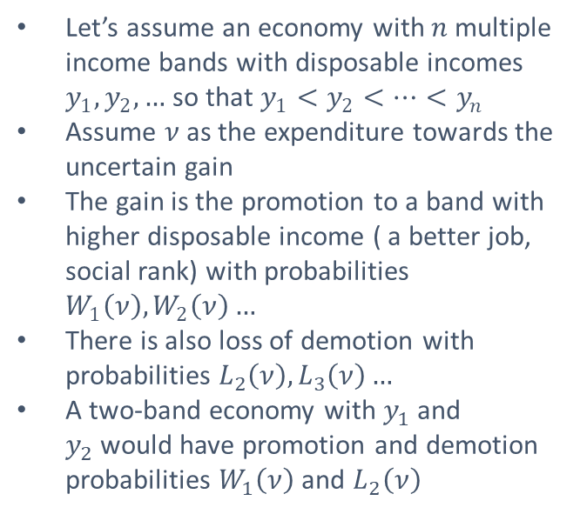
Status Competitions as a game of uncertainty
Let’s assume an economy with $n$multiple income bands with disposable incomes $y_{1},y_{2},…$ so that $y_{1}<y_{2}<…<y_{n}$
Assume $ν$as the expenditure towards the uncertain gain
The gain is the promotion to a band with higher disposable income ( a better job, social rank) with probabilities $W_{1}\left(ν\right),W_{2}\left(ν\right)…$
There is also loss of demotion with probabilities $L_{2}\left(ν\right), L_{3}\left(ν\right)…$
A two-band economy with $y_{1}$ and $y_{2}$would have promotion and demotion probabilities $W_{1}\left(ν\right)$ and $L_{2}\left(ν\right)$

Slide 4
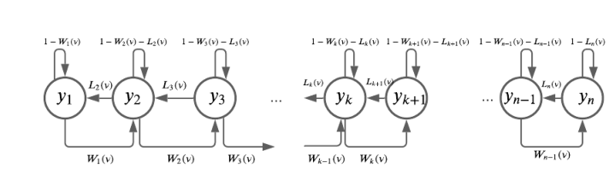
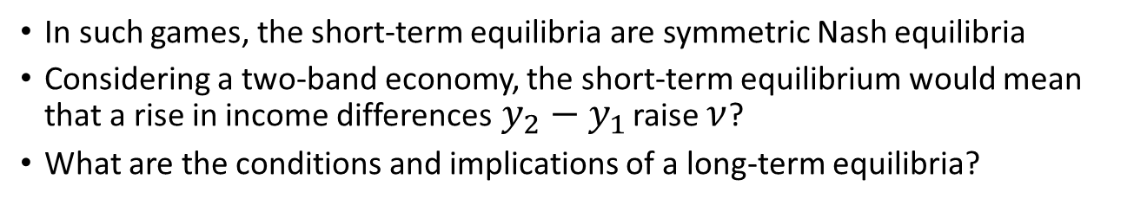
Does a long-term equilibrium exist?
In such games, the short-term equilibria are symmetric Nash equilibria
Considering a two-band economy, the short-term equilibrium would mean that a rise in income differences$y_{2}−y_{1}$ raise $ν$?
What are the conditions and implications of a long-term equilibria?

Slide 5
References
Choosing the Right Pond - Robert H. Frank
The Theory of the Leisure Class - Thorstein Veblen

