Slide 1
Status Consumption and Intertemporal Substitution
Department of Economics
a.srivastava@pgr.reading.ac.uk

Slide 2
Conspicuous or status-related Consumption
The tendency of consumers to indicate status by using goods of a higher quality or in higher quantity than what might be considered necessary
Veblen argued that signalling of status is innate in societies.

Slide 3
Is the demand status a universal “need”?
The public discourse often represents status consumption as something that only serves the rich. But is status a need?
All consumers do want to indicate status – but since status is always relative to a local reference point – there is no universal set of needs the way one exists for other basic needs.
A clear definition of needs could help us argue either way.

Slide 4
What are “needs”?
On one hand we have the view supported by Townsend that treats “needs” purely as subjective preferences
On the other extreme, there is the view that “needs” should be decided by a central authority
Doyal and Gough[3] define needs in terms of health and autonomy – deriving societal preconditions for them in a general theory

Slide 5
Status, Needs and Consumption
If needs are only those that are determined health and autonomy, then every consumer want is not necessarily a consumer need.
Accepting the Doyal-Gough definition, we do not consider status as a need.
In other words, if you “need” to indicate status, then you have wants other than needs.
We thus use a definition of needs to measure the quality of consumption for the consumer. Anything above the cost of needs is considered the quality of consumption.

Slide 6
An aggregate level of quality and quality in literature
When the quantities consumed and the market prices of the items are available, a quality measure based on the relative-price structure is more robust.
Without the quantities available, quality can only be measured based on a basket of necessary items (this is the cost-of-living indices problem in the literature).
An aggregate level of quality i.e. the overall quality that a consumer consumes in non-durable is not possible without considering a basket of necessary items.

Slide 7
Status and Consumption
We can now answer how status and consumption interact - i.e. if status (i.e. a position in society based on wealth or occupation) determines consumption or could consumption also influence status?
We make two straightforward claims to clarify our position:
A1. Rational Benefit from status consumption - There is a rational benefit to be had from status consumption (otherwise consumers would stay away from it in the long-run). The consumer preferences for status are not errors in judgment.
A2. Durable goods longevity - Status-related consumption that is not considered “wealth” (i.e. most of non-durable status-related consumption) cannot be inherited (bequeathed) but all else can be.

Slide 8
Status consumption in the literature
A game-theoretic ranking model – where consumers participate with income and status goods – has been explored in the literature – often focusing on the additional utility derived from visible consumption (ref: the model from Ireland[2] and Frank[4])
A general model more suitable for us is provided by Corneo et al. [5] who link status with social deference. The role of positional (or visible) consumption is thus to influence a consumer’s rank in society that is determined by her wealth and income
One would thus expect that wealth or assets do influence non-durable status consumption

Slide 9
A model for Status Demand
Recall that A1 is Rational Benefit from status consumption and A2 is Durable goods longevity
A1 ensures that all consumers – and hence the representative consumer in our model - benefit from expensive non-durable consumption
A2 separates the long-term consumption from short-term consumption in the context of differences in starting wealth of the consumers. This helps in identification of empirical variables.

Slide 10
A model for Status Demand (contd.)
With these two assumption we can claim:
Claim 1: Status utility can be achieved both by quality in non-durable consumption and inheritable wealth (which includes durable goods and other long-term characteristics such as education, social identity)
Claim 2: Long-term durable goods are more expensive but are a more stable provider of status than non-durable consumption
Claim 3: Fulfilment of minimum needs carries no status-advantage
The above can now be integrated in an intertemporal substitution framework

Slide 11
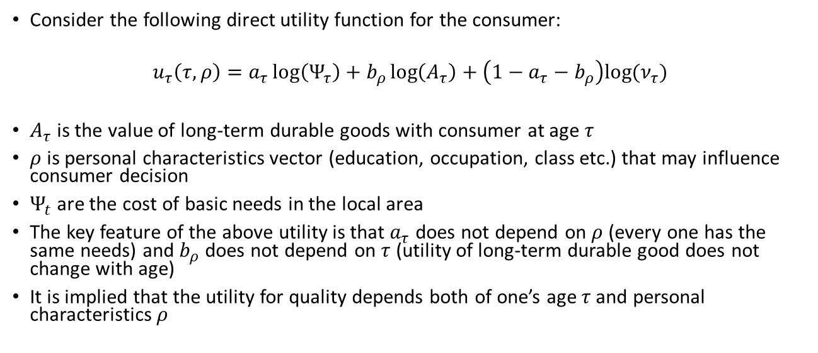
Model Details
Consider the following direct utility function for the consumer:
$$u_{τ}\left(τ,ρ\right)=a_{τ}\log\left(Ψ_{τ}\right)+b_{ρ}\log\left(A_{τ}\right)+\left(1−a_{τ}−b_{ρ}\right)log⁡(ν_{τ})$$
$A_{τ}$ is the value of long-term durable goods with consumer at age $τ$
$ρ$ is personal characteristics vector (education, occupation, class etc.) that may influence consumer decision
$Ψ_{t}$are the cost of basic needs in the local area
The key feature of the above utility is that $a_{τ}$ does not depend on $ρ$ (every one has the same needs) and $b_{ρ}$ does not depend on $τ$ (utility of long-term durable good does not change with age)
It is implied that the utility for quality depends both of one’s age $τ$and personal characteristics $ρ$

Slide 12
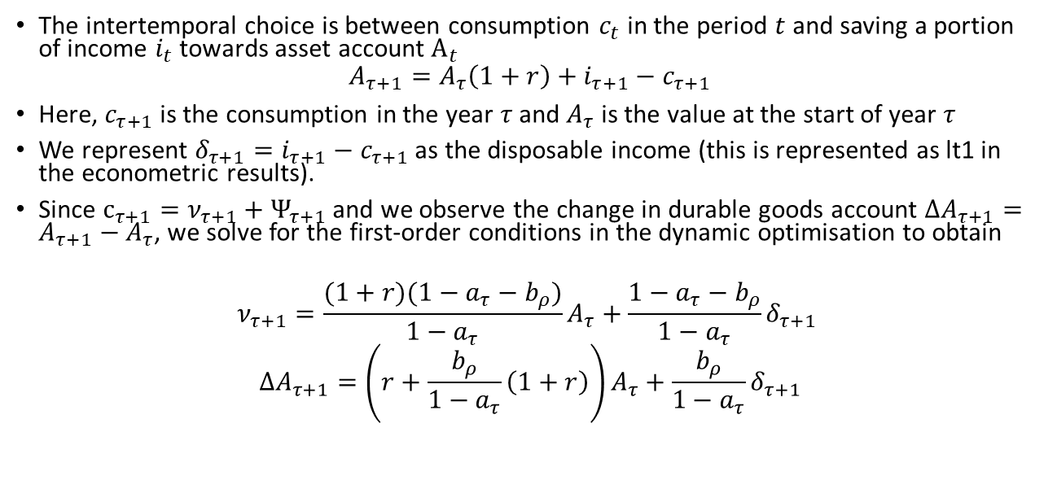
Model Details (contd.)
The intertemporal choice is between consumption $c_{t}$ in the period $t$ and saving a portion of income $i_{t}$ towards asset account $A_{t}$
$$A_{τ+1}=A_{τ}\left(1+r\right)+i_{τ+1}−c_{τ+1}$$
Here, $c_{τ+1}$ is the consumption in the year $τ$ and $A_{τ}$ is the value at the start of year $τ$
We represent ${δ_{τ+1}=i}_{τ+1}−c_{τ+1}$ as the disposable income (this is represented as lt1 in the econometric results).
Since $c_{τ+1}=ν_{τ+1}+Ψ_{τ+1}$ and we observe the change in durable goods account ${ΔA}_{τ+1}=A_{τ+1}−A_{τ}$, we solve for the first-order conditions in the dynamic optimisation to obtain
$$ν_{τ+1}=\frac{(1+r)(1−a_{τ}−b_{ρ})}{1−a_{τ}}A_{τ}+\frac{1−a_{τ}−b_{ρ}}{1−a_{τ}}δ_{τ+1}$$
$$ΔA_{τ+1}=\left(r+\frac{b_{ρ}}{1−a_{τ}}\left(1+r\right)\right)A_{τ}+\frac{b_{ρ}}{1−a_{τ}}δ_{τ+1}$$

Slide 13
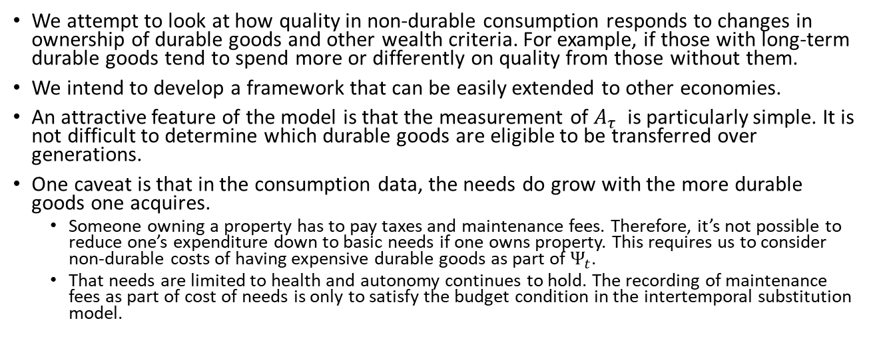
Econometric Goals
We attempt to look at how quality in non-durable consumption responds to changes in ownership of durable goods and other wealth criteria. For example, if those with long-term durable goods tend to spend more or differently on quality from those without them.
We intend to develop a framework that can be easily extended to other economies.
An attractive feature of the model is that the measurement of $A_{τ}$ is particularly simple. It is not difficult to determine which durable goods are eligible to be transferred over generations.
One caveat is that in the consumption data, the needs do grow with the more durable goods one acquires.
Someone owning a property has to pay taxes and maintenance fees. Therefore, it’s not possible to reduce one’s expenditure down to basic needs if one owns property. This requires us to consider non-durable costs of having expensive durable goods as part of $Ψ_{t}$.
That needs are limited to health and autonomy continues to hold. The recording of maintenance fees as part of cost of needs is only to satisfy the budget condition in the intertemporal substitution model.

Slide 14
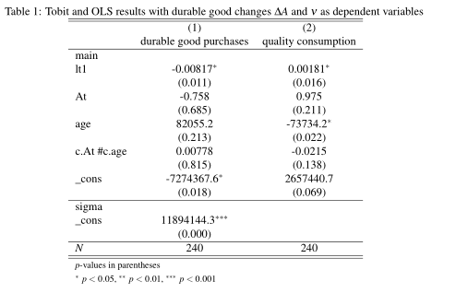
Results
Those with higher sources of income do spend less on durable goods. This could be both because i) land or house ownership is lower in the urban areas and ii) electricity is not available in the rural areas
Those with higher sources of income spend more on quality. Again this could be because the higher income consumers are concentrated in the urban areas where quality consumed has a higher reference level.
The consumption of quality does decline with age. The households with older members do spend less on quality. It remains to be seen whether this a life-cycle effect or an effect of the higher proportion of younger population in the data.

Slide 15
How is this different from visible consumption?
The theoretical view of status consumption as consumer’s attempt to transform the rank of wealth allows us to understand the relevance of the urban-rural differences in visible consumption
The LSMS data shows many opportunities for visible consumption – e.g. marriage price, expenditure on carpets rugs – but there too the effect of urban-rural differences dominates
Considering our general notion of quality, we observe that within urban areas, the role of non-durable quality relative to wealth is significant
Thus to the question whether status consumption exists in a developing economy or not, we can say that while the consumers in the developing countries do not spend fundamentally differently, the effect of wealth differences or urban-rural differences would dominate in a developing economy

Slide 16
References
A Deaton, Understanding Consumption, Clarendon Press 1993
N J Ireland, “On limiting the market for status signals,” Journal of Public Economics, 1994
L Doyal and I Gough, A Theory of Human Need, Palgrave London 1991
Robert H Frank, “The Demand for Unobservable and Other Nonpositional Goods”, The American Economic Review, vol. 75(1), pp. 101-116
G Corneo and O Jeanne, “Conspicuous consumption, snobbism and conformism,” Journal of Public Economics, vol. 66, pp. 55–71, 1997

