Slide 1
Status Consumption under extreme inequalities
Department of Economics
a.srivastava@pgr.reading.ac.uk

Slide 2
Conspicuous or status-related Consumption
The tendency of consumers to indicate status by using goods of a higher quality or in higher quantity than what might be considered necessary

Slide 3
Why do we want status goods?
A few perspectives:
Veblen : Signaling is inherent in all consumption
Hirsch: Post-war commercialisation and advertising has removed the difference between necessities and quality (physical and social scarcity)
Baudrillard : The “active manipulation of signs”– the mechanism to insert oneself within the consumer society (and working to differentiate oneself from others) is itself a form of labour
Frank: The consumer improves self-image and felicity through status competitions

Slide 4
Does consumption influence status?
Before one can evaluate a model for status consumption, consider if status – view as a social position based on wealth/occupation –should determine consumption or if consumption itself predominantly could determines status.
To answer this in empirical terms, one needs to define both status and status goods
We consider status as expected future wealth and the status value from consumption as a combination of durable consumption and non-durable consumption in excess of needs
This is different from visible good view but we believe that this definition is more generic for comparison between disparate economies

Slide 5
Status and Consumption
Two assumptions to support our definition:
A1. Rational Benefit from status consumption - There is a rational benefit to be had from status consumption (otherwise consumers would stay away from it in the long-run).
A2. Longevity of Durable goods - Status-related consumption that is not considered “wealth” (i.e. most of non-durable status-related consumption) cannot be inherited (bequeathed) but all else can be.

Slide 6
A model for Status Demand
A1 (benefit from status consumption) ensures that all consumers – and hence the representative consumer in our model - benefit from expensive non-durable consumption
A2 (durable good longevity) separates the long-term consumption from short-term consumption in the context of differences in starting wealth of the consumers.

Slide 7
Excess Non-Durable Consumption
What are needs? We accept the Doyal-Gough view which considers needs as only a guarantee of health and autonomy.
What is excess? Thus status is not a basic need. Arguing that different households cannot have different basic except for age-composition and cardinality, we thus argue that
Anything above the cost of needs of some potential status value to the consumer
Any durable goods purchased also of some status value

Slide 8
Durable Goods
We consider goods that can be transferred over generation as the durable goods relevant for status consumption. Rest is considered non-durable.
The LSMS survey which we rely upon provides assets owned by consumers for all the countries surveyed.

Slide 9
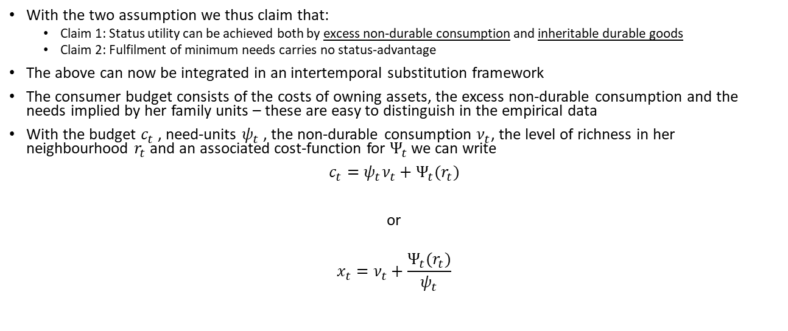
A model for Status Demand
With the two assumption we thus claim that:
Claim 1: Status utility can be achieved both by excess non-durable consumption and inheritable durable goods
Claim 2: Fulfilment of minimum needs carries no status-advantage
The above can now be integrated in an intertemporal substitution framework
The consumer budget consists of the costs of owning assets, the excess non-durable consumption and the needs implied by her family units – these are easy to distinguish in the empirical data
With the budget $c_{t}$ , need-units $ψ_{t}$ , the non-durable consumption $ν_{t}$, the level of richness in her neighbourhood $r_{t}$ and an associated cost-function for $Ψ_{t}$ we can write
$c_{t}=ψ_{t}ν_{t}+Ψ_{t}(r_{t})$
or
$$x_{t}=ν_{t}+\frac{Ψ_{t}(r_{t})}{ψ_{t}}$$

Slide 10
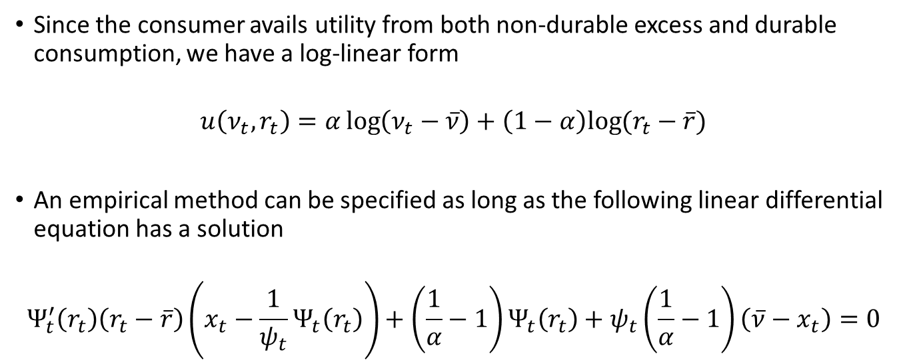
A model for Status Demand (contd.)
Since the consumer avails utility from both non-durable excess and durable consumption, we have a log-linear form
$$u\left(ν_{t},r_{t}\right)=α\log\left(ν_{t}−\overline{ν}\right)+\left(1−α\right)log⁡(r_{t}−\overline{r})$$
An empirical method can be specified as long as the following linear differential equation has a solution
$$Ψ_{t}^{′}\left(r_{t}\right)\left(r_{t}−\overline{r}\right)\left(x_{t}−\frac{1}{ψ_{t}}Ψ_{t}\left(r_{t}\right)\right)+\left(\frac{1}{α}−1\right)Ψ_{t}\left(r_{t}\right)+ψ_{t}\left(\frac{1}{α}−1\right)\left(\overline{ν}−x_{t}\right)=0$$

Slide 11
Classification of items
We attempt to look at how excess non-durable consumption varies across durable goods possession levels
Local non-durable consumption is relative to local
A necessary implication of the model is that consumers with both lower durable consumption and lower relative excess cannot compete with the consumer for whom both are higher
The framework can be easily extended to other economies – because of surveying difference economies – we rely only on excluding asset costs from non-durable consumption

Slide 12
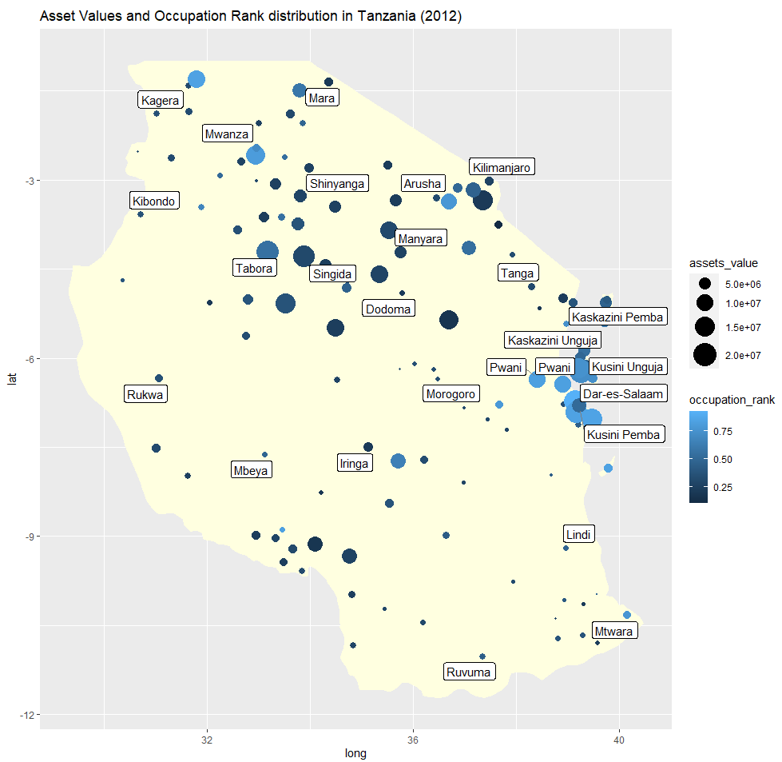
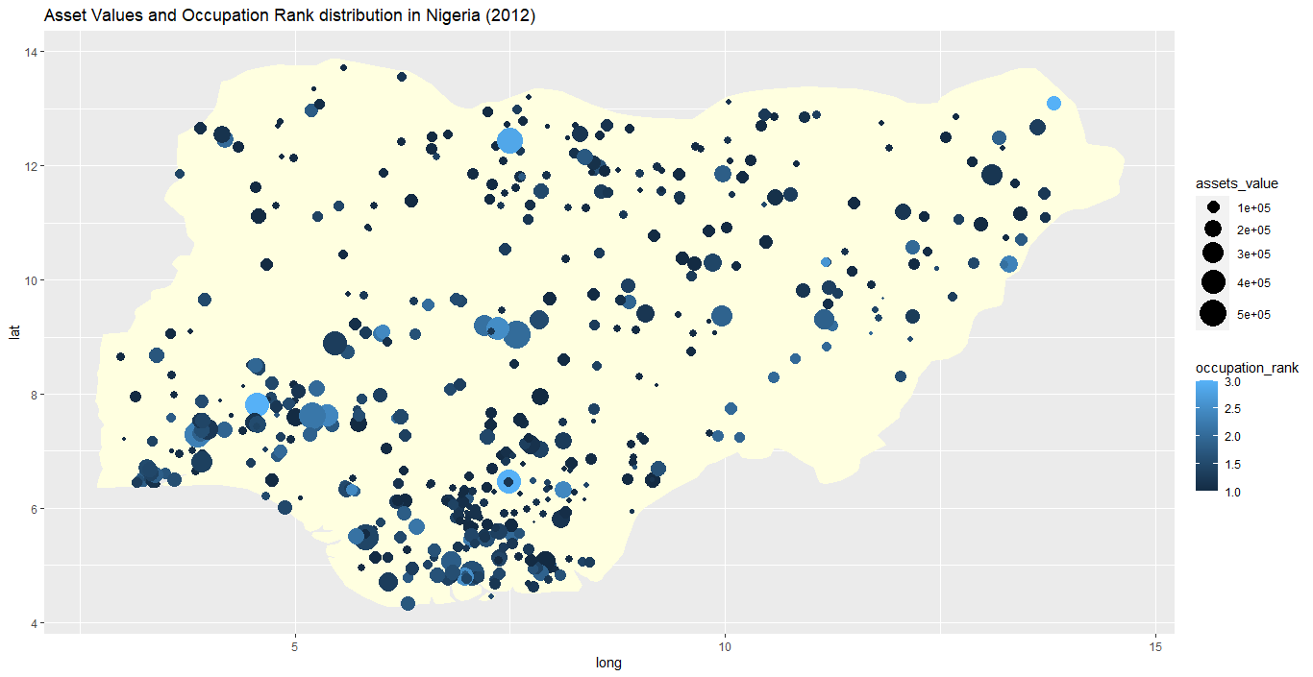
Comparing two economies – the role of occupation vs region
Using income data, we standardise occupations into occupation ranks for comparison across economies
Occupational and Asset differences are shown in the following chart. A more even distribution of assets and occupation-levels seems evident in Nigeria

Slide 13
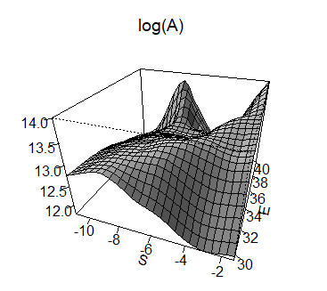
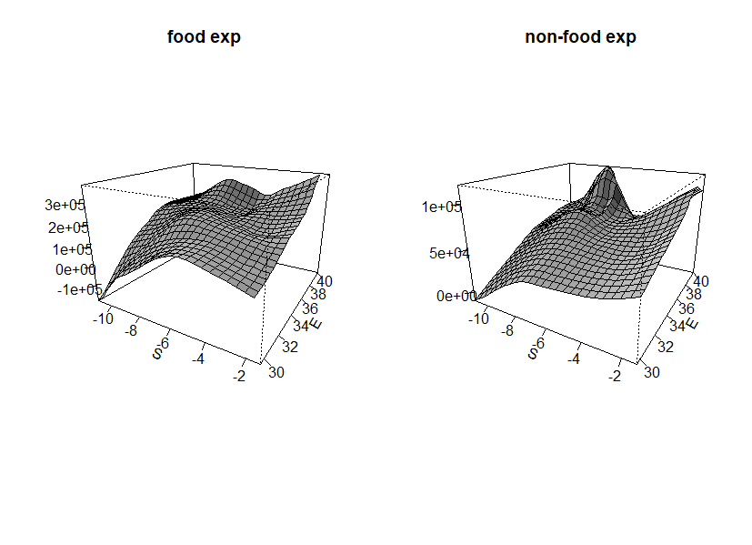
Tanzania
Non-food expenditures are much higher
in the east of the country
Vast asset differences exist across the country

Slide 14
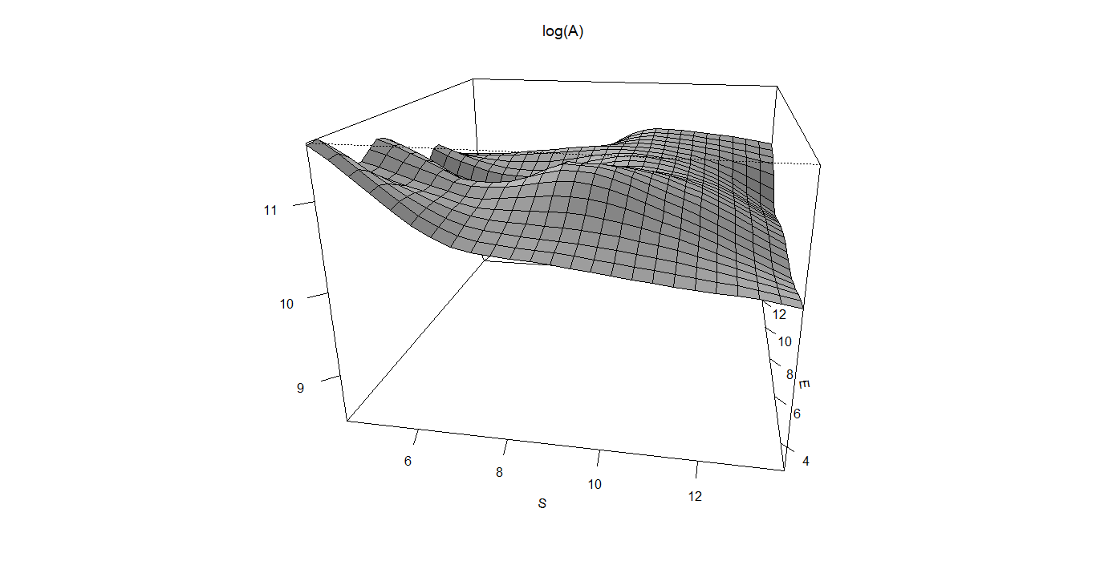
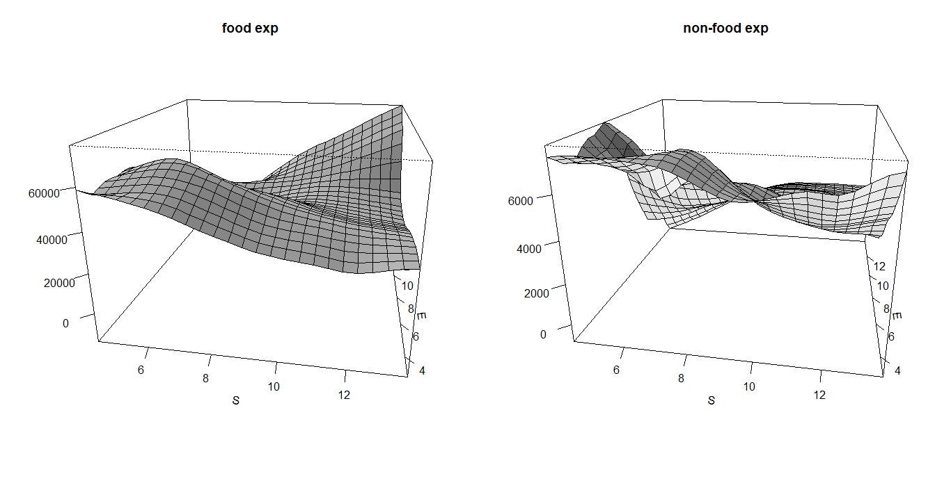
Nigeria
The asset differences are relatively flat
The north-east of the country has higher food expenditure but the coastal south-west has higher non-food expenditure

Slide 15
Interpreting non-parametric and descriptive data
Tanzania
The non-parametric view of data shows vast differences in assets
The overall role of occupation is strong in Tanzania
The south and east of Tanzania are too far apart in assets and have incomparable amenities. This is less so in the central parts of
The subjective well being does not align with the asset distribution
Nigeria
The asset differences are fewer
The role of occupation

Slide 16
Parametric Quantile Analysis

Slide 17
Tanzania

Slide 18
Finer details with quantile regression
Tanzania
Nigeria

Slide 19
How is this different from visible consumption?
The LSMS data shows many opportunities for visible consumption – e.g. marriage price, expenditure on carpets rugs – but there too the effect of urban-rural differences dominates

Slide 20
References
A Deaton, Understanding Consumption, Clarendon Press 1993
N J Ireland, “On limiting the market for status signals,” Journal of Public Economics, 1994
L Doyal and I Gough, A Theory of Human Need, Palgrave London 1991
Robert H Frank, “The Demand for Unobservable and Other Nonpositional Goods”, The American Economic Review, vol. 75(1), pp. 101-116
G Corneo and O Jeanne, “Conspicuous consumption, snobbism and conformism,” Journal of Public Economics, vol. 66, pp. 55–71, 1997

