Slide 1
Status Consumption under extreme inequalities
Department of Economics
a.srivastava@pgr.reading.ac.uk

Slide 2
Conspicuous or status-related Consumption
The tendency of consumers to indicate status by using goods of a higher quality or in higher quantity than what might be considered necessary

Slide 3
Does status consumption exist in developing countries?
For
Regardless of poverty levels, status competitions are universal
There is a reference level for all consumer choice (poorer countries have a lower reference level)
Against
Most consumers struggle to meet basic needs. So status is inseparable from fulfilling basic needs
The income differences are wide for there to be any use of status consumption

Slide 4
Why do we want status goods?
A few perspectives:
Veblen : Signaling is inherent in all consumption
Hirsch: Post-war commercialisation and advertising has removed the difference between necessities and quality (physical and social scarcity)
Baudrillard : The “active manipulation of signs”– the mechanism to insert oneself within the consumer society (and working to differentiate oneself from others) is itself a form of labour
Frank: The consumer improves self-image and felicity through status competitions

Slide 5
Does consumption influence status?
Before we talk about a model for status consumption, consider if status – viewed as a social position based on wealth/occupation –determines consumption or if instead, consumption itself predominantly drives status
This is an empirical assessment and requires us to define what status and status goods mean in a particular socio-cultural context
Since we wish to compare status consumption across economies, we consider status as expected future wealth and the status value from consumption. The latter is a combination of durable consumption and non-durable consumption in excess of needs
This is more general than the visible goods view and serves as a generic way of comparing status consumption across different economies

Slide 6
Status and Consumption
Two assumptions to support our definitions and the model:
A1. Rational Benefit from status consumption - There is a rational benefit to be had from status consumption (otherwise consumers would stay away from it in the long-run).
A2. Longevity of Durable goods - Status-related consumption that is not considered “wealth” (i.e. most of non-durable status-related consumption) cannot be inherited (bequeathed) but all else would be.

Slide 7
Status Demand Assumptions
A1 (benefit from status consumption) ensures that all consumers –benefit from high non-durable consumption relative to their needs
A2 (durable good longevity) separates the long-term consumption from short-term consumption in the context of differences in consumer wealth levels

Slide 8
Definitions: Excess Non-Durable Consumption
How do we define needs?
We accept the Doyal-Gough view and consider needs as only a guarantee of health and autonomy. Therefore status is not a basic need.
Defining Excess : Arguing that different households cannot have different basic except for age-composition and cardinality, we argue that
Anything above the cost of needs is of some potential status value to the consumer
Any durable goods purchased are also of some status value
All else are basic needs
Empirical interpretation of needs: We argue that food would carry some status value in societies where food security problems are widespread

Slide 9
Durable Consumption
Goods that can be transferred over generation as the durable goods relevant for status consumption. All else is non-durable consumption.
The LSMS survey which we rely upon provides assets owned by consumers for all the countries surveyed.

Slide 10
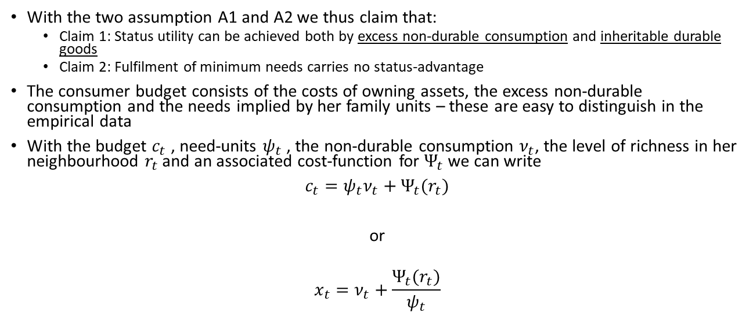
Modelling Status Consumption
With the two assumption A1 and A2 we thus claim that:
Claim 1: Status utility can be achieved both by excess non-durable consumption and inheritable durable goods
Claim 2: Fulfilment of minimum needs carries no status-advantage
The consumer budget consists of the costs of owning assets, the excess non-durable consumption and the needs implied by her family units – these are easy to distinguish in the empirical data
With the budget $c_{t}$ , need-units $ψ_{t}$ , the non-durable consumption $ν_{t}$, the level of richness in her neighbourhood $r_{t}$ and an associated cost-function for $Ψ_{t}$ we can write
$c_{t}=ψ_{t}ν_{t}+Ψ_{t}(r_{t})$
or
$$x_{t}=ν_{t}+\frac{Ψ_{t}(r_{t})}{ψ_{t}}$$

Slide 11
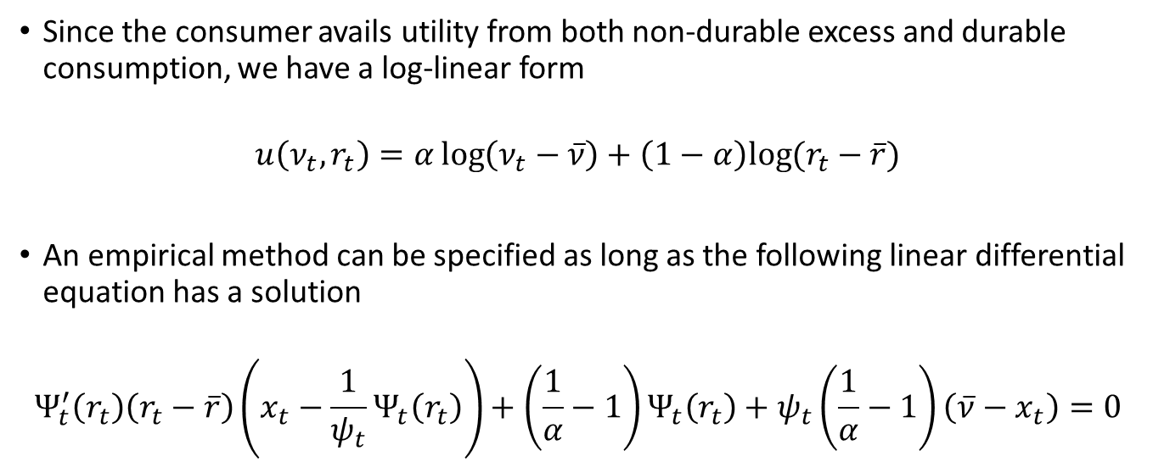
A model for Status Demand (contd.)
Since the consumer avails utility from both non-durable excess and durable consumption, we have a log-linear form
$$u\left(ν_{t},r_{t}\right)=α\log\left(ν_{t}−\overline{ν}\right)+\left(1−α\right)log⁡(r_{t}−\overline{r})$$
An empirical method can be specified as long as the following linear differential equation has a solution
$$Ψ_{t}^{′}\left(r_{t}\right)\left(r_{t}−\overline{r}\right)\left(x_{t}−\frac{1}{ψ_{t}}Ψ_{t}\left(r_{t}\right)\right)+\left(\frac{1}{α}−1\right)Ψ_{t}\left(r_{t}\right)+ψ_{t}\left(\frac{1}{α}−1\right)\left(\overline{ν}−x_{t}\right)=0$$

Slide 12
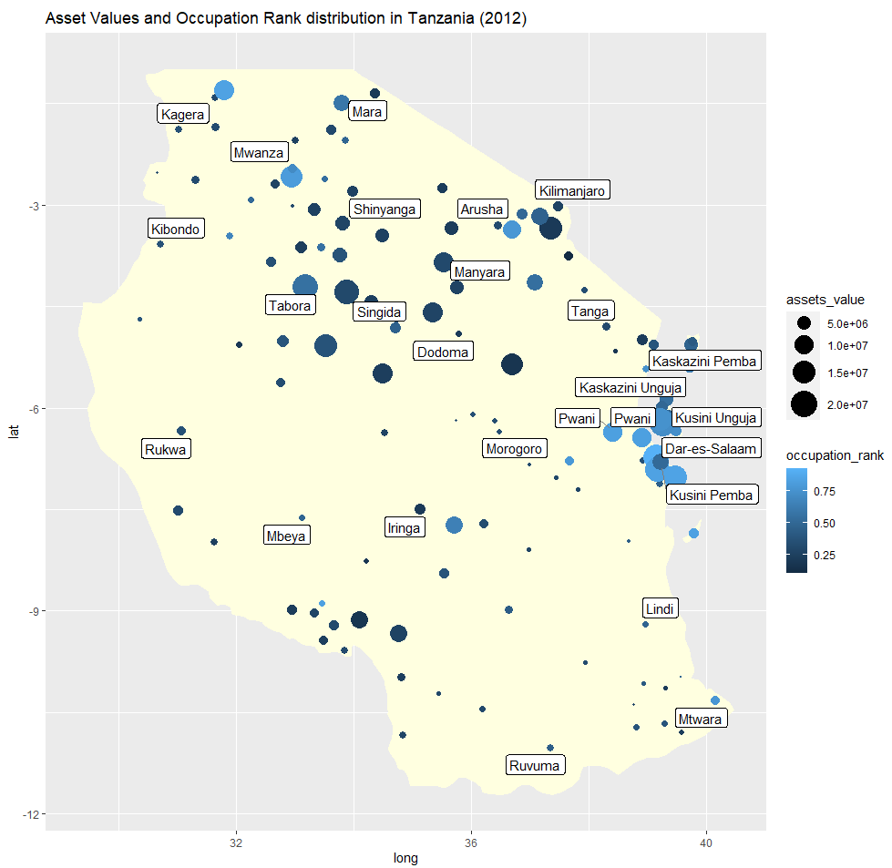
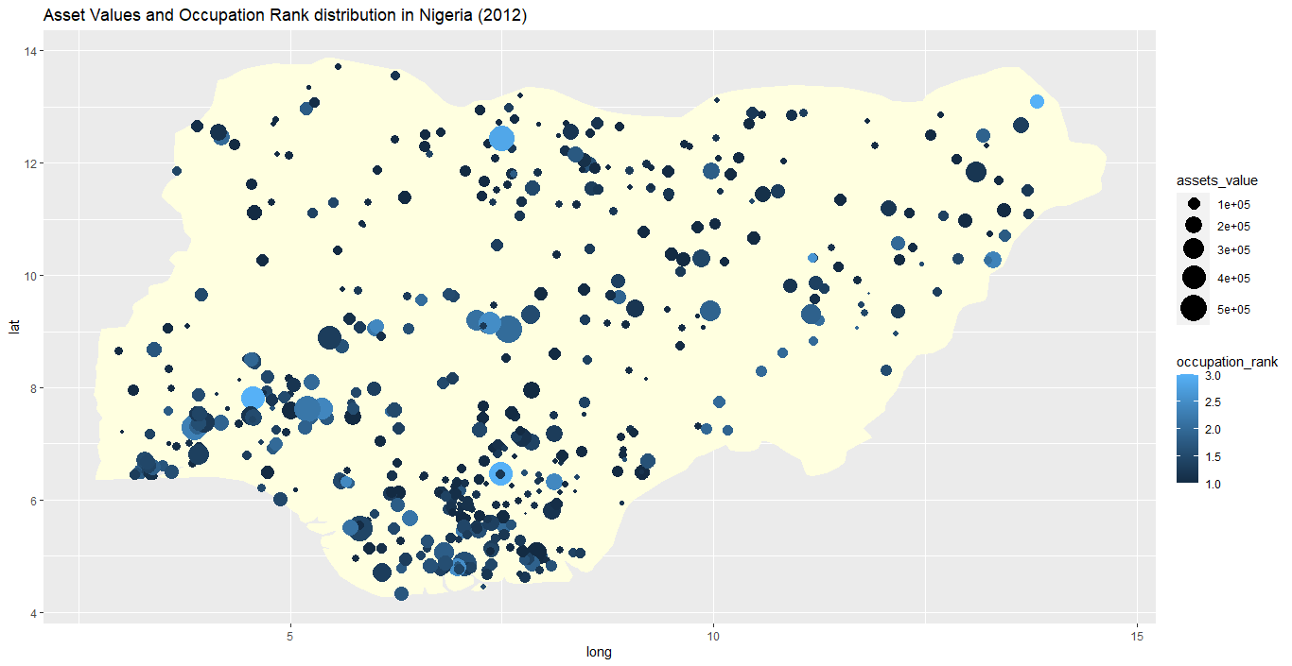
Comparing economies – the role of occupation vs region
Using income data, we standardise occupations into occupation ranks for comparison across economies
Occupational and Asset differences are shown in the following chart. A more even distribution of assets and occupation-levels seems evident in Nigeria.

Slide 13
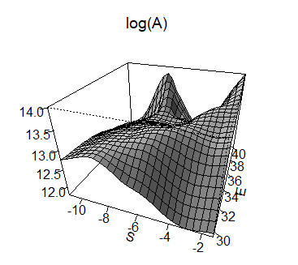
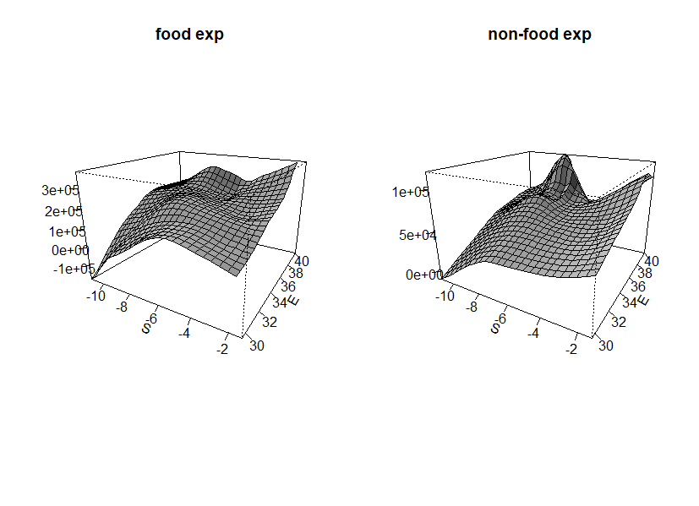
Tanzania
Non-food expenditures are much higher
in the east of the country
Vast differences in asset ownership across the country

Slide 14
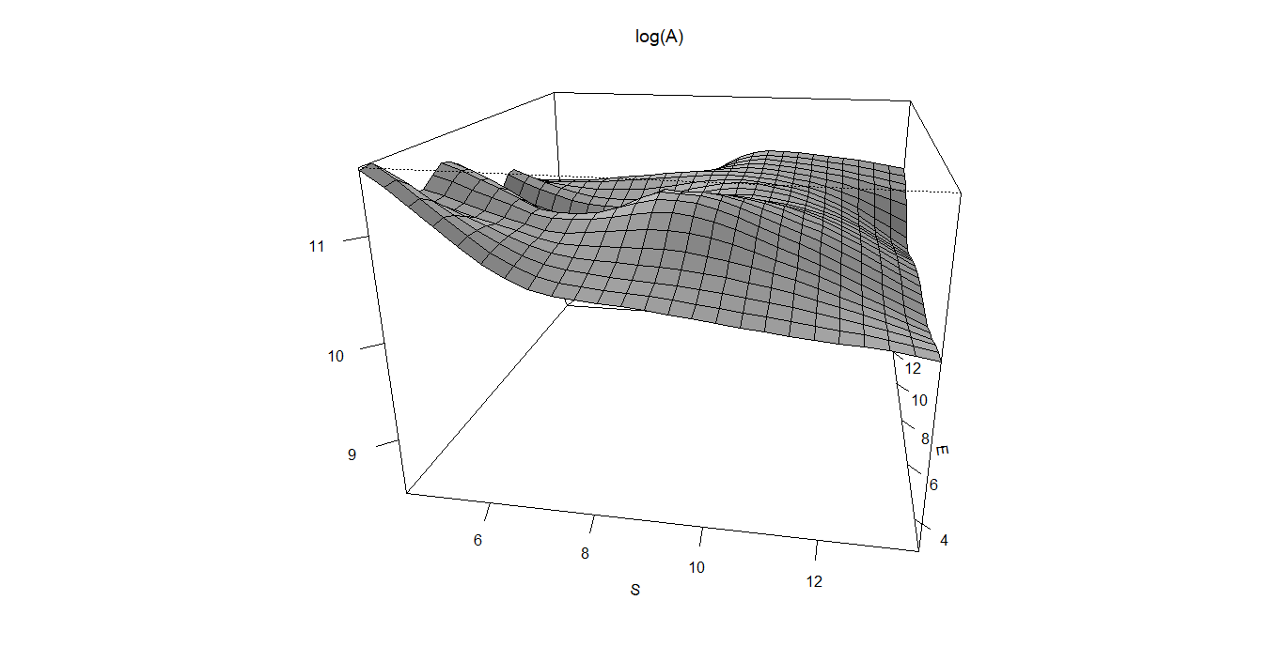
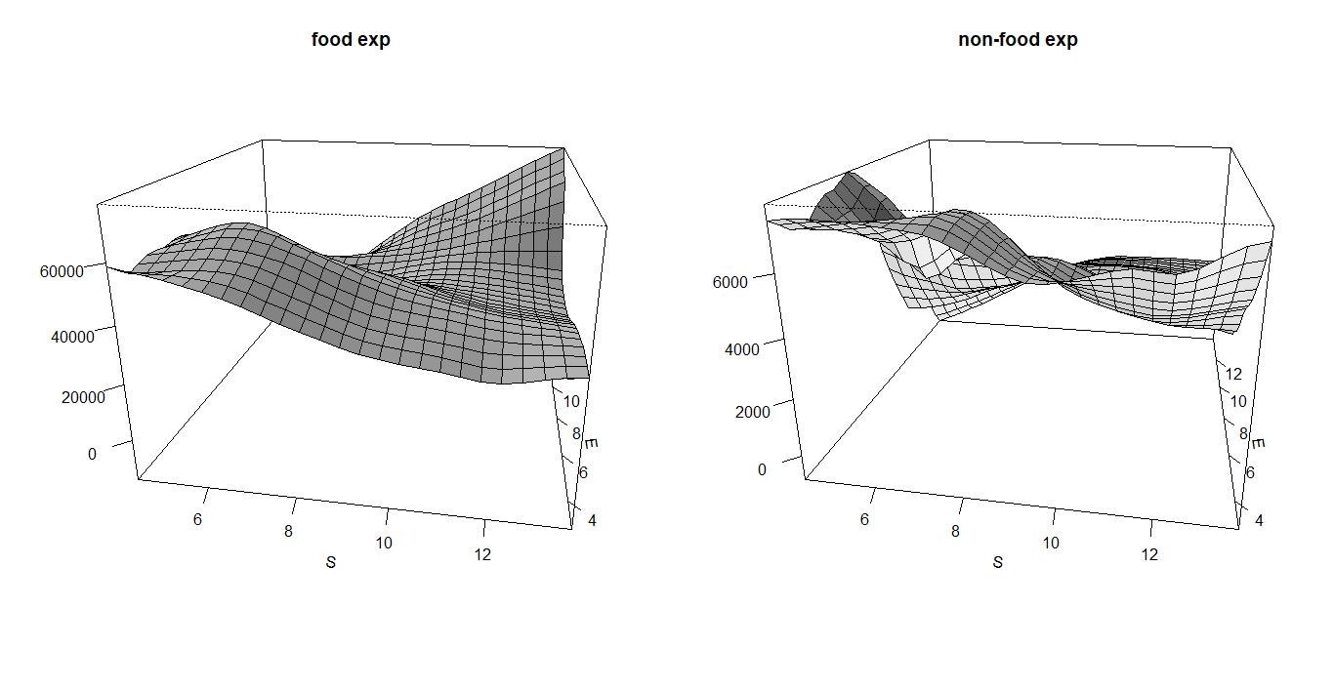
Nigeria
The asset differences are relatively flat
The north-east of the country has higher food expenditure but the coastal south-west has higher non-food expenditure

Slide 15
Interpreting non-parametric and descriptive data
Tanzania
There are vast differences in assets
Occupational differences across regions are high
The south and east of Tanzania are too far apart in assets and have incomparable amenities. This is less so in the central parts.
The subjective well being does not align with the asset distribution.
Nigeria
The asset differences are fewer
The role of education is also significant
Occupational differences more uniform across regions

Slide 16
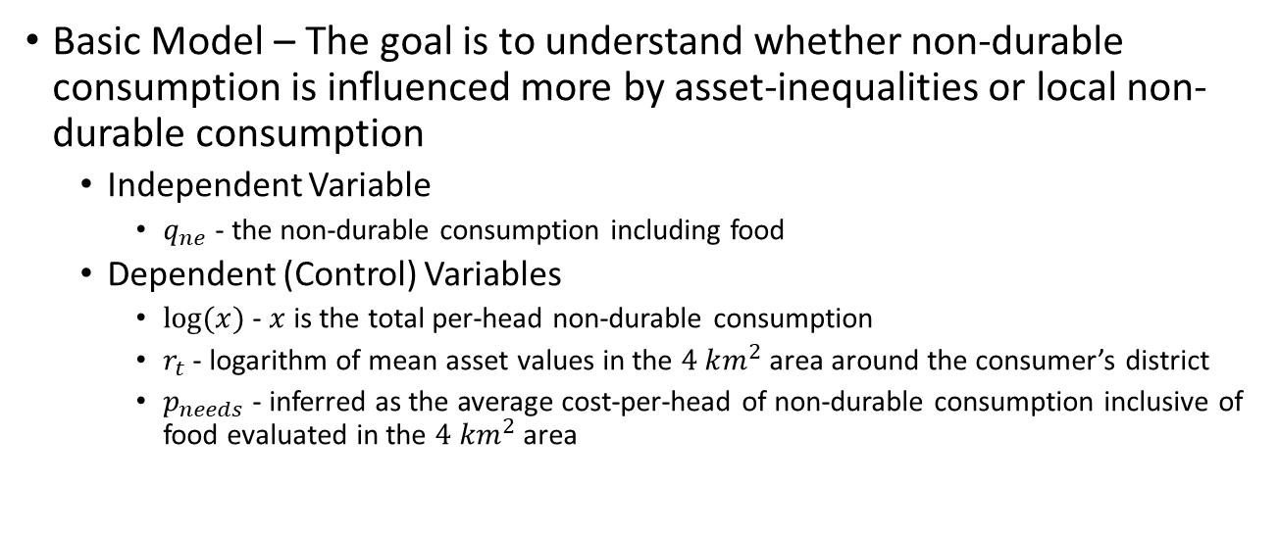
Parametric Analysis
Basic Model – The goal is to understand whether non-durable consumption is influenced more by asset-inequalities or local non-durable consumption
Independent Variable
$q_{ne}$ - the non-durable consumption including food
Dependent (Control) Variables
$log⁡(x)$ - $x$ is the total per-head non-durable consumption
$r_{t}$ - logarithm of mean asset values in the $4 km^{2}$ area around the consumer’s district
$p_{needs}$ - inferred as the average cost-per-head of non-durable consumption inclusive of food evaluated in the $4 km^{2}$ area
Notes:
The idea is that the consumer spending on non-durable consumption inclusive of food is influence by her total expenditure (depending on her own income) and the overall factors.

Slide 17
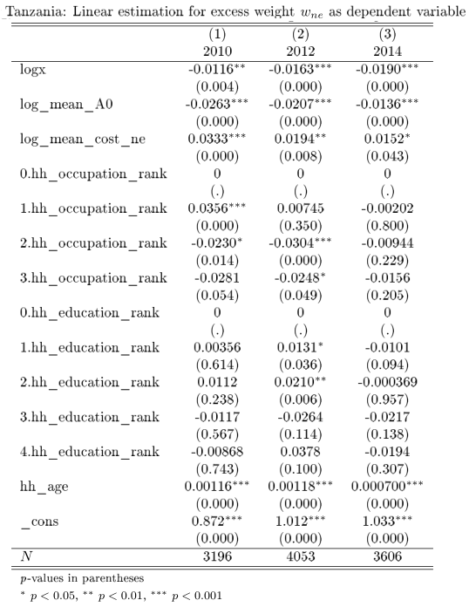
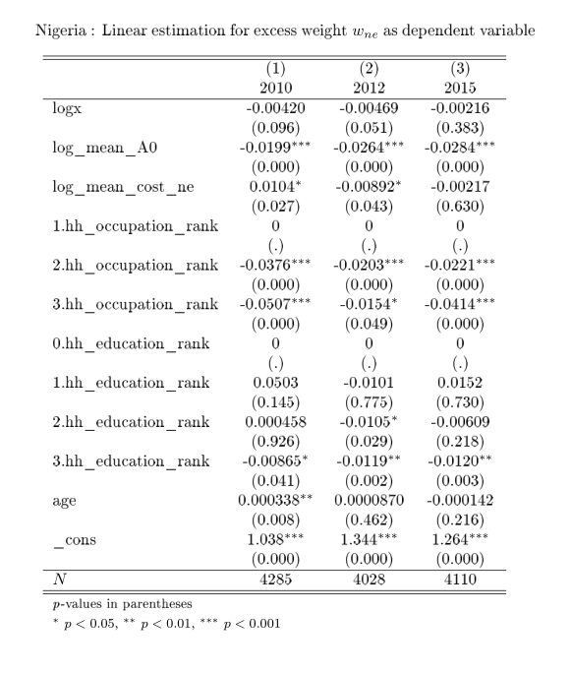
Parametric Analysis (contd.)

Slide 18
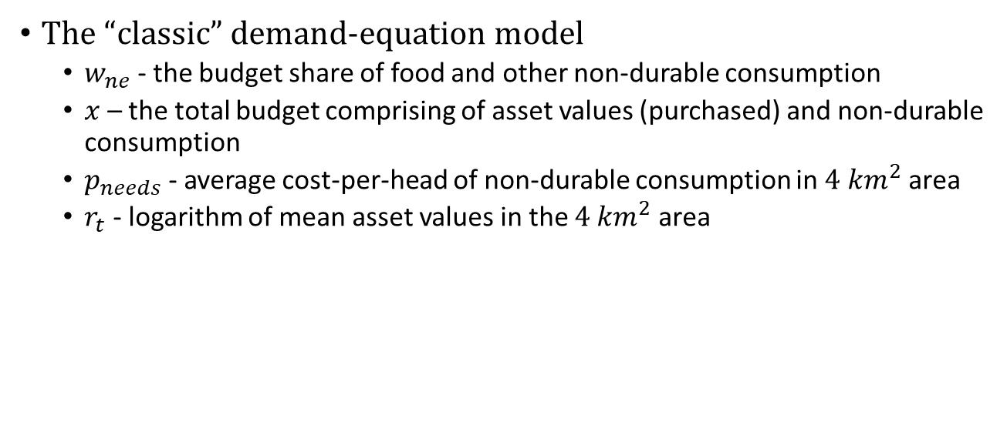
Parametric Analysis (contd.)
The “classic” demand-equation model
$w_{ne}$ - the budget share of food and other non-durable consumption
$x$ – the total budget comprising of asset values (purchased) and non-durable consumption
$p_{needs}$ - average cost-per-head of non-durable consumption in $4 km^{2}$ area
$r_{t}$ - logarithm of mean asset values in the $4 km^{2}$ area

Slide 19
Results for Tanzania

Slide 20
Results for Nigeria

Slide 21
Quantile regression - Tanzania
Tanzania
Nigeria

Slide 22
Quantile regression - Nigeria

Slide 23
Conclusions
A necessary implication of the model is that consumers with both lower durable consumption and lower relative excess cannot compete with the consumer for whom both are higher
The framework can be easily extended to other economies – because of surveying difference economies – we rely only on excluding asset costs from non-durable consumption

Slide 24
How is this different from visible consumption?
The LSMS data shows many opportunities for visible consumption – e.g. marriage price, expenditure on carpets rugs – but there too the effect of urban-rural differences dominates

Slide 25
Discussion
Is food a basic need ?
On one hand, food is a basic need (the current assumption)
There is quite a lot of support for a pressure on food quality in sub-Saharan Africa. Would food quality difference be “visible” for status?

Slide 26
References
A Deaton, Understanding Consumption, Clarendon Press 1993
N J Ireland, “On limiting the market for status signals,” Journal of Public Economics, 1994
L Doyal and I Gough, A Theory of Human Need, Palgrave London 1991
Robert H Frank, “The Demand for Unobservable and Other Nonpositional Goods”, The American Economic Review, vol. 75(1), pp. 101-116
G Corneo and O Jeanne, “Conspicuous consumption, snobbism and conformism,” Journal of Public Economics, vol. 66, pp. 55–71, 1997

