Slide 1
Status Consumption and Intertemporal Substitution
Department of Economics
a.srivastava@pgr.reading.ac.uk

Slide 2
Conspicuous or status-related Consumption
The tendency of consumers to indicate status by using goods of a higher quality or in higher quantity than what might be considered necessary*
Veblen argued that signalling of status is innate in societies.
Frederic Hirsch and Robert Frank have argued for status needs to be considered in consumption

Slide 3
Is conspicuous consumption universal?
The public discourse regards it as something that only serves the rich (recent description of Ecclestone’s home is a great example). Is that true?
Do the rich wealthy really status consumption (more than the non-rich)?
Can the poor benefit from status-related consumption?

Slide 4
Assumptions for a status demand model
A1. There is a rational benefit to be had from status consumption (otherwise consumers would stay away from it in the long-run)
A2. Status-related consumption that is not considered “wealth” (most of the non-durable status-related consumption) cannot be inherited and thus cannot be passed across generations

Slide 5
The representative consumer
A1 ensures that all consumers benefit from non-durable consumption
A2 separates long-term consumption from short-term consumption
It is easy to determine in the empirical data – which characteristics can be passed down to generations
Claim 1: Status can come from either quality in non-durable consumption or wealth (which is durable consumption plus other long-term characteristics)
Claim 2: Assets are more expensive but a certain provider of status

Slide 6
What influences purchase of assets?
In deciding whether to purchase assets or quality, does it matter how much wealth (or long term stability of income) the consumer has?

Slide 7
Enter the Intertemporal substitution
The poor and the rich may consider different factors for purchasing assets
The poor would need confidence (or credit) that the income and savings would rise to asset price
The rich would need confidence that their wealth would be unaffected by the asset purchase
The confidence however is subject to how the consumers perceive the respective risks. Thus against the usual direction:
Sb with less income stability may believe in possibility of a windfall
Sb with high income stability may be fearful of a downturn
A probabilistic model should allow the behaviours in both directions
How does this fit into the intertemporal substitution problem?

Slide 8
Recap: Intertemporal substitution
Recall that Intertemporal substitution problem is one where consumer can either choose to consume now or accumulate in the future
The first applications of the technique were performed with the data on savings, interest rate and consumption. The framework (Euler Equations) allows us to test assertions such as the life-cycle assumption, Permanent Income or random-walk hypothesis (see Deaton)
The “wealth” in such models is the monetary wealth (as in PIH)
We seek a model with the effects of non-monetary wealth as well

Slide 9
Where does status fit in?
Consider a PhD student, a professional boxer and a banker – all have different considerations of wealth and status
Higher status for all of them would mean different things but their financial decisions would be determined by the same notion of wealth – let’s call it material status
The real probability of the ownership of the same material status varies significantly across the three professionals
Status is a subjective perception of the real probability of wealth transition
A utility function that formalises the preferences of the three professionals, would allow them to assign different weights to the probability of wealth gain in the real world
Usually one needs to make the subjective probabilities coherent for analysis

Slide 10
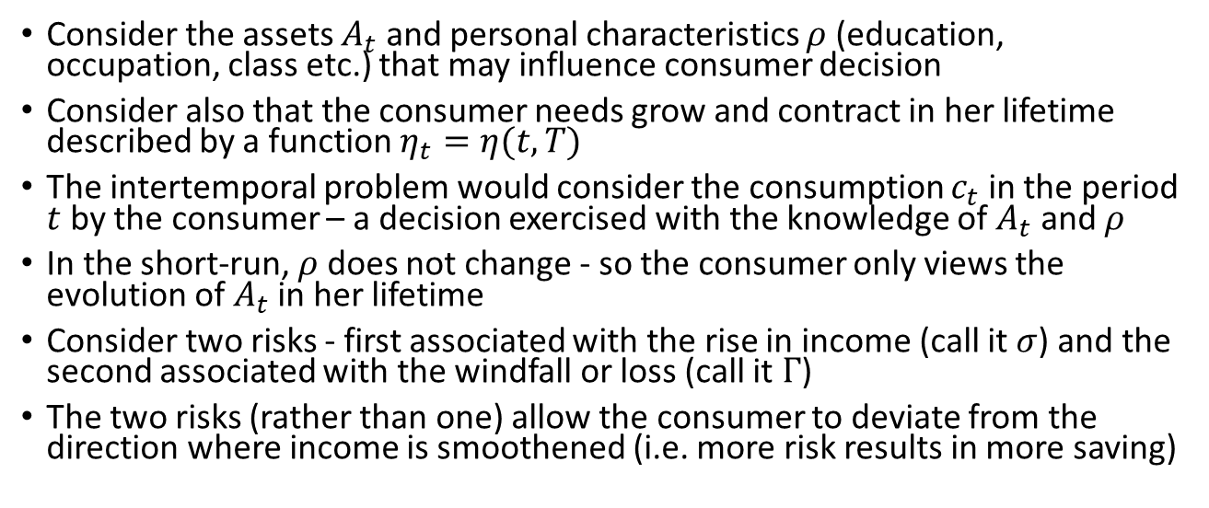
Intertemporal Substitution
Consider the assets $A_{t}$ and personal characteristics $ρ$ (education, occupation, class etc.) that may influence consumer decision
Consider also that the consumer needs grow and contract in her lifetime described by a function $η_{t}=η(t,T)$
The intertemporal problem would consider the consumption $c_{t}$ in the period $t$ by the consumer – a decision exercised with the knowledge of $A_{t}$ and $ρ$
In the short-run, $ρ$ does not change - so the consumer only views the evolution of $A_{t}$ in her lifetime
Consider two risks - first associated with the rise in income (call it $σ$) and the second associated with the windfall or loss (call it $Γ$)
The two risks (rather than one) allow the consumer to deviate from the direction where income is smoothened (i.e. more risk results in more saving)

Slide 11
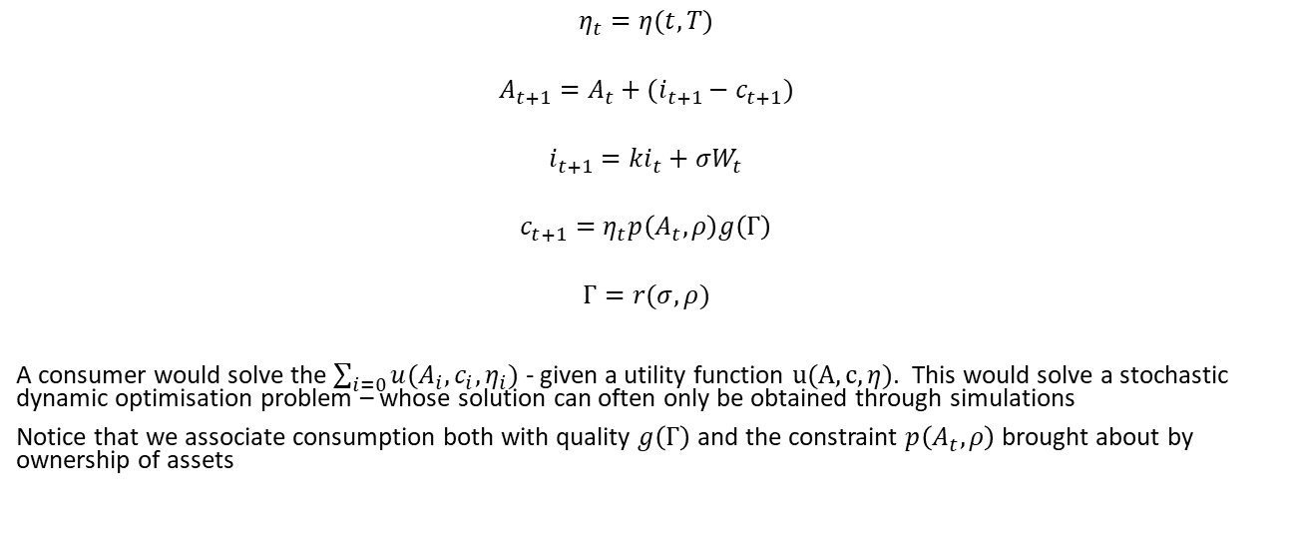
A Stochastic Model
$$η_{t}=η(t,T)$$
$$A_{t+1}=A_{t}+(i_{t+1}−c_{t+1})$$
$$i_{t+1}=ki_{t}+σW_{t}$$
$$c_{t+1}=η_{t}p\left(A_{t},ρ\right)g\left(Γ\right)$$
$$Γ=r(σ,ρ)$$
A consumer would solve the $\sum_{i=0}{u(A_{i},c_{i},η_{i})}$ - given a utility function $u(A,c,η)$. This would solve a stochastic dynamic optimisation problem – whose solution can often only be obtained through simulations
Notice that we associate consumption both with quality $g\left(Γ\right)$ and the constraint $p\left(A_{t},ρ\right)$ brought about by ownership of assets

Slide 12
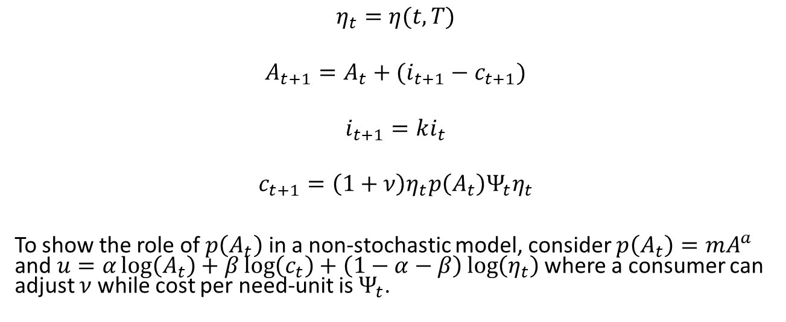
Solution for a non-stochastic formulation
$$η_{t}=η(t,T)$$
$$A_{t+1}=A_{t}+(i_{t+1}−c_{t+1})$$
$$i_{t+1}=ki_{t}$$
$$c_{t+1}={\left(1+ν\right)η}_{t}p\left(A_{t}\right)Ψ_{t}η_{t}$$
To show the role of $p\left(A_{t}\right)$ in a non-stochastic model, consider $p\left(A_{t}\right)=mA^{a}$ and $u=α\log\left(A_{t}\right)+β\log\left(c_{t}\right)+\left(1−α−β\right)\log\left(η_{t}\right)$ where a consumer can adjust $ν$ while cost per need-unit is $Ψ_{t}$.

Slide 13
How close is this with reality?
Credit plays a significant role in the current setting (directly to consumers or through governments in the LDCs) – thus requiring us to consider interest rates
Credit can also be seen as a means to bring discipline in the consumer behaviour

Slide 14
References
A Deaton, Understanding Consumption, Clarendon Press 1993

