Slide 1
Status Consumption under Uncertainty
A Stochastic utility view of Status Consumption

Slide 2
Status Consumption
Status consumption is a consumption of goods with a quality or quantity higher than what may be considered necessary
Necessities cannot be subjective in this view (or else there would no status consumption)
But how do we determine status goods?
Identify Visible Items: Commodities that are meant to be only signaling purposes e.g. Personal Items or vehicles - see Charles et al https://www.nber.org/papers/w13392
Identify items associated with wealth – For example, Mazzocco et al https://www.jstor.org/stable/26578155 use fur coat, cuff links, caviar as high-status products while low-status products are vacuum cleaner, sofa, refrigerator, washing machine, and an unbranded shirt
Both the approaches have been used to understand how disparities in wealth (where notions of status come from) relate with non-durable consumption by disadvantaged socio-economic classes in urban areas

Slide 3
Problems with the Demand Analysis Visible for Consumption
For the most part, the analysis of non-durable consumption entails identifying status-goods based on an observed sociological trend and then testing for the sociological trend in the demand for identified status-goods:
Observing historically restricted ownership of vehicles by social groups and then testing for high proportion of expenditure on vehicles etc. (African Americans in the US)
Observing restrictions on conspicuous goods in collective governments and then testing for higher expenditure on conspicuous goods after the end of collectivism(East Germany)
Observing social stratification and wealth disparities to find disproportionate spending on status items (South Africa, India)
Apart from the varied social contexts for classification of items, a serious issue with the above approach is that in name of status consumption one is limited to observing a bandwagon effect spread over a few generations. That artificially suppressed demands rise after the barriers have been lifted does not say much about the utility of status goods.

Slide 4
Why do we want status goods?
Veblen : Signaling is inherent in all consumption
Hirsch: Commercialisation and advertising remove the difference between necessities and quality (physical and social scarcity)
Baudrillard : The “active manipulation of signs”– the mechanism to insert oneself within the consumer society (and working to differentiate oneself from others) is itself a form of labour
Frank: The consumer improves self-image and felicity through status competitions

Slide 5
A general view of status consumption
Leaning towards the Frank’s view of status consumption we take the general approach that a consumer maximises happiness through status goods by participating in competitions for
Wealth : Maximizing expected wealth
Permanence: extraordinary consumption to mark special occasions or relationships
In the first sense, status goods are used to distill away those with less wealth-retaining abilities (and to attract those with wealth-gaining attitudes)
In the second sense, status goods are used to strengthen social bonds and improve self-image
The above opposing directions balance the right amount of status consumption
We argue that
Wealth goals are better represented with utility under risk
The feelings of permanence/security are better understood in a framework of dynamic reference points (see Koszegi http://www.jstor.org/stable/40784505 )

Slide 6
Risk Aversion
The investments in development of social networks or splurge in social events – which are clearly instances of status consumption - do not provide a deterministic material advantage. Therefore, we associate a probability function with the future wealth points to represent the consumer’s subjective future goal in the competition for wealth and permanence
As far as the maximization of expected wealth is concerned, the consumer’s risk-aversion has a direct influence on her destiny in the environment of uncertainty
Through acquiring habits, taste and identity that develop around status items, the consumer also obtains a subjective security (or a boost in self-image) that makes her believe that she would not drift into an unfavourable risk-aversion
We use both Prospect Theory and a framework for dynamic references to develop the model for a competition for wealth and permanence

Slide 7
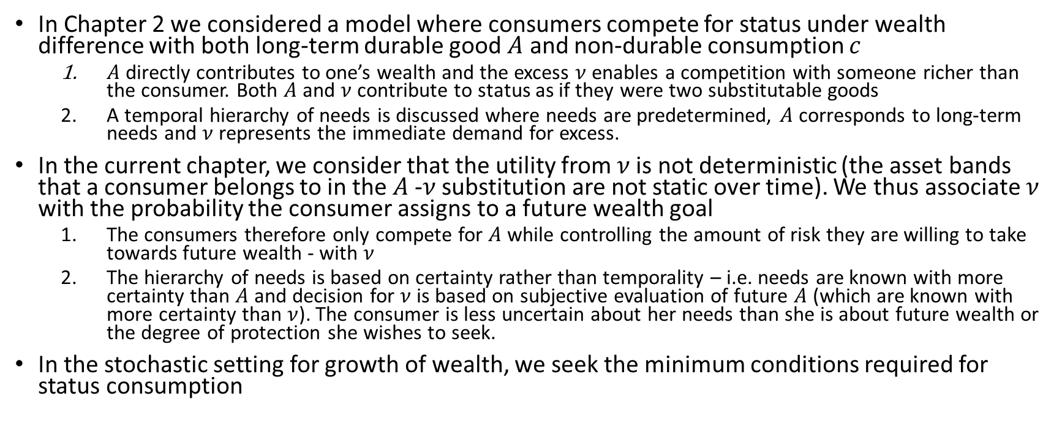
Comparison with past empirical approaches
In Chapter 2 we considered a model where consumers compete for status under wealth difference with both long-term durable good $A$ and non-durable consumption $c$
$A$ directly contributes to one’s wealth and the excess $ν$enables a competition with someone richer than the consumer. Both $A$ and $ν$contribute to status as if they were two substitutable goods
A temporal hierarchy of needs is discussed where needs are predetermined, $A$ corresponds to long-term needs and $ν$ represents the immediate demand for excess.
In the current chapter, we consider that the utility from $ν$is not deterministic (the asset bands that a consumer belongs to in the $A$-$ν$ substitution are not static over time). We thus associate $ν$ with the probability the consumer assigns to a future wealth goal
The consumers therefore only compete for $A$ while controlling the amount of risk they are willing to take towards future wealth - with $ν$
The hierarchy of needs is based on certainty rather than temporality – i.e. needs are known with more certainty than $A$ and decision for $ν$ is based on subjective evaluation of future $A$ (which are known with more certainty than $ν$). The consumer is less uncertain about her needs than she is about future wealth or the degree of protection she wishes to seek.
In the stochastic setting for growth of wealth, we seek the minimum conditions required for status consumption

