Slide 1
Status related consumption in the sub-Saharan Africa
Year 3 (PT) report - Anurag Srivastava
Department of Economics
a.srivastava@pgr.reading.ac.uk

Slide 2
Conspicuous consumption
The tendency of consumers to indicate status by use goods of a higher quality or in higher quantity than what might be considered necessary
Veblen argued that signalling of status is innate in societies.
More recently, Frederic Hirsch and Robert Frank have argued that for status needs to be considered in consumption

Slide 3
Can status consumption exist in sub-Saharan Africa?
While it can always exist, scarcity is more relevant in the developing countries
Certain characteristics being limited to the rich may result in status being developed – a feature that requires a requires a feedback model for status
A survey on visible consumption proxies the underlying factors we wish to understand

Slide 4
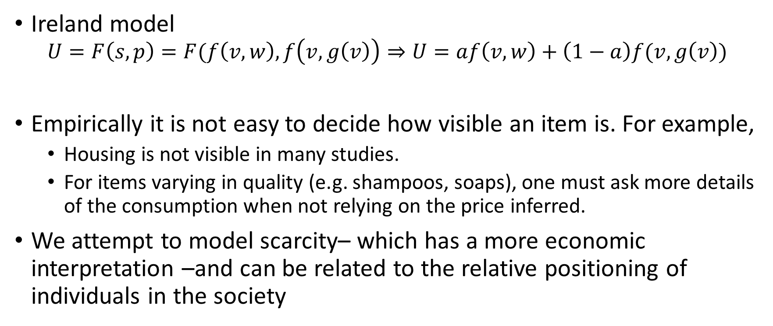
Visible consumption and Status-related consumption
Ireland model
$$U=F\left(s,p\right)=F(f\left(v,w\right),f\left(v,g\left(v\right)\right)⇒U=af\left(v,w\right)+\left(1−a\right)f(v,g\left(v\right))$$
Empirically it is not easy to decide how visible an item is. For example,
Housing is not visible in many studies.
For items varying in quality (e.g. shampoos, soaps), one must ask more details of the consumption when not relying on the price inferred.
We attempt to model scarcity– which has a more economic interpretation –and can be related to the relative positioning of individuals in the society

Slide 5
Factors for status consumption – How do consumers choose items?
We observe the basic tendency to accumulate assets and seek permanence – even education should be seen as an asset (an extension to the idea of permanent income)
Those who consistently buy high priced items and own more expensive assets would consistently have higher status
Market forces i) making assets available for cheaper and ii) looking for new assets to replace old ones – both form the context of status consumption

Slide 6
Identity and barriers
Ownership of assets helps social networks through an identity of ownership
The choices that the representative consumer faces are amongst
Satisifying immediate status needs
Later status needs (through accumulation of wealth and assets)
Establishment of social networks.
The barriers to status represent expectations that shape observed status in society – these could be state variables in a time-series model

Slide 7
Empirical Issues
Barriers are not measurable – the changing ownership of assets is the the only proxy for a barrier
Arbitrary factors cannot be added to the demand equation without the rather stringent conditions of the demand equation
Assets data (the number and type of assets owned) is recorded in the LSMS survey for every household

Slide 8
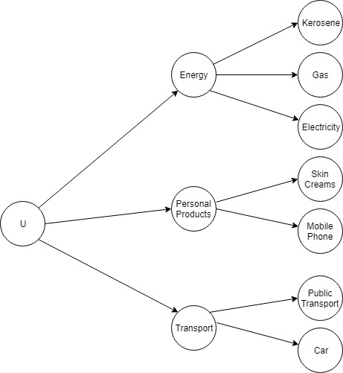
A two state budgeting model
Status is aggregated across all categories. There is not status item per se but – it exists as an item within every category.
Linear aggregation of status sub-utilities assumed
Snob and bandwagon items are thus mirrored in a two-state budgeting model

Slide 9
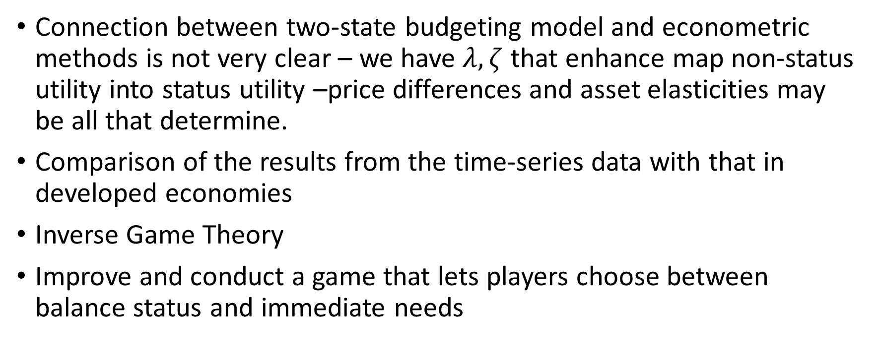
Future Directions
Connection between two-state budgeting model and econometric methods is not very clear – we have $λ,ζ$ that enhance map non-status utility into status utility –price differences and asset elasticities may be all that determine.
Comparison of the results from the time-series data with that in developed economies
Inverse Game Theory
Improve and conduct a game that lets players choose between balance status and immediate needs

Slide 10
References
Norman J Ireland, "On limiting the market for status signals", Journal of Public Economics (1994)
Fred Hirsch, Social Limits to Growth (Routledge and Kegan Paul Ltd, 1977)
Robert H Frank, Choosing the Right Pond (OUP USA, 1993).

