Slide 1
Status competitions under income differences
Department of Economics
a.srivastava@pgr.reading.ac.uk

Slide 2
Status Competitions – An overview
Status competitions were first elaborated by Veblen (1899).
Veblen’s ideas have resurfaced in the post-war years of greater security and are constituted in the concerns of conspicuous consumption
The idea of futility of conspicuous consumption is key to its modern interpretations – notably by Frank (1987).
There are – nevertheless - some status competitions that are fuelled by investments that reduce uncertainty of outcome. Some approaches thus focus on gains in non-transactional markets – e.g. Cole et al (1992)
In varied forms, these may exist in both developed and developing markets

Slide 3
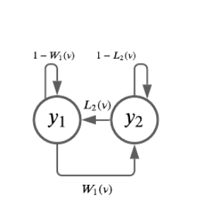
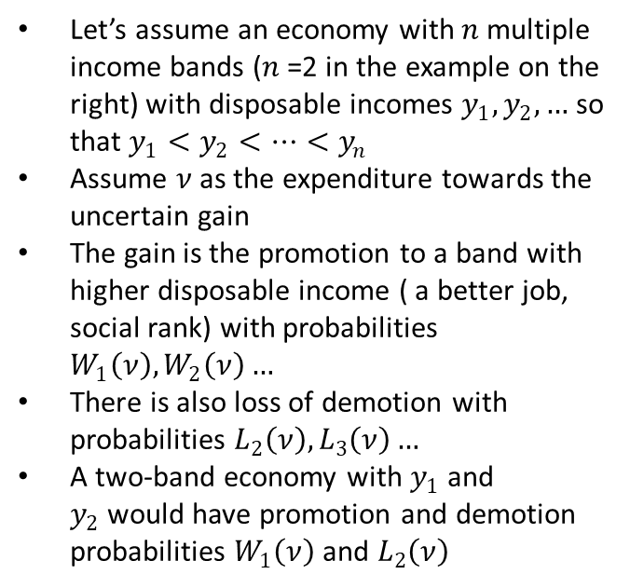
Status Competitions as a game of uncertainty
Let’s assume an economy with $n$multiple income bands ($n$=2 in the example on the right) with disposable incomes $y_{1},y_{2},…$ so that $y_{1}<y_{2}<…<y_{n}$
Assume $ν$as the expenditure towards the uncertain gain
The gain is the promotion to a band with higher disposable income ( a better job, social rank) with probabilities $W_{1}\left(ν\right),W_{2}\left(ν\right)…$
There is also loss of demotion with probabilities $L_{2}\left(ν\right), L_{3}\left(ν\right)…$
A two-band economy with $y_{1}$ and $y_{2}$would have promotion and demotion probabilities $W_{1}\left(ν\right)$ and $L_{2}\left(ν\right)$

Slide 4
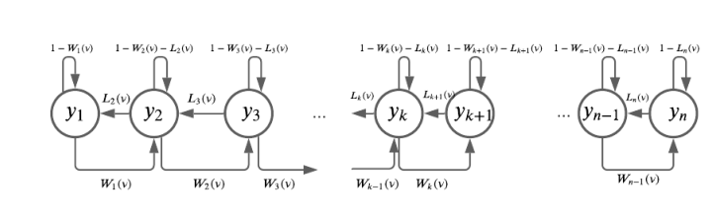
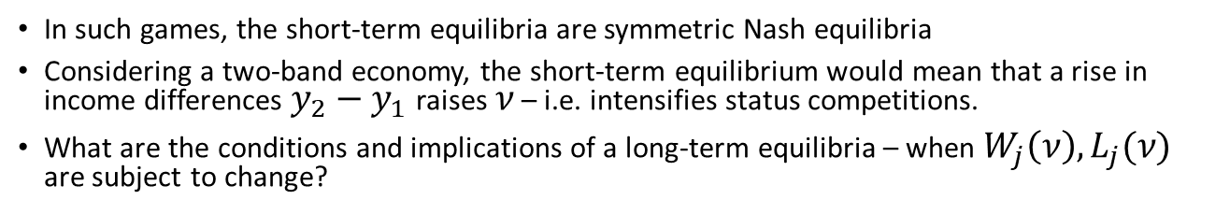
Does a long-term equilibrium exist?
In such games, the short-term equilibria are symmetric Nash equilibria
Considering a two-band economy, the short-term equilibrium would mean that a rise in income differences$y_{2}−y_{1}$ raises $ν$ – i.e. intensifies status competitions.
What are the conditions and implications of a long-term equilibria – when $W_{j}\left(ν\right),L_{j}(ν)$ are subject to change?

Slide 5

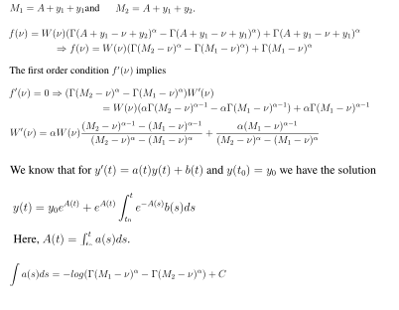

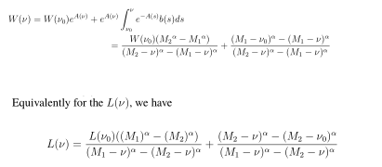
Solution for short-term equilibirium

Slide 6
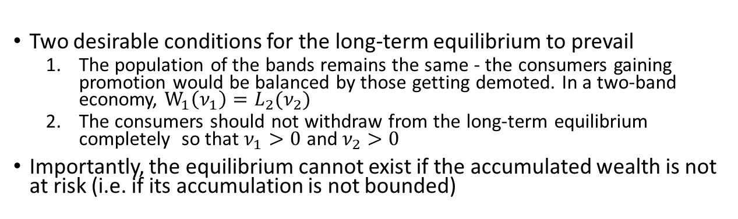
Long-term equilibrium
Two desirable conditions for the long-term equilibrium to prevail
The population of the bands remains the same - the consumers gaining promotion would be balanced by those getting demoted. In a two-band economy, $W_{1}\left(ν_{1}\right)=L_{2}(ν_{2})$
The consumers should not withdraw from the long-term equilibrium completely so that $ν_{1}>0$ and $ν_{2}>0$
Importantly, the equilibrium cannot exist if the accumulated wealth is not at risk (i.e. if its accumulation is not bounded)

Slide 7
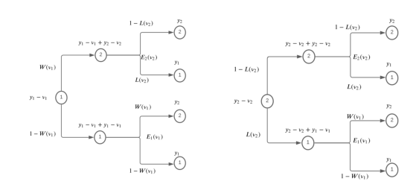
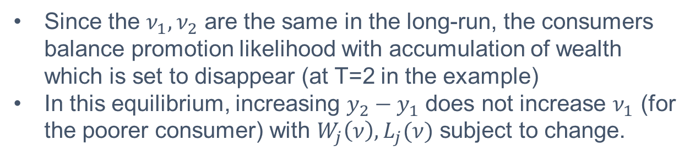
A two period equilibrium
Since the $ν_{1}{,ν}_{2}$ are the same in the long-run, the consumers balance promotion likelihood with accumulation of wealth which is set to disappear (at T=2 in the example)
In this equilibrium, increasing $y_{2}−y_{1}$ does not increase $ν_{1}$ (for the poorer consumer) with $W_{j}\left(ν\right),L_{j}(ν)$ subject to change.

Slide 8
Conclusions
When status competitions provide gains to the consumers, then the long-term dynamics differ from the short-term dynamics
More specifically, a rise in income differences does not necessarily imply a higher incentive or “motivation” for success through status competitions in the long-term
Unless the accumulated wealth is at risk, there are no incentives in the long-term for the poor to participate in status competitions which provide promotions to the poorer consumer

Slide 9
References
Choosing the Right Pond - Robert H. Frank
The Theory of the Leisure Class - Thorstein Veblen
Social Norms, Savings Behavior, and Growth - Harold L Cole, George J Maliath and Andrew Postlewaite

