Slide 1
Status competitions under income differences
Department of Economics
a.srivastava@pgr.reading.ac.uk

Slide 2
Status Competitions – An overview
Status competitions had been elaborated first by Veblen (1899).
Veblen’s ideas have resurfaced in the post-war years and are constituted in the concerns of conspicuous consumption
The idea of futility of conspicuous consumption is key to its modern interpretations – notably by Frank (1987).
However, there are some competitions that are fuelled by uncertain investments and some approaches focus on gains in non-transactional markets – e.g. by Cole et al (1992)

Slide 3
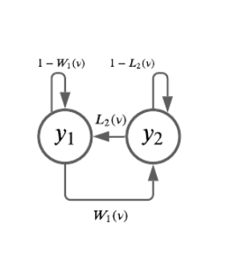
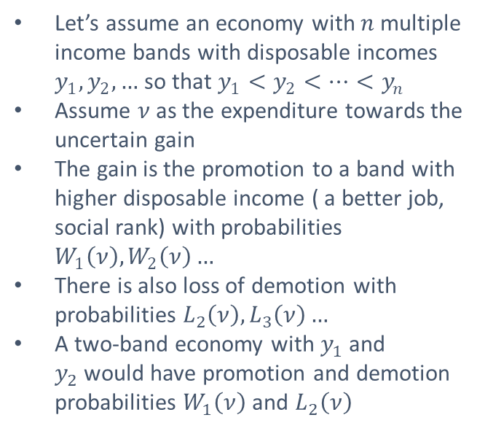
Status Competitions as a game of uncertainty
Let’s assume an economy with $n$multiple income bands with disposable incomes $y_{1},y_{2},…$ so that $y_{1}<y_{2}<…<y_{n}$
Assume $ν$as the expenditure towards the uncertain gain
The gain is the promotion to a band with higher disposable income ( a better job, social rank) with probabilities $W_{1}\left(ν\right),W_{2}\left(ν\right)…$
There is also loss of demotion with probabilities $L_{2}\left(ν\right), L_{3}\left(ν\right)…$
A two-band economy with $y_{1}$ and $y_{2}$would have promotion and demotion probabilities $W_{1}\left(ν\right)$ and $L_{2}\left(ν\right)$

Slide 4
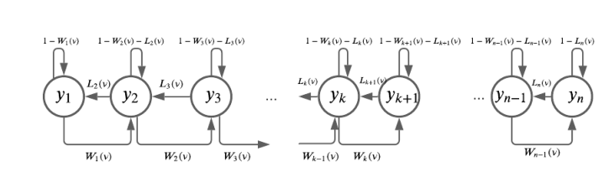
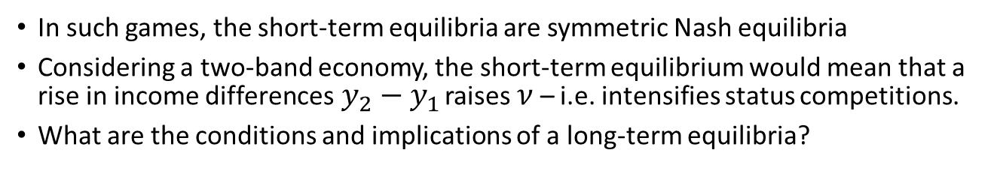
Does a long-term equilibrium exist?
In such games, the short-term equilibria are symmetric Nash equilibria
Considering a two-band economy, the short-term equilibrium would mean that a rise in income differences$y_{2}−y_{1}$ raises $ν$ – i.e. intensifies status competitions.
What are the conditions and implications of a long-term equilibria?

Slide 5

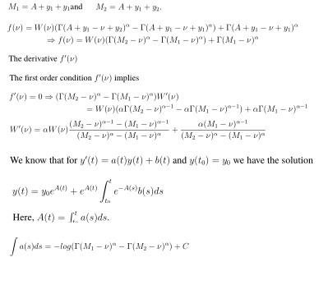

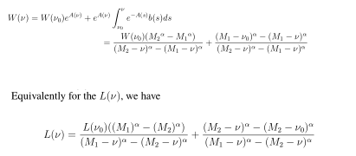
Solution for short-term equilibiria

Slide 6
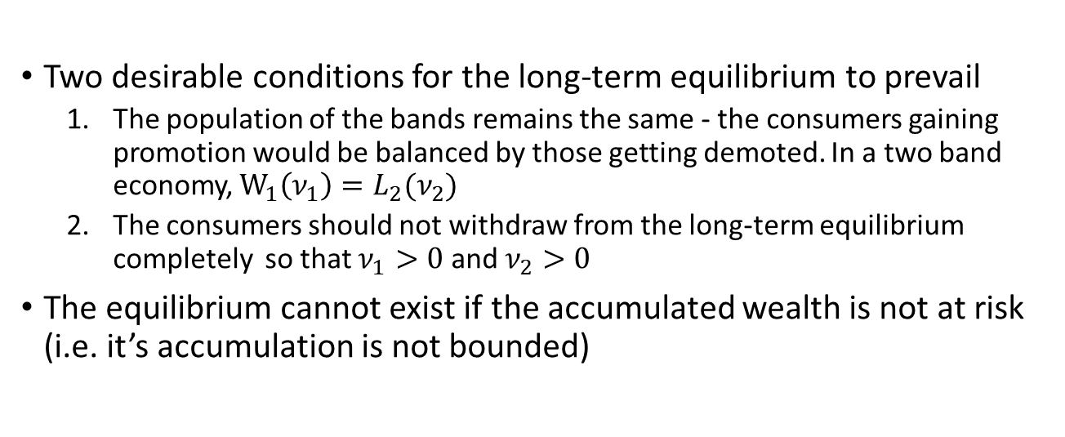
Long-term equilibrium
Two desirable conditions for the long-term equilibrium to prevail
The population of the bands remains the same - the consumers gaining promotion would be balanced by those getting demoted. In a two band economy, $W_{1}\left(ν_{1}\right)=L_{2}(ν_{2})$
The consumers should not withdraw from the long-term equilibrium completely so that $ν_{1}>0$ and $ν_{2}>0$
The equilibrium cannot exist if the accumulated wealth is not at risk (i.e. it’s accumulation is not bounded)

Slide 7
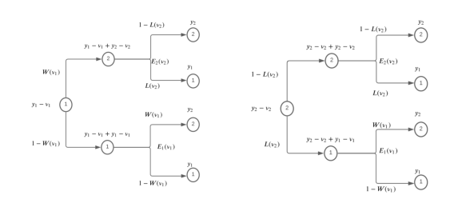
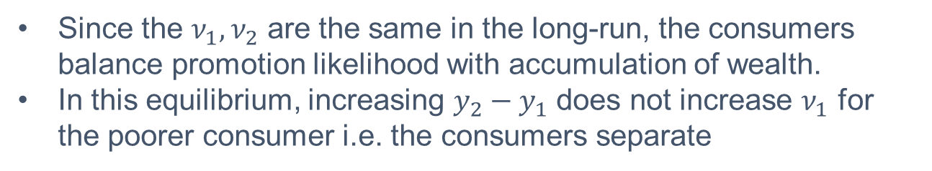
A two period equilibrium
Since the $ν_{1}{,ν}_{2}$ are the same in the long-run, the consumers balance promotion likelihood with accumulation of wealth.
In this equilibrium, increasing $y_{2}−y_{1}$ does not increase $ν_{1}$ for the poorer consumer i.e. the consumers separate

Slide 8
Conclusions
When status competitions provide gains to the consumers, then the long-term dynamics differ from the short-term dynamics
Rise in income differences don’t necessarily imply a higher incentive or “motivation” for success through status competitions
Unless the accumulated wealth is at risk, there are no incentives in the long-term for the poor to participate in status competitions that provide positive externality

Slide 9
References
Choosing the Right Pond - Robert H. Frank
The Theory of the Leisure Class - Thorstein Veblen
Social Norms, Savings Behavior, and Growth - Harold L Cole, George J Maliath and Andrew Postlewaite

