Slide 1
Travel Planner Agent
IBM HACKATHON PROJECT
Presented By: ANURAG RAGHUWANSHI
Student name :College Name: SCHOOL OF INFORMATION TECHNOLOGY
Department : CSE - AIML

Slide 2
OUTLINE
Problem Statement
Technology used
Wow factor
End users
Result
Conclusion
Git-hub Link
Future scope
IBM Certifications

Slide 3
Problem Statement
Travelers often struggle to get instant, personalized travel recommendations, booking support, and itinerary planning — especially across different time zones, languages, or platforms. Traditional travel services lack AI-driven 24/7 assistance.

Slide 4
Technology used
IBM cloud lite services
Natural Language Processing (NLP)
Retrieval Augmented Generation (RAG)
IBM Granite model

Slide 5
IBM cloud services used
IBM Watsonx.ai (for AI model hosting and inference)
Watson Assistant (for conversational interface)
LangGraph (ReAct) for multi-step reasoning
IBM Cloud Object Storage (to store location and travel data)
IBM Cloud Functions (for dynamic query handling and API integration)
Node.js backend (optional, for custom logic and APIs)

Slide 6
Wow factors
Multilingual, instant travel assistant available 24/7
Personalized trip planning based on budget, preferences, and season
Real-time flight/hotel search using APIs
Scalable and serverless via IBM Cloud
Integrates with calendars and sends reminders or documents

Slide 7
End users
Frequent travelers and tourists
Travel agencies looking to automate client support
Students and professionals traveling internationally
Elderly or non-tech-savvy individuals needing voice-guided help

Slide 8
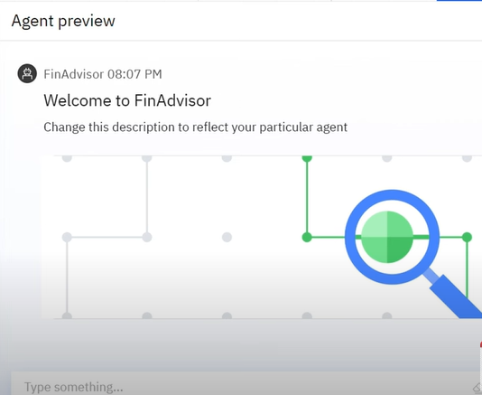
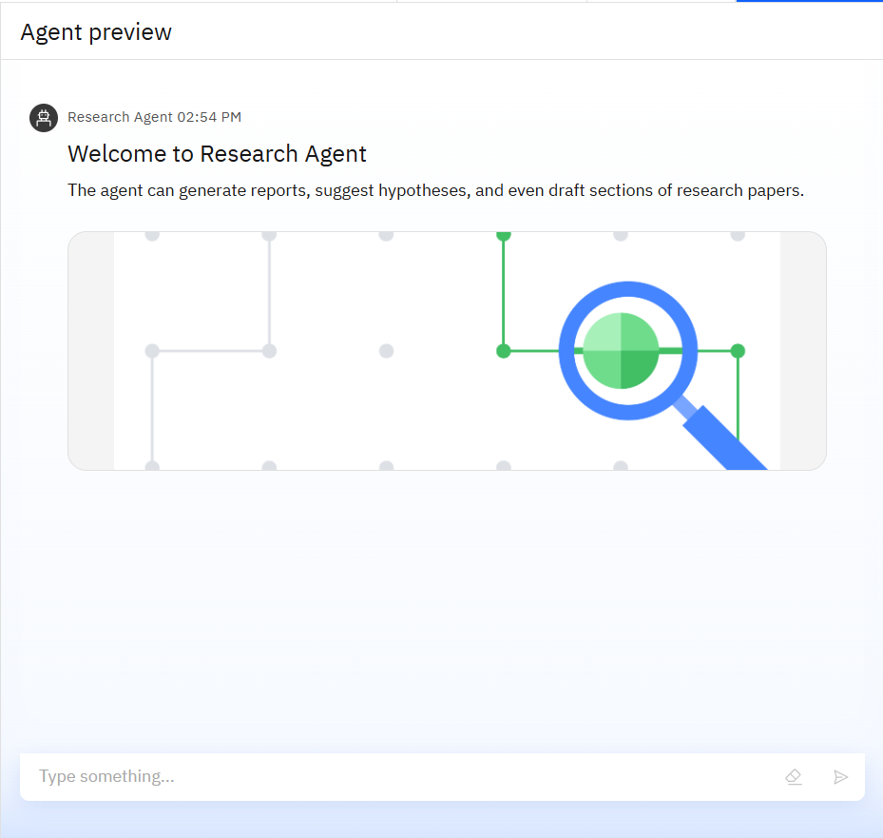
Results

Slide 9
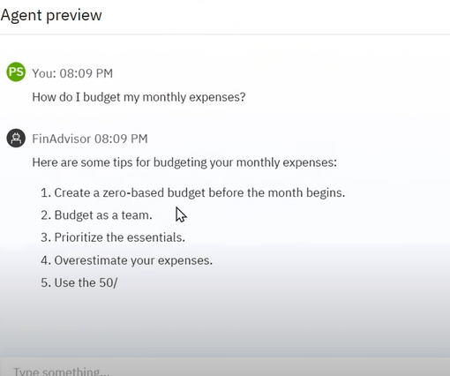
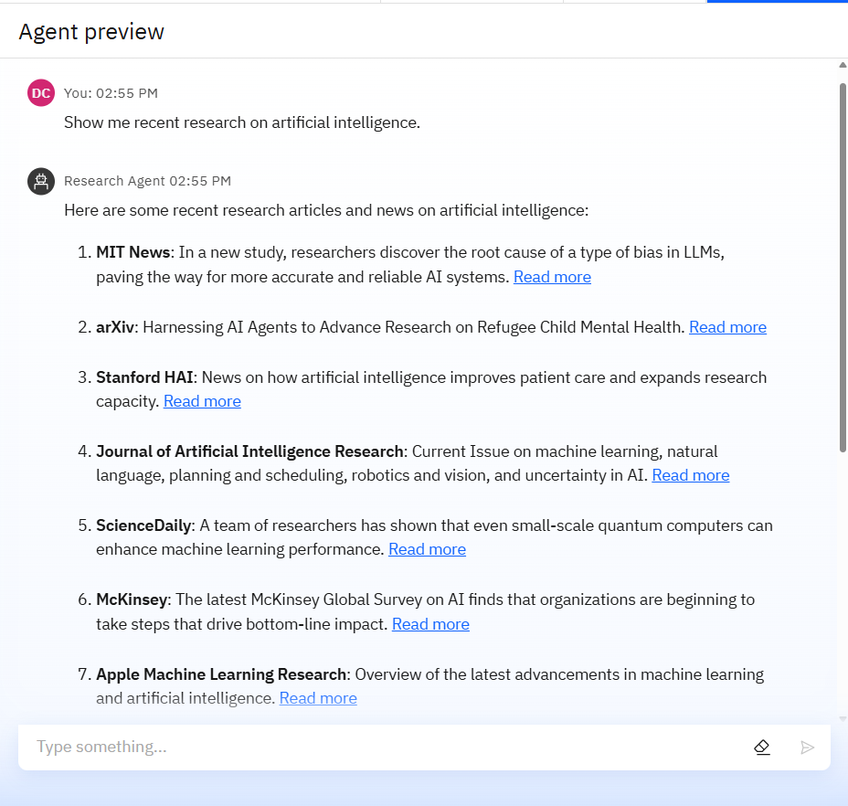
Results

Slide 10
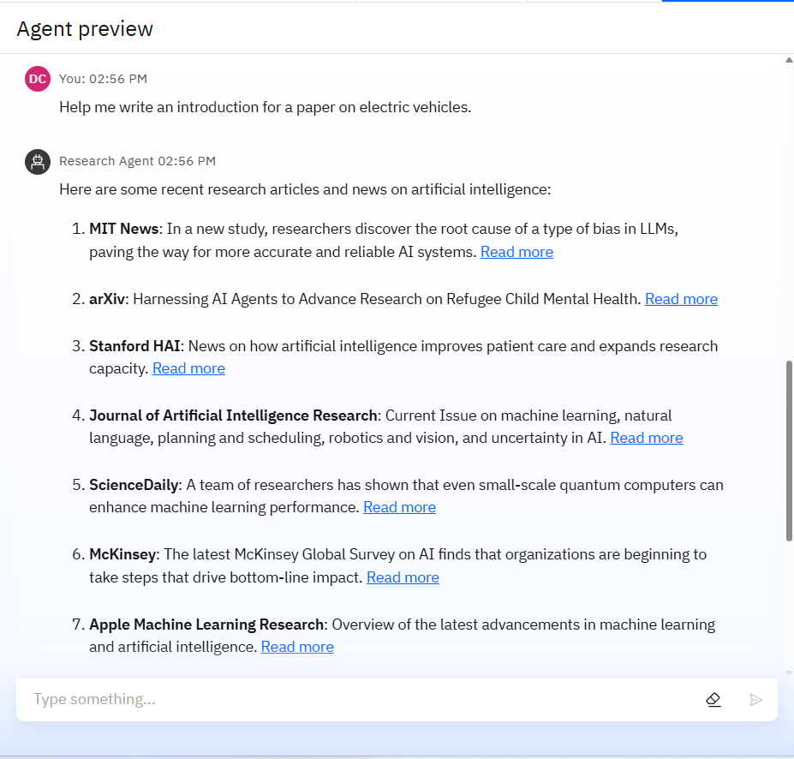
Results

Slide 11
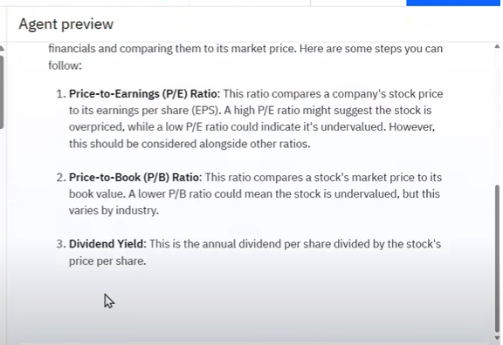
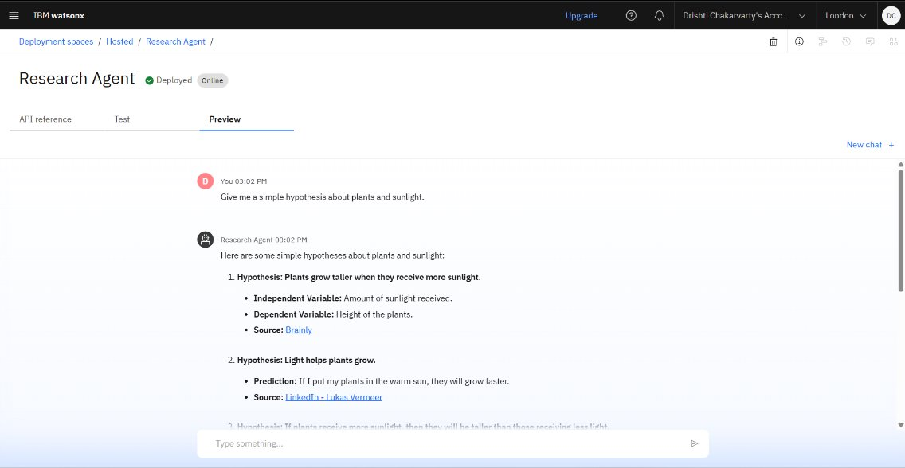
Results
Deployed AI Agent

Slide 12
Conclusion
This IBM Cloud-based travel agent offers a smart, scalable, and multilingual solution to modern travel queries. It showcases how cloud and AI can improve customer engagement, reduce wait times, and enhance travel planning experiences.

Slide 13
GitHub Link
https://github.com/anuragraghuwanshi123/Digital-Financial-Literacy-AI-agent.git

Slide 14
Future scope
Integrate with AR/VR for virtual trip previews
Add voice-command support using Watson Speech-to-Text
Predictive pricing alerts and climate-aware travel suggestions
Add train/bus ticket booking APIs for regional users
Offline mobile app sync with cloud assistant

Slide 15
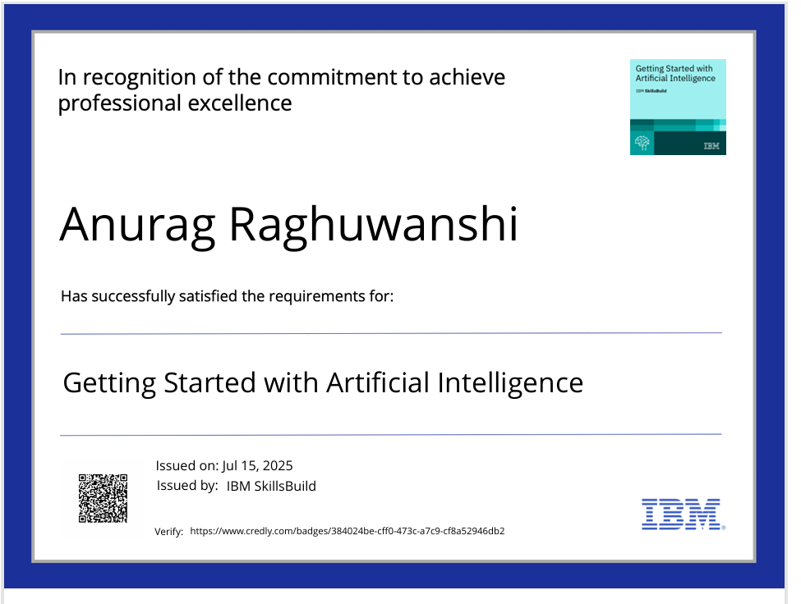
IBM Certifications

Slide 16
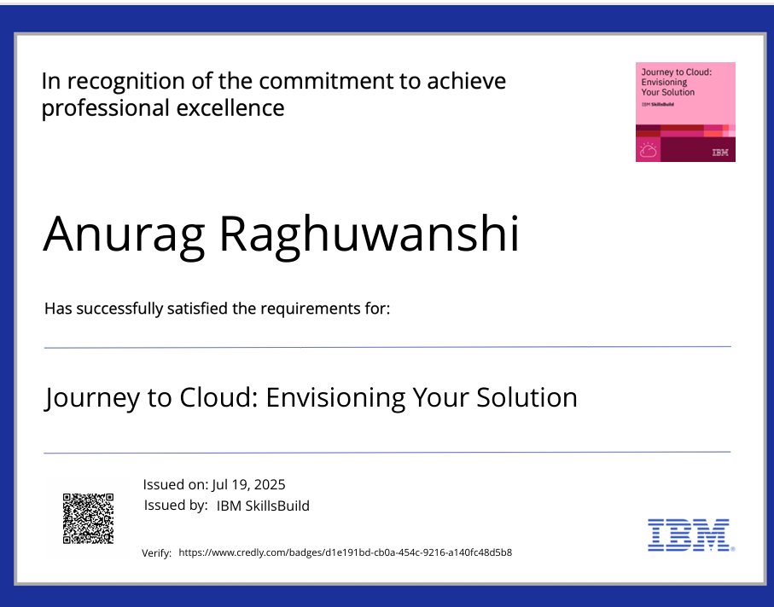

Slide 17
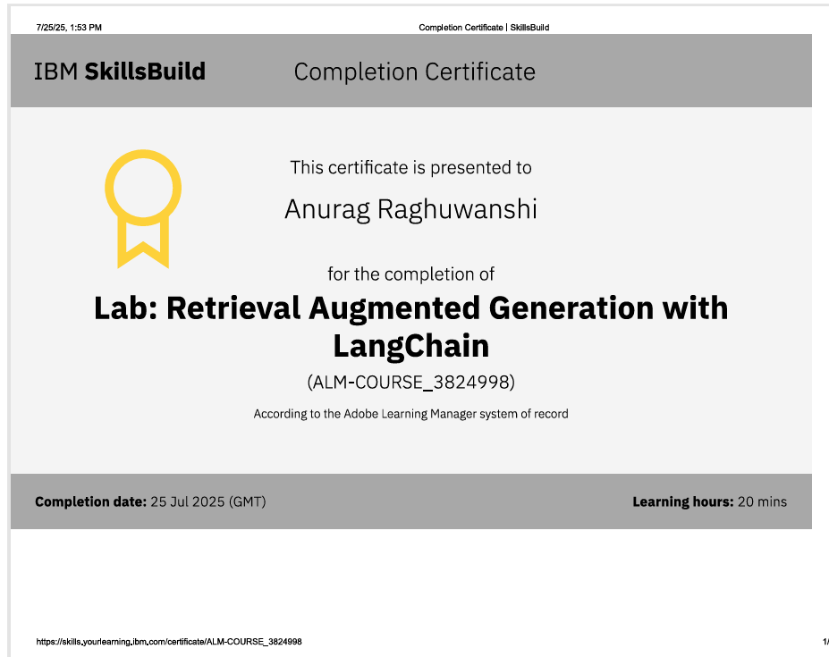

Slide 18
THANK YOU

