Slide 1
MAJOR PROJECT – CYBER SECURITY
PhishAware
A Self-Contained Phishing Awareness Simulation Web App
Node.js + Express • JSON file datastore • no passwords ever transmitted or stored
Project Summary

Slide 2
The Problem
Objectives
Phishing exploits human judgment, not a technical flaw. Measuring real behavior needs a realistic — but genuinely safe — simulation.
1
Build a working simulation
A mock sign-in page, an event-logging backend, and a results dashboard.
2
Guarantee credential safety
No password ever sent to or stored by the server, by construction.
3
Measure real behavior
Opens, clicks, sign-in attempts, and self-reports, timestamped.
0
4
Turn data into recommendations
Use the dashboard results to guide awareness training.
real passwords ever transmitted to or stored by the backend, by design

Slide 3
System Architecture
Plain Node.js/Express app — no external database required
Endpoint
Purpose
project/
backend/
server.js
package.json
data/
data.json
public/
index.html
dashboard.html
styles.css
script.js
GET /
Serve sign-in simulation page
GET /dashboard.html
Serve results dashboard
POST /api/events
Log an event (no password)
GET /api/stats
Return aggregate counts
DELETE /api/events
Reset the event log
Privacy-by-design safeguard
script.js sends only { event_type, username } to the server — the password field's value is never included in the network request. The event API has no password field at all, so a modified client can't smuggle one into storage without a code change.

Slide 4
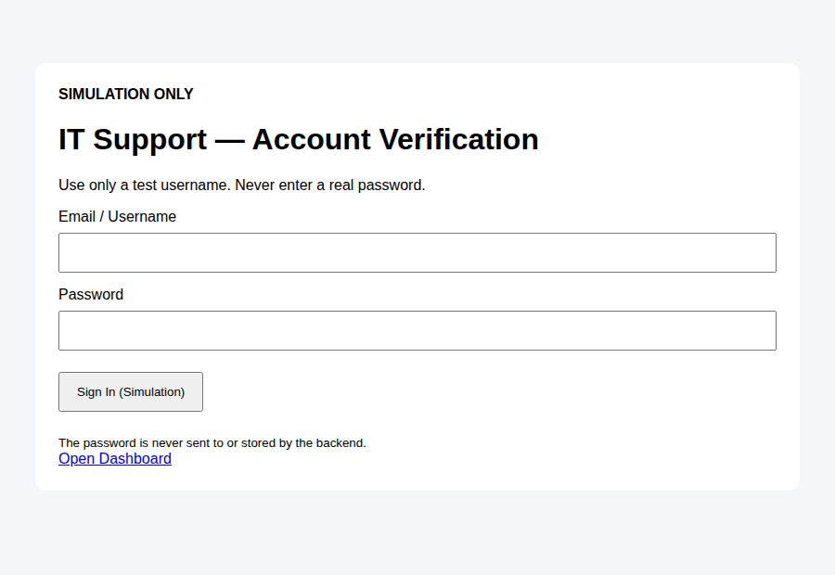
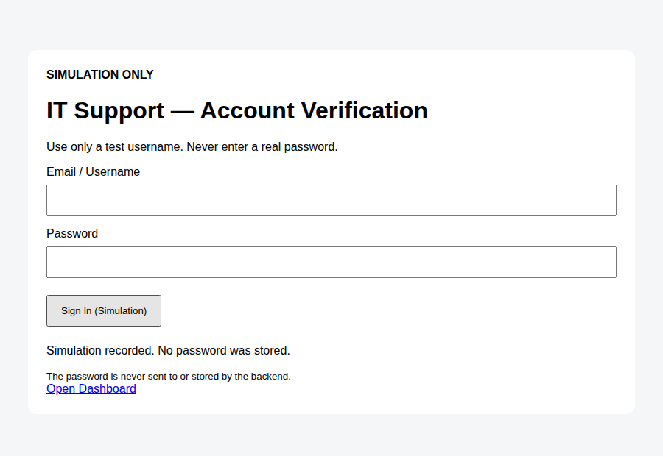
The Simulation in Action
Clearly labeled SIMULATION ONLY — password never transmitted
Sign-in page (pre-submit)
Confirmation after submit
“Simulation recorded. No password was stored.” — shown immediately after every submit

Slide 5
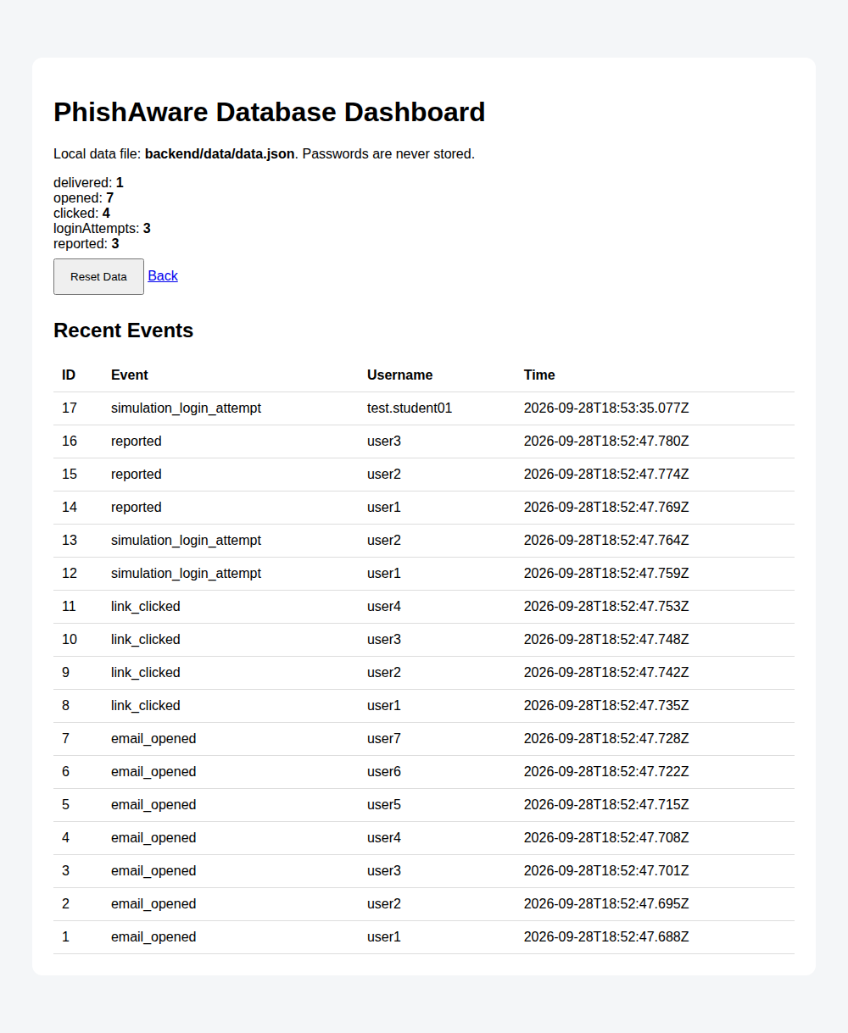
Results
Live counts from the PhishAware dashboard
7
emails opened
4
clicked the link
3
attempted sign-in
3
self-reported as suspicious
Sign-in attempts = self-reports in this run — several participants noticed only after interacting with the page, not before.

Slide 6
Lessons & Recommendations
What the data says, and what to do next
1
2
3
Believable prompts still work
Behavior-only logging is enough
Reporting lagged recognition
Even with a test window disclosed in advance, participants still engaged with the lure.
Useful awareness metrics never required touching a real password.
Some participants noticed only after interacting — pre-click inspection is the training gap.
4
5
6
Close the loop
Track the trend, not one run
Scale thoughtfully
Add a one-click 'Report Phishing' habit and debrief every run immediately, blame-free.
Repeat with varied lures and watch the click-rate trend over successive simulations.
A JSON file suits a class project; real deployments need a proper DB and dashboard auth.

